Slide 1
Thin film Modeling

Slide 2
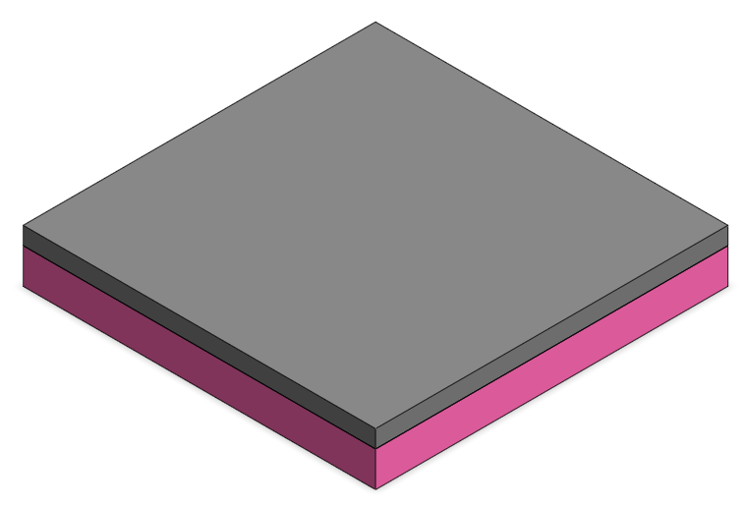
Information of the specimen
Substrate ( Silicon; hot pink color )
  Width X : 5 mm
  Width Y : 5 mm
  Height : 750 um
Thin film ( Platinum; gray color )
  Width X : 5 mm
  Width Y : 5 mm
  Height : 100 nm
Notes:
As I said, I used ray transfer matrix method.
It is a type of ray tracing technique used in the design of optical system.
It involves the construction of a ray transfer matrix which describes the optical system.
Tracing of a light path through the system can be performed by multiplying the matrix with a vector representing the light.
This equation is ray fransfer matrix for gaussian beam. Q is complex beam parameter consist of beam waist, wavelength, radius of curvature.
K is constant, and A B C D is a ray transfer matrix and it depends on the type of lens or mirror.
Using this technique, I did collimating.

Slide 3
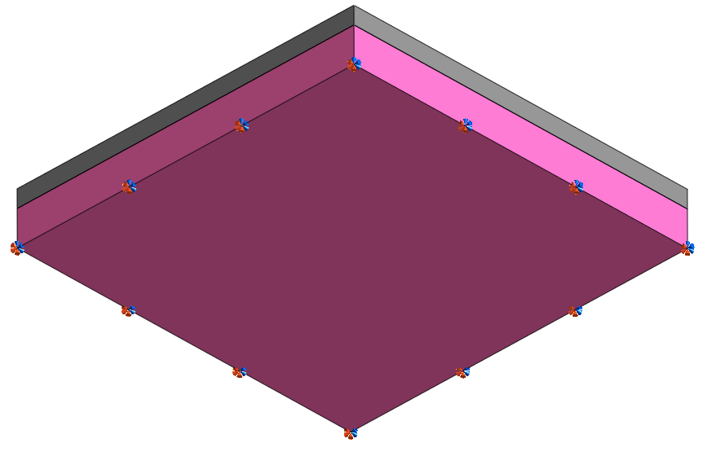
Information of the specimen
Boundary condition
  Fixed ; bottom surface
Interface
  There is a gap(10nm) between substrate and thin film
  Connect substrate and thin film with spring.
  Spring constant : 4.5N/m
Notes:
As I said, I used ray transfer matrix method.
It is a type of ray tracing technique used in the design of optical system.
It involves the construction of a ray transfer matrix which describes the optical system.
Tracing of a light path through the system can be performed by multiplying the matrix with a vector representing the light.
This equation is ray fransfer matrix for gaussian beam. Q is complex beam parameter consist of beam waist, wavelength, radius of curvature.
K is constant, and A B C D is a ray transfer matrix and it depends on the type of lens or mirror.
Using this technique, I did collimating.

