Slide 1
Replication of Thermal tuners on a silicon nitride platform
Om Raj Sapkota
September 05, 2019
Photonics Research Lab.
Department of Electronic Engineering
Kwangwoon University

Slide 2
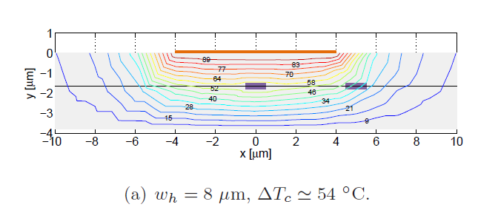
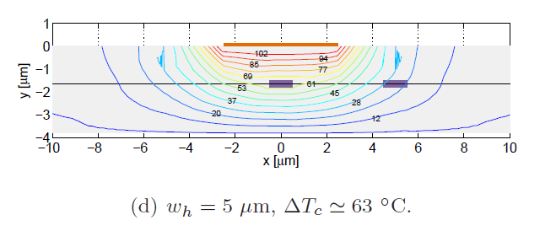
Replication of previous works
Purpose: We would like to replicate the temperature gradient result of the previous paper
D. Perez., ‘Thermal tuners on a silicon nitride platform,’ arXiv , 2016
Ref. https://arxiv.org/abs/1604.02958

Slide 3
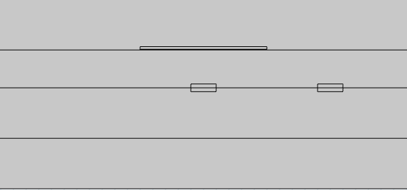
Structure and parameter
Table of parameters
W_{e}
Air
Item | Value | Unit | Description
T_{SiO2} | 3.5 | um | Thickness of SiO₂
T_{au} | 100 | nm | Thickness of Au
T_{cr} | 30 | nm | Thickness of Cr
W_{e} | 5 | um | Width of electrode
T_{SiN} | 300 | nm | Thickness of SiN
W_{SiN} | 1 | um | Width of SiN
T_{box} | 2 | um | Thickness of BOX
T_{ele} | 130 | nm | T_{au}+T_{cr}
T_{ele}
Electrode (Au and Cr)
T_{SiO2}
T_{SiN}
SiN
T_{box}
BOX (SiO₂)
W_{SiN}
Si substrate
Schematic diagram
We designed the structure by using parameters written on the paper

Slide 4
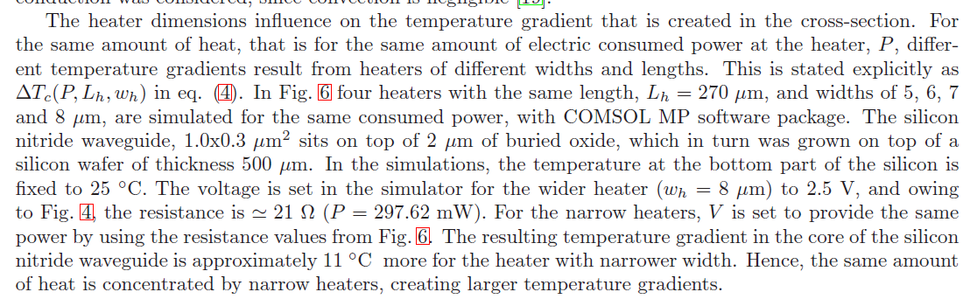
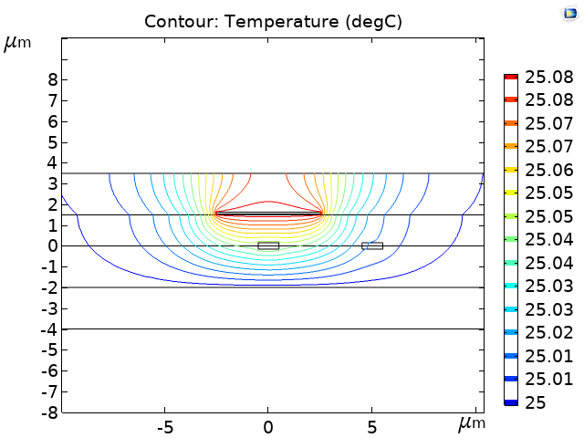
Comparison of contour map of temperature ) Expected vs. Calculated
Temperature [°C]
No change
Expected result
Calculated result from COMSOL
 | Min. Temperature | Max. Temperature
Expected | 12 | 102
Calculated | 25 | 25.08
Totally different
To apply the power (297.32 mW) to the electrode, we used the physics called ‘Heat transfer in solids. (For the details, please refer to next slide)
But, the result is totally different from the expected result of the paper.

Slide 5
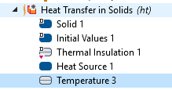
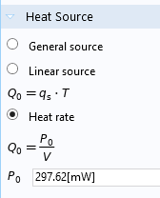
Used physics – Heat transfer in solids
Air
Electrode (Au and Cr)
SiO₂
SiN
Si
The temperature at this boundary is set to T = 25 °C
We used electrode as a heat source and applied the power (297.62 mW) to the electrode (Au and Cr)

Slide 6
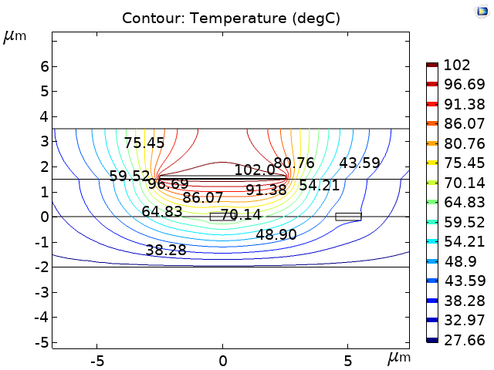
Comparison: Temperature range (Expected vs. Calculated)
P₀: 297.32 mW → 275.45 W
Temperature [°C]
P = 297.62 mW
Change
Expected result
Calculated result from COMSOL
 | Min. Temperature | Max. Temperature
Expected | 12 | 102
Calculated | 27.66 | 102
If we changed the P₀ of ‘Heat Source’ from 297.32 mW to 275.45 W, we could see some changes in the result

Slide 7
Question
From the calculated result, it looks we approached a wrong way to replicate the paper result. Is this right way to use physics ‘Heat Transfer in solids’?
Which physics do you suggest for this situation? If so, please let us know any example to understand that physics?

