Slide 1
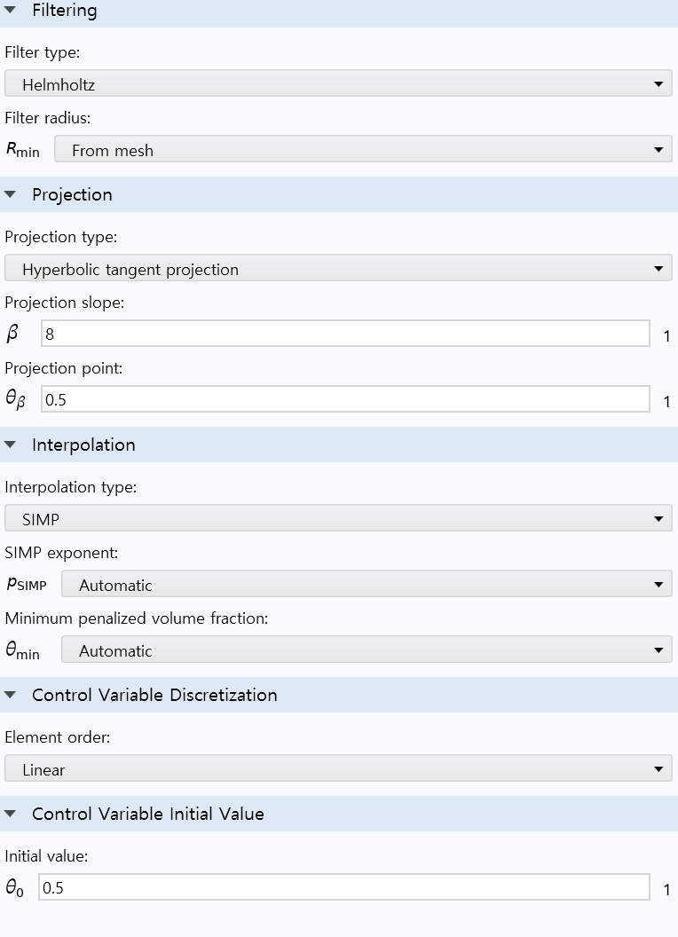
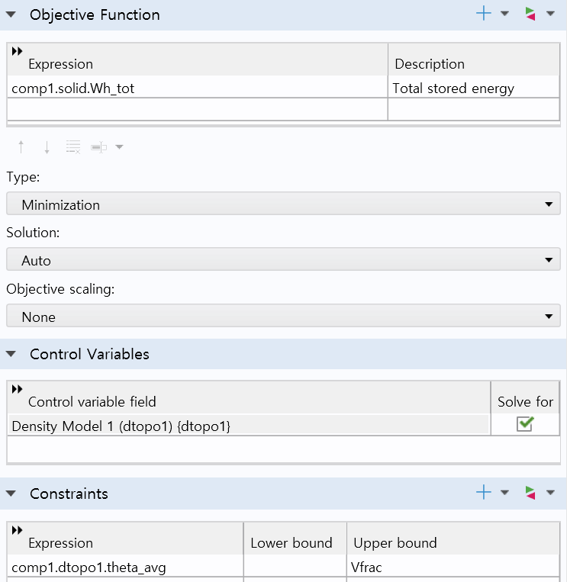

Question for COMSOL
1) Modeling
- Cantilever Model
2) Topology optimization options
- Harmonic analysis in frequency domain was applied as a initial value
- SIMP model was used
- Target is total stored energy and constraint is only volume fraction
1N
Total stored energy
SIMP
Fixed
Volume constraints

Slide 2
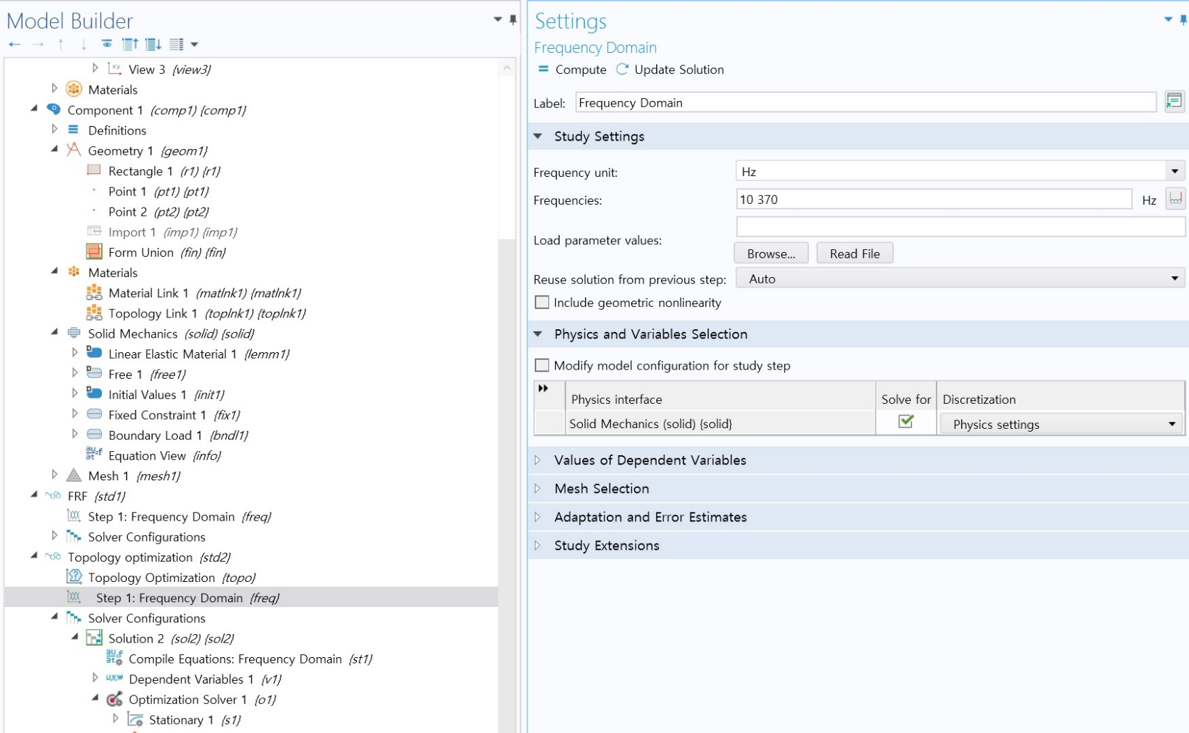
2. Approach to solve current problem
3) Question
- I have inserted like as follows. The results in next page looks like a solution of superposition.
But I don’t know the exact meaning of this calculation. Please let me know the truth

Slide 3
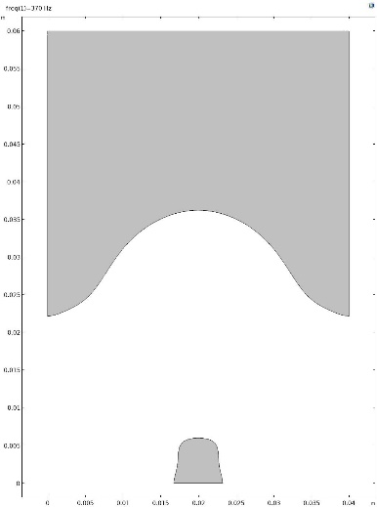
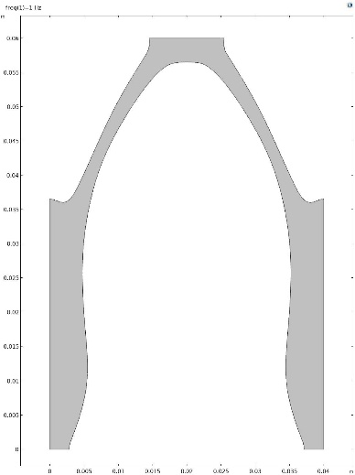
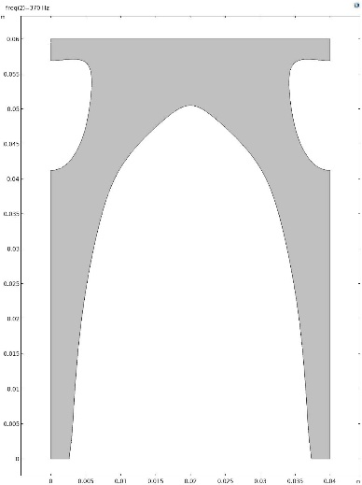
2. Approach to solve current problem
The results
Only 370Hz
Only 1Hz
1Hz and 370Hz

