Slide 1
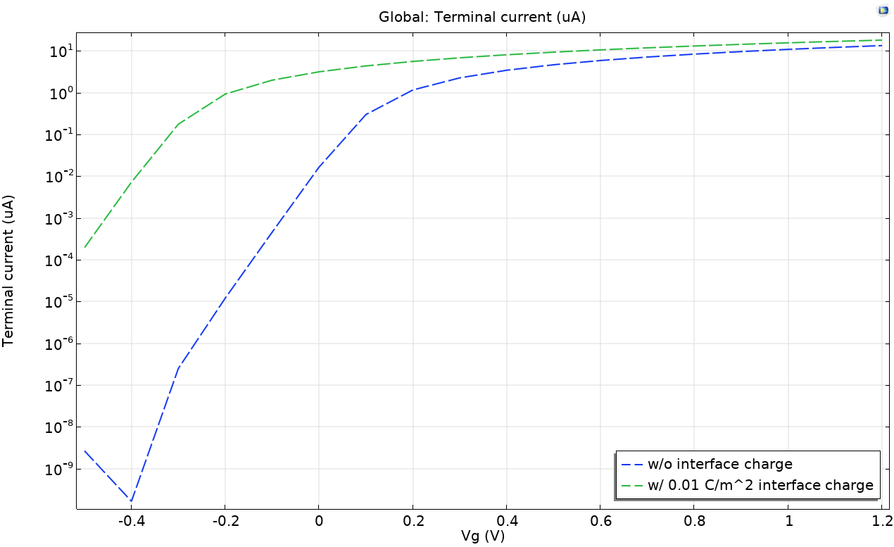
Finite Volume Method

Slide 2
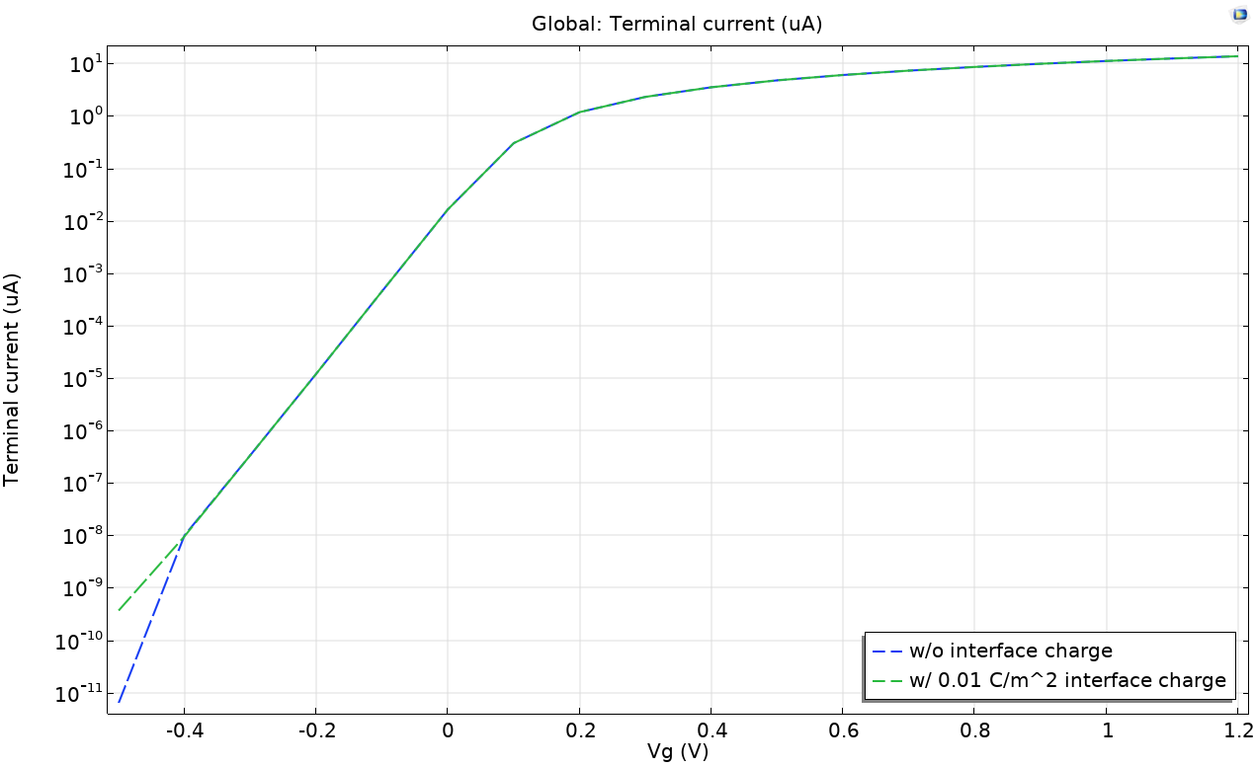
Finite Element Quasi Fermi level Method

