Slide 1
Multipole Analysis of Electromagnetic Scattering
COMSOL

Slide 2

Multipole Expansion
The field scattered by a particle, regardless of the particle’s geometrical shape or composition, can always be expressed through the multipole expansion. The expression for the electric field reads (see Ref. 1):
The vector functions

Slide 3

Multipole Expansion
and
generate a complete basis, where each function describes the field created by a unique multipole.

Slide 4
Multipole Coefficients
The coefficients a_{E}(l,m) and a_{M}(l,m) characterize the scatterer as they reveal the electric and magnetic excitations in it.
The integer l describes the order of the multipole (dipole, quadrupole, …), whereas the subscripts E and M distinguish between electric and magnetic multipoles. The integer m describes the amount of the z-component of angular momentum that is carried per photon.

Slide 5

Multipole Coefficients
For optical scatterers, the source of the scattered field is the scattering current density
where ε_{h} is the permittivity of the host medium and E(r) is the total field.
The multipole coefficients can be extracted from the scattering current density, using volume integrals over the whole space (see Ref. 2).

Slide 6
Mie Scattering
Scattering of a plane wave by a spherical particle.
Analytical solution exists as an expansion, in which the coefficients are called Mie coefficients.
MATLAB code (see Ref. 3) exists for computing the Mie coefficients (α_{l} and β_{l}).
The Mie expansion is a special case of the Multipole expansion, obtained by setting
  all coefficients to zero, if not |m| = 1
  a_{E}(l,-1) = -a_{E}(l,1)
  a_{M}(l,-1) = a_{M}(l,1)
Connection between the remaining multipole coefficients and the Mie coefficients is
  a_{E}(l,1) = -α_{l}
  a_{M}(l,1) = -β_{l}

Slide 7
COMSOL Implementation
Equations for extracting a_{E}(l,1) and a_{M}(l,1) are implemented in COMSOL using functions and variables
Implementation can be added to any scattering model
Also applicable to periodic systems

Slide 8
Associated Legendre Polynomials
Rodrigues' formula is used for calculating the associated Legendre polynomials P_{l}^{m}(cosθ)

Slide 9
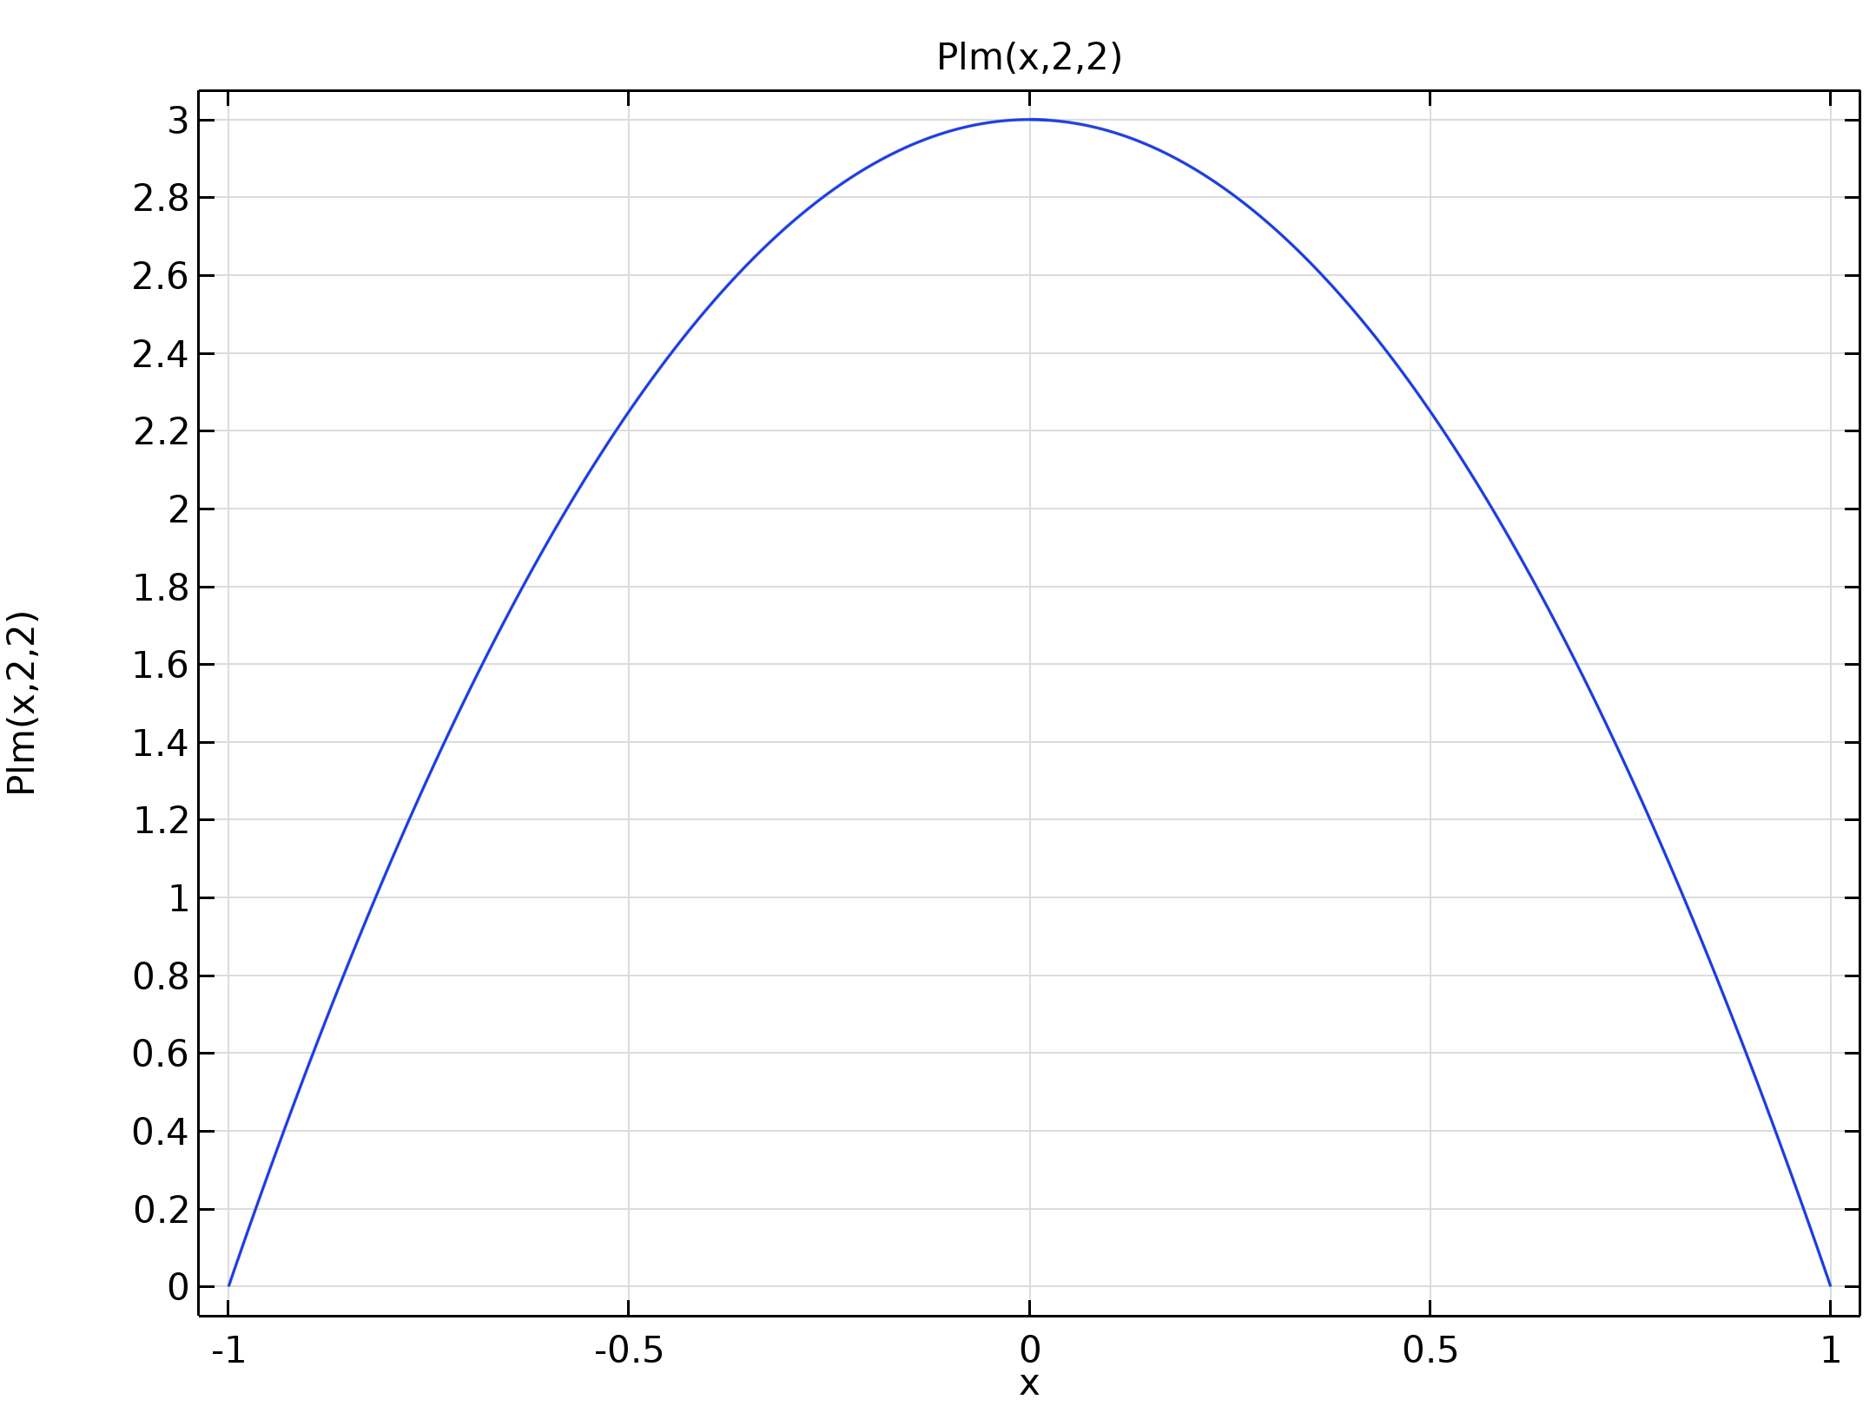
Associated Legendre Polynomials
Associated Legendre Polynomial

Slide 10
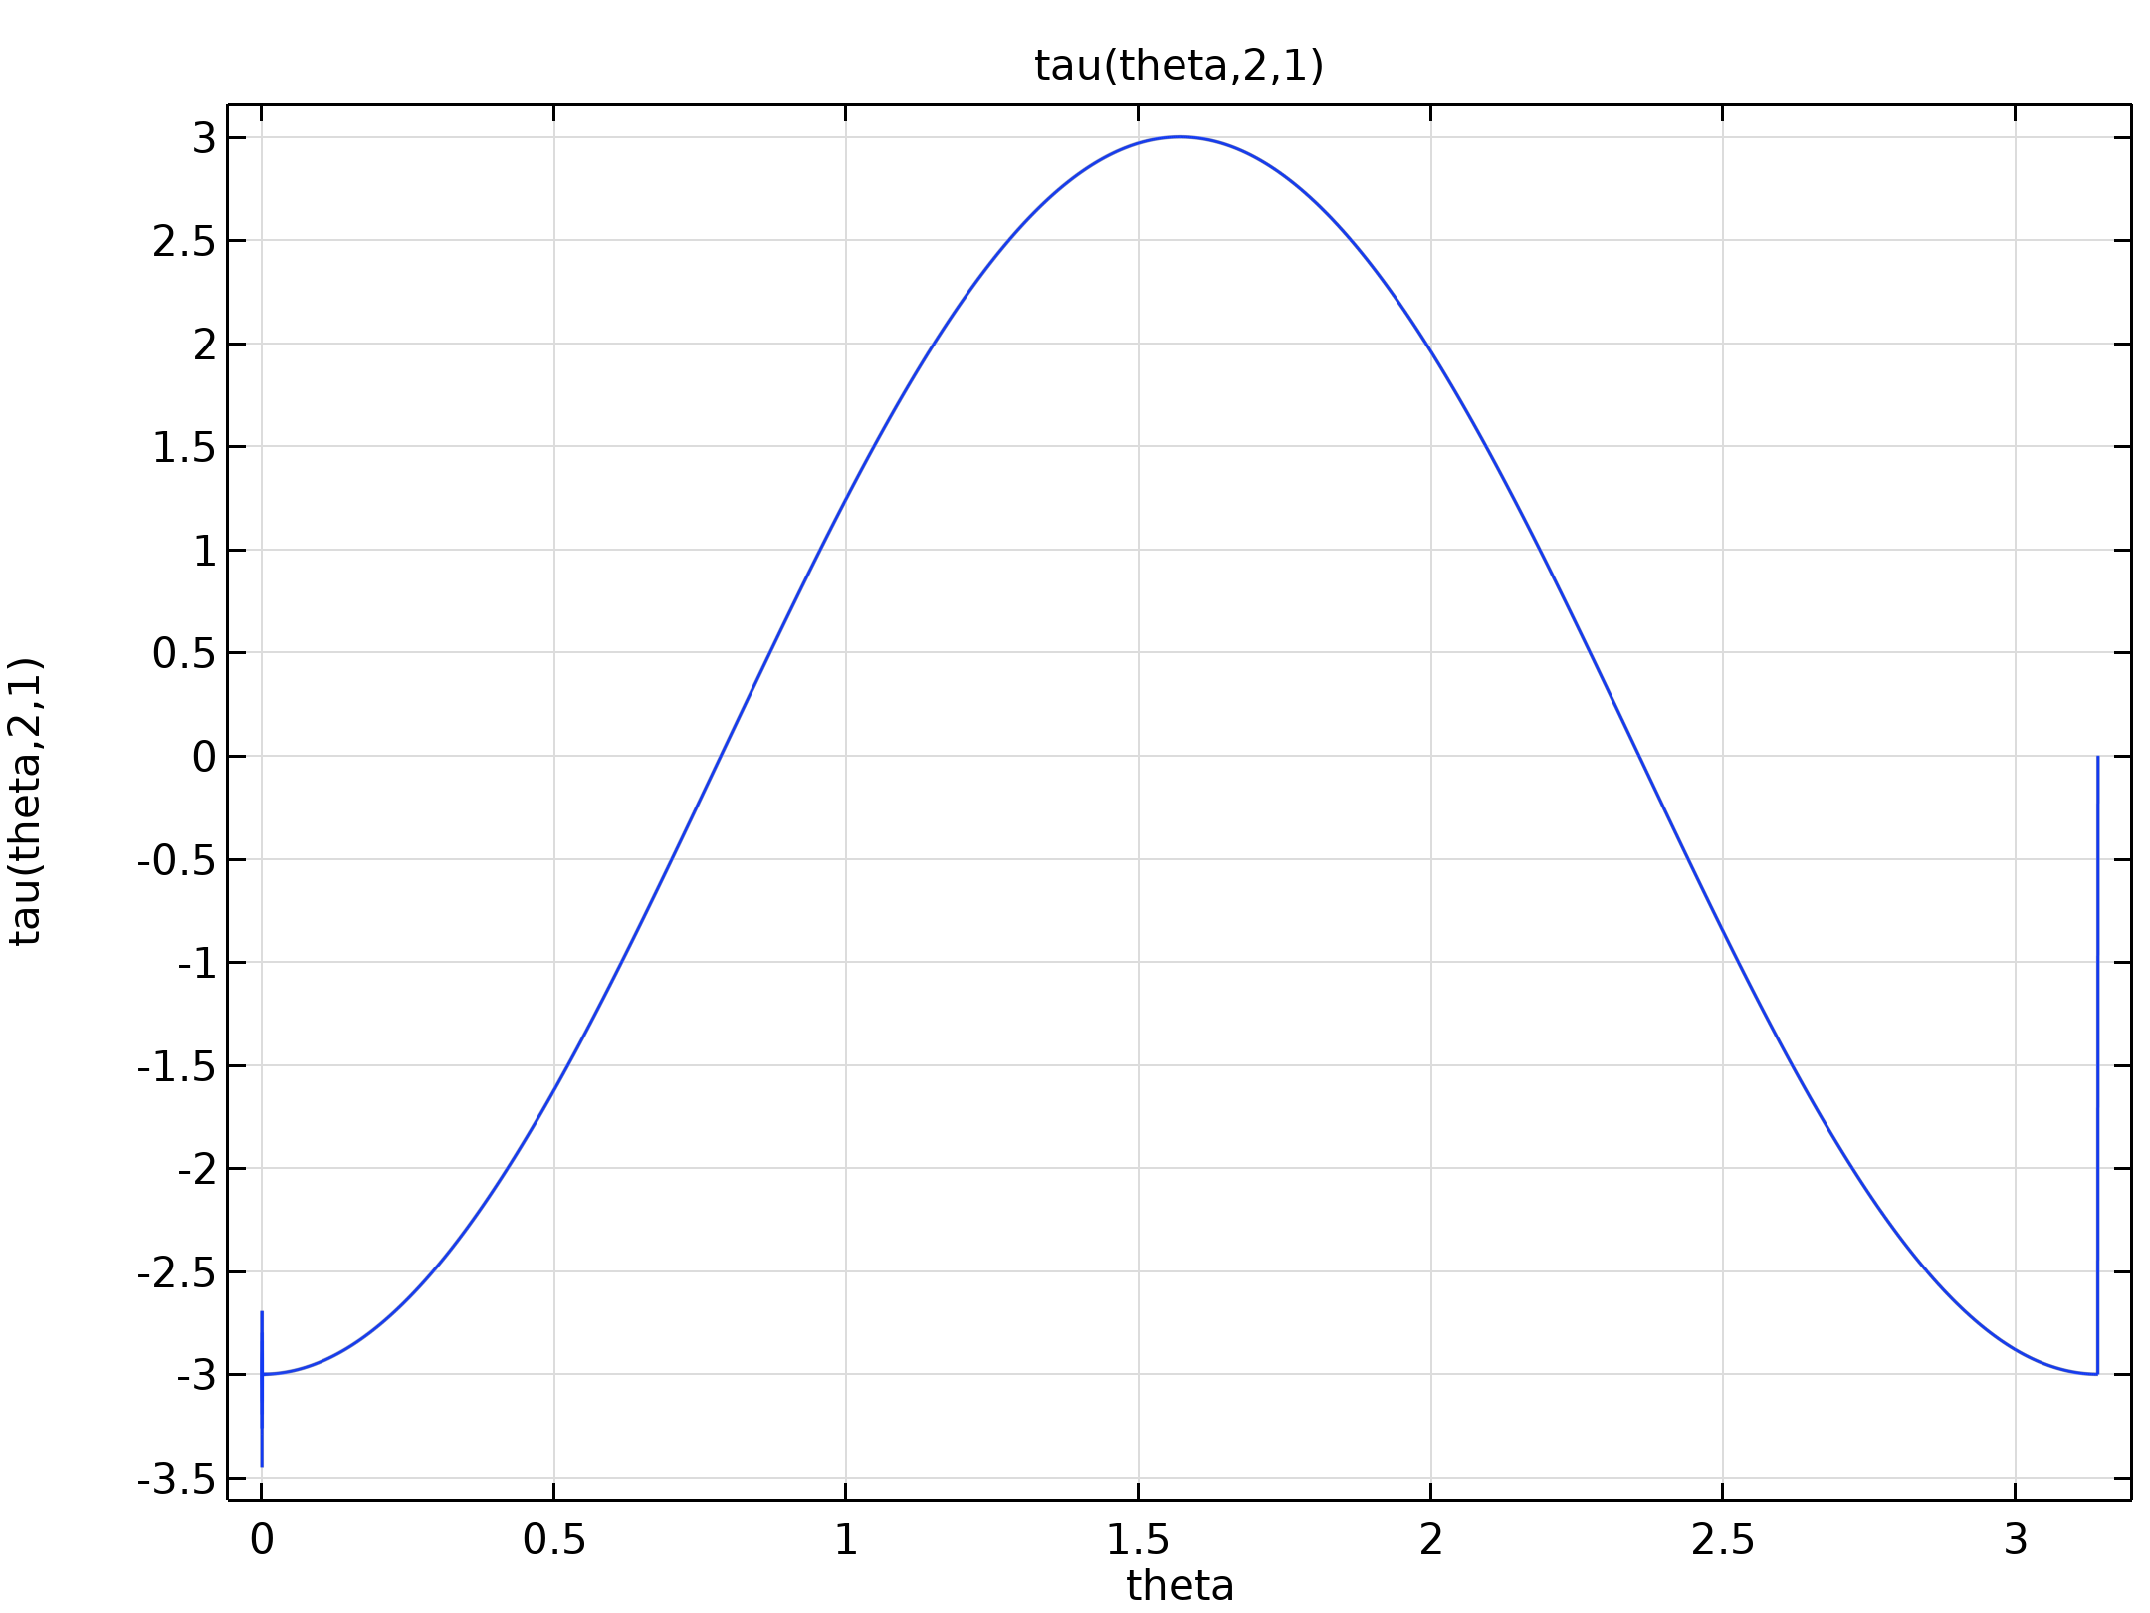

Angular Functions
Function tau

Slide 11
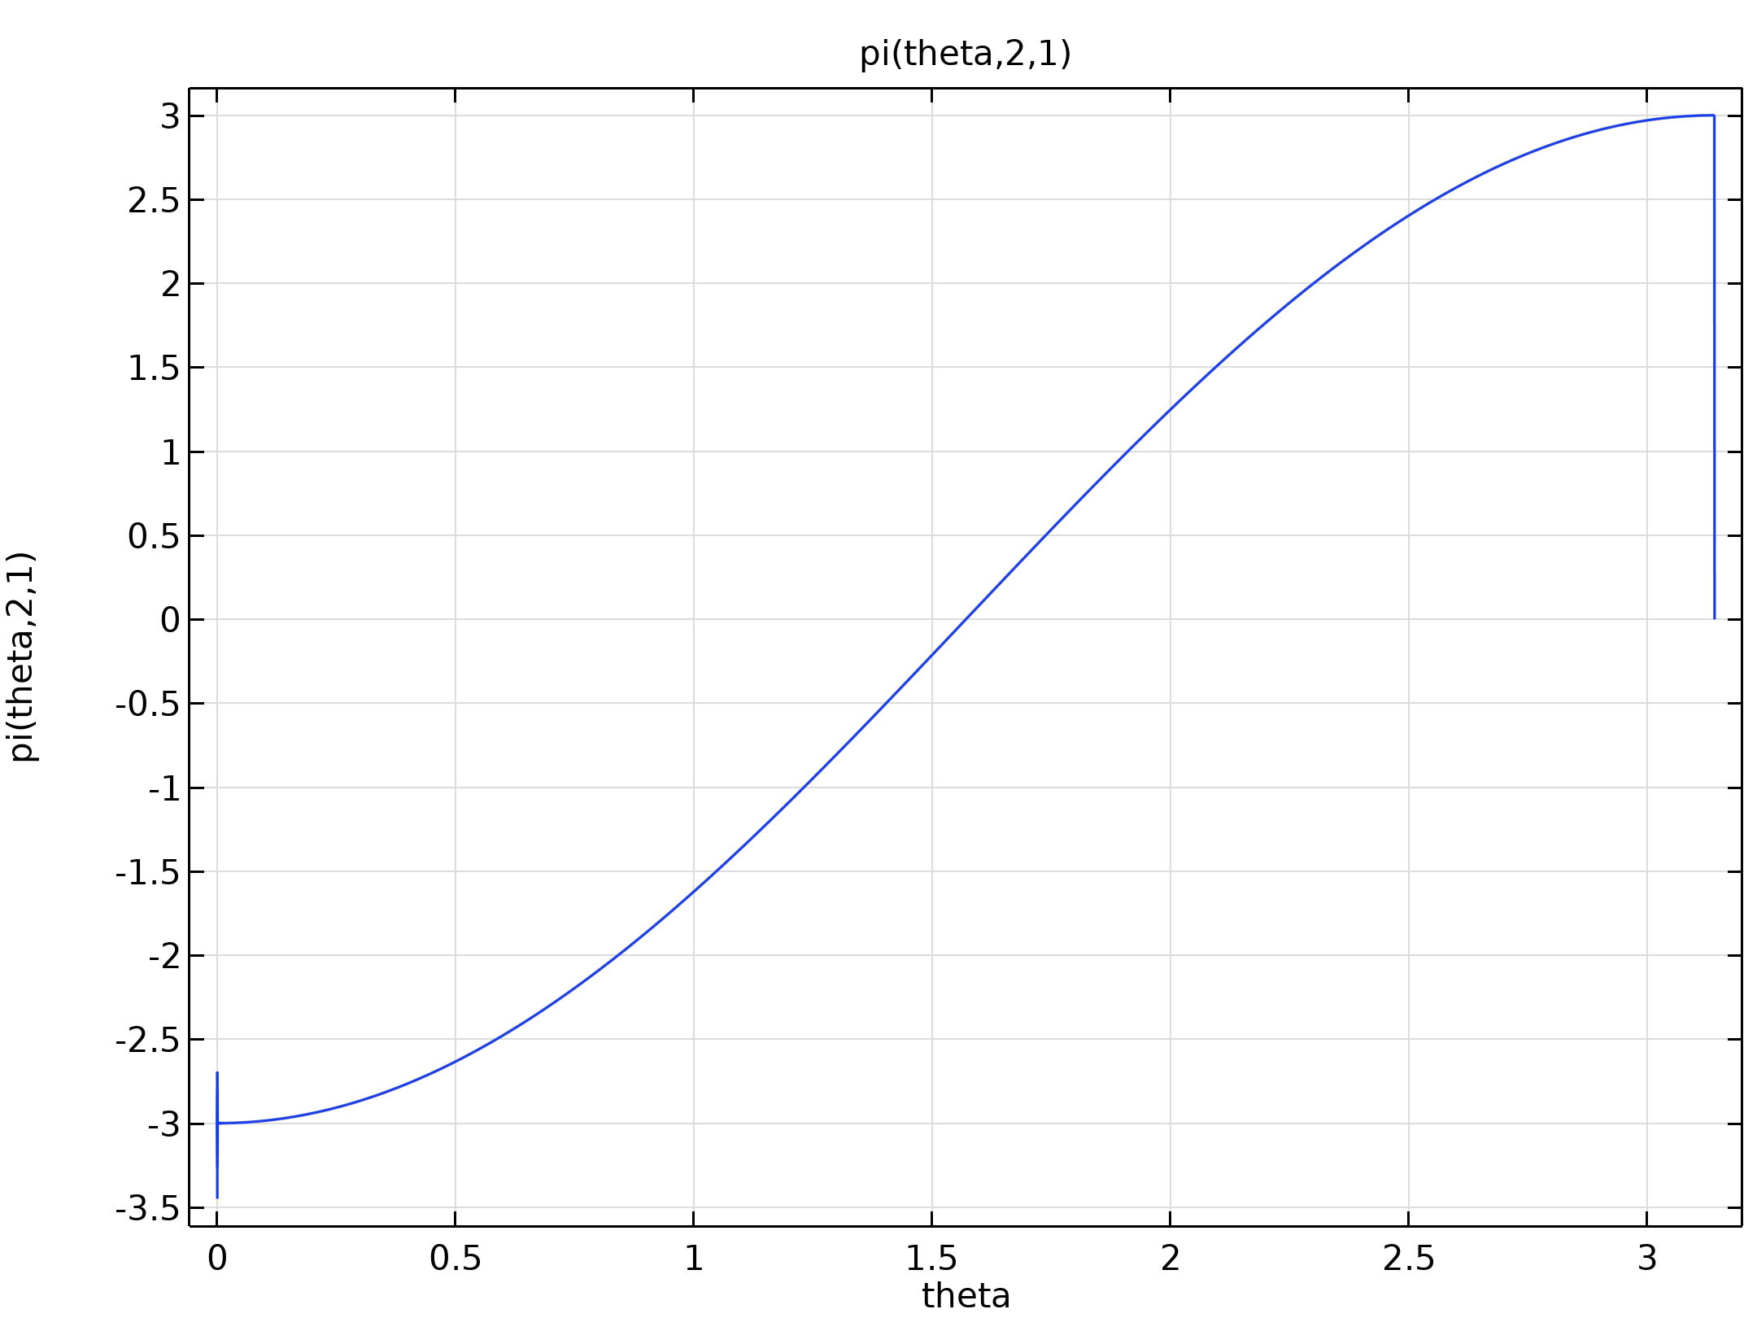

Angular Functions
Function pi

Slide 12
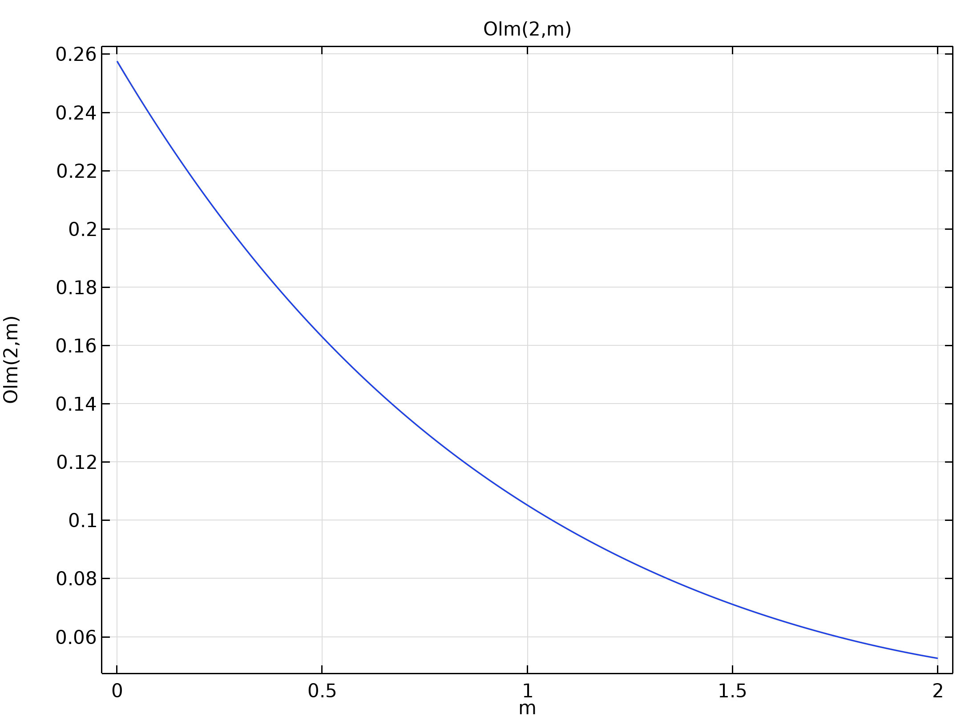

Coefficient O
Coefficient O

Slide 13
Multipole Variables
Calculation of a_{E}(l,1) and a_{M}(l,1)
Defined under Component 1 > Definitions

Slide 14
Mie Benchmark
Mie scattering as a benchmark
  600 nm vacuum wavelength
  Au sphere of 100 nm radius
  Host medium with a refractive index of 1.5
Numerical results are compared to Mie coefficients evaluated in MATLAB
Note: COMSOL uses exp(+jωt) convention, which is handled by setting the imaginary unit i→−j in the equations of this presentation. Complex-conjugation of obtained multipole coefficients returns to exp(-jωt) convention.

Slide 15
Benchmark Results
Electric Multipole Coefficients
l | m=-3, ae (1) | m=-2, ae (1) | m=-1, ae (1) | m=0, ae (1) | m=1, ae (1) | m=2, ae (1) | m=3, ae (1)
1 | 0 | 0 | 0.93538 + 0.082177i | 3.8439E-5 + 2.6268E-5i | -0.93537 - 0.082191i | 0 | 0
2 | 0 | -4.4753E-5 - 7.4743E-6i | 0.70154 + 0.21893i | -8.3438E-6 + 4.0457E-5i | -0.70154 - 0.21893i | 2.3403E-5 + 3.7582E-5i | 0
3 | -5.2441E-6 - 9.8016E-6i | -1.9776E-5 - 7.0469E-6i | 0.0075631 + 0.038522i | -1.74E-6 - 2.6072E-6i | -0.0075571 - 0.038524i | 1.804E-5 - 6.096E-6i | -1.3288E-5 + 5.1912E-6i

Slide 16
Benchmark Results
Magnetic Multipole Coefficients
l | m=-3, am (1) | m=-2, am (1) | m=-1, am (1) | m=0, am (1) | m=1, am (1) | m=2, am (1) | m=3, am (1)
1 | 0 | 0 | -0.094182 + 0.26713i | 1.3235E-6 + 1.2755E-6i | -0.094186 + 0.26714i | 0 | 0
2 | 0 | 5.0097E-7 + 4.0868E-7i | -0.0037616 + 0.034094i | 2.9986E-6 + 4.3089E-7i | -0.0037614 + 0.034094i | 1.4535E-6 - 1.4479E-6i | 0
3 | -2.1472E-7 + 9.8539E-8i | -8.4862E-8 - 2.0176E-7i | -1.7064E-4 + 0.001774i | -2.7469E-8 - 2.8486E-7i | -1.7058E-4 + 0.0017741i | 9.7061E-8 - 1.446E-7i | 3.4911E-7 - 3.5377E-7i

Slide 17
Comparison to Reference Values
Conjugate and negate the values in the m = 1 column to get values according to the exp(-jω t) convention

Slide 18
Comparison to Reference Values
Mie Coefficients
l | m | -conj(ae) (1) | -conj(am) (1)
1 | 1 | 0.93537 - 0.082191i | 0.094186 + 0.26714i
2 | 1 | 0.70154 - 0.21893i | 0.0037614 + 0.034094i
3 | 1 | 0.0075571 - 0.038524i | 1.7058E-4 + 0.0017741i

Slide 19
Reference Values
Reference Values, using exp(-jω t) convention
Reference Values
l | alpha_l | beta_l
1 | 0.9350 - 0.0826i | 0.0941 + 0.2671i
2 | 0.7003 - 0.2209i | 0.0038 + 0.0341i
3 | 0.0075 - 0.0384i | 0.0002 + 0.0018i
COMSOL values and reference values agree well

Slide 20
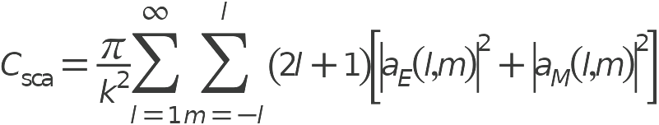
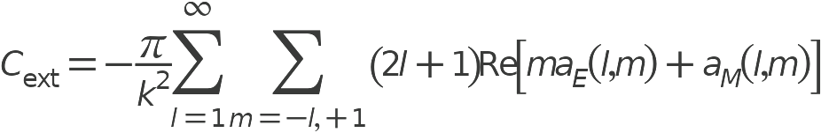
Cross Sections
Scattering cross setion:
Extinction cross setion:

Slide 21
Cross Sections
Interaction Cross Sections
Integral: Scattering cross section (m^2) | Integral: Absorption cross section (m^2) | Integral: Extinction cross section (m^2)
1.4268E-13 | 2.7156E-14 | 1.6983E-13

Slide 22
Cross Sections
Cross Sections from Fields
lambda0 (µm) | Scattering cross section (m^2) | Absorption cross section (m^2) | Extinction cross section (m^2)
0.6 | 1.4201E-13 | 2.7199E-14 | 1.6921E-13
Cross sections from MATLAB code
Cross Section (m2) | Value
Scattering | 1.4252e-13
Absorption | 2.7148e-14
Extinction | 1.6967e-13

Slide 23
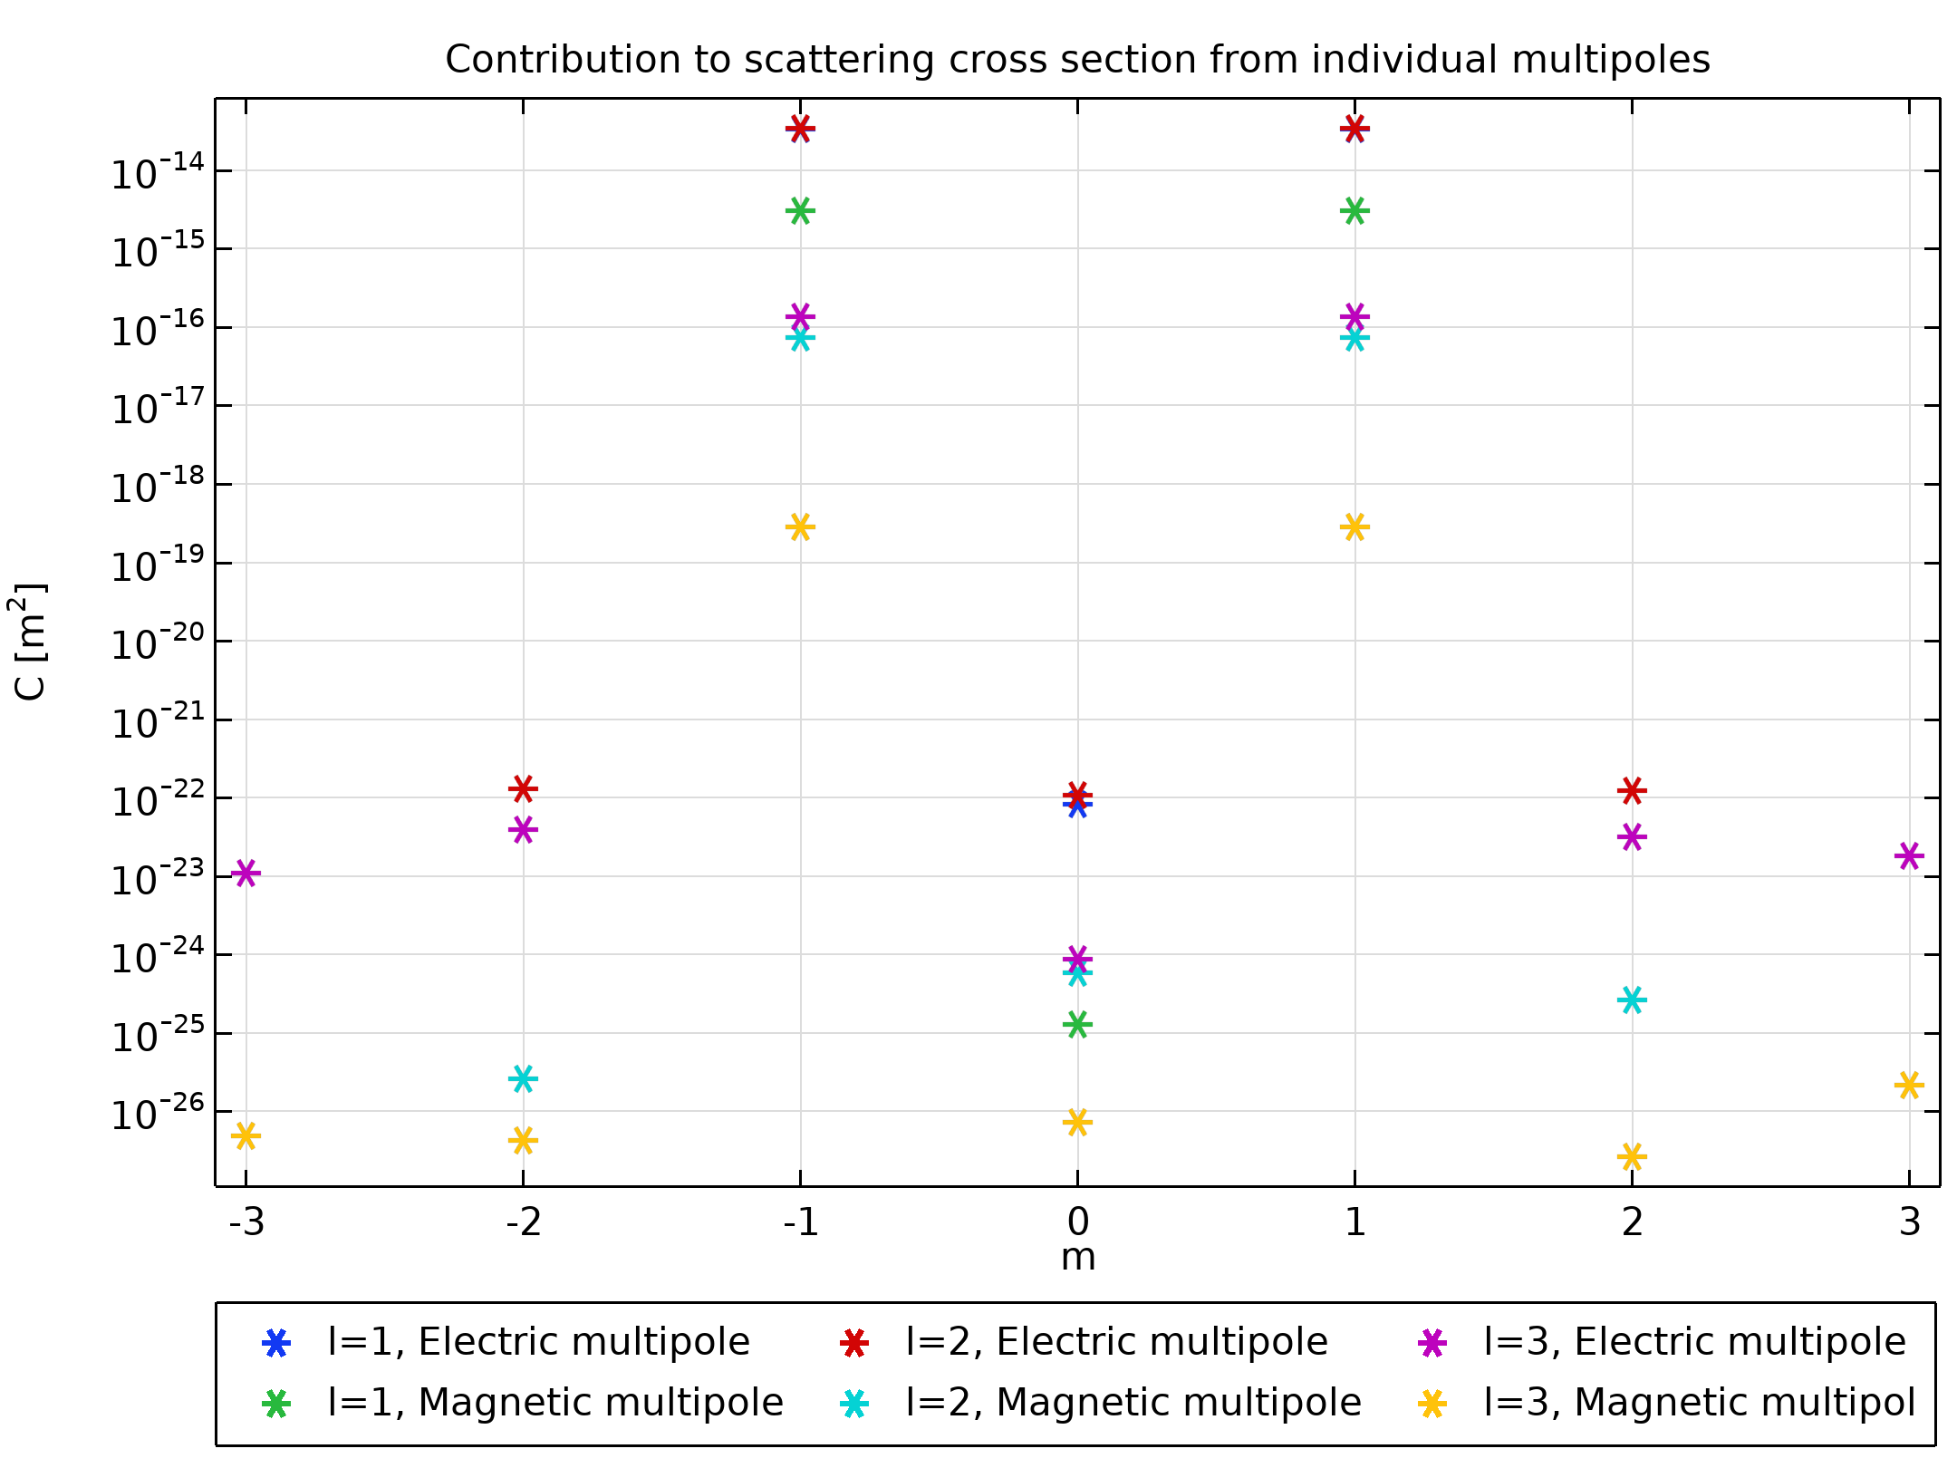
Modal Scattering Cross Section
Only essential contributions from m = -1 and m = 1 terms.

Slide 24
References
J. D. Jackson, Classical Electrodynamics, 3rd Ed., Wiley, 1999.
P. Grahn, A. Shevchenko, and M. Kaivola, "Electromagnetic multipole theory for optical nanomaterials," New Journal of Physics, vol. 14, no. 9, p. 093033, 2012.
C. Mätzler, "MATLAB functions for Mie scattering and absorption, version 2," in IAP Research Report, University of Bern, 2002.

