Slide 1
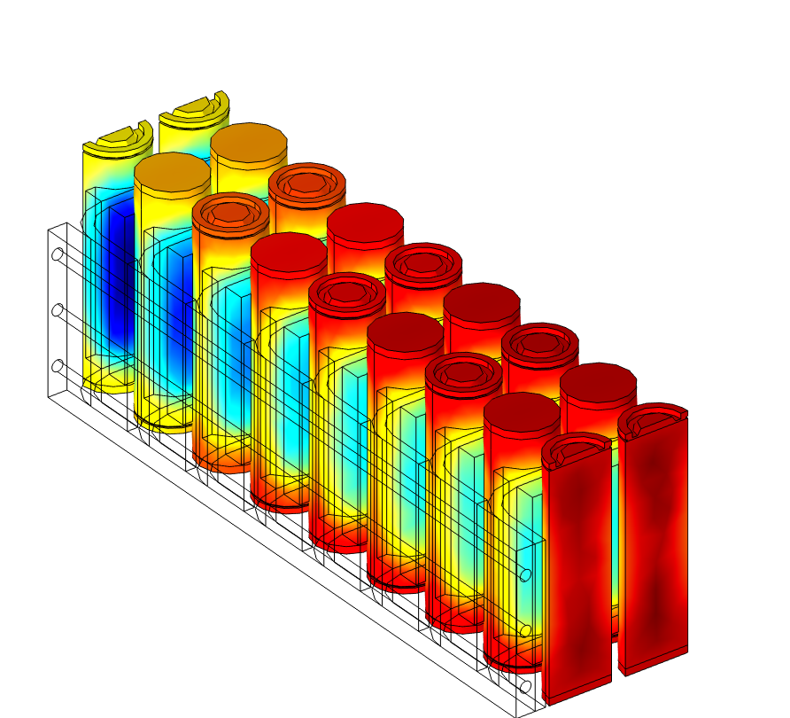
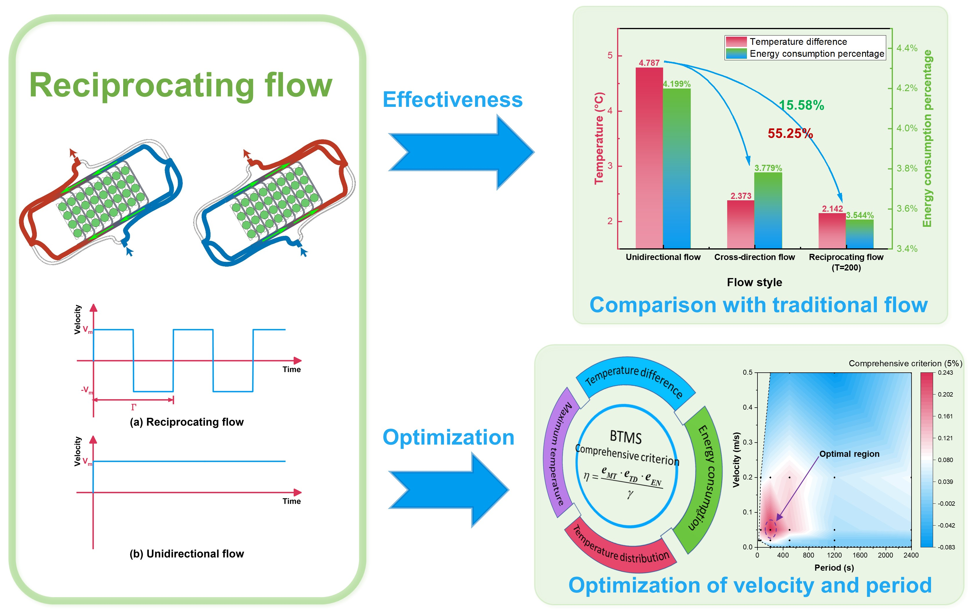
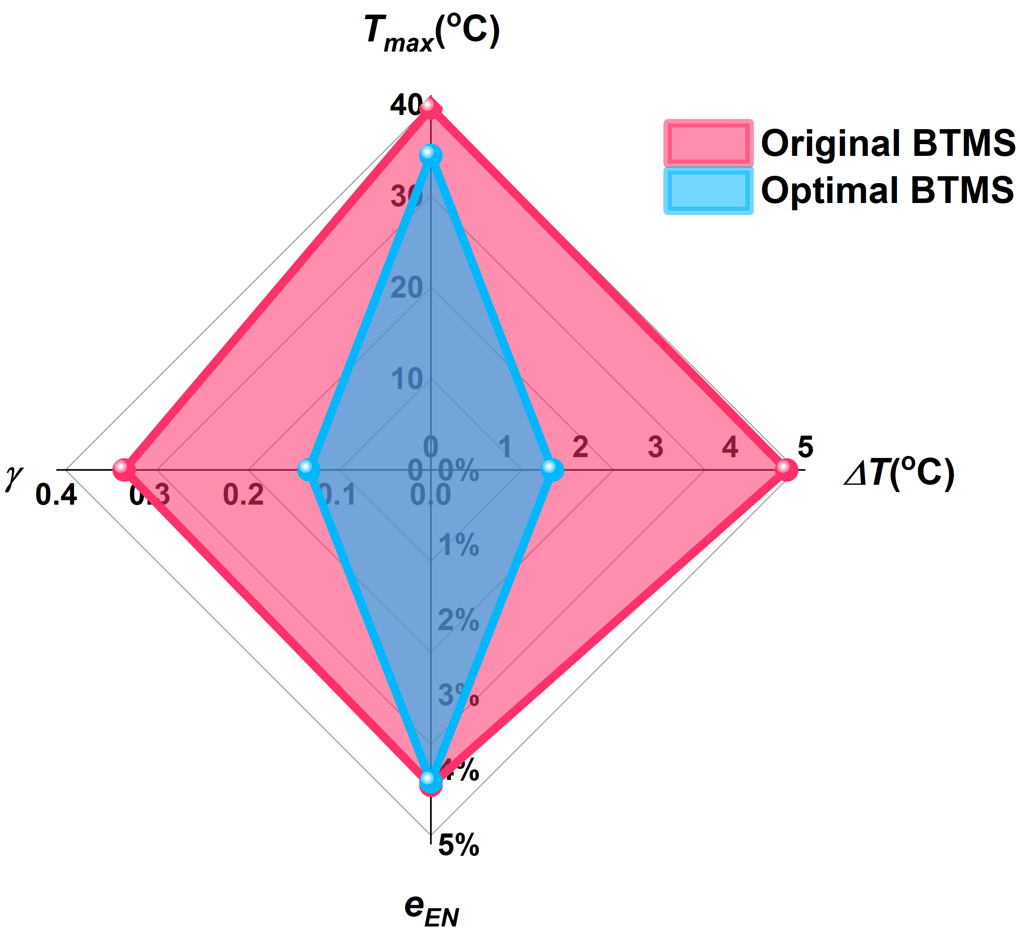

Reciprocating Flow Applied For Liquid-cooling-based Battery Thermal Management System
We first use a reciprocating liquid flow-based BTMS (RLF-BTMS) for cylindrical batteries to release those issues that high energy consumption and high temperature difference between upstream and downstream.
Wei Zeng, Jinhua Sun *, Qiangling Duan *
State Key Laboratory of Fire Science, University of Science and Technology of China, Hefei, China
Abstract
The comparison among unidirectional flow, crossdirection flow, and reciprocating flow was carried out to investigate the effectiveness of reciprocating flow. After that, the effects of velocity and reciprocating period, two key factors of reciprocating flow, were systematically explored.
A comprehensive criterion of the performance of BTMS considering maximum temperature, temperature difference, temperature distribution coefficient, and energy consumption was proposed to optimize the reciprocating flow.
Methodology
Heat generation of LIB
Energy conservation equation
Flow velocity
Energy consumption of the pump
FIGURE 1. Graphical Abstract.
Results
with the reciprocating period decreasing, the varies of maximum temperature and temperature difference of the battery pack can be divided into three stages.
FIGURE 3. Thermal performance of reciprocating flow in different periods.
The optimal BTMS has a better performance in all aspects. ΔT and γ are reduced by 65.8% and 60.3% respectively. T_{max} is decreased by 13.1%. More importantly, there is light energy consumption reduction (1.21%)
FIGURE 2. Temperature distribution of batteries and cooling plate under reciprocating flow cooling (Γ = 200 s), taking a period 600 ~ 800 s for example.
FIGURE 4. the comparison between the original BTMS and the optimal BTMS.
REFERENCES
Wei Zeng, et al. [J]. Energy Conversion and Management, 2023, 292: 117378.
Excerpt from the proceedings of the COMSOL conference 2024 Shanghai

