Slide 1


氢气与甲烷的化学气相沉积模型
SCU
朱铧丞，黄宇清
四川大学电子信息学院
Notes:
Good morning, everyone. Today, I will be presenting our research on the simulation and analysis of chemical vapor deposition (CVD) processes for hydrogen (H₂) and methane (CH₄). The focus of our study is to explore the growth rates and reaction kinetics involved in these processes.

Slide 2

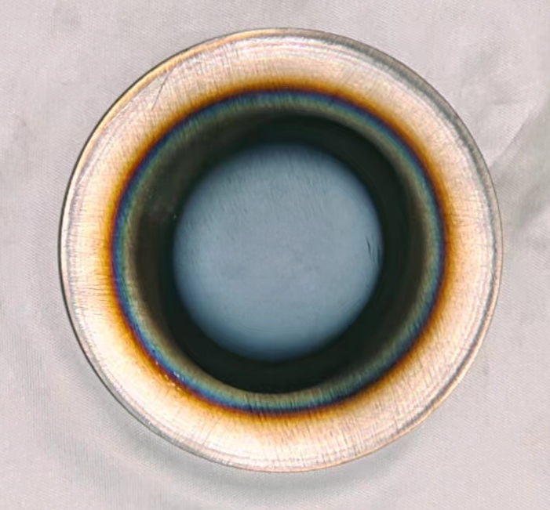
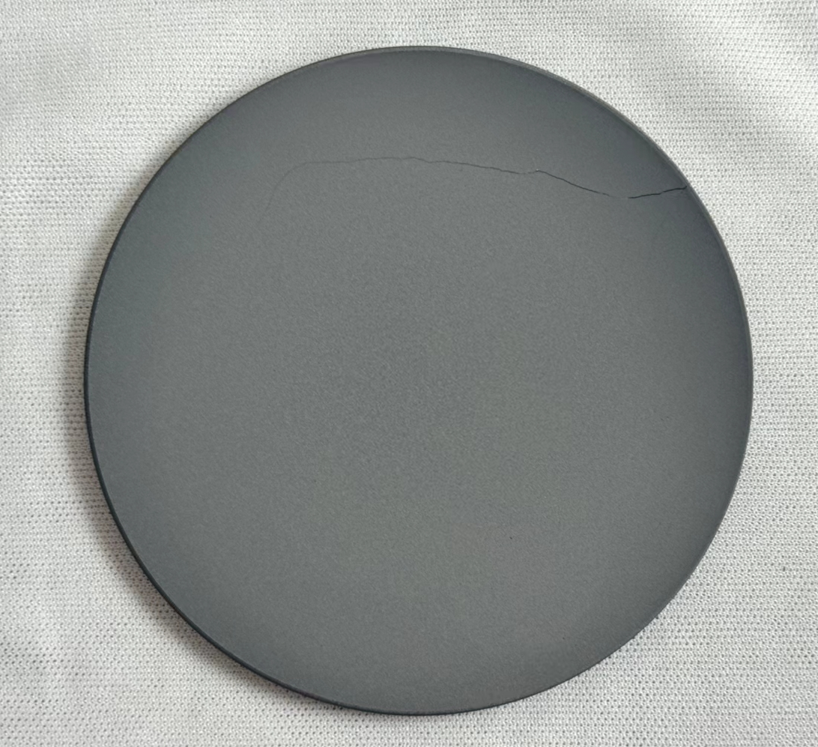
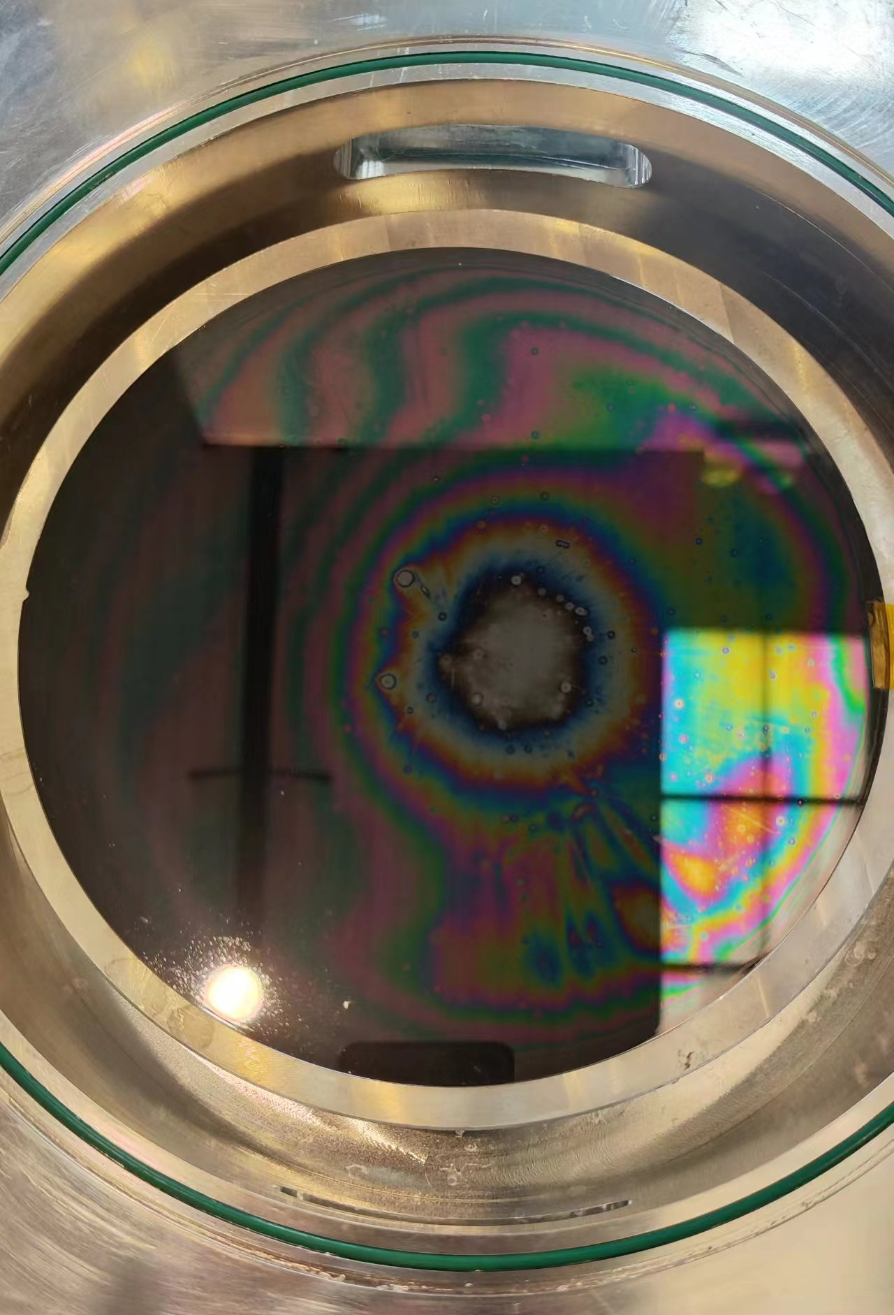
微波等离子体处理工艺的常见问题
生长不均匀
基底裂痕
清洗不彻底
Notes:
Microwave plasma is frequently employed in applications such as cleaning and deposition. However, issues such as Non-uniform growth, cracks on the substrate, and incomplete cleaning frequently arise during this process. These issues have a significant impact on industrial applications.

Slide 3
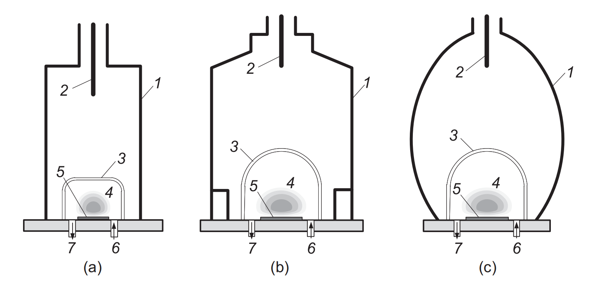
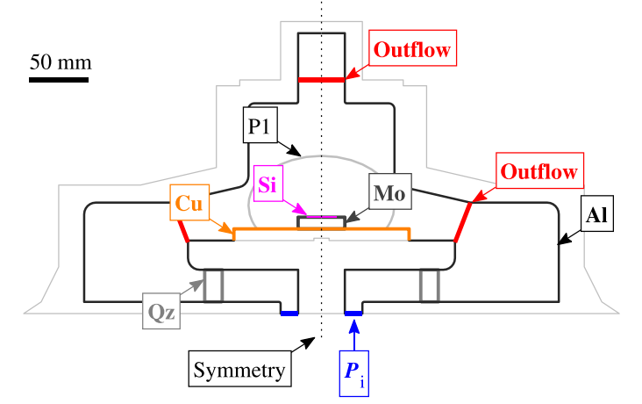
在MPCVD中常见解决方案
常见可调参数:
调整微波功率与压强；
气体的类型与组分；
进气方式与流速；
装置的设计；
额外的补温或散热结构
……
Bogdanov, S.A. et al. (2023) Plasma Processes and Polymers 20(10)
MPCVD的工业实践需要大量的实验，费时费力。
Cuenca, J.A. et al. (2022) Diamond and Related Material 124
Notes:
There are a number of factors that can be adjusted in order to optimise the diamond MPCVD process, including microwave power, gas type and proportion, inlet method and flow rate, device structure, and more. As a result, the industrial practice of MPCVD is a time-consuming and labour-intensive process.

Slide 4
多物理场仿真的优势
Raw gas
H₂+CH₄
Microwave energy
构建由微波到等离子体气相反应再到表面反应的多物理场模型，可以显著降低试错成本，指导参数选择。
Gas-phase reaction
e+H₂=>e+H+H
CH₄+H<=>CH₃+H₂
…
Flow and diffusion
Surface reaction
substrate
Notes:
Constructing a multi-physics field simulation model from microwave to plasma (gas-phase reactions) to surface reactions can greatly reduce trial-and-error costs and guide parameter selection.

Slide 5
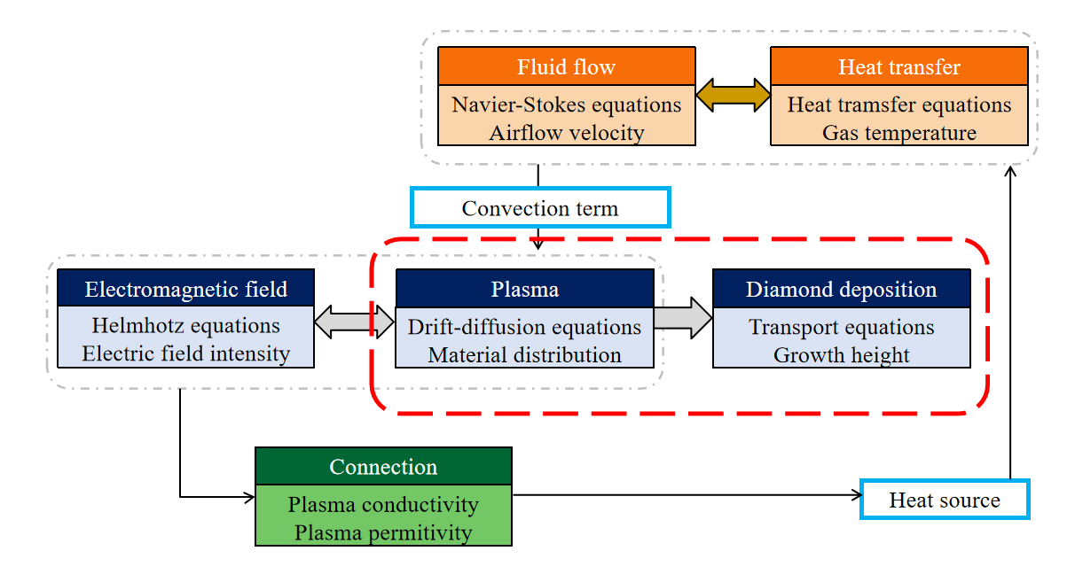
复杂的全耦合模型
Fluid flow
Heat transfer
Different time scale
Navier-Stokes equations
Airflow velocity
Heat tramsfer equations
Gas temperature
Convection term
Electromagnetic field
Plasma
Diamond deposition
Helmhotz equations
Electric field intensity
Drift-diffusion equations
Material distribution
Transport equations
Growth height
Connection
Plasma conductivity
Plasma permitivity
Heat source
Notes:
However, the self-consistent fully coupled simulation of the process from microwave to plasma to diamond deposition is very challenging. Coupling between physical fields with different time scale is difficult. Therefore, our research focuses only on the chemical vapour deposition process in plasma, as shown by the red dashed line.
然而，对微波到等离子体再到金刚石沉积的复杂的自洽全耦合模型进行多物理场建模是非常具有挑战的。其中的挑战之一就是不同物理场所具有的不同时间尺度。因此我们仅将重点放在等离子体到金刚石沉积的化学气相沉积过程。

Slide 6
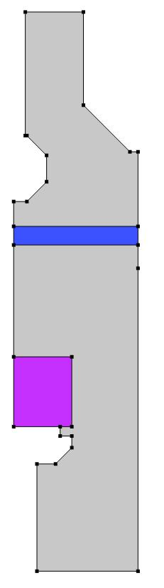
简化模型的构建
axis of symmetry
Glass
Plasma Absorbed Power
Gas inlet
Energy input
Gas Reaction
Plasma Column
Heavy species transport
Holder and substrate
Surface Reaction and Deposition
Gas oulet
Notes:
我们假设了一个等离子体柱区域并在流体传热中指定了一个热源项来表征等离子体的沉积功率，为后续的化学气相沉积反应供能。通过调用重物质输运模块求解不同化学物质在等离子体区域的浓度分布情况，并最终计算金刚石生长高度。

Slide 7
初始条件与边界条件
Parameters | Domains/species | Value
Initial Temperature | Plasma Else | 2800K 800K
Initial molar fraction | CH4 H2 H | 0.01 0.85 0.05
Initial Pressure | All domains | 1000Pa
Absorbed MW Power | Plasma | 1000W
成比例增大

Slide 8
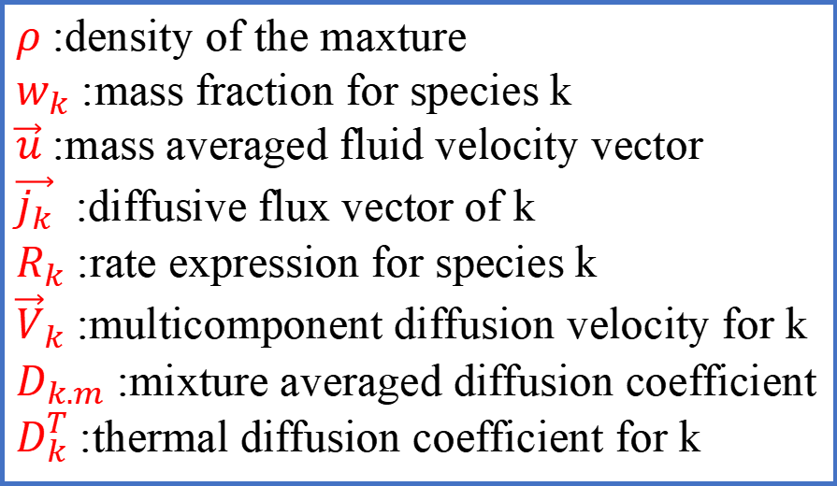

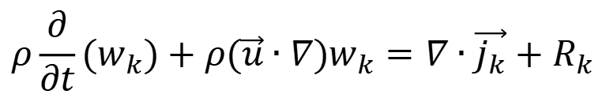
多组分扩散方程
来自重物质传递模块
$ρ$ :density of the maxture
$w_{k}$ :mass fraction for species k
$\vec{u}$ :mass averaged fluid velocity vector
$\vec{j_{k}}$ :diffusive flux vector of k
$R_{k}$ :rate expression for species k
${\vec{V}}_{k}$ :multicomponent diffusion velocity for k
$D_{k.m}$ :mixture averaged diffusion coefficient
$D_{k}^{T}$ :thermal diffusion coefficient for k
$$ρ\frac{∂}{∂t}(w_{k})+ρ(\vec{u}∙∇)w_{k}=∇∙\vec{j_{k}}+R_{k}$$
$$\vec{j_{k}}=ρw_{k}{\vec{V}}_{k}$$
$$\vec{V_{k}}=D_{k.m}\frac{∇w_{k}}{w_{k}}+D_{k.m}\frac{∇M_{n}}{M_{n}}+D_{k}^{T}\frac{∇T}{T}$$
Notes:
We analyze the two-dimensional distribution of chemical substances by solving the multicomponent diffusion equations or the component continuity equation, with a particular focus on heavy species transport in chemical reactions.

Slide 9
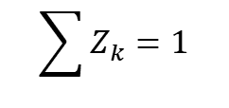
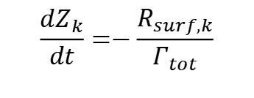
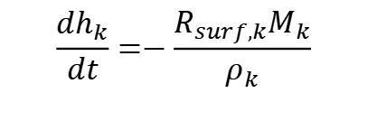
表面反应与沉积
来自重物质传递模块
+H
+H
+H
+CH3(g)
$$\frac{dZ_{k}}{dt}=−\frac{R_{surf,k}}{Γ_{tot}}$$
CH3(s)
CH2(s)
CH(s)
C(s)
C(b)
Surface species | Site fraction (Z_{k})
CH3(s) | 0.01
CH2(s) | 0.01
CH(s) | 0.01
C(s) | 0.97
$$\sum{Z_{k}=1}$$
$$\frac{dh_{k}}{dt}=−\frac{R_{surf,k}M_{k}}{ρ_{k}}$$
$Z_{k}$ is the site fraction, $R_{surf,k}$ is the surface rate expreesion, $Γ_{tot}$ is the total surface site concentration, $M_{k}$ and $ρ_{k}$ is the molecular weight and density of bulk species k, respectively.
Notes:
This page presents the formula for calculating the surface reaction process and the height of diamond deposition.
It is widely acknowledged that methyl and hydrogen are the precursors for diamond deposition.
Answer
In this model, the site fraction of the first three surface substances declines rapidly over time, while the site fraction of carbon increases rapidly until it reaches 99%.

Slide 10

H₂/CH₄ 等离子体中的烃类反应
来自重物质传递模块
主要物质
C2H6
CH₄
(+H/-H2)
C2H5
Red arrows: 主要反应路径
Black arrows: 中间态快速转化物质
Dashed arrows: 动力学存在限制的转化
(+H/-H2)
CH₃
(+H/-H2)
(+H/-H2)
C2H4
CH₂
(+H/-H2)
(+H/-H2)
C2H3
CH
(+H/-H2)
C2H2
Arrhenius公式
(+H/-H2)
C
(+H/-H2)
C2H
$$k=A∙T^{n}e^{(−E/RT)}$$
Hassouni, K., F. Silva and A. Gicquel (2010) Journal of Physics D: Applied Physics 43(15).
(+H/-H2)
C2
Notes:
This page illustrates the hydrocarbon conversion reaction in a H2/CH4 plasma. The red arrows show the major reaction paths, the black arrows show the quantitative fast conversions, and the dashed arrows show the kinetically limiting conversions. The Arrhenius formula is used to calculate the reaction rates.

Slide 11
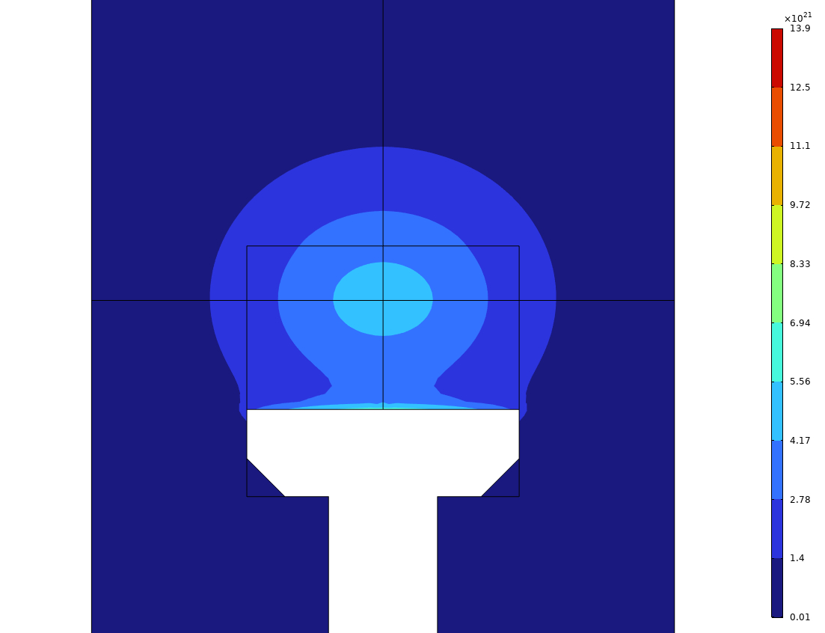
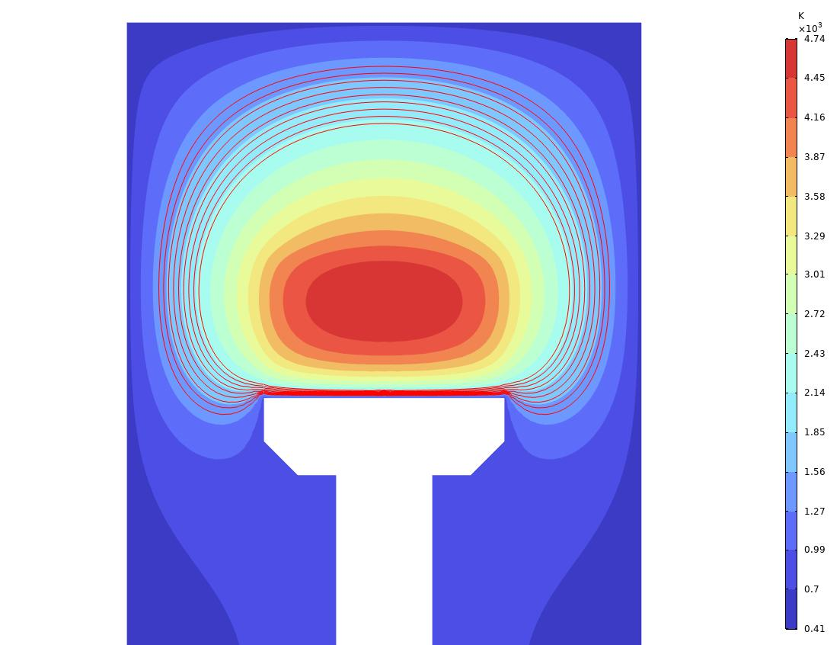
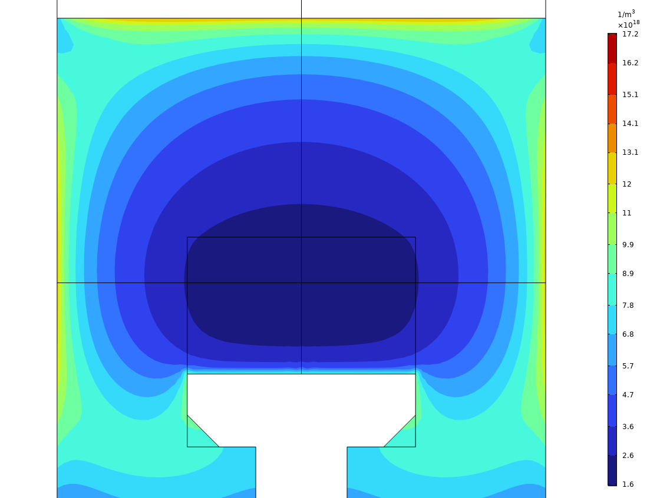
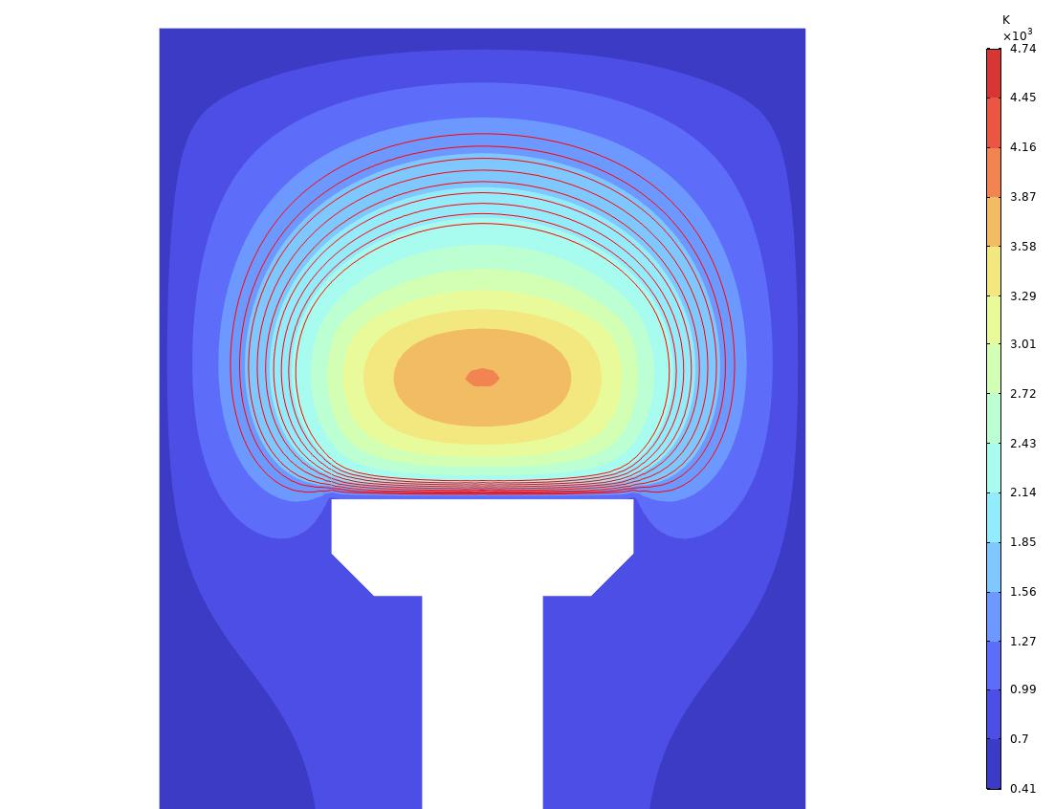
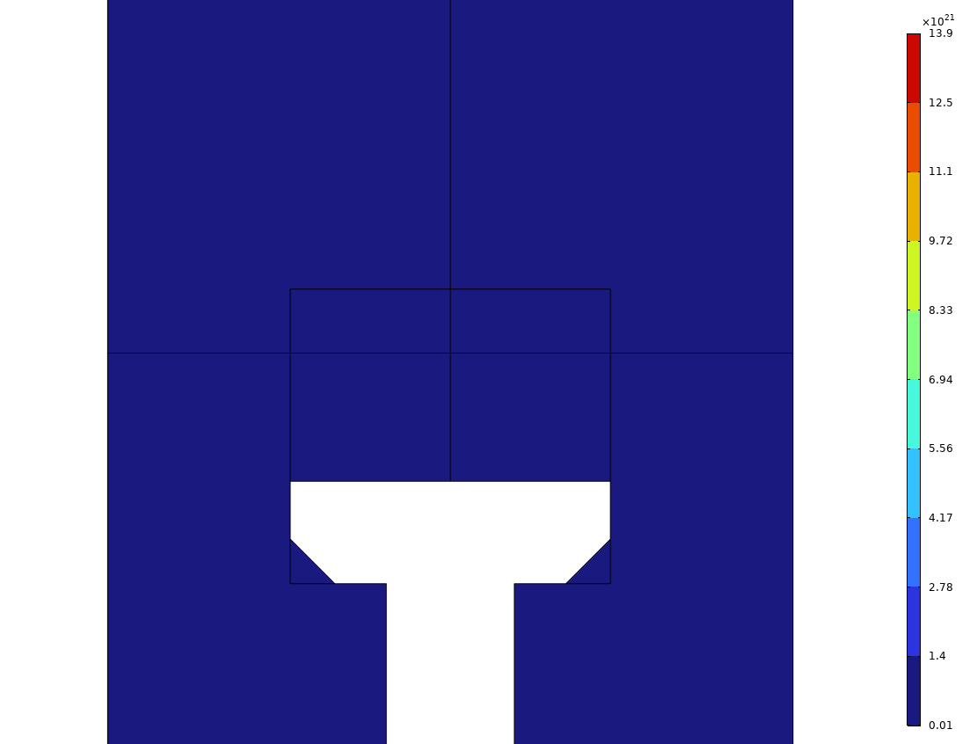
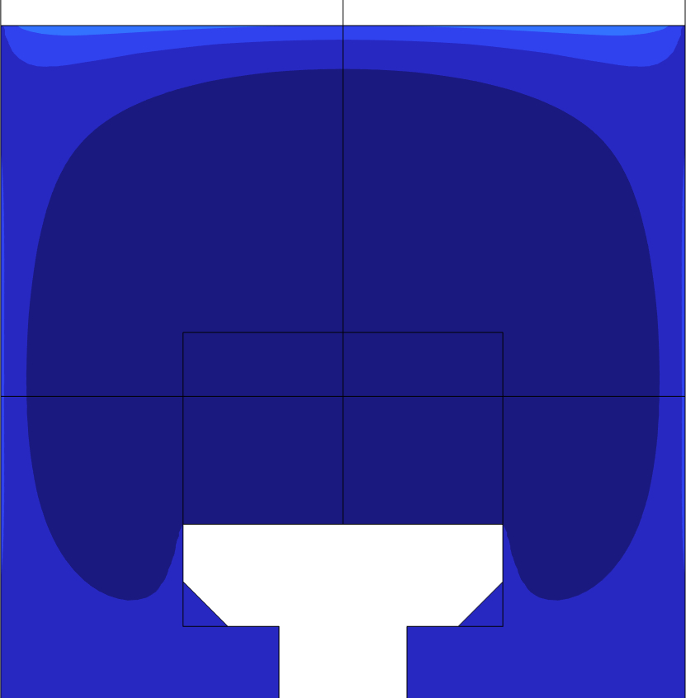
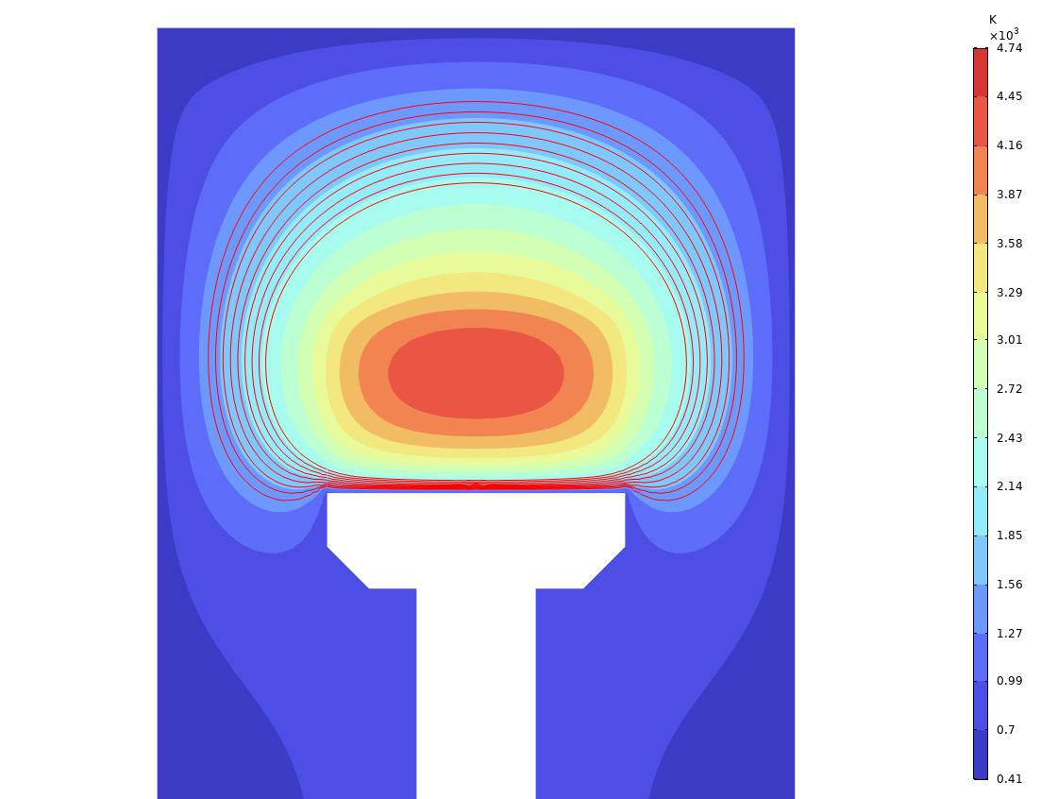
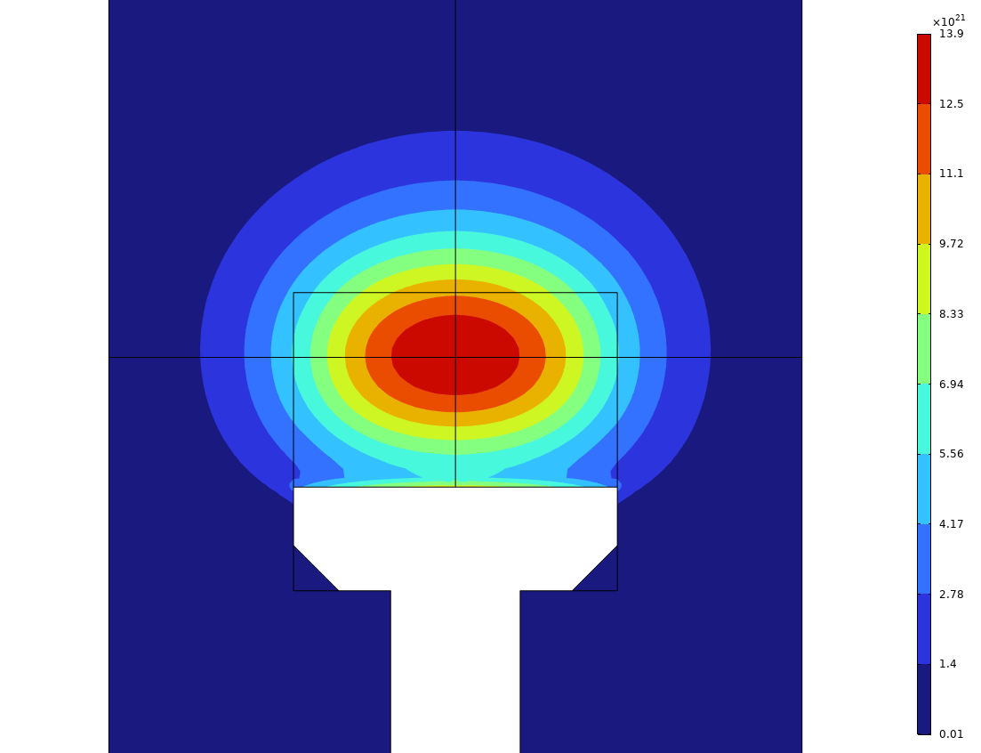
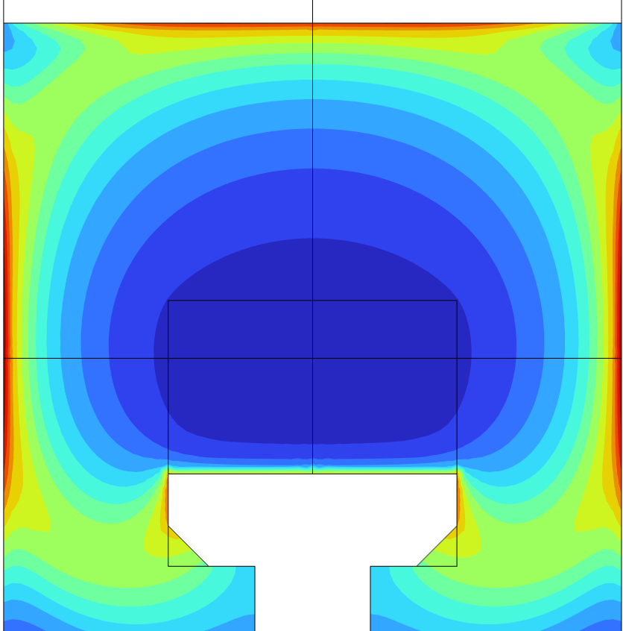
低压低功率条件下的仿真
 | Tg |  | nH |  | nCH₃
1kW 1kPa
1.5kW 3kPa
2kW 4.5kPa
Notes:
At low pressure, the gas temperature increases with increasing pressure and power. The hydrogen density is highest in the centre and lowest at the edge.

Slide 12
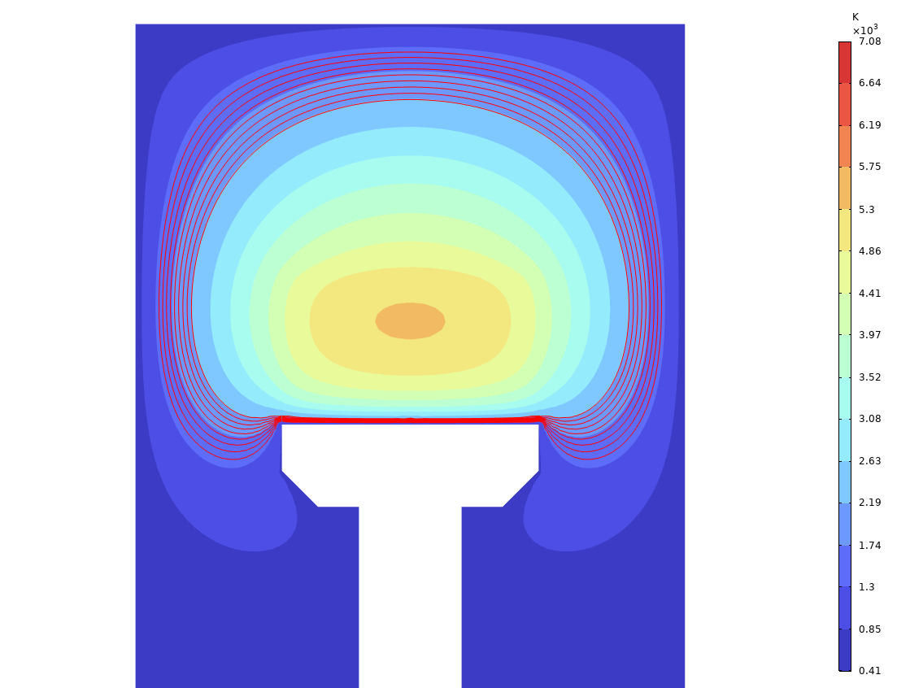
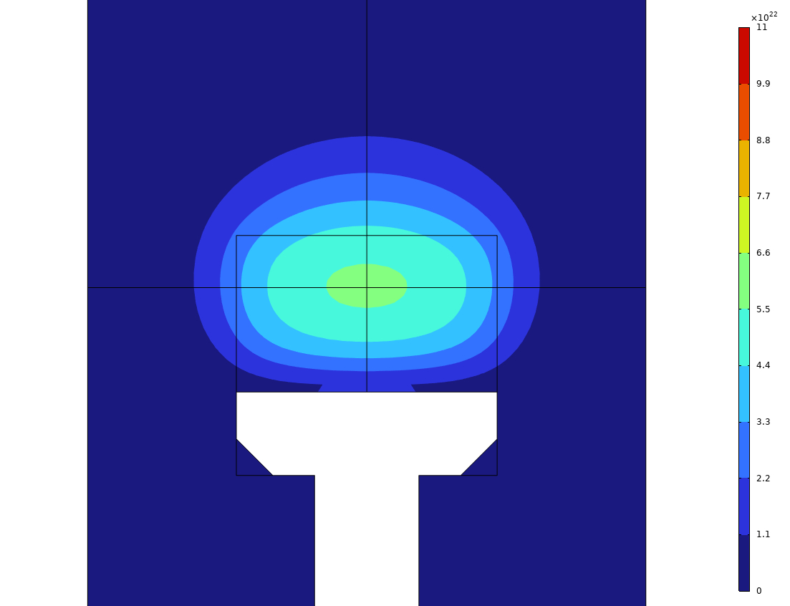
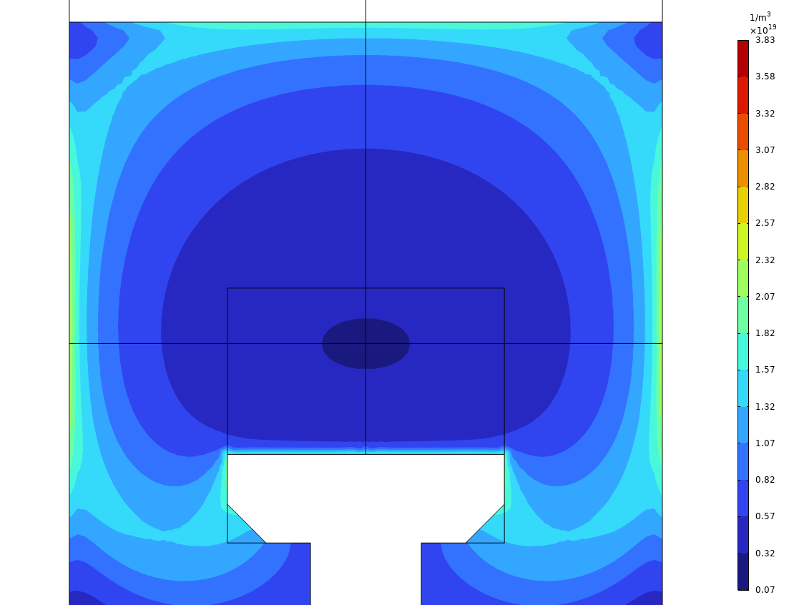
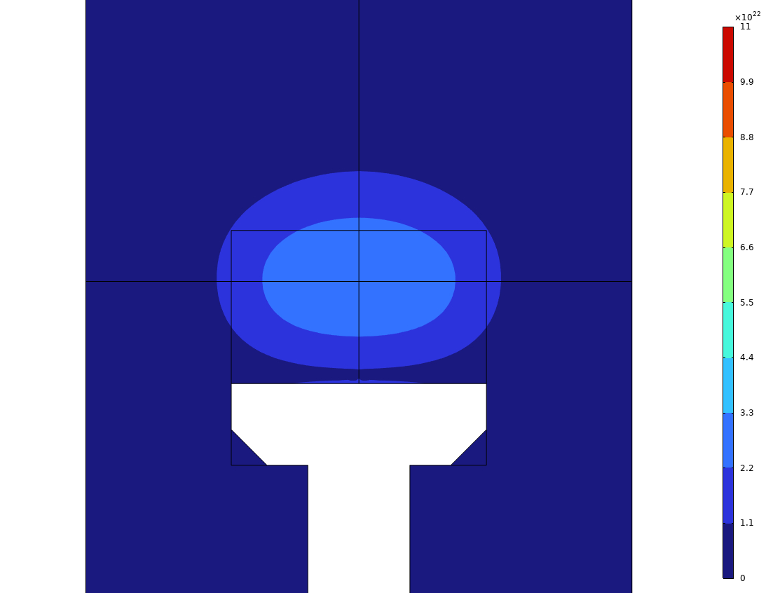
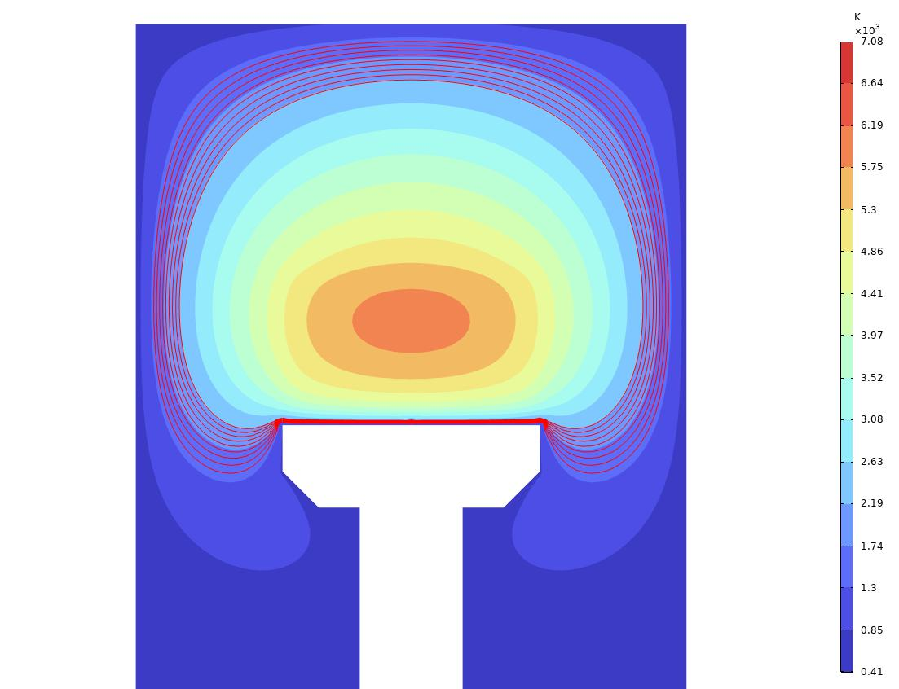
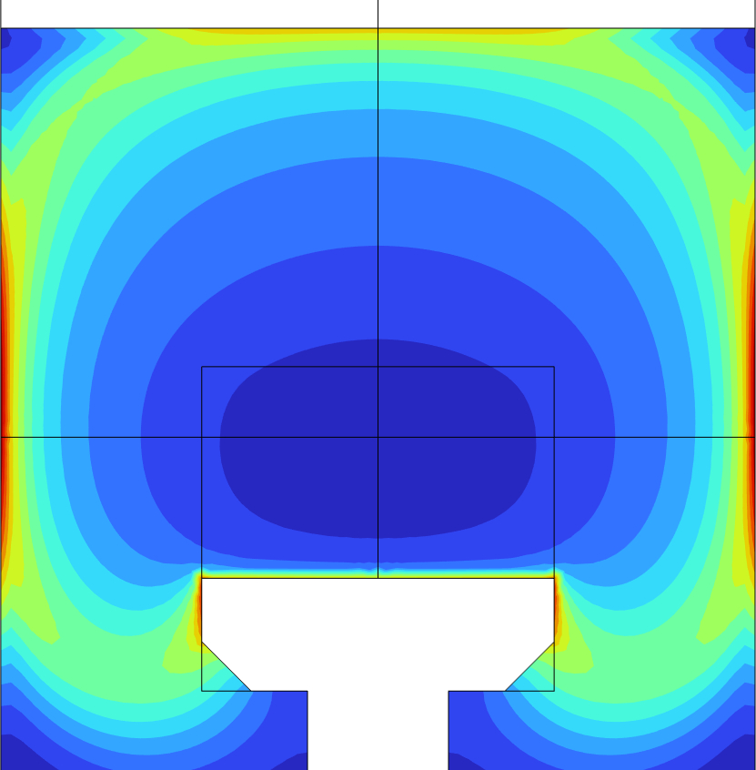
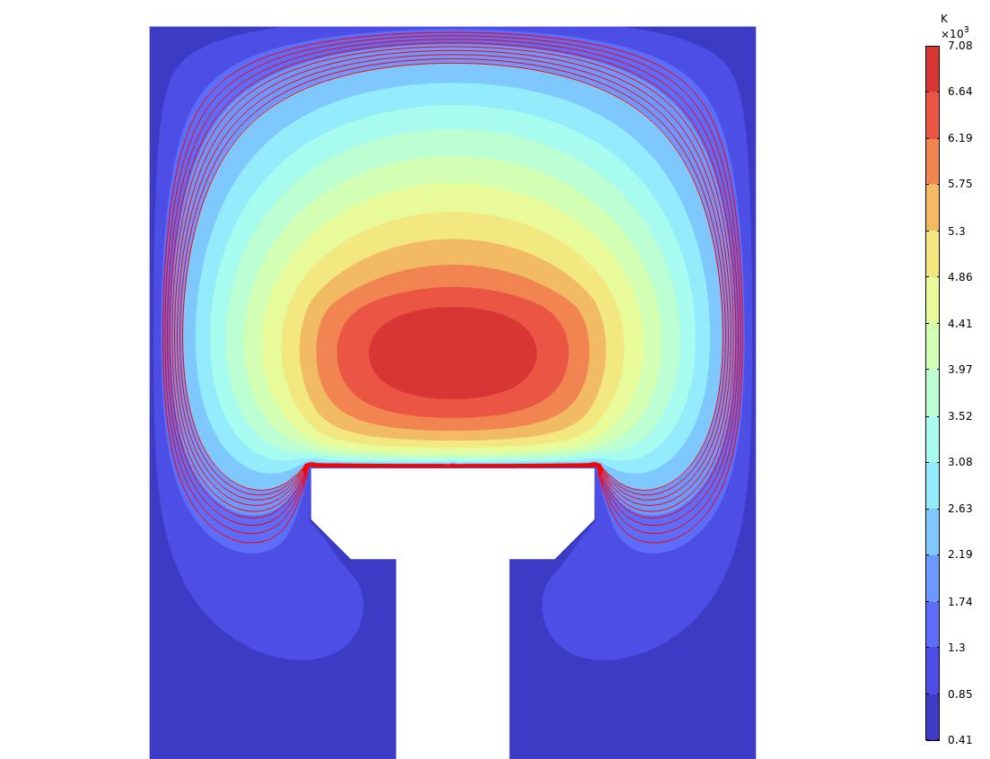
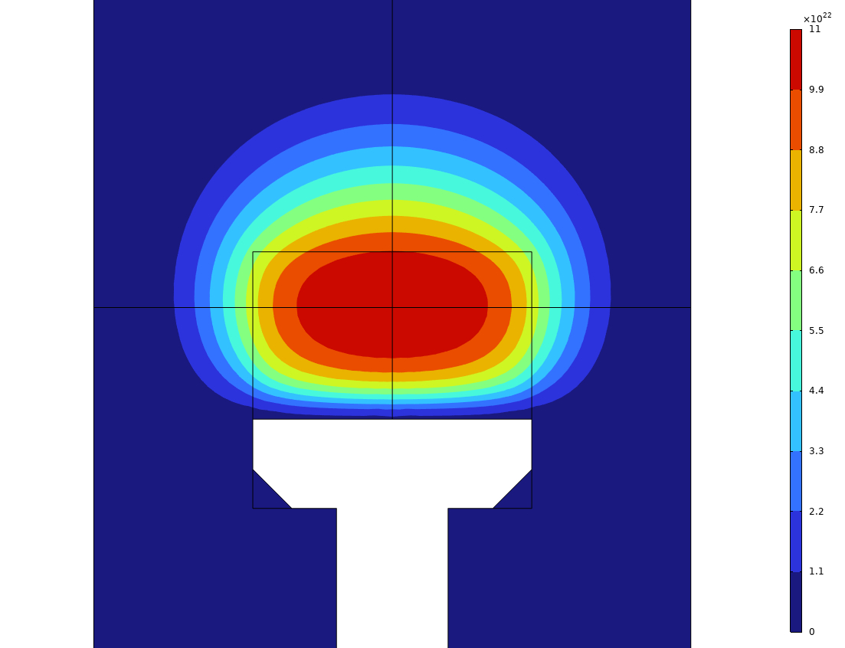
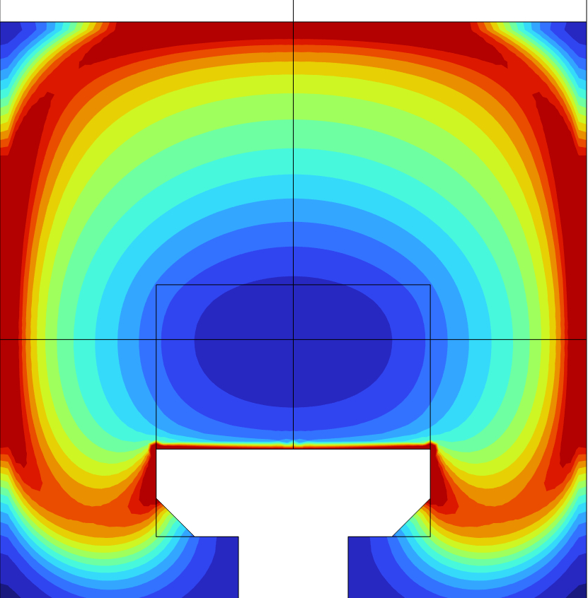
中等压强功率条件下的仿真
 | Tg |  | nH |  | nCH₃
3kW 6kPa
4kW 9kPa
6kW 15kPa
Notes:
At higher input power and pressure, the gas temperature and hydrogen density increase further. The methyl group shows a typical cyclic distribution.

Slide 13
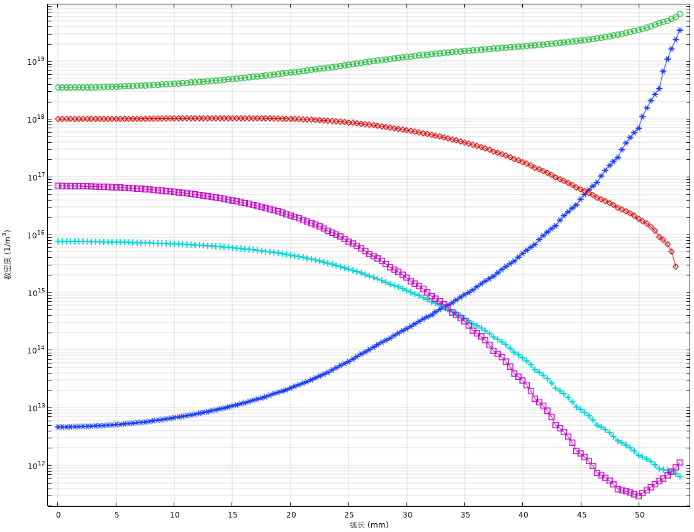
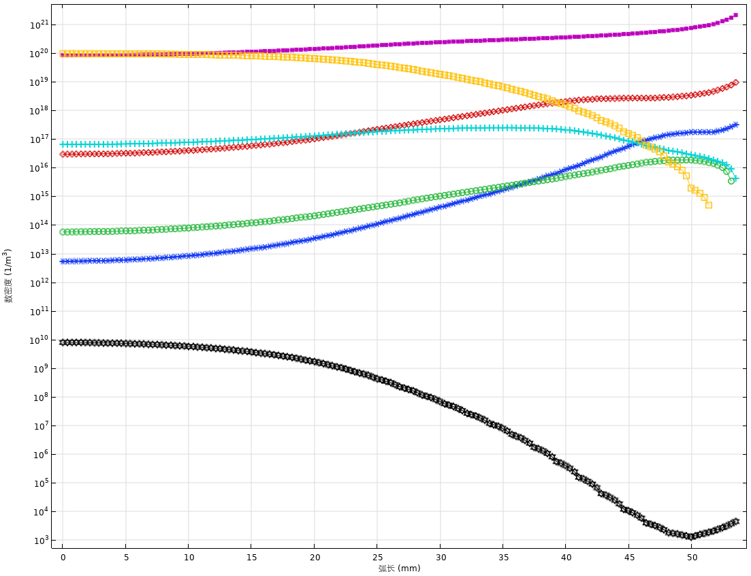
径向物质分布
C₂H₂
CH₃
C₂H
C₂H₄
CH₄
C₂H₃
CH₂
C₂H₅
Density(1/m³)
Density(1/m³)
C₂H₆
C₂
CH
C
CH_{y}
C₂H_{y}
Z=10mm Pin=6kW p=15kPa
Notes:
This page shows the radial distribution of chemical molecules in plasma at 6kW and 15kPa. The cavity is primarily comprised of methyl and ethylene.

Slide 14
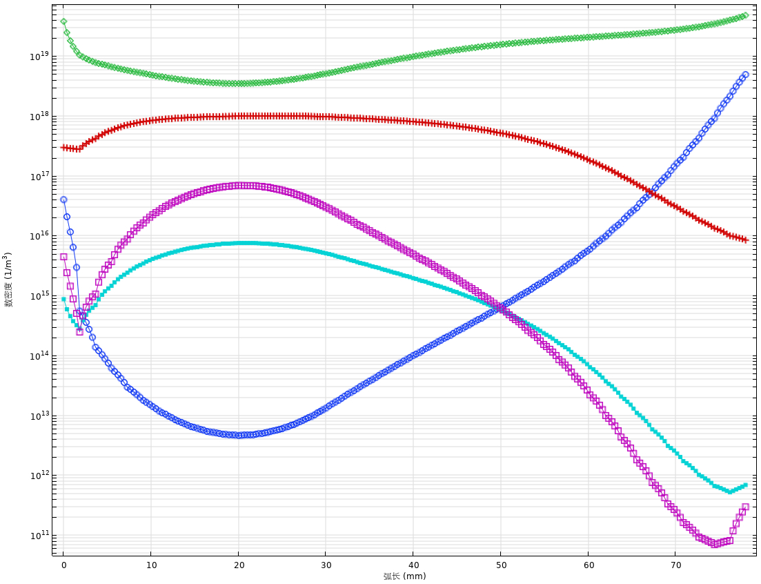
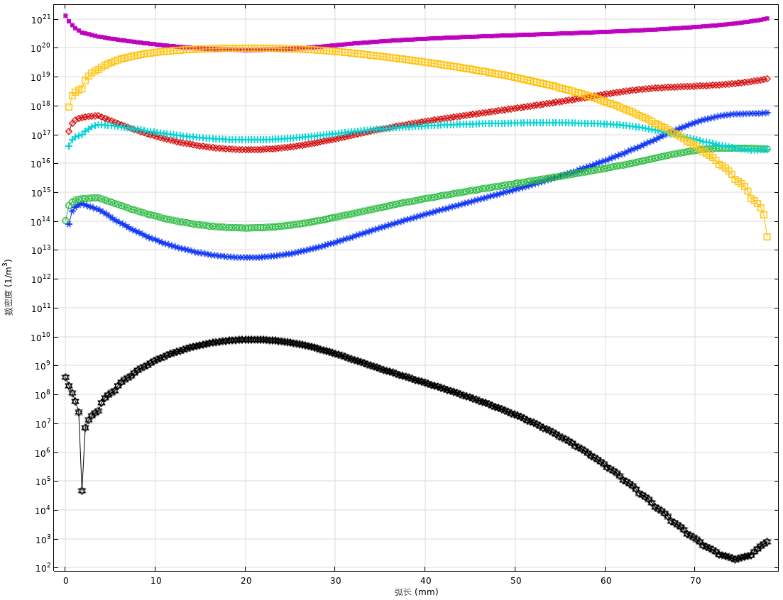
轴向物质分布
CH₃
C₂H₂
C₂H
C₂H₄
CH₄
C₂H₃
CH₂
C₂H₅
Density(1/m³)
Density(1/m³)
C₂H₆
C₂
CH
C
20cm
CH_{y}
C₂H_{y}
20cm
Pin=6kW p=15kPa
Notes:
In the axial direction, the distribution is shown to decrease and then increase, or to increase and then decrease, with the extremum occurring at the centre of the plasma. It’s about 20 milimeter from the substrate.

Slide 15
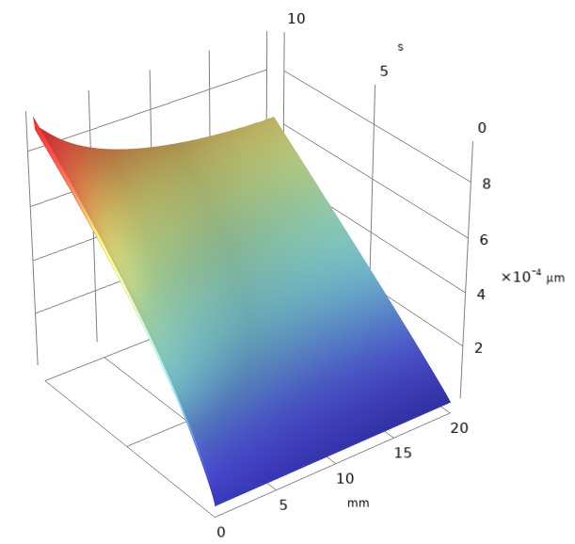
金刚石沉积高度
Diamond growth height
Time Position | 5 s | 10 s
Center (x=0 mm) | 0.580 nm | 0.943 nm
Mid (x=10 mm) | 0.367 nm | 0.683 nm
Edge (x=20 mm) | 0.333 nm | 0.641 nm
z(Growth height)
y(Times)
Pin=3kW p=10kPa
x(Radius direction of the substrate)
Notes:
The growth rates are highest in the central areas and lowest at the edges. This finding is in line with the results of the experiment. However, the average growth rate is below the normal growth rate at a power of 3 kW and a pressure of 10 kPa.

Slide 16
结论
1. 这一方法计算了化学气相沉积中物质的二维分布情况；
2. 这一方法可以分析不同组分在不同的输入功率与压强下的分布情况，并计算金刚石的沉积高度与速率；
3. 输入功率与压强需要等比例增长以保证模型的收敛性，同时这也是实验中维持稳定的等离子体的必要条件；
4. 初步构建了一个CVD金刚石模型。该模型下，烃类物质在等离子体中分布情况由内到外饱和度递增。由于未考虑微波-等离子体过程，金刚石的生长速率相比于实验结构偏低，气体温度相对实际情况偏高。这一模型提供了一个用于优化MPCVD的仿真工具。
Notes:
下一步怎么弄

Slide 17
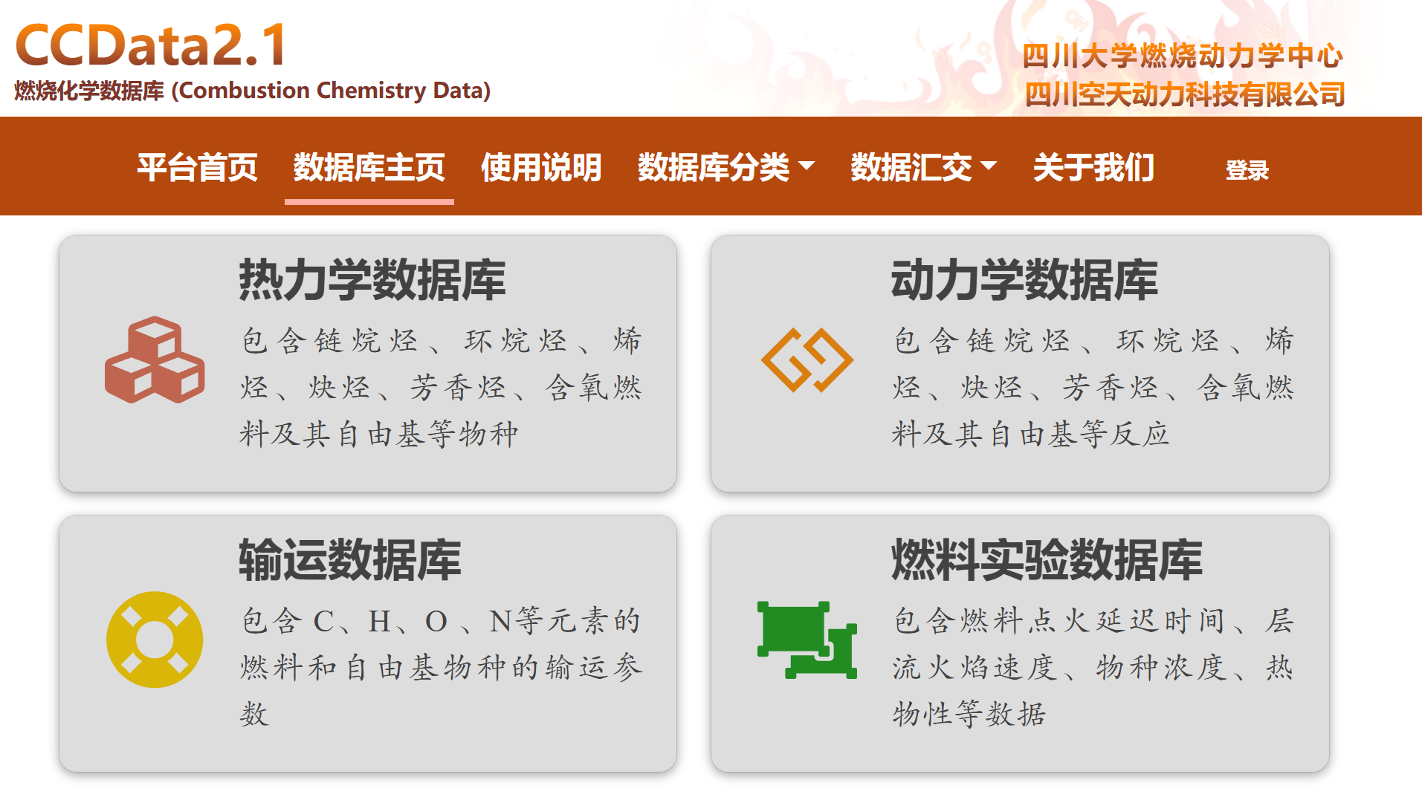
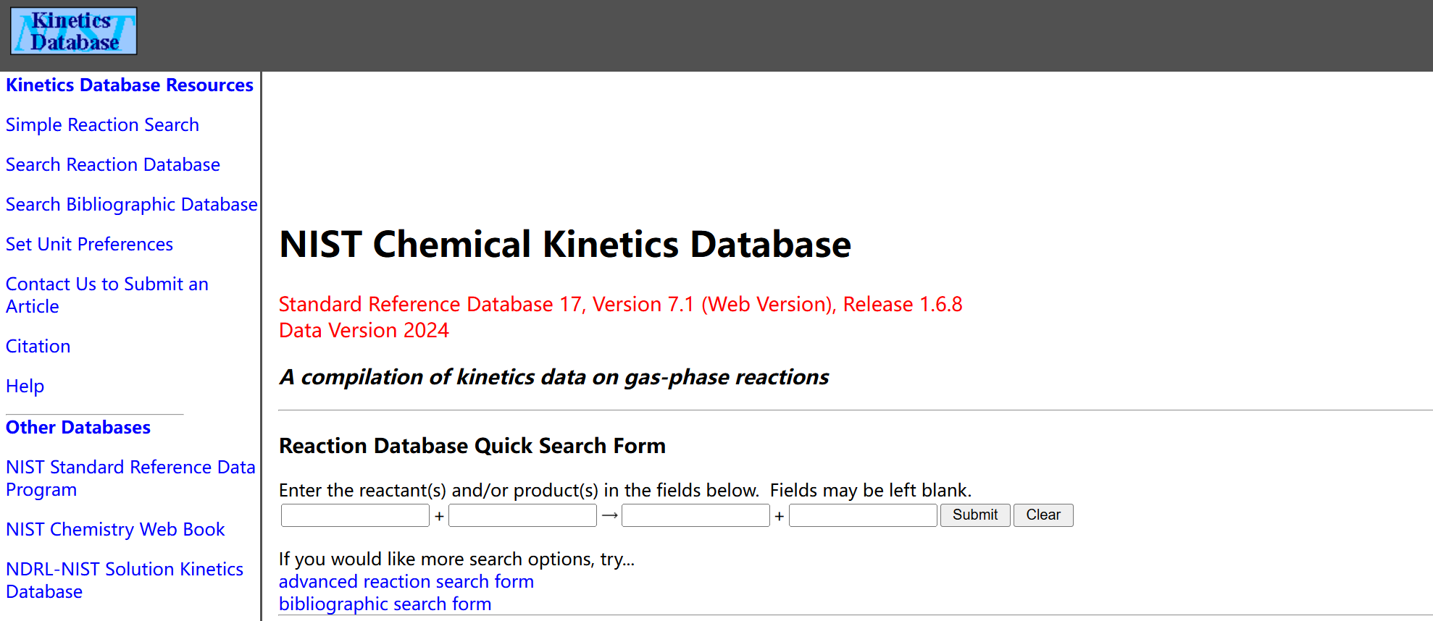
如何获取化学气相沉积反应的相关参数
NIST化学动力学数据库
四川大学燃烧动力学数据库
其他参考文献
Notes:
下一步怎么弄

Slide 18
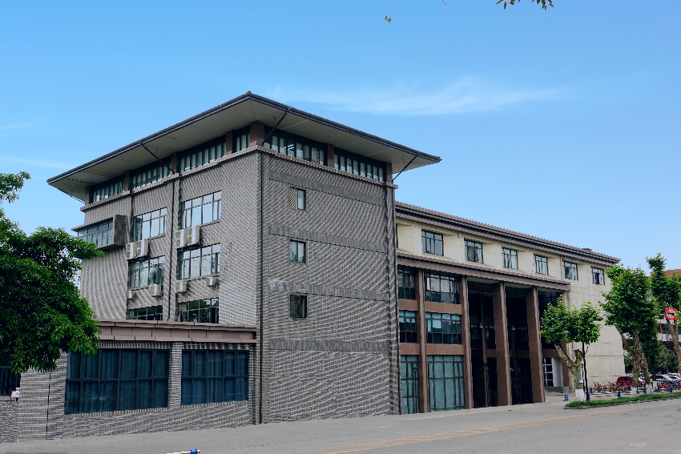
感谢各位的聆听！
感谢各位的批评指正！

