Slide 1
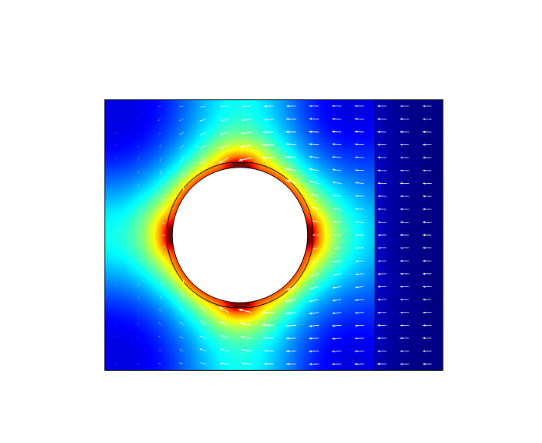
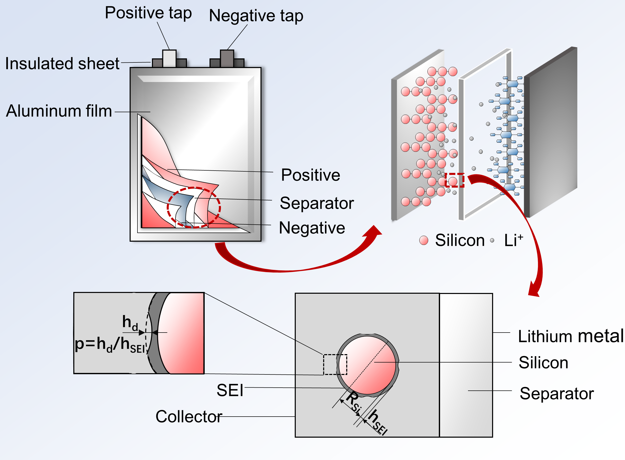
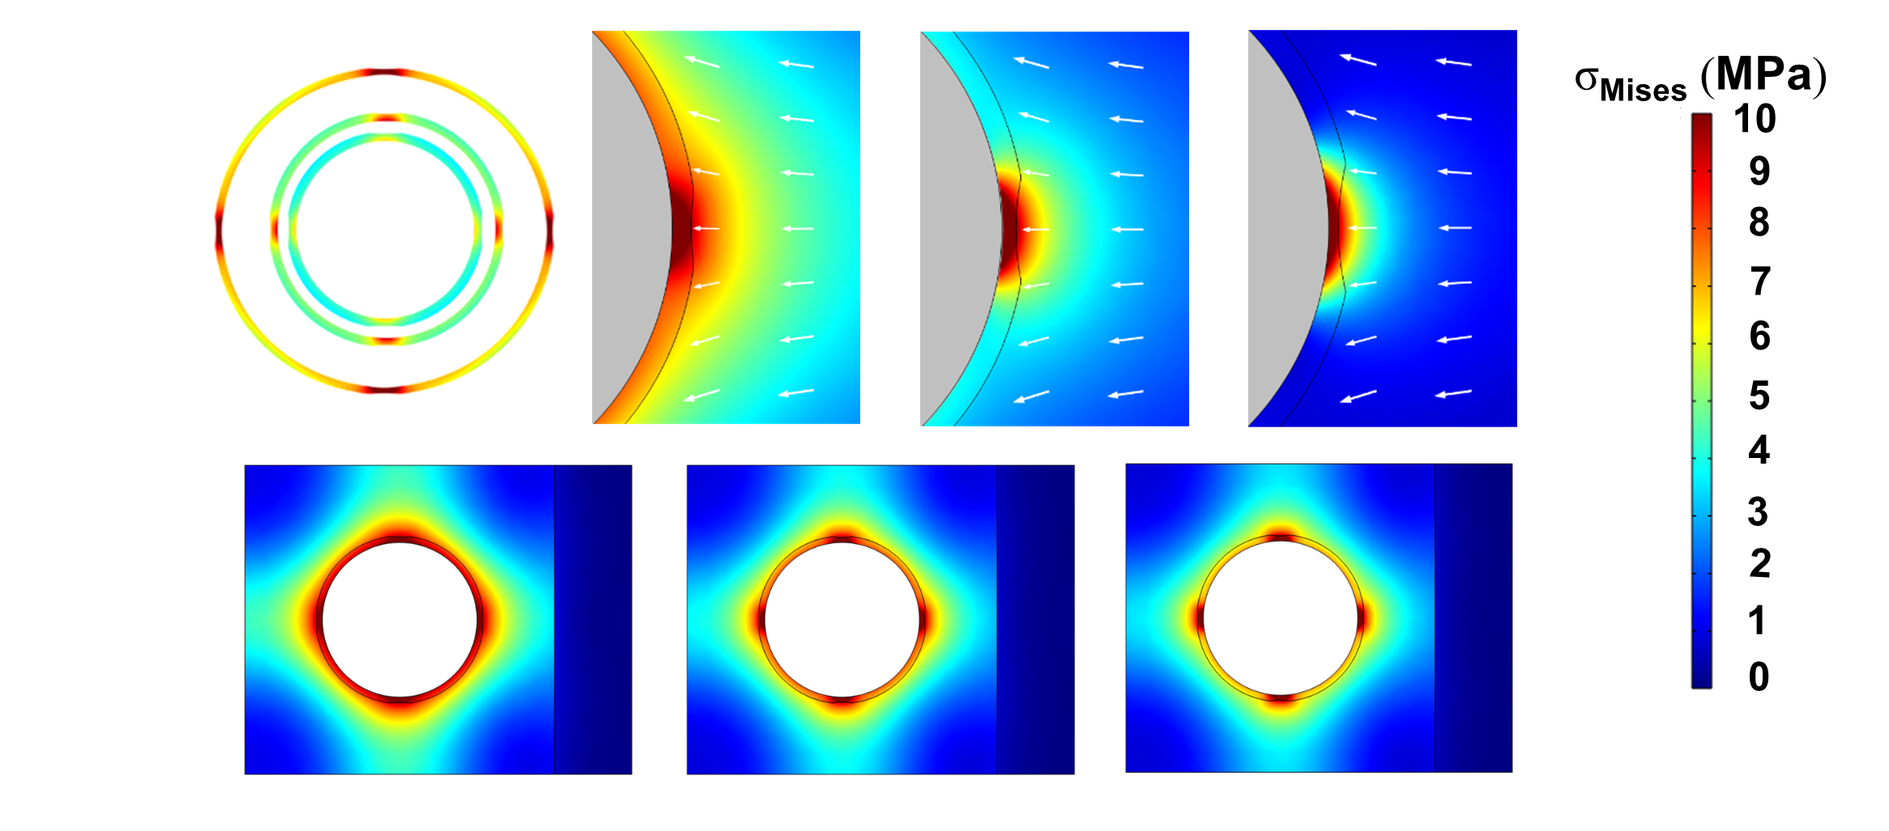

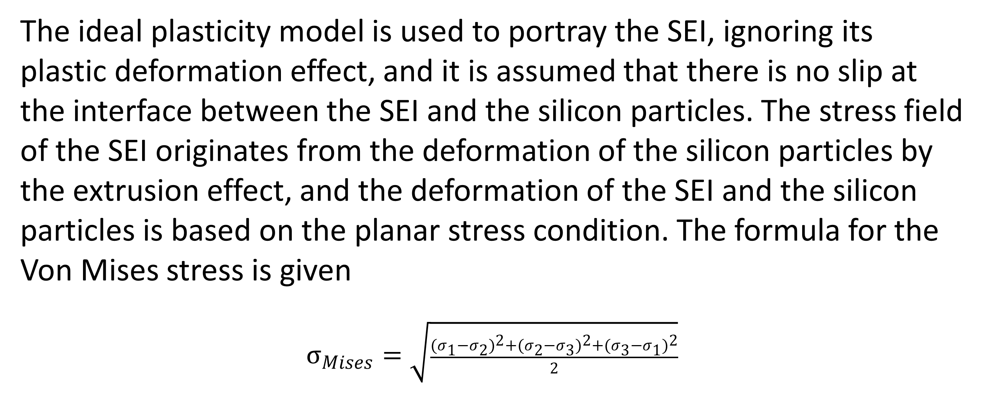
Lithium-ion battery electrode interphase failure simulation
Calculation of battery SEI stability under different conditions based on coupled mechanistic-electrochemical modeling
Junjie Ding¹,Peng Tan¹² 1. Department of Thermal Science and Energy Engineering, University of Science and Technology of China (USTC), Hefei 230026, Anhui, China. 2. State Key Laboratory of Fire Science, University of Science and Technology of China (USTC), Hefei 230026, Anhui, China.
Abstract
Silicon is considered one of the most promising anode materials owing to its high theoretical energy density, however, the volume expansion/contraction during electrochemical lithiation/delithiation cycles leads to instability of the solid electrolyte interphase (SEI), which ultimately results in capacity degradation. Herein, the local stress and deformation evolution status of an SEI layer on an anode particle are investigated through a quantitative electrochemical-mechanical model. The impacts of structural uniformity, mechanical strength, and operating conditions on the stability of the SEI layer are investigated in detail. The simulation results demonstrate that when the silicon particle radius decreases from 800 ​nm to 600 and 400 ​nm, the failure time increases by 29% and 65%, respectively, of the original failure time; When the structural defect depth ratio is reduced from 0.6 to 0.4 and 0.2, the failure time increases by 72% and 132%, respectively; For the discharge rate, the condition at 0.1 C has 34% and 139% longer time to failure than that at 0.2 C and 0.3 C, respectively. This work provides insight into the rational design of stable SEI layers and sheds light on possible methods for constructing silicon-based lithium-ion batteries with longer cycling lives.
Methodology
The ideal plasticity model is used to portray the SEI, ignoring its plastic deformation effect, and it is assumed that there is no slip at the interface between the SEI and the silicon particles. The stress field of the SEI originates from the deformation of the silicon particles by the extrusion effect, and the deformation of the SEI and the silicon particles is based on the planar stress condition. The formula for the Von Mises stress is given
$σ_{Mises}=\sqrt{\frac{{{(σ}_{1}−σ_{2})}^{2}+{(σ_{2}−σ_{3})}^{2}+{(σ_{3}−σ_{1})}^{2}}{2}}$
FIGURE 1. Computational model and model validation: From the 3D soft pack cell to the 2D model.
Results
The results are shown in Fig. 2.First, decreasing the size of silicon electrode particles leads to better SEI stability. When the radius of silicon particles is gradually reduced from 1µm to 0.2µm, the SEI failure time increases from 373 s to 1180 s, and the decreasing radius has an increasingly significant effect on the prolongation of the SEI failure time; therefore, the radius of the silicon electrode particles should be minimized when constructing silicon-based lituium-ion batteries. When the defect depth ratio decreases, the SEI stability increases significantly with the increase of structural homogeneity. In addition, high discharge rate decreases the stability of SEI, and if it is necessary to maintain SEI without failure, the discharge capacity is higher at high discharge rate.
FIGURE 2. Mises stress cloud of SEI with three factors: silicon particle radius, current density, and structural homogeneity
REFERENCES
D.M. Piper, S.-H. Lee, Stable silicon-ionic liquid interface for next-generation lithium-ion batteries, Nat. Commun. 6,6230,2015 .
M.Y. Jin, B.W. Sheldon, Optimum particle size in silicon electrodes dictated by chemomechanical deformation of the SEI, Adv. Funct. Mater. 31,2010640,2021 .

