Slide 1
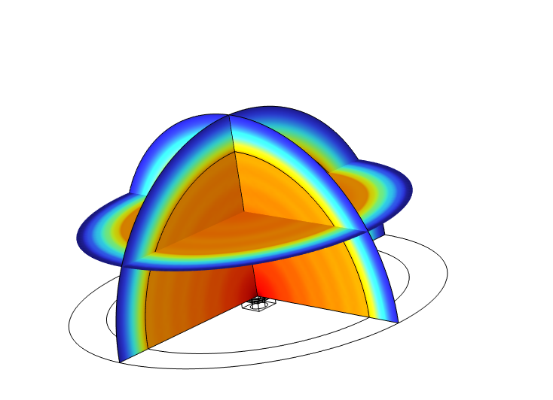

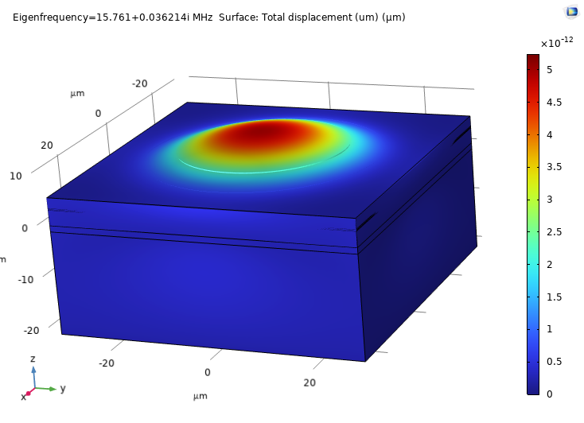

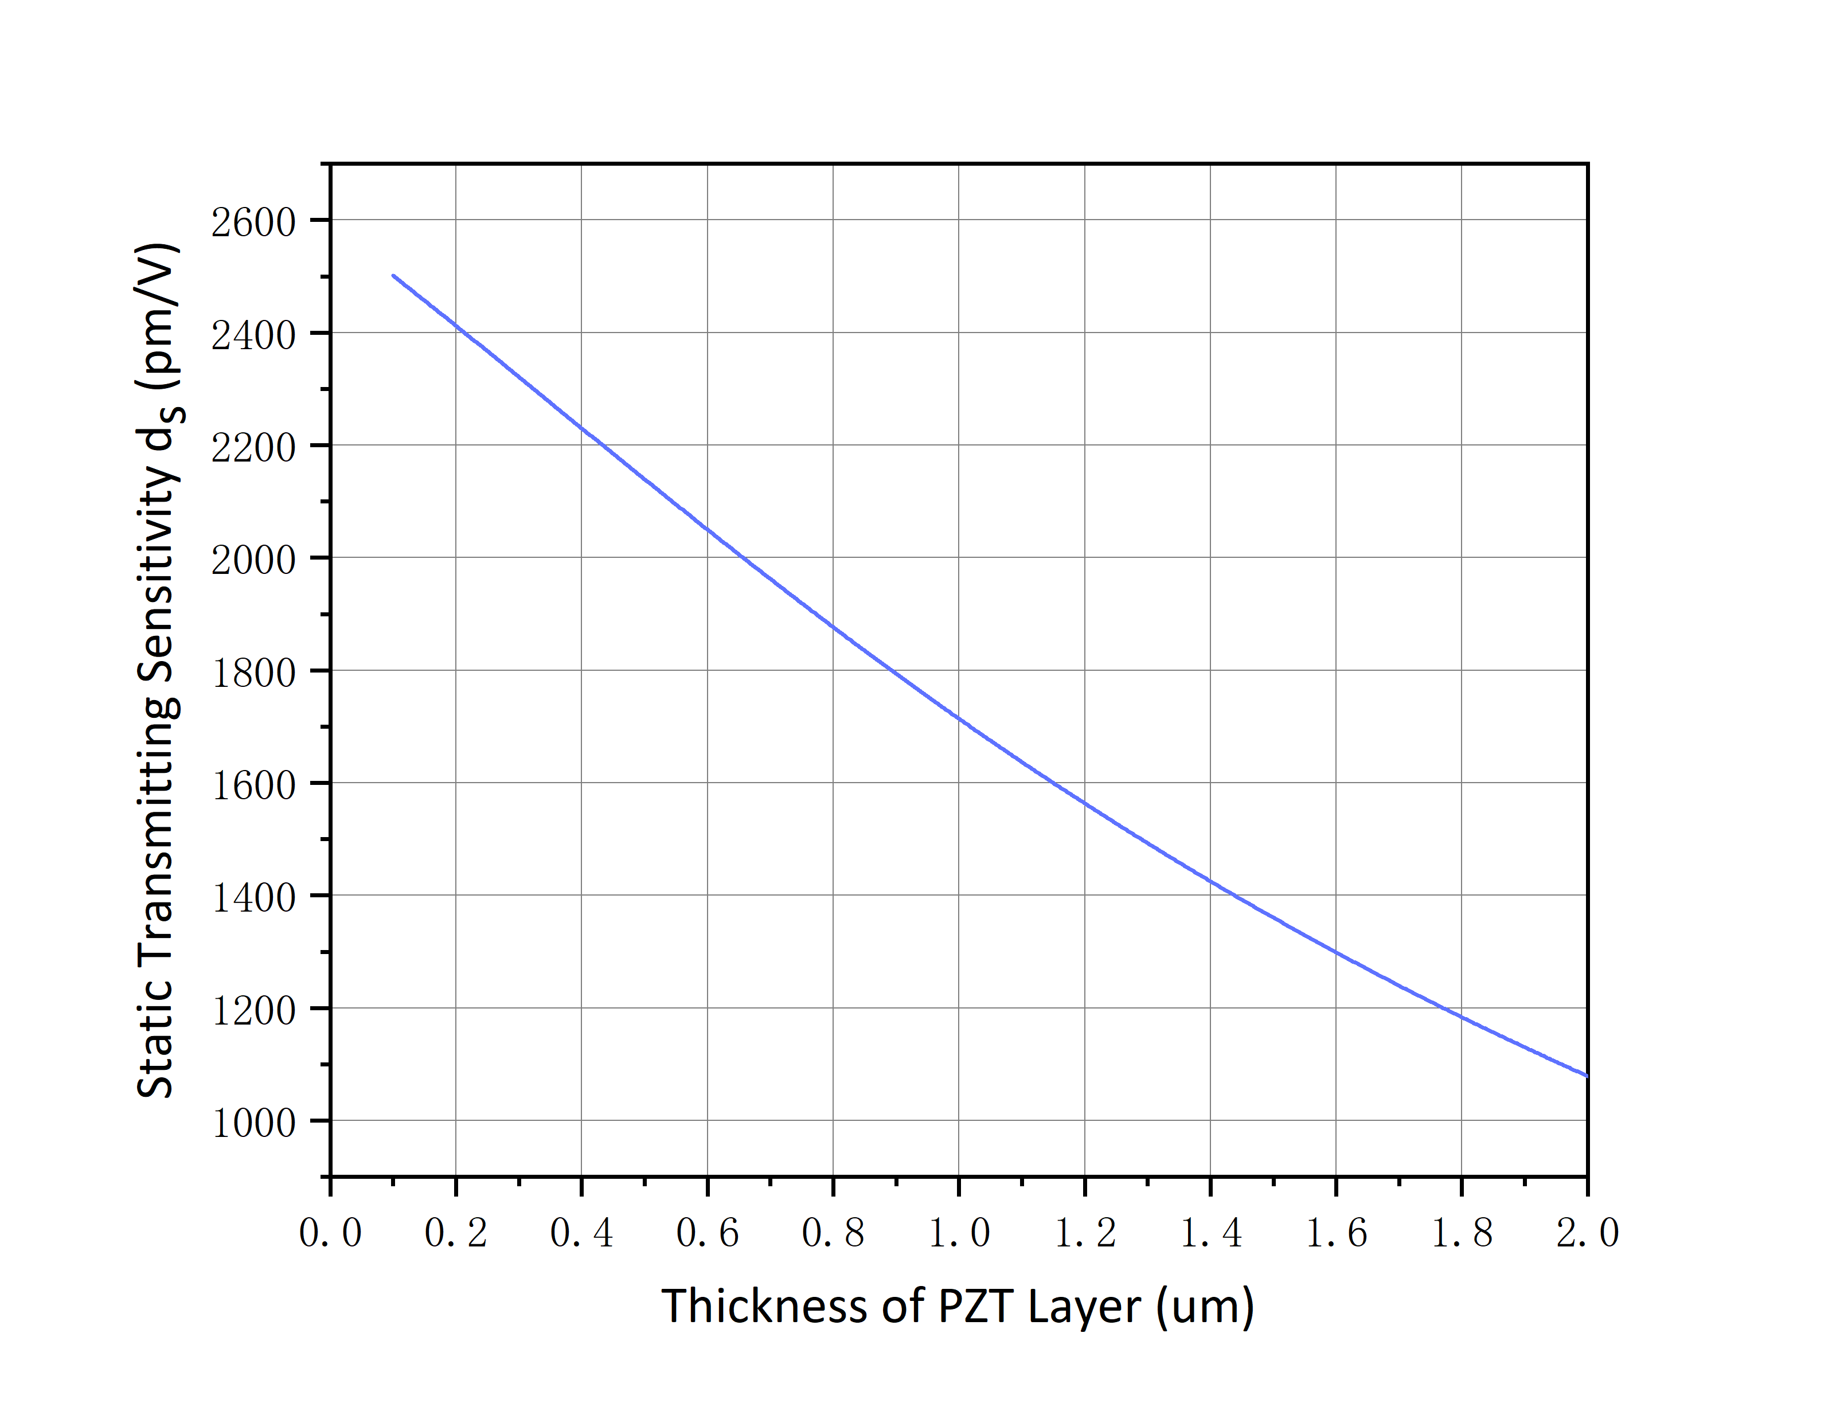
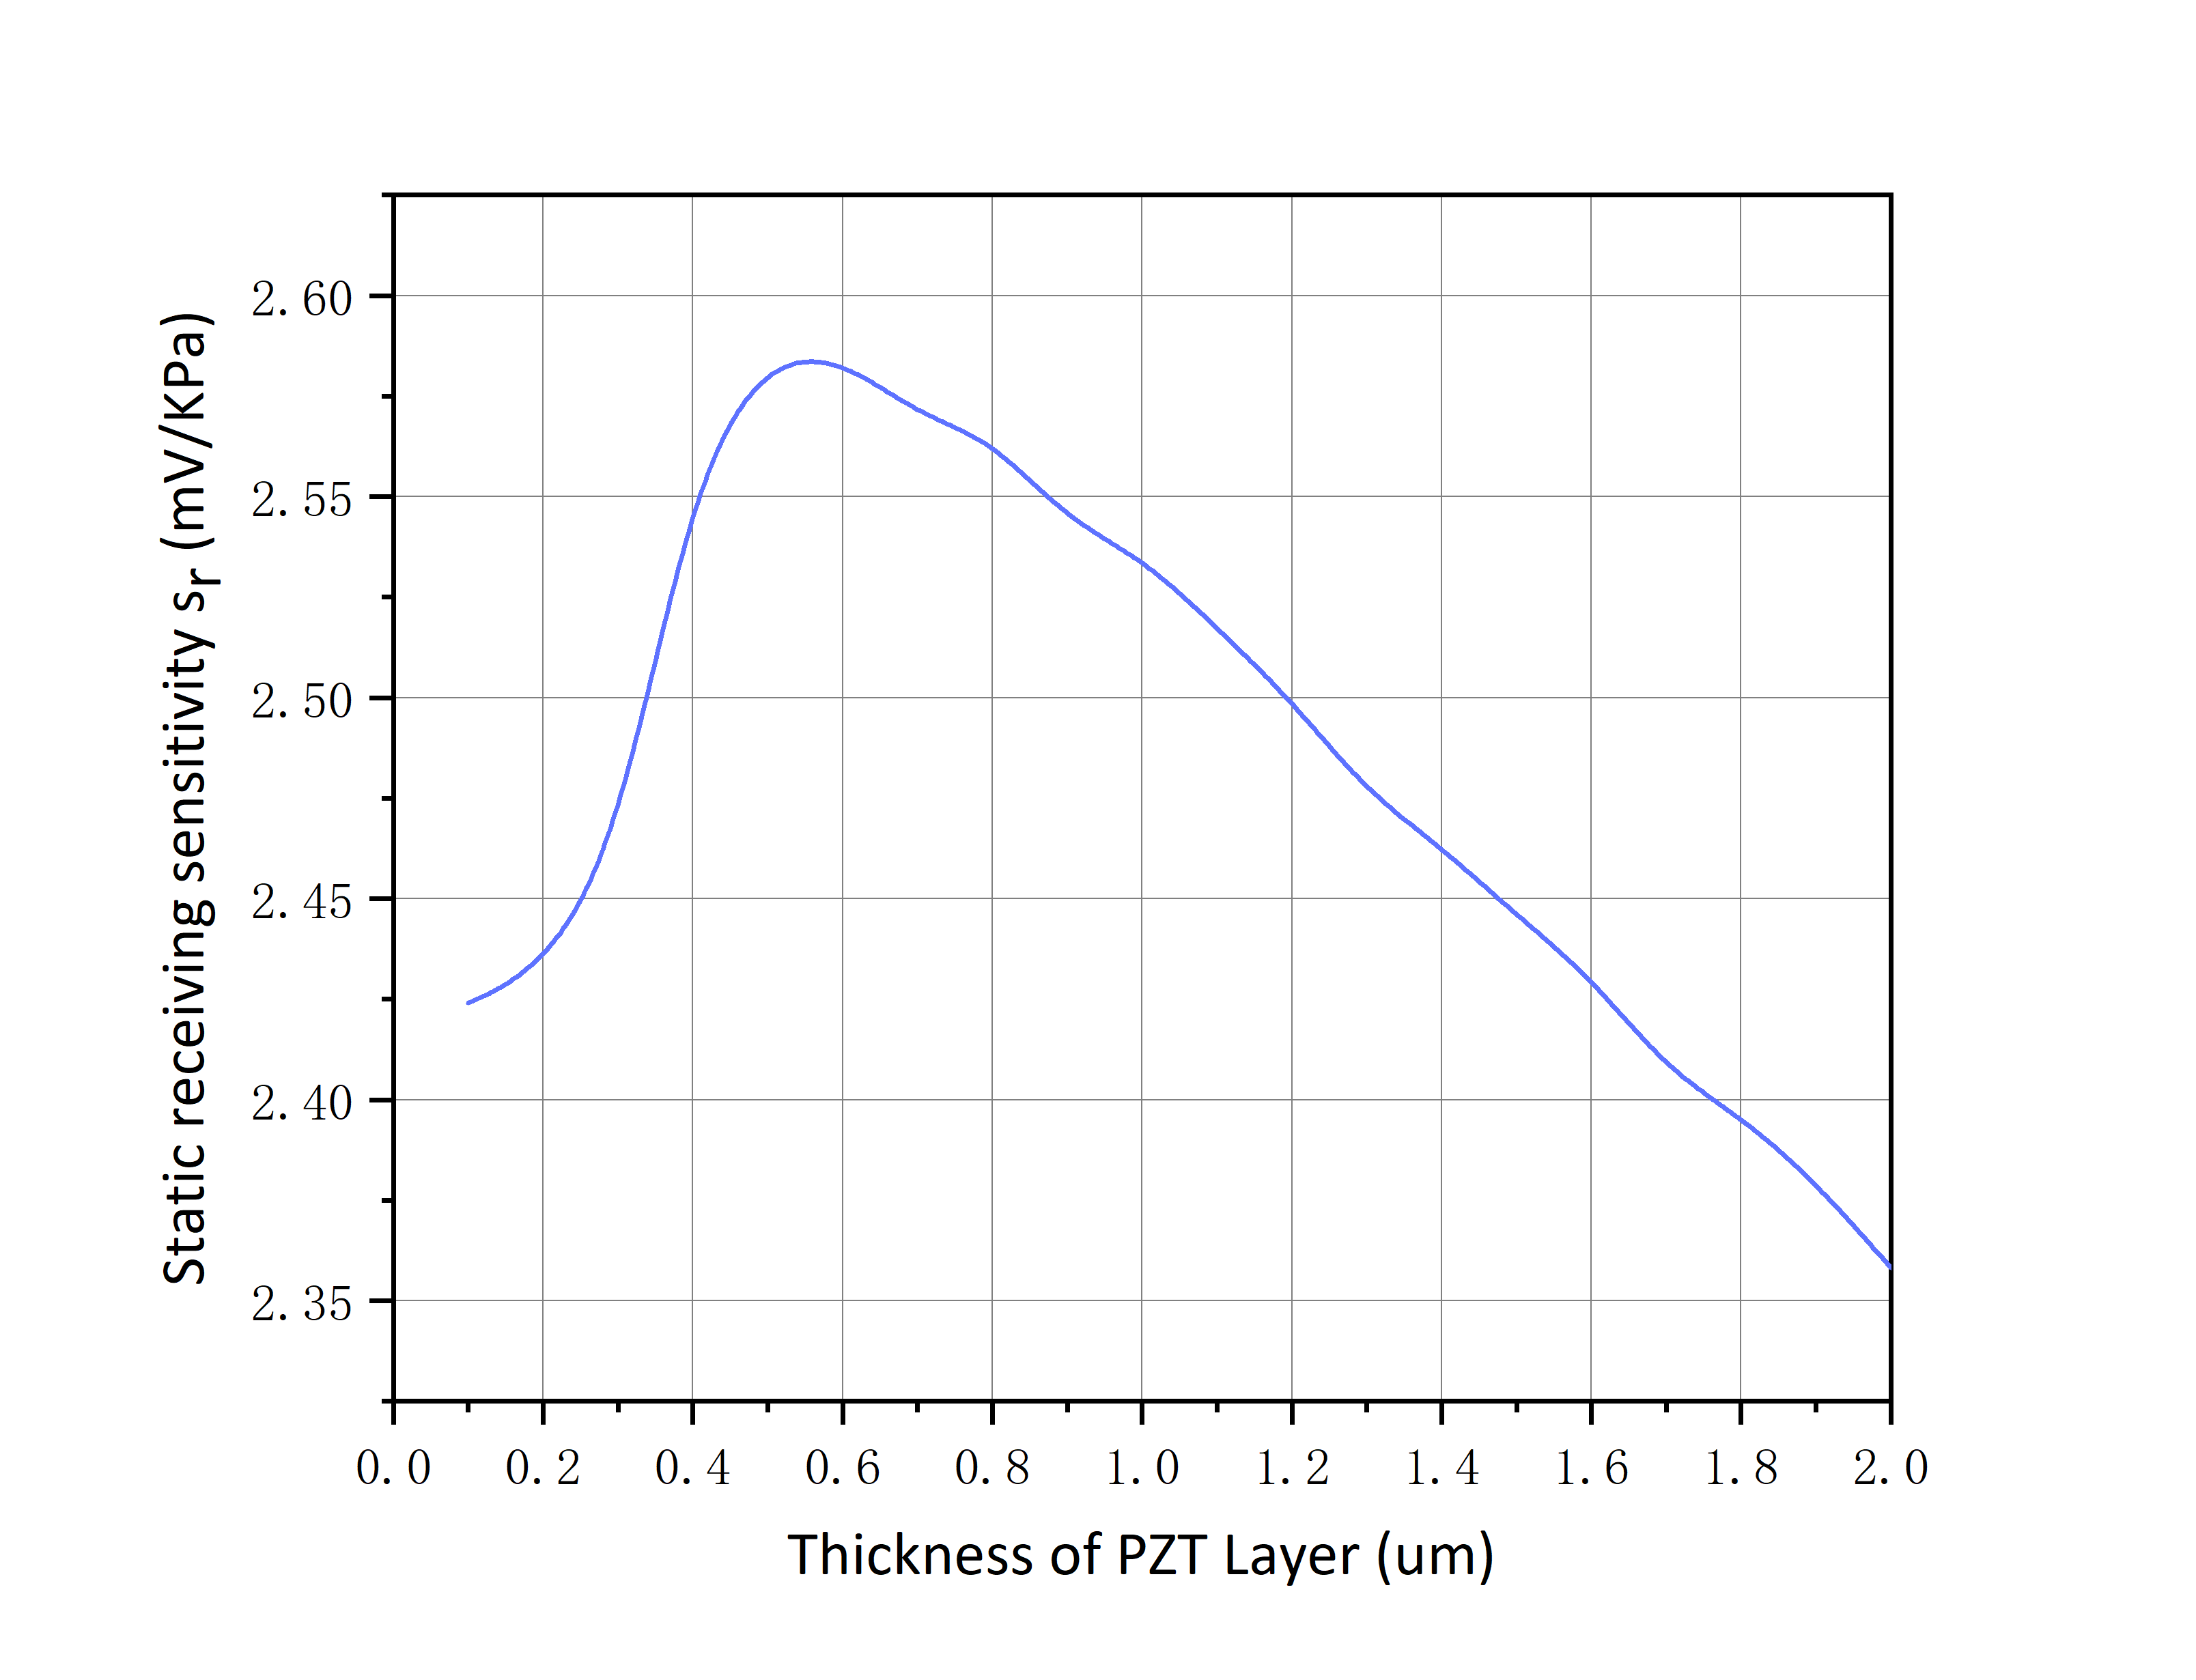
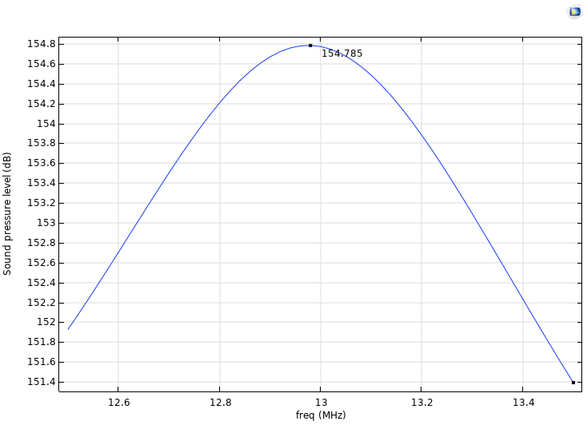
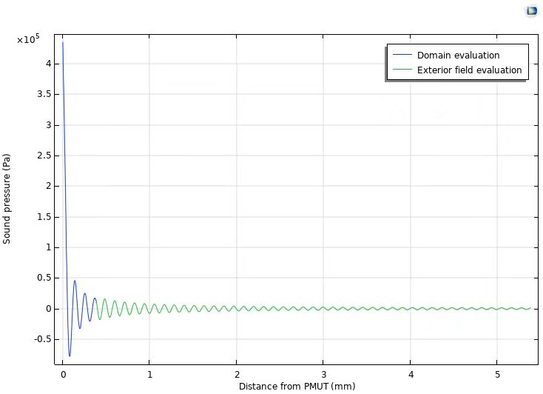
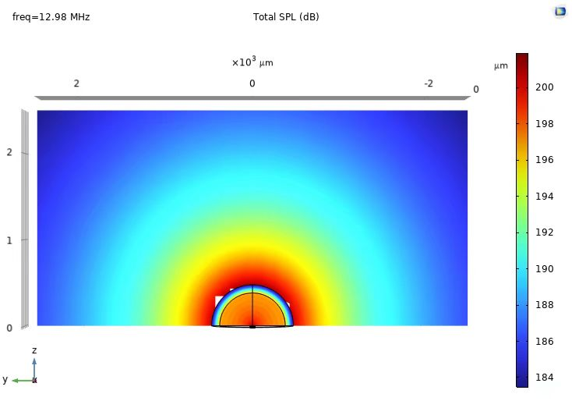
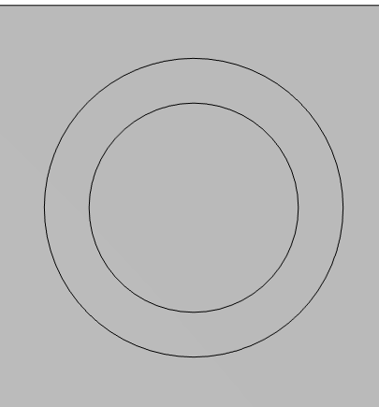
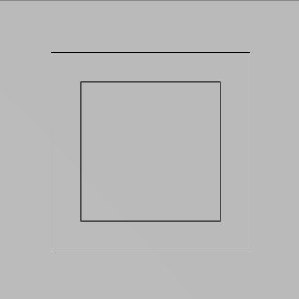

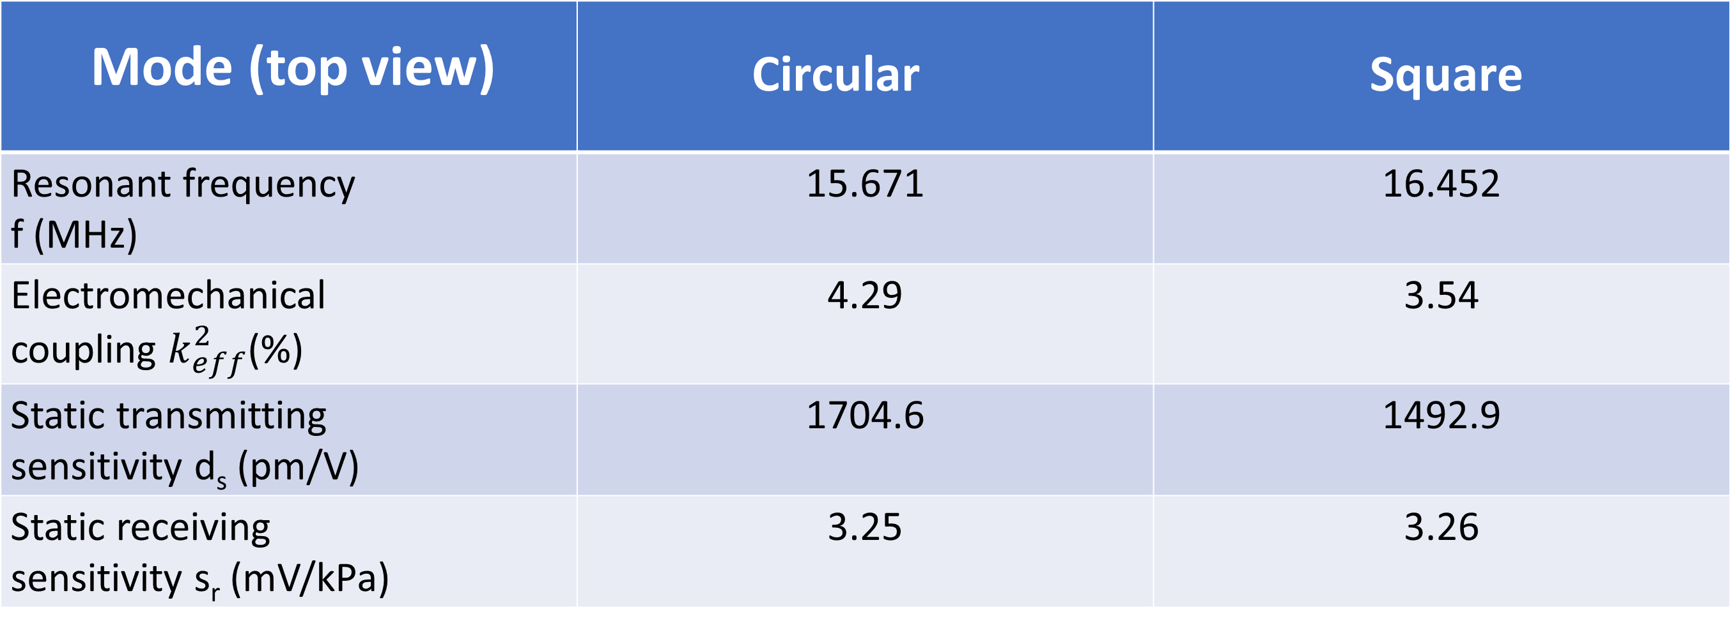
Development of Ultrasonic Transducers Based on PZT Piezoelectric Thin Films
Ultrasonic transducers applied underwater, including structural optimization and analysis of transmission and reception performance
Shicheng Zhao¹，Qiaozhen Zhang^{1*} ，Xiangyong Zhao^{2*}
1. School of Information and Mechanical and Electrical Engineering, Shanghai Normal University, Shanghai 200234, China.
2. College of Mathematics and Physics, Shanghai Normal University, Shanghai 200234, China
* Correspondence: zhangqz@shnu.edu.cn and xyzhao@shnu.edu.cn
As the ultrasonic sensor industry evolves towards lower costs, miniaturization, higher integration, and superior performance, Microelectromechanical Systems (MEMS)-based ultrasonic transducers have emerged as a prominent trend. This article introduces a Piezoelectric Micromachined Ultrasonic Transducer (PMUT) device utilizing a PZT (Lead Zirconate Titanate) piezoelectric thin film. Through the establishment of a three-dimensional model via finite element simulation, the study delves into structural optimization, transmission characteristic analysis, and the acoustic field behavior of PMUT devices in an aqueous environment. This exploration offers novel insights and potential applications for PMUT devices in medical fields, fingerprint recognition and object detection, medical imaging, and various other sectors.
Methodology:
A PMUT comprises a suspended membrane and its supporting framework. The floating membrane is constructed by layering a top electrode, a piezoelectric film, and a bottom electrode, which are adhered to a silicon-on-insulator (SOI) chip via an adhesive layer. The SOI chip utilizes a SiO2 insulation layer to isolate the elastic silicon membrane from the supporting silicon substrate, thereby minimizing parasitic capacitance and reducing power consumption. When an alternating current (AC) bias is applied across the top and bottom electrodes, the membrane vibrates and generates sound waves as a result of the inverse piezoelectric effect. Conversely, when the PMUT is subjected to external sound waves, the piezoelectric effect induces charges on the membrane's surface. The resonant frequency of the PMUT can be calculated using the following formula:
$f= \frac{α}{2πr^{2}}\sqrt{\frac{D_{E}}{ρh}}$ $D_{E}= \frac{Eh^{3}}{12(1−v^{2})}$
α is the resonant mode constant, r is the radius of the membrane, D_{E} is the bending stiffness, h is the thickness of the membrane, and ρ is effective density, E is the effective Young's modulus, and v is Poisson ratio.
Figure 1. Cross-sectional schematic of PZT-based PMUT.
Figure 2. Analysis of the eigen mode resonant frequency.
Performance evaluation :
Acoustic performance analysis :
Studied the influence of piezoelectric layer thickness on the emission and reception performance of PMUT.
A comparative analysis was performed to assess the performance characteristics of PMUT equipped with circular electrodes and bottom cavities versus those featuring square electrodes and bottom cavities.
The acoustic performance of the PMUT device was studied within a semi-circular water domain, the radius of which measures five wavelengths.
Figure 3. Static transmitting sensitivity d_{s} shift with thickness of PZT layer.
Figure 4. Static receiving sensitivity s_{r} shift with thickness of PZT layer.
Figure 5. Sound pressure level at 10cm from the PMUT.
Figure 6. On-axis Sound Pressure.
Table 1 Performance properties of PZT-based PMUTs with two different configurations.
Mode (top view) | Circular | Square
Resonant frequency f (MHz) | 15.671 | 16.452
Electromechanical coupling $k_{eff}^{2}$(%) | 4.29 | 3.54
Static transmitting sensitivity d_{s} (pm/V) | 1704.6 | 1492.9
Static receiving sensitivity s_{r} (mV/kPa) | 3.25 | 3.26
Figure 7. Exterior SPL Slice.
References: 1) Design and analysis of piezoelectric micromachined ultrasonic transducer using high coupling PMN-PT single crystal thin film for ultrasound imaging, Smart Mater. Struct. 30 (2021) 055006 (9pp)
Excerpt from the Proceedings of the COMSOL Conference 2024 Shanghai
Notes:
1

