Slide 1
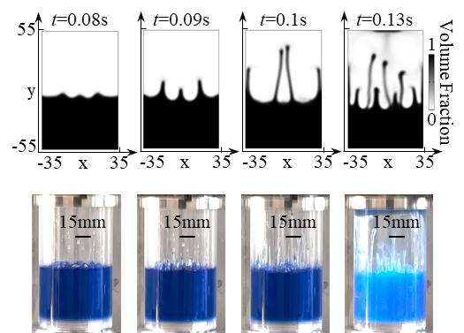
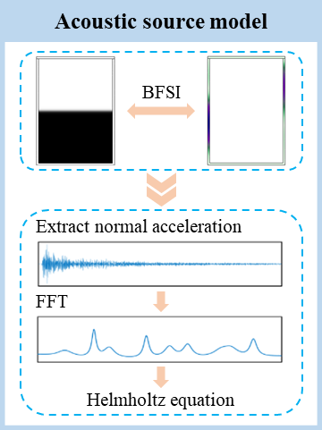
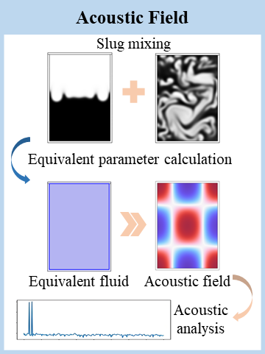
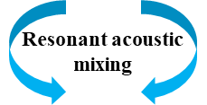
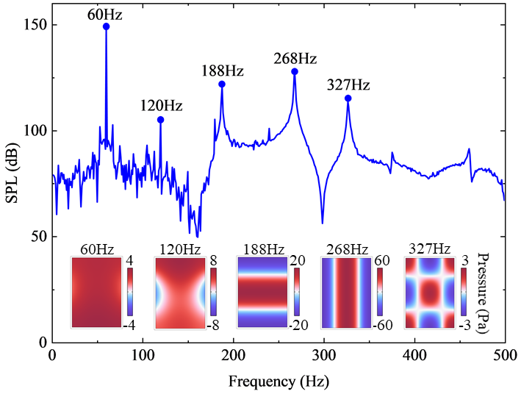
Acoustic field Characterization of Resonant Acoustic Mixing
This work characterizes the acoustic field of power-law non-Newtonian fluids mixed using the resonant acoustic technique.
Qiang Huo¹, Xiaopeng Wang^{1,2}
1. School of Mechanical Engineering, Xi‘an Jiaotong University, Xi’an, China.
2. State Key Laboratory for Strength and Vibration of Mechanical Structures, Xi‘an Jiaotong University, Xi’an, China.
Abstract
Resonant acoustic mixing technology, which utilizes vertical vibration with frequency around 60Hz and acceleration not exceeding 100G to produce a full-field mixing effect of the mixed materials, is regarded as a “disruptive technology in the field of energetic materials”.
However, this technology is a new mixing technology based on multi-physical field coupling, and its mixing mechanism is still not well developed.
In this work, we take the composite energetic materials with power-law non-Newtonian fluid characteristics as the research object, and use COMSOL to perform the numerical simulation research on the coupling of multi-physical fields of flow-solid-acoustic.
The research results can provide theoretical guidance for solving the uniform mixing problem of composite energetic materials.
Methodology
An acoustic field characterization method based on bidirectional flow-solid coupling is proposed, and the flow of the method is shown in Fig. 1. First, the bidirectional flow-solid coupling is accomplished by considering the interaction between the fluid and the container wall, and then the wall normal acceleration is extracted. Next, the Fourier transformed normal acceleration is substituted into the Helmholtz equation to build the acoustic source model. Finally, the equivalent parameters are calculated according to the slug mixing pattern, the equivalent fluid is established, and the acoustic analysis is completed by combining with the acoustic source model to characterize the mixed acoustic field.
FIGURE 1. Flowchart of the method for characterizing the acoustic field.
Results
When the vibration acceleration is 60G and the vibration frequency is 60Hz, the SPL curves of the container center at different frequencies are shown in Fig. 2. It can be found that the SPL of the center is larger at 60Hz, 120Hz, 188Hz, 268Hz and 327Hz. It is worth noting that, 60Hz and 120Hz are the working and second octave frequencies of the excitation frequency, while 188Hz, 268Hz and 327Hz are not octave frequencies. From the acoustic pressure cloud below the curve, it can be seen that the acoustic pressure at the center of the container is larger compared to other positions, which explains the larger acoustic pressure levels at 188Hz, 268Hz and 327Hz at this point.
FIGURE 2. SPL at the center of the container and acoustic pressure contour corresponding to the peak frequency.
REFERENCES
S. M. Yuan, et al. "Faraday instability of a liquid layer in ultrasonic atomization," Phys. Rev. Fluids 7, (2022).
S. S. Jain, "Accurate conservative phase-field method for simulation of two-phase flows," J. Comput. Phys. 469, (2022).
B. H. Liu, et al. "Deagglomeration of fine granular materials under low-frequency vertical harmonic vibration," Powder Technol. 396, 754 (2022).
X. B. Zhan, et al. "Mixing Characteristics of High-Viscosity Fluids under Forced Vertical Vibration," Chem. Eng. Technol. 43, 1327 (2020).

