Slide 1


Improving RRAM Performance through Uncertainty Quantification
Ziyan Liao¹, Zhiheng Huang¹, Min Xiao¹, Yuezhong Meng¹, Hui Yan² and Yang Liu³
¹ The Key Laboratory of Low-carbon Chemistry & Energy Conservation of Guangdong Province,
and School of Materials Science and Engineering, Sun Yat-sen University, Guangzhou, China
² School of Computer Science and Engineering, Sun Yat-sen University, Guangzhou, China
³ School of Electronics and Information Technology, Sun Yat-sen University, Guangzhou, China
liaozy9@mail2.sysu.edu.cn

Slide 2
Contents
1
Background
RRAM: structure, advantages and challenges
2
Model and Method
The filamentary switching mechanism
The geometry and PDEs
Uncertainty quantification method
Model implementation
3
Results
Achieving an increase in on/off ratio
Reducing the SET and RESET power consumption

Slide 3
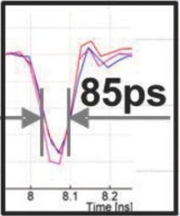
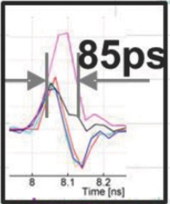
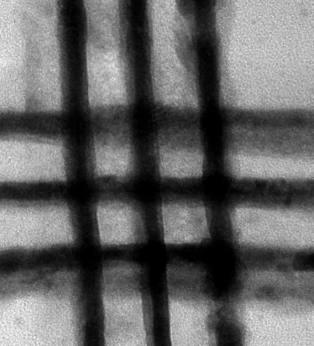
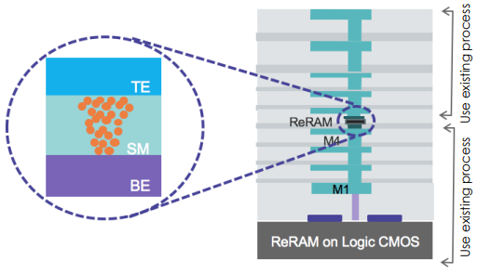


Background
RRAM: a promising candidate for next-generation memory
Characteristics
High switching speed (85 ps)
Simple structure
Scalability
CMOS compatibility
Non-volatility
Low power consumption
Cycling endurance
……
Pt / AlN / Al
OFF
ON
Choi et al., Adv. Funct. Mater. 26, 5290 (2016)
2.2 nm
2.1 nm
Pi et al., Nat. Nanotechnol. 14, 35 (2019)
© CrossBar, Inc.

Slide 4
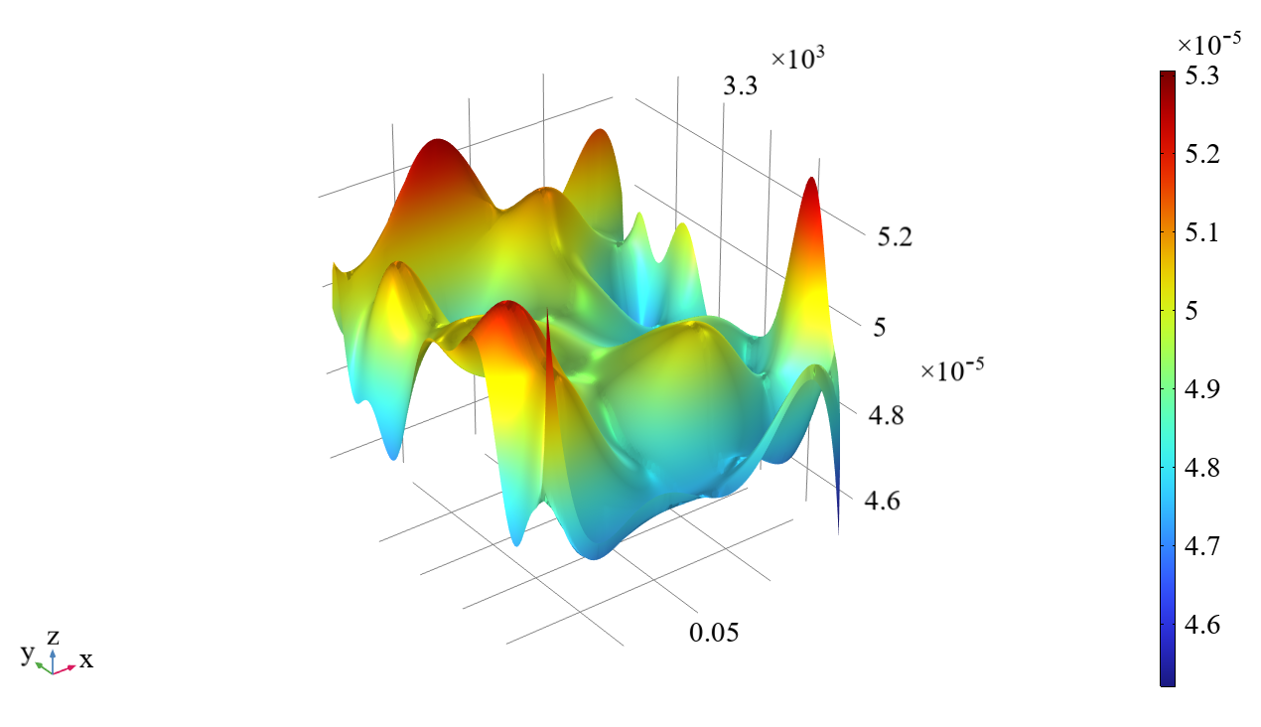
RRAM: challenges
Simple structure but rich materials, physics, chemistry and electrical issues
Challenges
The continuous reduction of feature size may affect the reliability of RRAM devices
No quantitative relationship between material properties and RRAM device properties
……
How to solve?
The uncertainty of material microstructure is particularly important
The Uncertainty quantification (UQ) module in COMSOL Multiphysics is an ideal platform
A response surface in UQ module

Slide 5
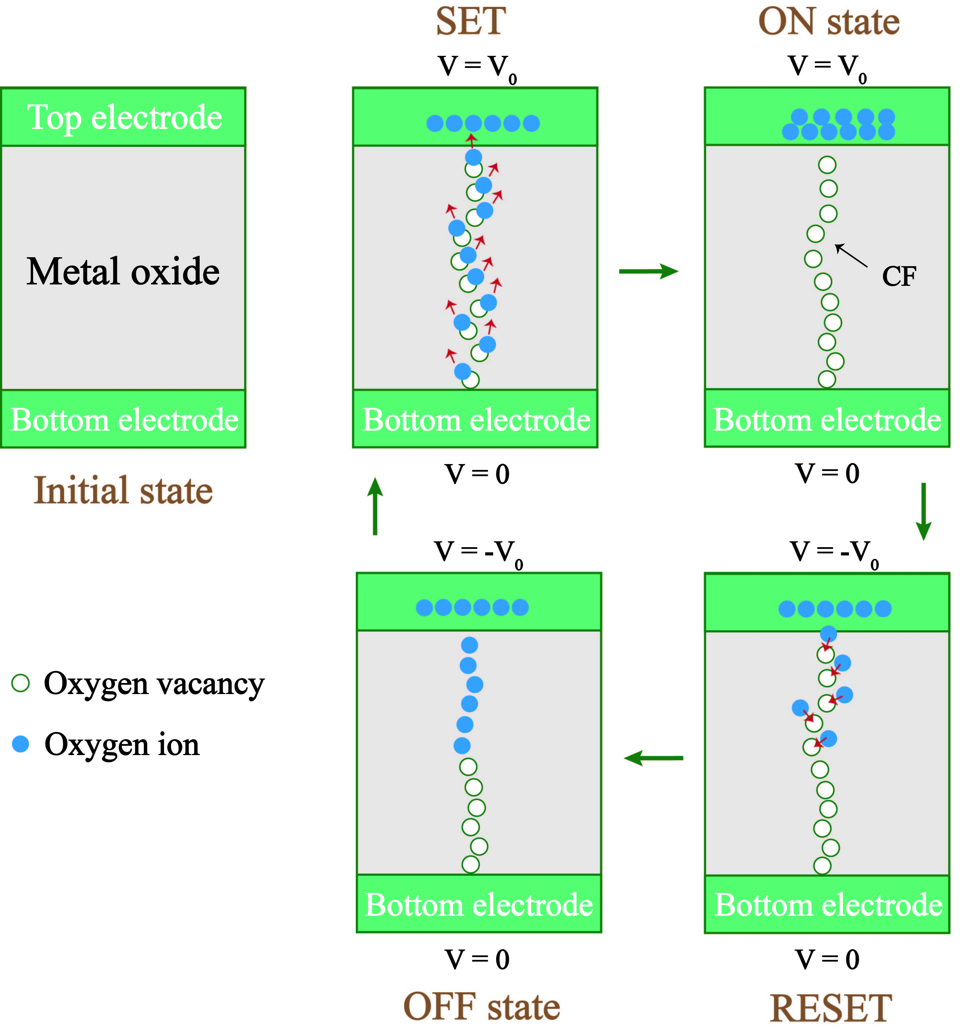
RRAM: switching mechanism
The switching mechanism is based on the formation and break of conductive filament (CF) in the oxide layer
The model consists of four modules corresponding to ON and OFF states and SET (OFF→ON) and RESET (ON→OFF) switching process
SET: OFF→ON
ON: conducting
RESET: ON→OFF
OFF: insulation
Formation of CF
Low resistance
Breaking of CF
High resistance

Slide 6
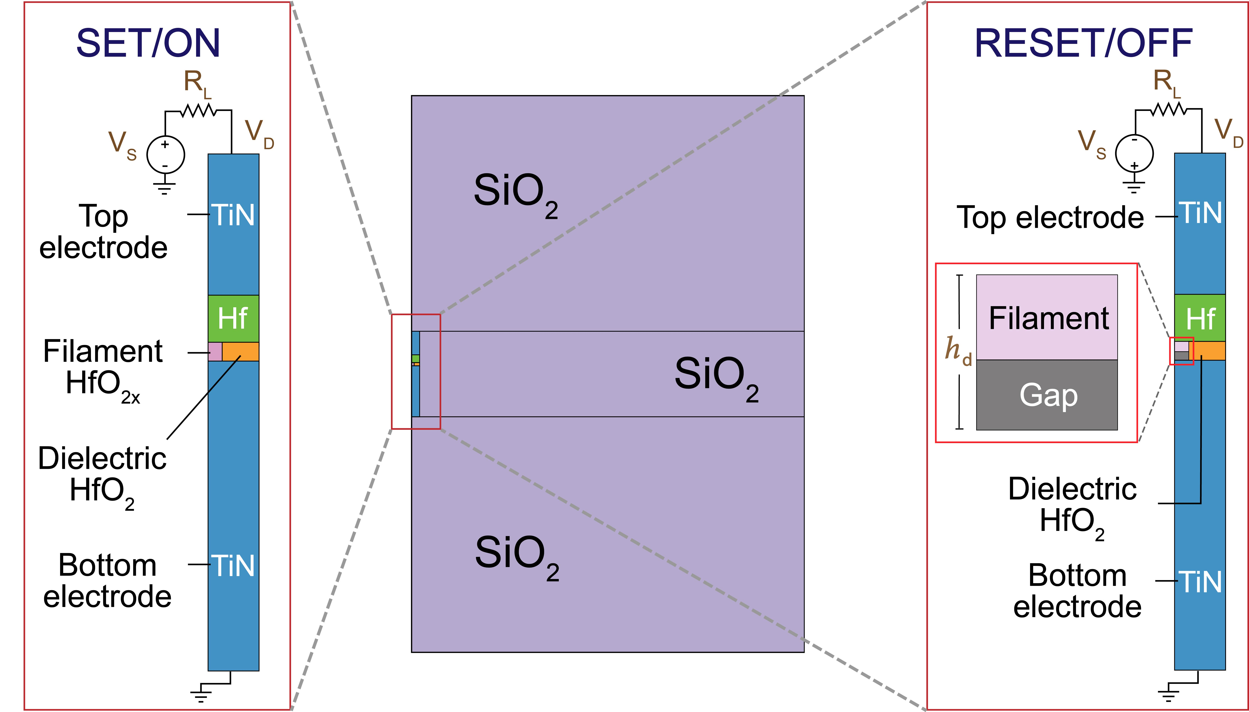
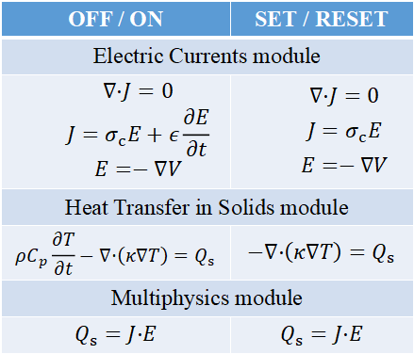
RRAM: model
TiN / Hf / HfO₂ / TiN RRAM device is modeled in COMSOL Multiphysics
Geometry
Electro-thermo coupled PDEs
OFF / ON | SET / RESET
Electric Currents module
$$∇·J=0$$ $$J=σ_{c}E+ε\frac{∂E}{∂t}$$ $$E=−∇V$$ | $$∇·J=0$$ $$J=σ_{c}E$$ $$E=−∇V$$
Heat Transfer in Solids module
$$ρC_{p}\frac{∂T}{∂t}−∇·\left(κ∇T\right)=Q_{s}$$ | $$−∇·\left(κ∇T\right)=Q_{s}$$
Multiphysics module
$$Q_{s}=J·E$$ | $$Q_{s}=J·E$$
D. Niraula et al., J. Appl. Phys. 124, 174502 (2018)

Slide 7
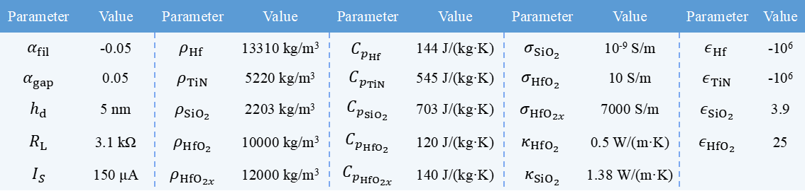
UQ method
Quantities of interest (QoIs)
The on/off ratio
The power consumption of SET and RESET processes
Input parameters
Evaluate the importance of 24 input parameters
The 24 input parameters
Parameter | Value | Parameter | Value | Parameter | Value | Parameter | Value | Parameter | Value
$$α_{fil}$$ | -0.05 | $${ρ_{Hf}}^{ }$$ | 13310 kg/m³ | $${C_{p_{Hf}}}^{ }$$ | 144 J/(kg·K) | $$σ_{SiO_{2}}$$ | 10⁻⁹ S/m | $${ε_{Hf}}^{ }$$ | -10⁶
$$α_{gap}$$ | 0.05 | $$ρ_{TiN}$$ | 5220 kg/m³ | $$C_{p_{TiN}}$$ | 545 J/(kg·K) | $${σ_{HfO_{2}}}^{ }$$ | 10 S/m | $$ε_{TiN}$$ | -10⁶
$$h_{d}$$ | 5 nm | $$ρ_{SiO_{2}}$$ | 2203 kg/m³ | $$C_{p_{SiO_{2}}}$$ | 703 J/(kg·K) | $$σ_{HfO_{2x}}$$ | 7000 S/m | $$ε_{SiO_{2}}$$ | 3.9
$$R_{L}$$ | 3.1 kΩ | $$ρ_{HfO_{2}}$$ | 10000 kg/m³ | $$C_{p_{HfO_{2}}}$$ | 120 J/(kg·K) | $${κ_{HfO_{2}}}^{ }$$ | 0.5 W/(m·K) | $$ε_{HfO_{2}}$$ | 25
$$I_{S}$$ | 150 μA | $$ρ_{HfO_{2x}}$$ | 12000 kg/m³ | $$C_{p_{HfO_{2x}}}$$ | 140 J/(kg·K) | $$κ_{SiO_{2}}$$ | 1.38 W/(m·K)
D. Niraula et al., J. Appl. Phys. 124, 174502 (2018)

Slide 8
UQ analysis
1
2
Inputs
Inputs
MOAT scattergram
Sobol diagram
MOAT
screening
Sensitivity
analysis
3
4
Inputs
Inputs
Predicted output
Probability
Uncertainty
propagation
Reliability
analysis

Slide 9
Model implementation
Focusing on two key performance indicators (KPIs) for RRAM devices
The on/off ratio
The power consumption of SET and RESET processes
The four modules of RRAM are constructed in COMSOL
LiveLink for MATLAB
Use MATLAB to integrate these modules seamlessly and extract KPIs as outputs
MATLAB function
Conduct UQ and optimization
To integrate KPIs into QoIs of UQ analyses, corresponding MATLAB functions are created within the COMSOL Desktop
Start COMSOL server manually

Slide 10
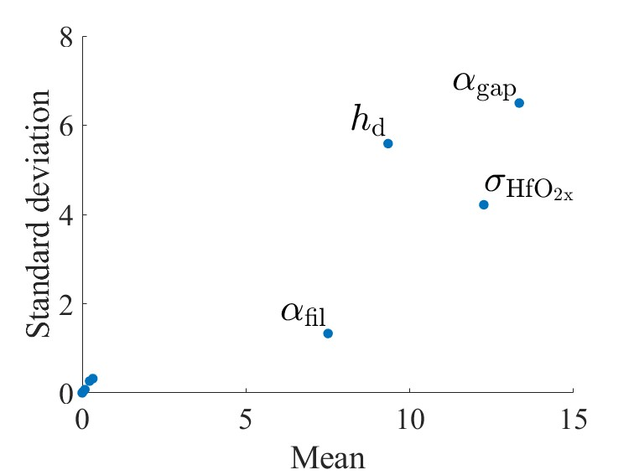
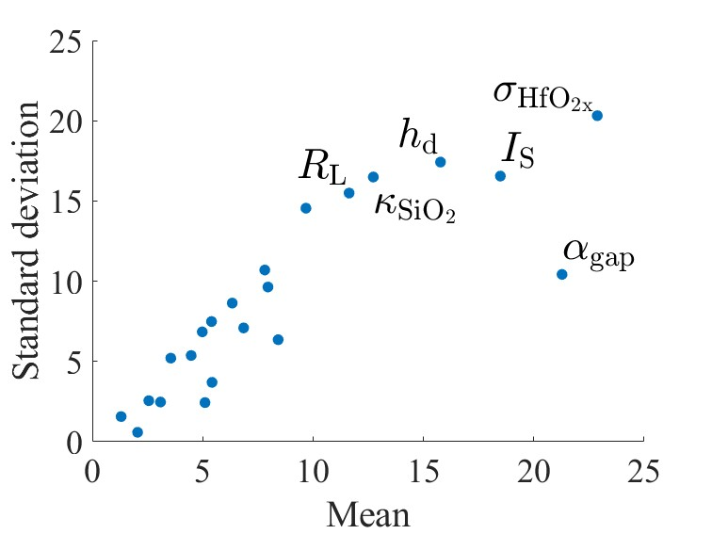
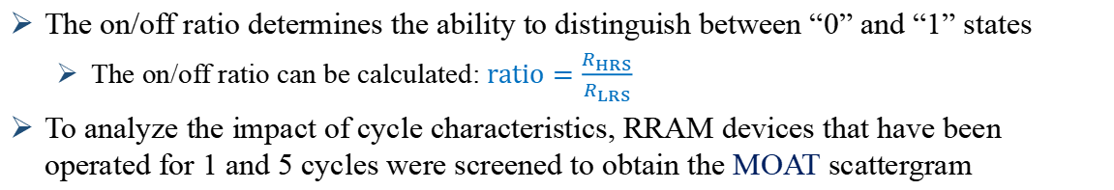
Result: on/off ratio
The on/off ratio determines the ability to distinguish between “0” and “1” states
The on/off ratio can be calculated: $ratio=\frac{R_{HRS}}{R_{LRS}}$
To analyze the impact of cycle characteristics, RRAM devices that have been operated for 1 and 5 cycles were screened to obtain the MOAT scattergram
The horizontal axis represents the overall impact of a parameter on the output
The vertical axis represents the interaction and nonlinear effects between parameters
1 cycle
5 cycles

Slide 11
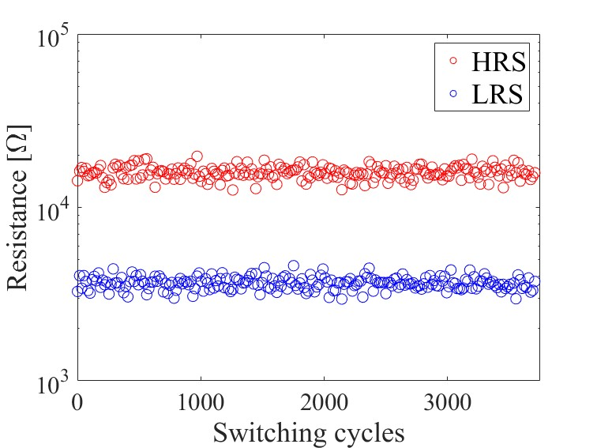
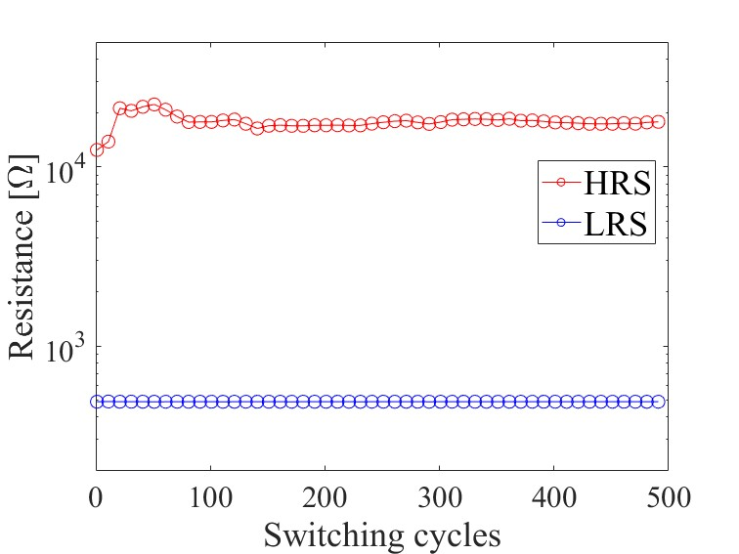
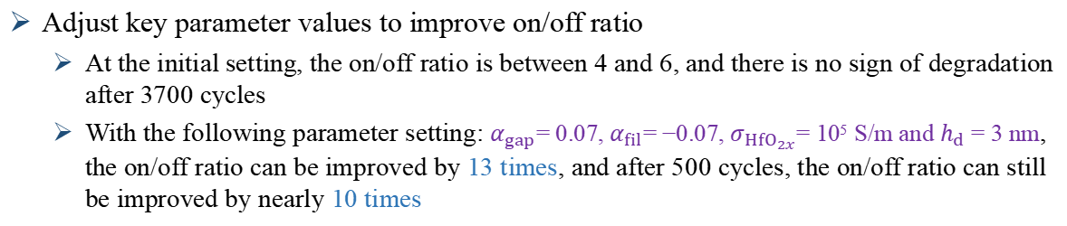
Result: on/off ratio
Adjust key parameter values to improve on/off ratio
At the initial setting, the on/off ratio is between 4 and 6, and there is no sign of degradation after 3700 cycles
With the following parameter setting: $α_{gap}$= 0.07, $α_{fil}$= −0.07, $σ_{HfO_{2x}}$= 10⁵ S/m and $h_{d}$ = 3 nm, the on/off ratio can be improved by 13 times, and after 500 cycles, the on/off ratio can still be improved by nearly 10 times
At the initial setting
Adjusting key parameters
3700 cycles
500 cycles

Slide 12
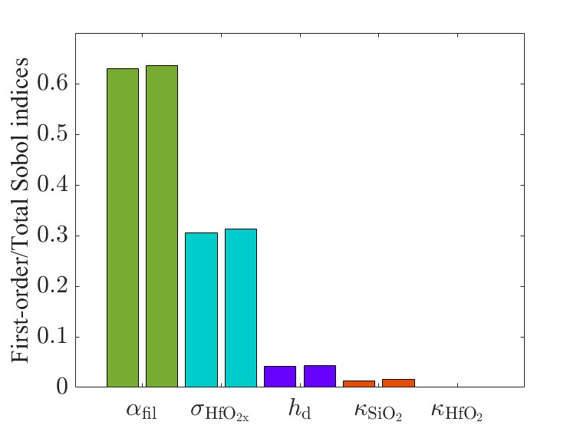
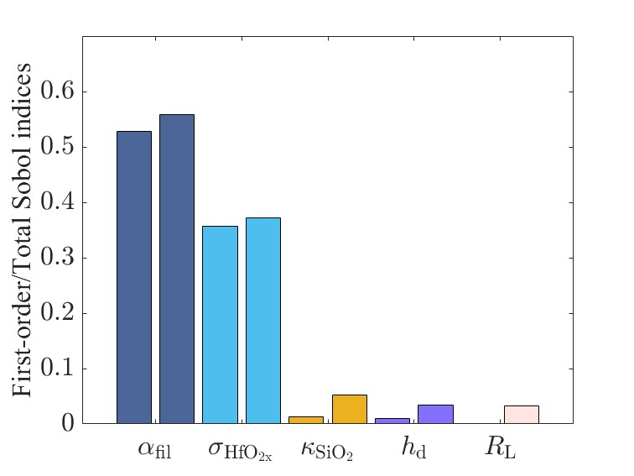




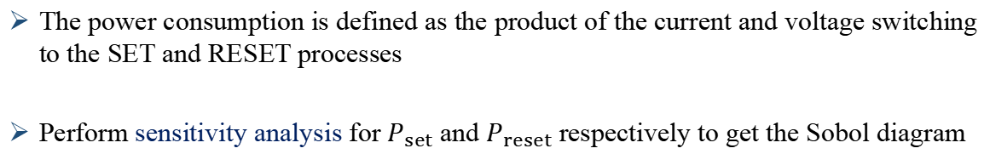
Result: power consumption
The power consumption is defined as the product of the current and voltage switching to the SET and RESET processes
Perform sensitivity analysis for $P_{set}$and $P_{reset}$respectively to get the Sobol diagram
$P_{set}=I_{set}×V_{set}$
$P_{reset}=I_{reset}×V_{reset}$
The LHS column of each parameter represents the first-order Sobol indices, indicating the sensitivity when the parameter is varied alone.
The RHS column of each parameter represents the total Sobol indices, indicating the contribution of that parameter to the overall sensitivity.
$$P_{set}$$
$$P_{reset}$$

Slide 13
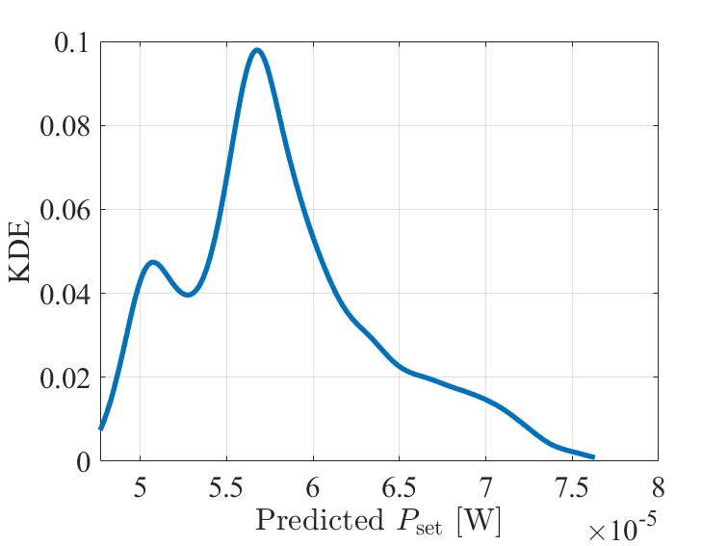
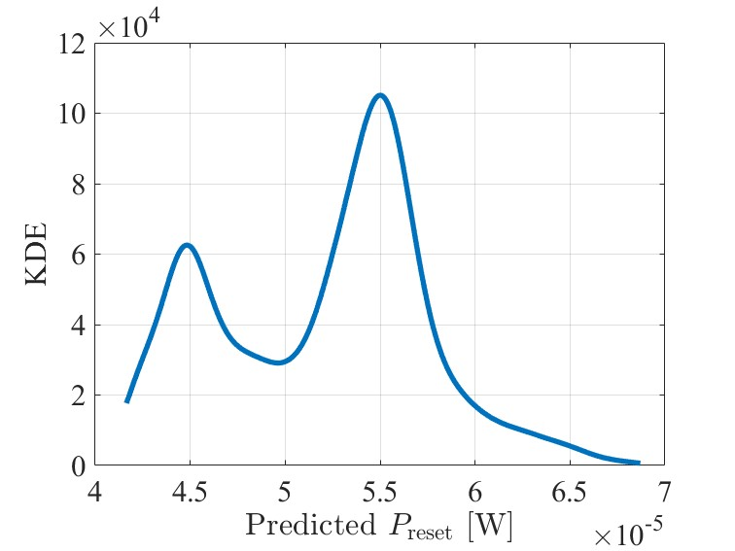
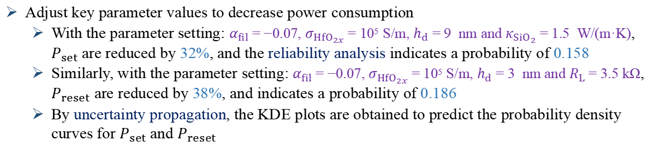


Result: power consumption
Adjust key parameter values to decrease power consumption
With the parameter setting: $α_{fil}$= −0.07, $σ_{HfO_{2x}}$= 10⁵ S/m, $h_{d}$ = 9 nm and $κ_{SiO_{2}}$= 1.5 W/(m·K), $P_{set}$are reduced by 32%, and the reliability analysis indicates a probability of 0.158
Similarly, with the parameter setting: $α_{fil}$= −0.07, $σ_{HfO_{2x}}$= 10⁵ S/m, $h_{d}$ = 3 nm and $R_{L}$= 3.5 kΩ, $P_{reset}$ are reduced by 38%, and indicates a probability of 0.186
By uncertainty propagation, the KDE plots are obtained to predict the probability density curves for $P_{set}$and $P_{reset}$
KDE plot of $P_{set}$
KDE plot of $P_{reset}$

Slide 14
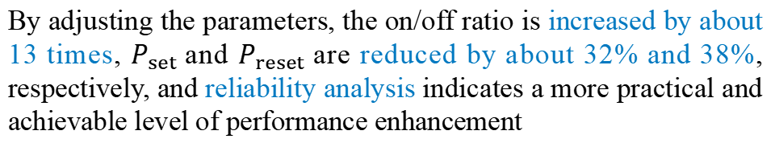
Conclusions
By using UQ methods, the influence of material uncertainty on RRAM on/off ratio and power consumption is discussed, and the probability distribution relationship between input parameters and device performance is predicted
1
By adjusting the parameters, the on/off ratio is increased by about 13 times, $P_{set}$and $P_{reset}$are reduced by about 32% and 38%, respectively, and reliability analysis indicates a more practical and achievable level of performance enhancement
2

Slide 15
Thanks for your attention!

