Slide 1
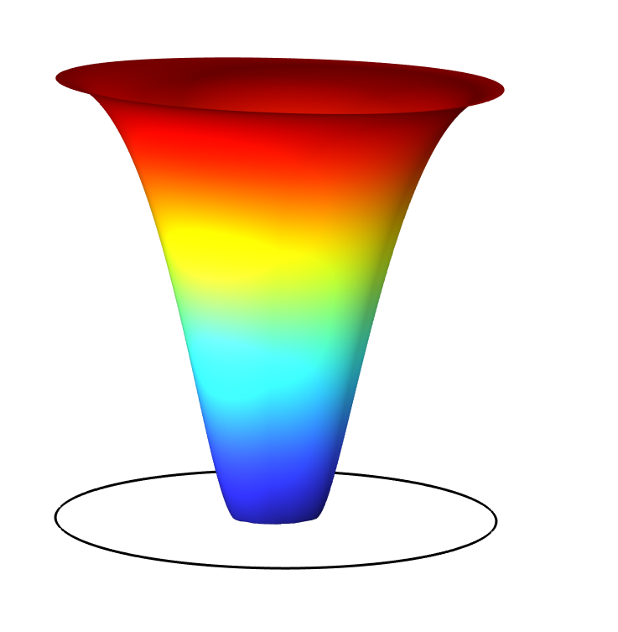
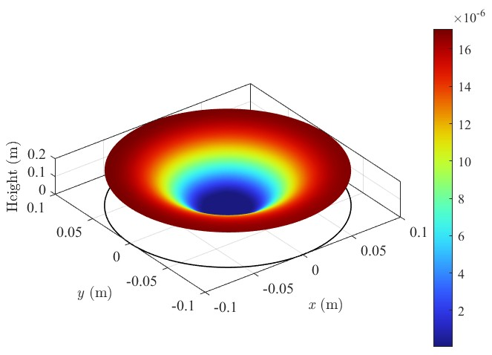
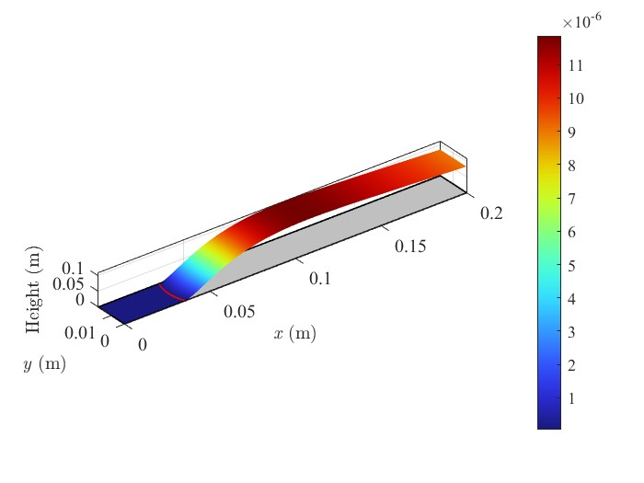
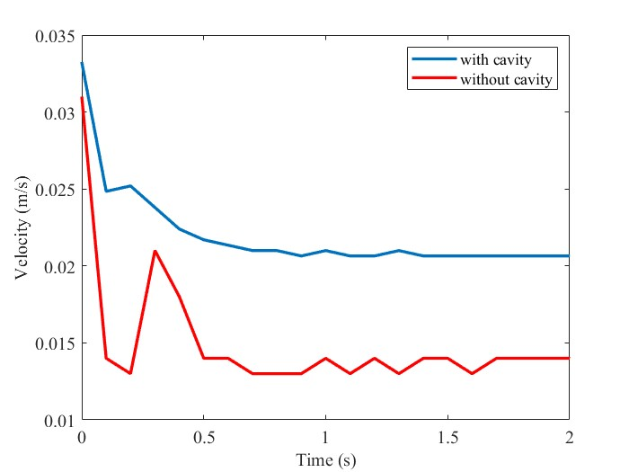
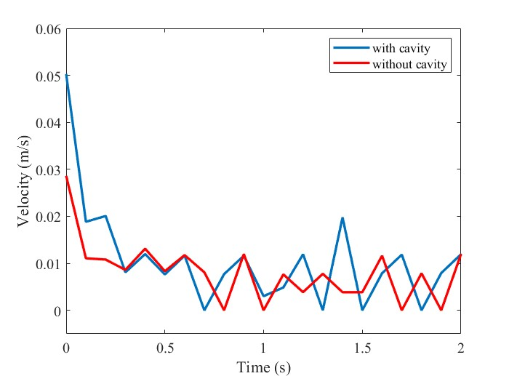

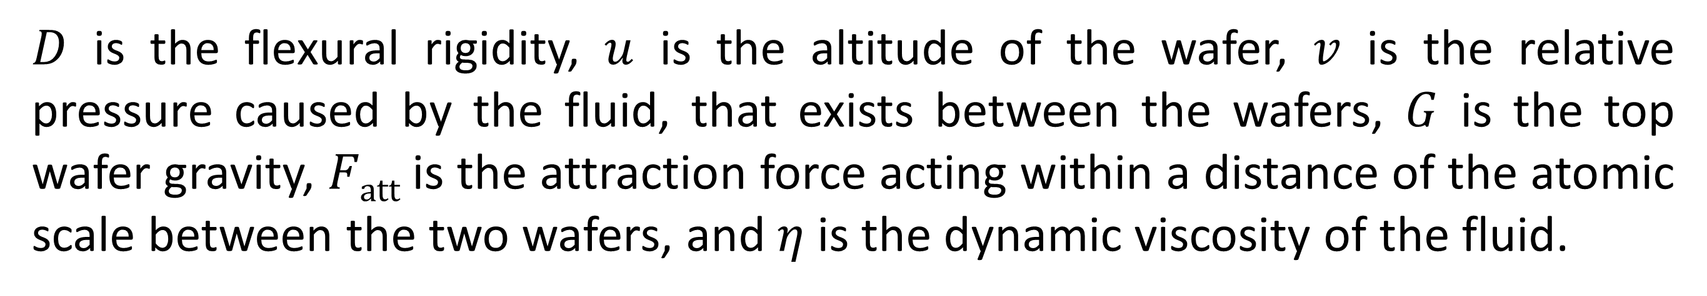
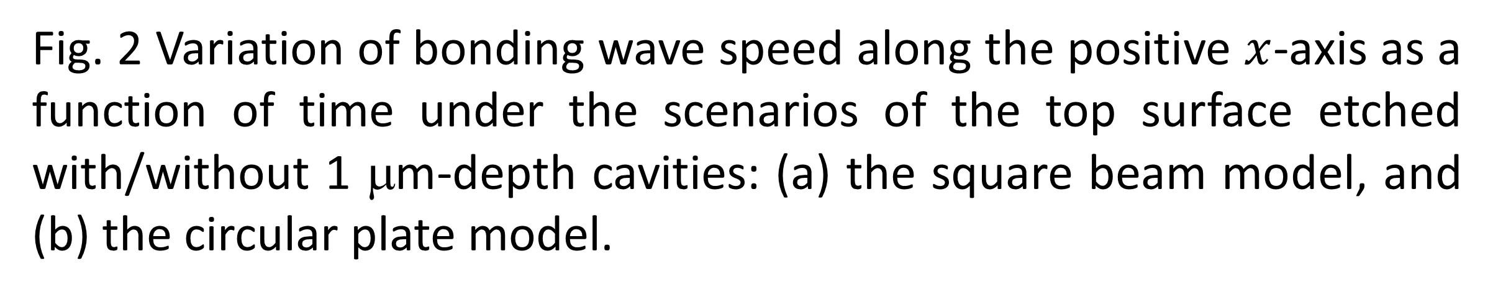
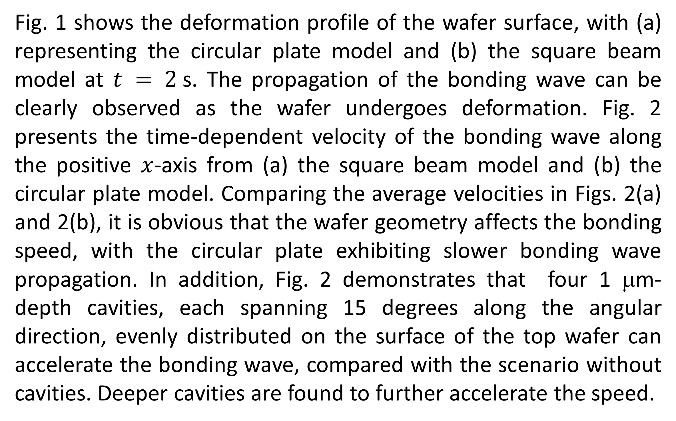
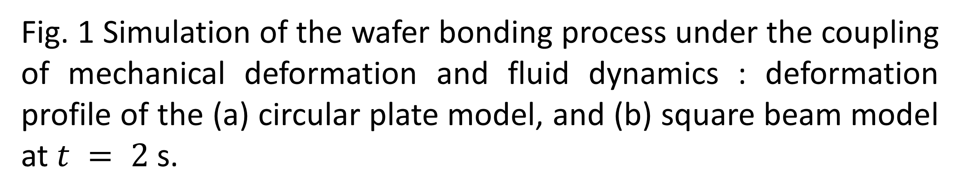

Direct Wafer Bonding Process Based on Coupled Structural Deformation and Fluid Dynamics
Wafer bonding enables advanced 3D integrated circuits (ICs), which is crucial for enhancing device performance and miniaturization. This study explores how wafer geometry and etched cavities impact wafer bonding.
Sichen Liang¹*, Zhiheng Huang¹, Min Xiao¹, Yuezhong Meng¹, Hui Yan² and Yang Liu³
¹School of Materials Science and Engineering, Sun Yat-sen University, Guangzhou, China
²School of Computer Science and Engineering, Sun Yat-sen University, Guangzhou, China
³School of Electronics and Information Technology, Sun Yat-sen University, Guangzhou, China
*E-mail: liangsch5@mail2.sysu.edu.cn
Abstract
Wafer bonding technology is essential for 3D IC integration without TSVs. Pre-manufacture simulation is needed to address mechanical stress and reliability issues. This study uses COMSOL Multiphysics to simulate wafer direct bonding, combining mechanical deformation with fluid dynamics through general form partial differential equations (PDEs) for greater flexibility. The wafer is modeled as a plate with a thickness of 750 µm, with bonding energy serving as the driving force that governs the propagation of the bonding wave through the interaction between the surfaces of the upper and lower wafers. The model combines the thin plate small-deformation equation from mechanics and the Reynolds equation from fluid dynamics, accurately capturing bonding wave propagation, wafer deformation, and the distribution of pressure around the whole wafer surface. A circular plate model was developed to replace the original square beam model, as it better represents the real situation during wafer bonding process in manufacturing. The results suggest that the circular plate model exhibiting slower bonding speed compared to the square model, and cavity patterns can obviously alter the bonding dynamics, with deeper cavities further accelerating the speed.
Methodology
The model captures the bonding process between two wafers, where the upper wafer is of a thickness of 750 µm, and the lower one is assumed to be perfectly flat under the control of a special designed chuck. The dynamics of the bonding process is governed by the following coupled equations:
 | $$D2u=v+G+Fatt$$ | (1)
 | $$∇∙\left(u3∇v\right)=12η\frac{∂u}{∂t}$$ | (2)
(a) | (b)
Fig. 1 Simulation of the wafer bonding process under the coupling of mechanical deformation and fluid dynamics : deformation profile of the (a) circular plate model, and (b) square beam model at $t = 2$s.
$D$ is the flexural rigidity, $u$ is the altitude of the wafer, $v$ is the relative pressure caused by the fluid, that exists between the wafers, $G$ is the top wafer gravity, $Fatt$ is the attraction force acting within a distance of the atomic scale between the two wafers, and$η$ is the dynamic viscosity of the fluid.
Results
Fig. 1 shows the deformation profile of the wafer surface, with (a) representing the circular plate model and (b) the square beam model at $t = 2$s. The propagation of the bonding wave can be clearly observed as the wafer undergoes deformation. Fig. 2 presents the time-dependent velocity of the bonding wave along the positive $x$-axis from (a) the square beam model and (b) the circular plate model. Comparing the average velocities in Figs. 2(a) and 2(b), it is obvious that the wafer geometry affects the bonding speed, with the circular plate exhibiting slower bonding wave propagation. In addition, Fig. 2 demonstrates that four 1 μm-depth cavities, each spanning 15 degrees along the angular direction, evenly distributed on the surface of the top wafer can accelerate the bonding wave, compared with the scenario without cavities. Deeper cavities are found to further accelerate the speed.
(a) | (b)
Fig. 2 Variation of bonding wave speed along the positive $x$-axis as a function of time under the scenarios of the top surface etched with/without 1 μm-depth cavities: (a) the square beam model, and (b) the circular plate model.
N. Ip et al., “Overlay performance in permanent bonded wafer integration schemes”, in Metrology, Inspection, and Process Control XXXVII, SPIE, pp. 319–324, Apr. 2023.
D. Radisson, “Direct bonding of patterned surfaces”, Ph.D. thesis of University of Grenoble, 2014.
E. M. Lifshitz et al., Theory of Elasticity, Oxford: Butterworth-Heinemann, pp. 38–86, 1986.

