Slide 1
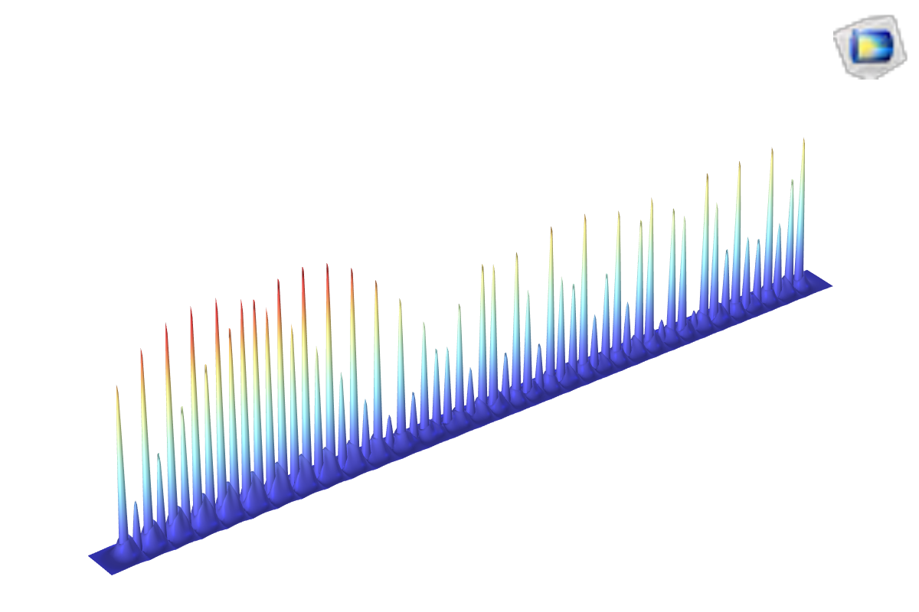
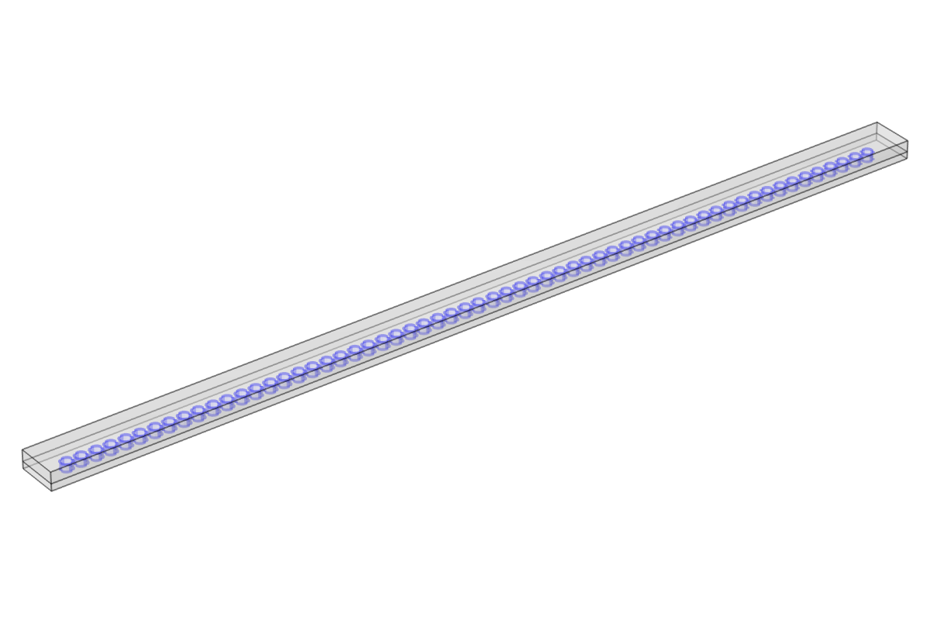
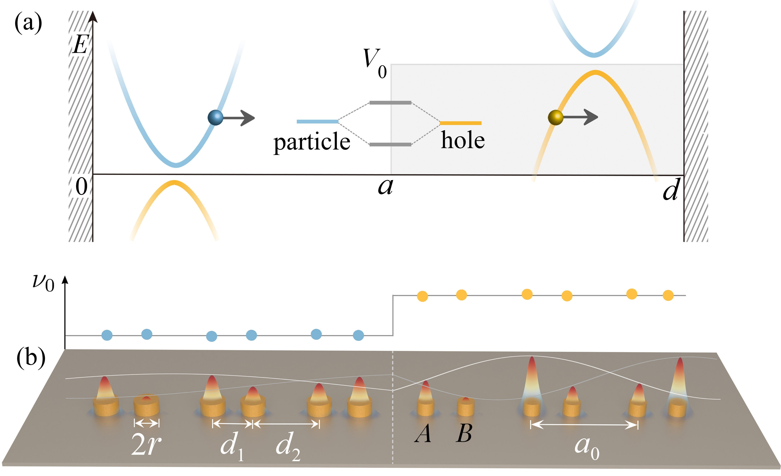
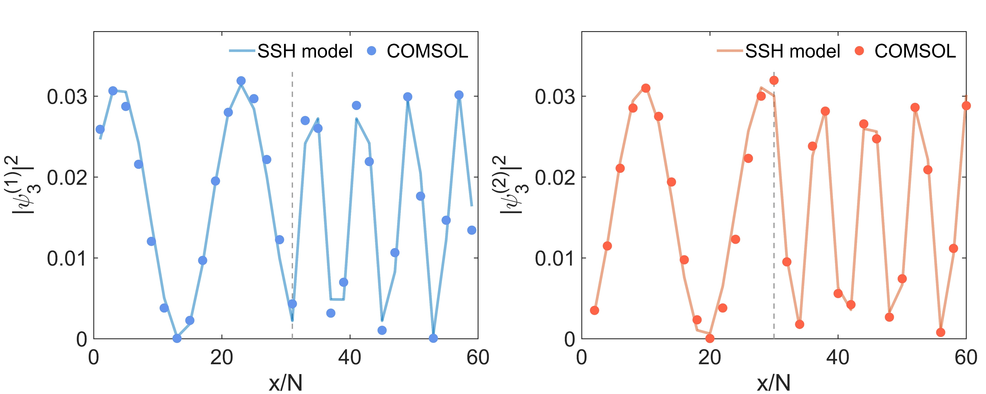
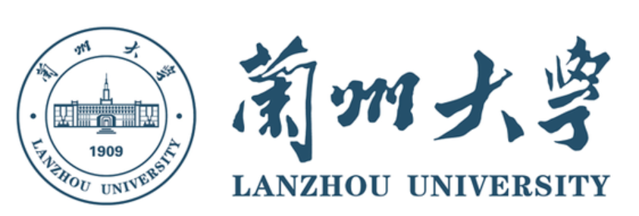
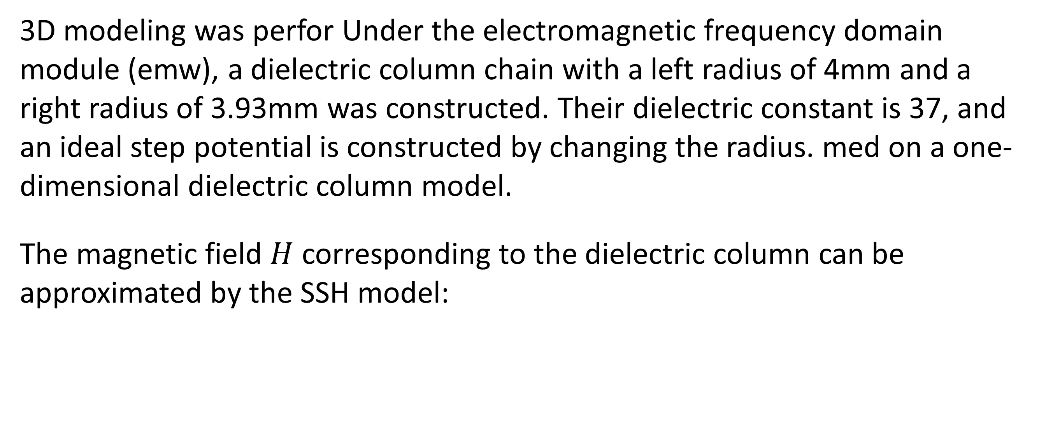
The Simulation And Experiment Of Quantized Klein Tunneling In A Dielectric Resonator Chain
Quantum Klein tunneling is simulated by one-dimensional microwave photonic crystals, and COMSOL simulations were compared with experiments
Ruijie Zhang¹, Xiaozhen Peng¹ 1. Lanzhou University, Lanzhou, China.
Abstract
Klein tunneling is one of the most striking consequences of Dirac equation. Now this is achieved in a bounded Dirac system implemented by a dimer chain of dielectric microwave resonators. Both the unusual quantized levels and corresponding spinor states hybridized from distinct particle and hole wavefunctions are measured. All observations are in quantitative agreement with the hitherto-untested prediction of Dirac equation. We used the electromagnetic frequency domain module of COMSOL Multiphysics® to construct a one-dimensional photonic crystal using a dielectric column in microwave bands. Our results make an important step to realize and understand the quantized particle-hole physics of Klein tunneling in bounded Dirac systems, and also shed light on potential applications for manipulating particle-hole hybridized spinor waves.
Methodology
3D modeling was perfor Under the electromagnetic frequency domain module (emw), a dielectric column chain with a left radius of 4mm and a right radius of 3.93mm was constructed. Their dielectric constant is 37, and an ideal step potential is constructed by changing the radius. med on a one-dimensional dielectric column model.
The magnetic field $H$ corresponding to the dielectric column can be approximated by the SSH model:
FIGURE 1. a: Theoretical Dirac potential well model. b: Schematic diagram of experimental and simulation models.
Results
The results can be seen in Figure 2, the one-dimensional Klein tunneling bound state formed by a chain of 60 medium cylinders (with 30 on the right having a reduced radius) is consistent with the results of the theoretical Dirac equation (SSH model).
The direct observation of quantized levels and Klein tunneling states in microwave realizations of a bounded Dirac system has been demonstrated. Our experiment offers a versatile platform for exploring relativistic particle-hole physics with the capability of tailoring heterogeneous spinor waveforms.
FIGURE 2. The third wave function of Klein tunneling obtained from COMSOL simulation corresponds to the SSH model results, where the left figure shows the A sublattice results in the lattice and the right figure shows the B sublattice results.
REFERENCES
[1] O. Klein et. al., Die reflexion von elektronen an einem potentialsprung nach der relativistischen dynamik von Dirac, Z. Phys. 53, 157 (1929).
[2] W. P. Su et. al., Solitons in polyacetylene, Phys. Rev. Lett. 42, 1698 (1979).
[3] J. A. Franco-Villafañe et. al., First experimental realization of the Dirac oscillator, Phys. Rev. Lett. 111, 170405 (2013).

