Slide 1
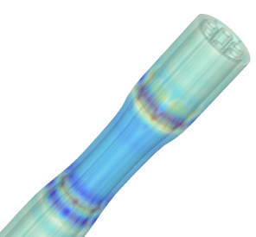
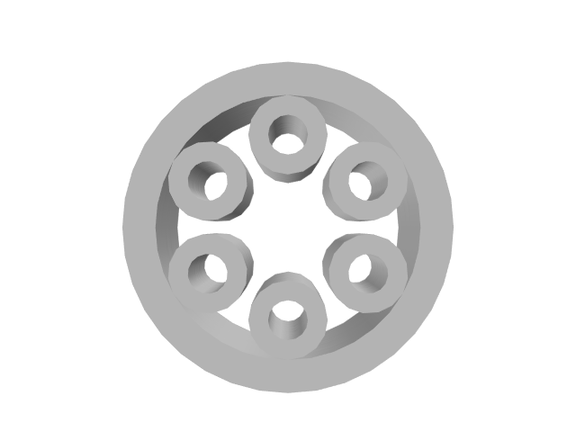
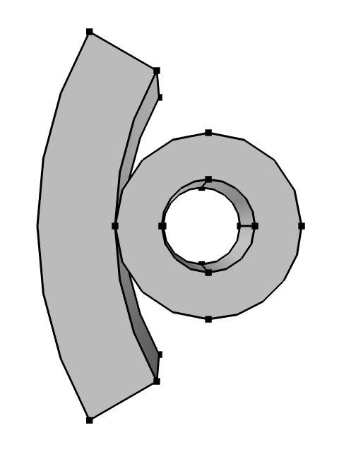
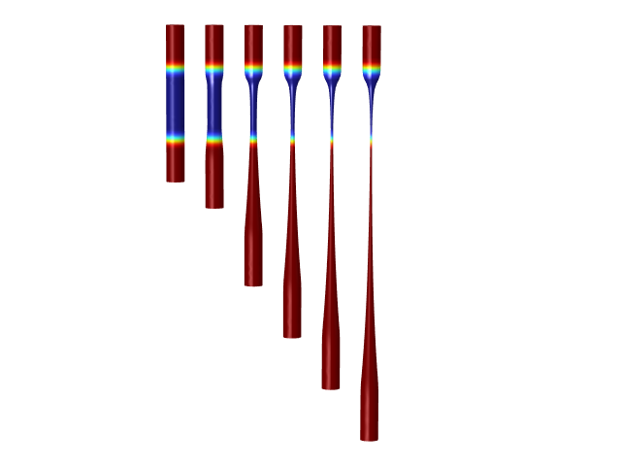
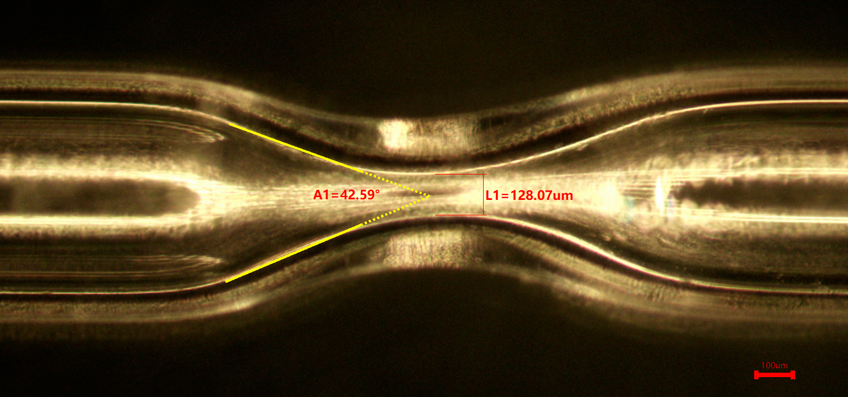
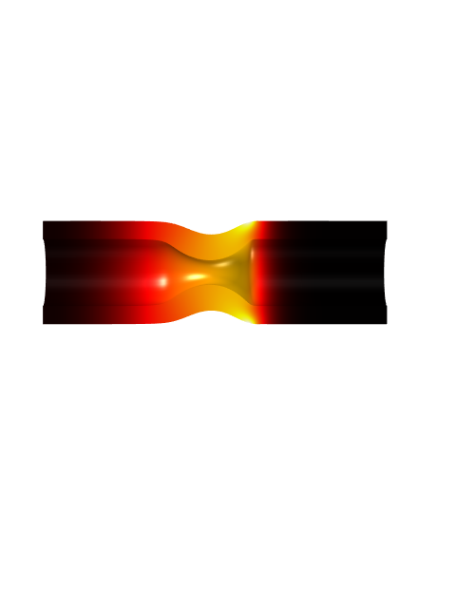
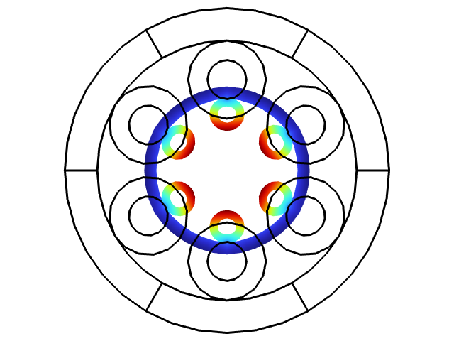
Simulation of optical fiber drawing
A dynamic model of the optical fiber drawing process was developed. The model integrates temperature and pressure distributions, drawing speed, along with the viscosity and tension characteristics of the material. The impact of various process parameters on the outcomes was investigated, providing theoretical guidance for optimizing the actual manufacturing process.
Zhuo Chen^{1,2}, Fei Yu^{1,2}
1. Key Laboratory of Materials for High Power Laser, Shanghai Institute of Optics and Fine Mechanics, Chinese Academy of Sciences, Shanghai 201800, China.
2. Hangzhou institute for Advanced study, University of Chinese Academy of Sciences, Hangzhou 310024, China
Introduction
The fiber drawing process typically involves heating the optical fiber above its glass transition temperature, transitioning the material from a glassy state to a viscoelastic state. External forces are then applied to control the drawing speed, manipulating the fiber's deformation to achieve the desired structural dimensions.
By integrating the heat transfer in solids, fluid dynamics, and moving mesh modules, a fully three-dimensional dynamic simulation system was constructed.
The model can be further extended to simulate processes such as fiber tapering. By changing the heating method from area heating to point heating, it can be adapted to simulate laser point-source processing.
Methodology
Due to the uniformity of the heat distribution, a 2D axisymmetric model can be employed to simplify the computations. The appropriate heat transfer coefficient is selected to simulate the thermal convection between the material and air, while surface radiation from the outer material boundaries or a Gaussian point source can be used to simulate electrical heater heating or laser point-source heating, respectively.
The laminar flow module is configured to account for the temperature-dependent viscosity and surface tension of the. Different pressures are applied to the free surface of the fluid to reflect varying environmental conditions. Since this is a dynamic simulation, a moving mesh is utilized to define the model. The mesh velocity can also be used to specify the external drawing speed.
FIGURE 1. The creation of the axisymmetric simplified model is employed.
Results
The results are illustrated in Figure 2, showing that the trends of the optical fiber's transverse and longitudinal structures over time align well with actual observations. The temperature, pressure, and drawing speed settings in the model provide a rough prediction of the outcomes.
The process of laser point-source heating of a glass capillary tube is also depicted alongside. The upper section shows the experimental results, while the lower section presents the simulation results. By adjusting the waist radius and moving speed of the Gaussian point source, the model can simulate the scenario of laser oblique incidence. As illustrated, the temperature on the left side is slightly higher compared to the right side.
FIGURE 2. Left: Simulation of the optical fiber drawing process. Right: Experimental and simulation results of laser processing on a glass capillary tube with oblique incidence from a point source.
REFERENCES
Qiannan Jia, Weiwei Tang, Wei Yan, Min Qiu. “Fibre tapering using plasmonic microheaters and deformation-induced pull”[J]. Light: Advanced Manufacturing 4, 5(2023). doi: 10.37188/lam.2023.005

