Slide 1
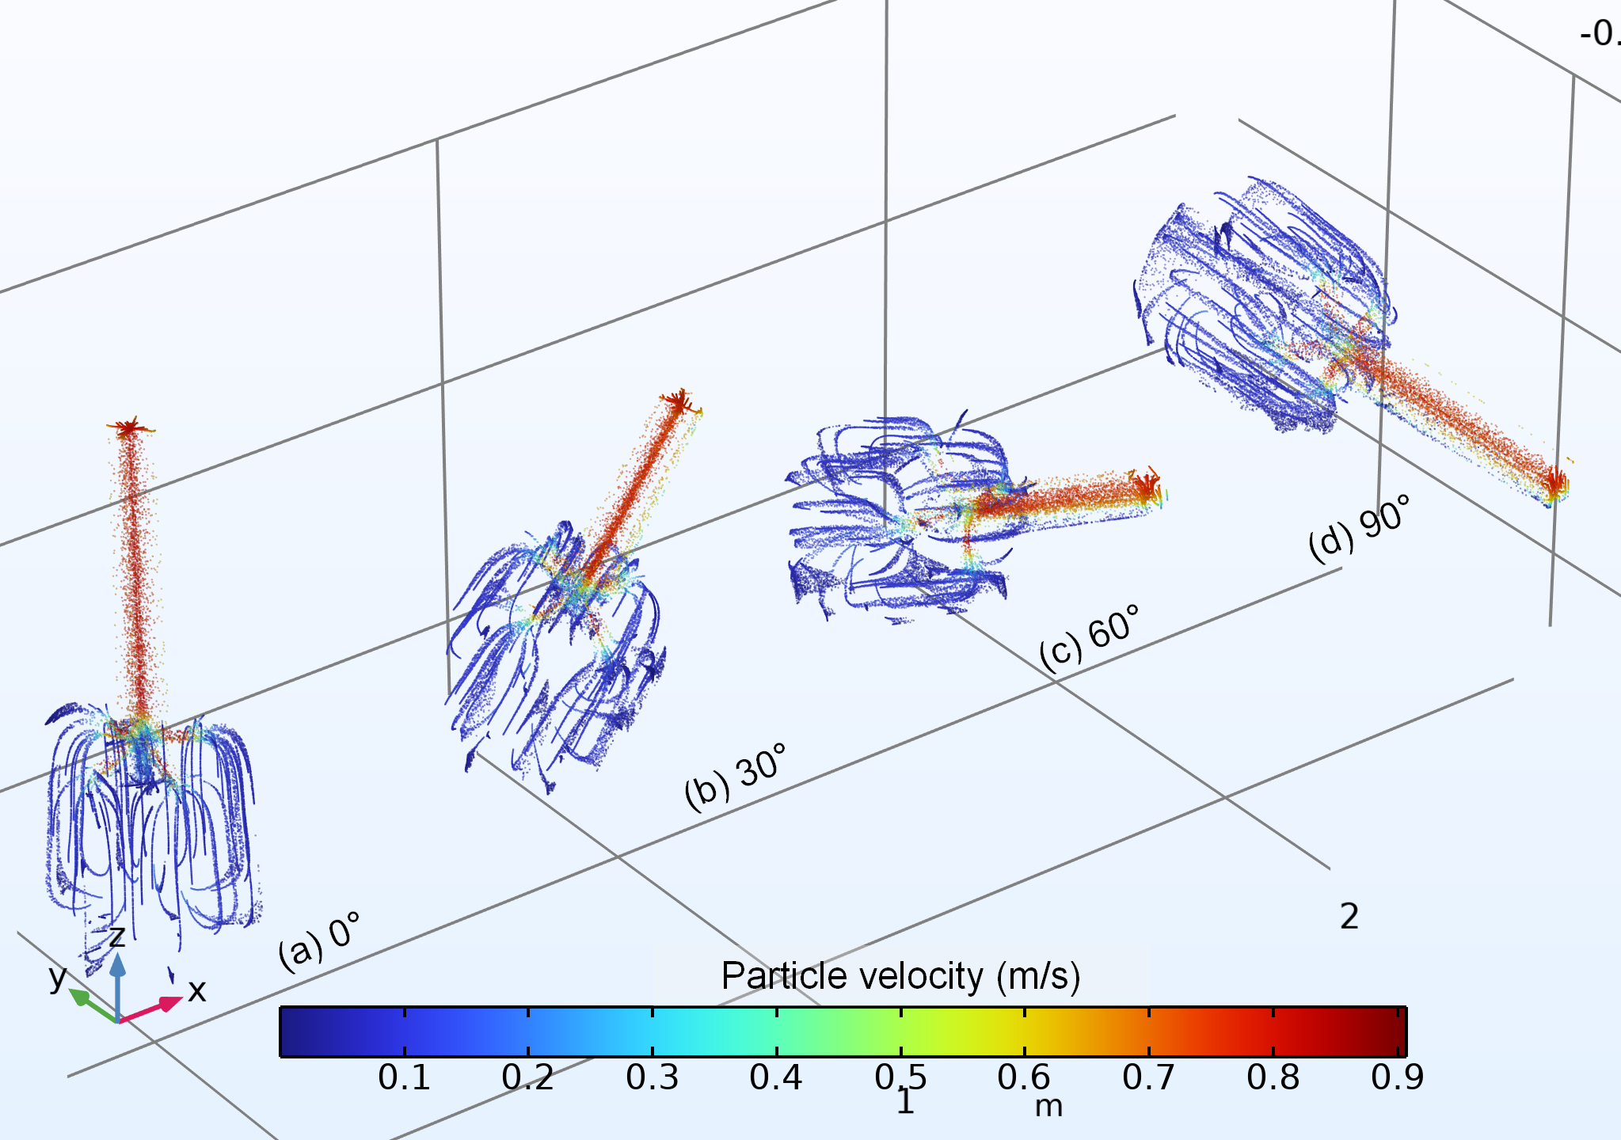
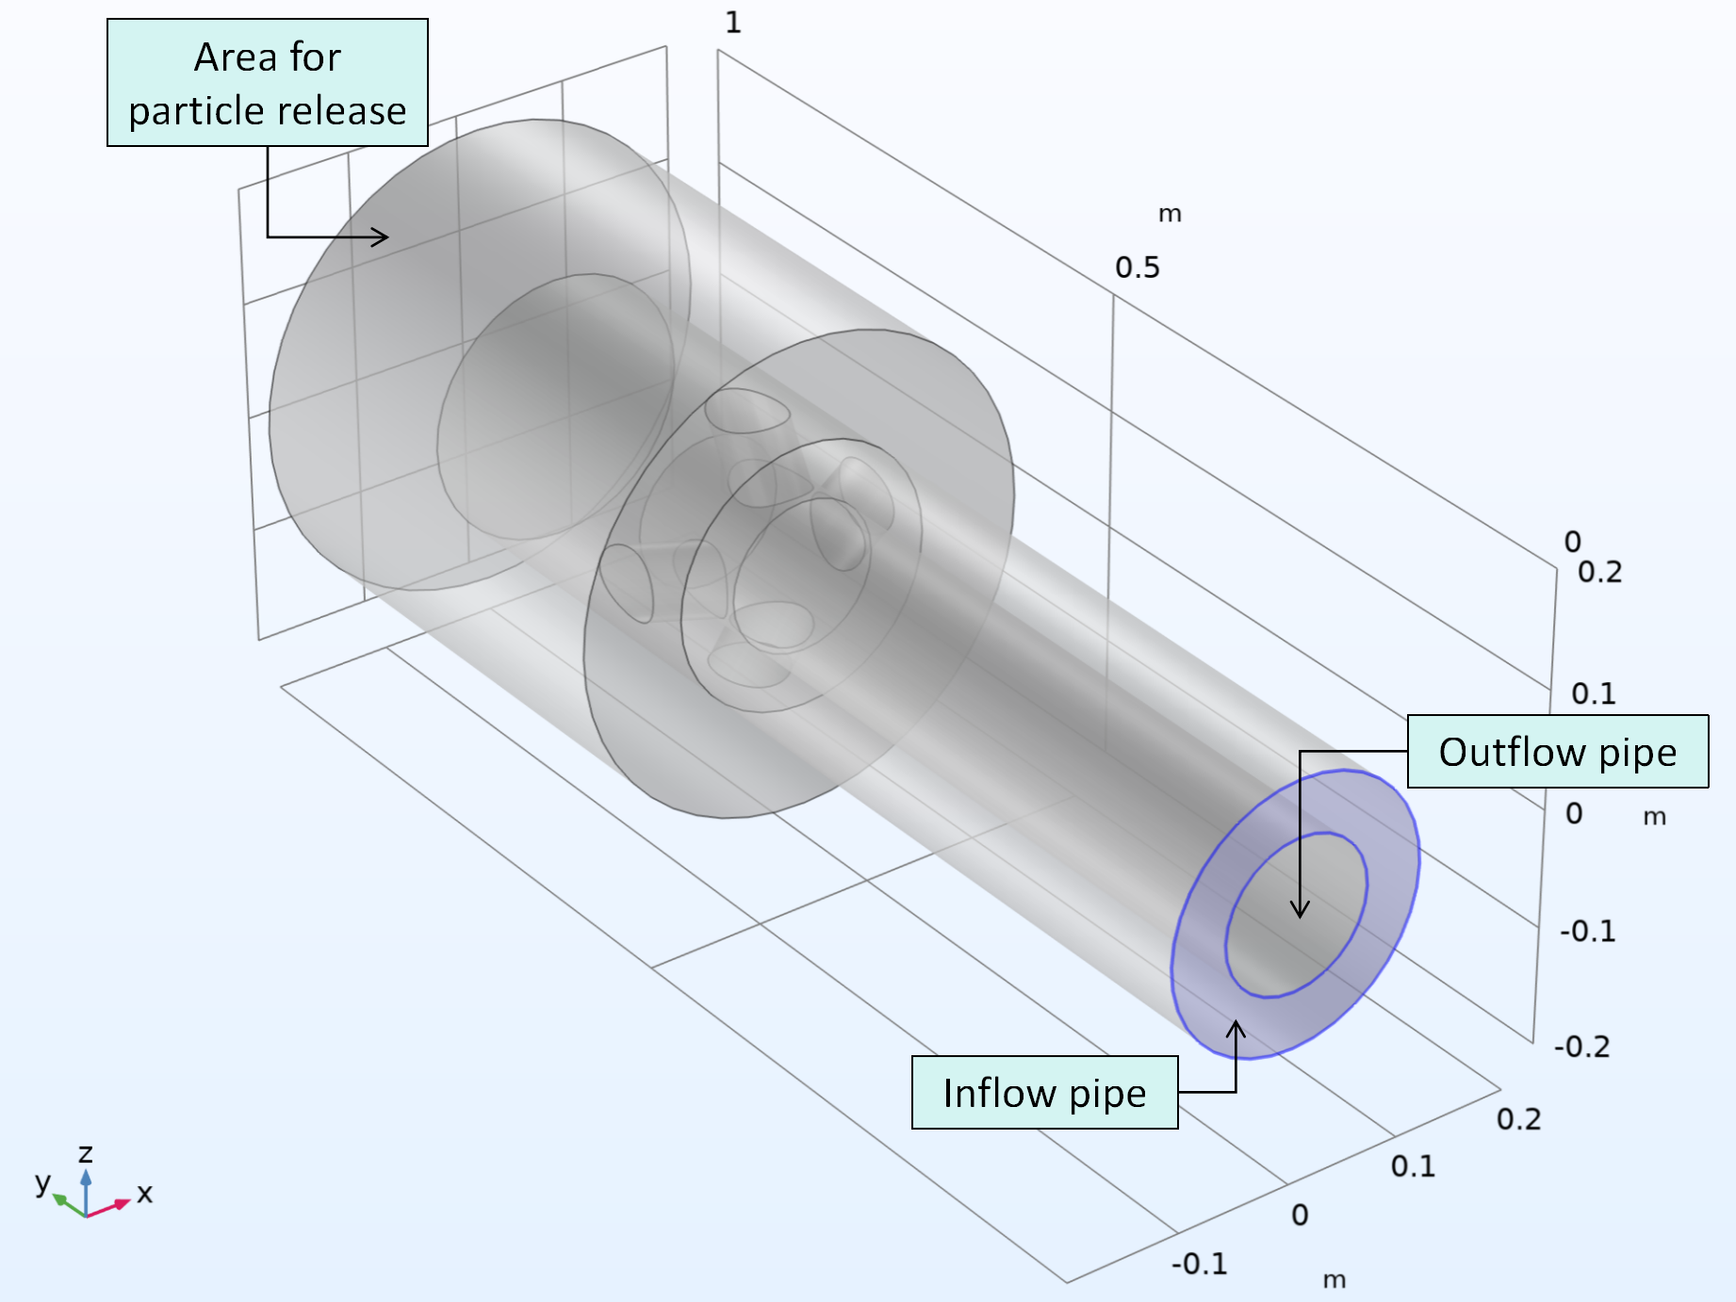
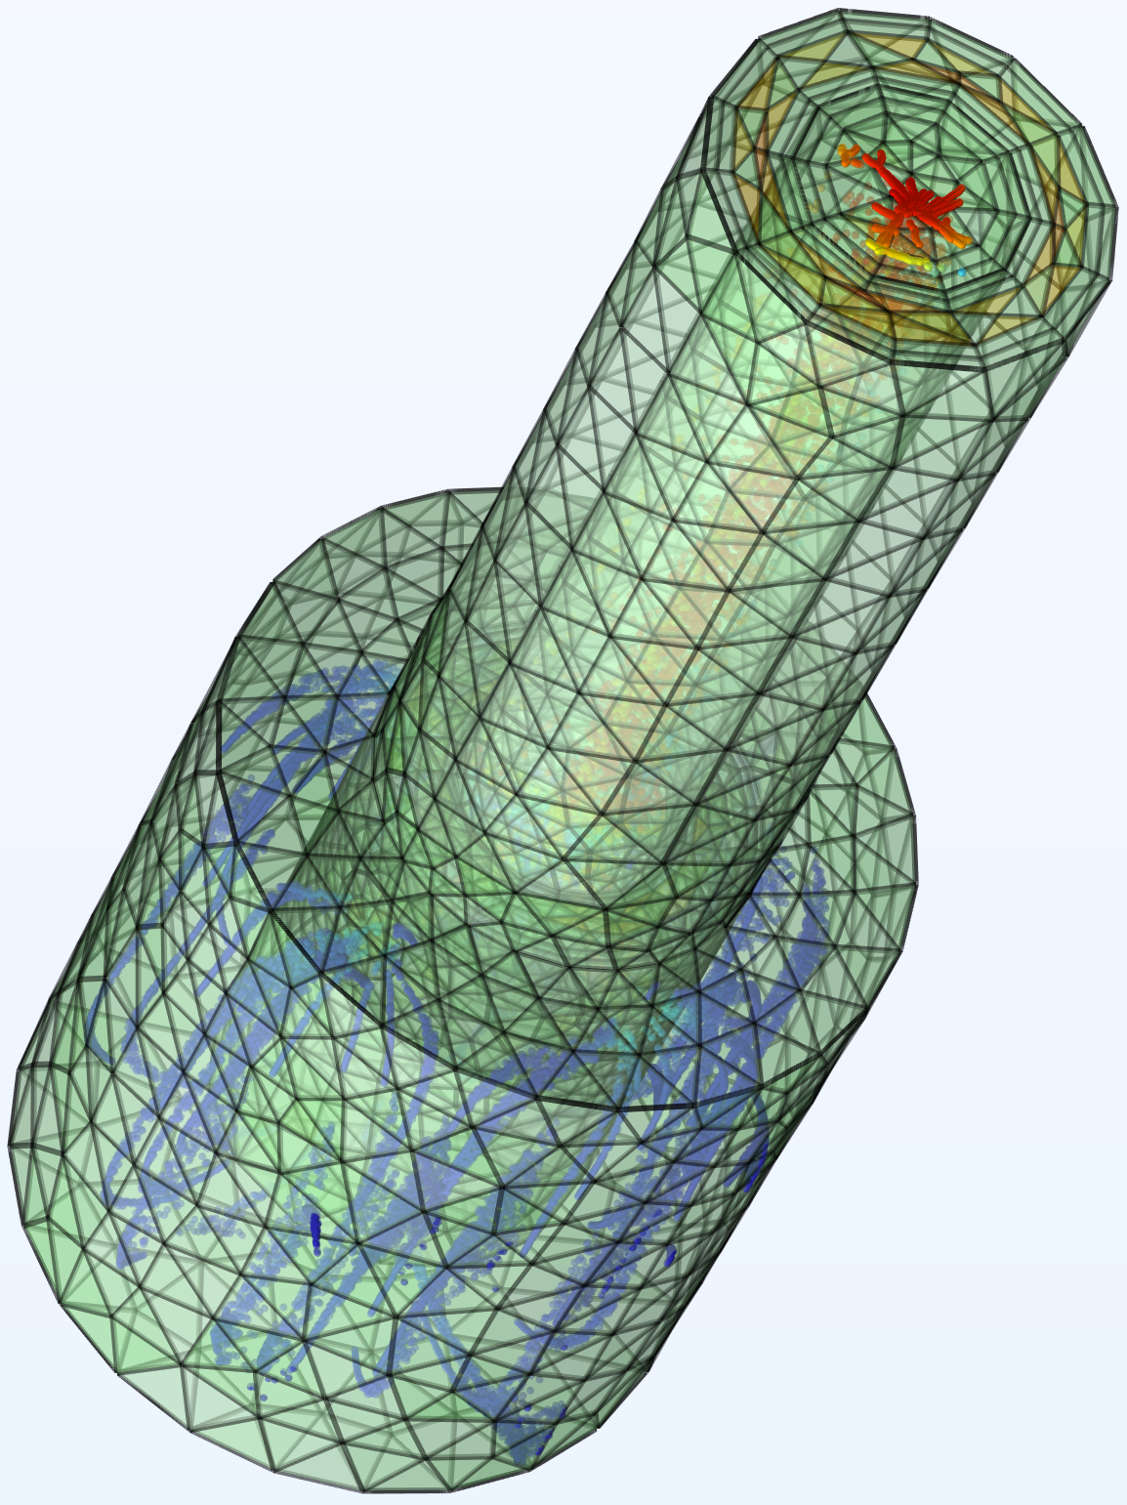
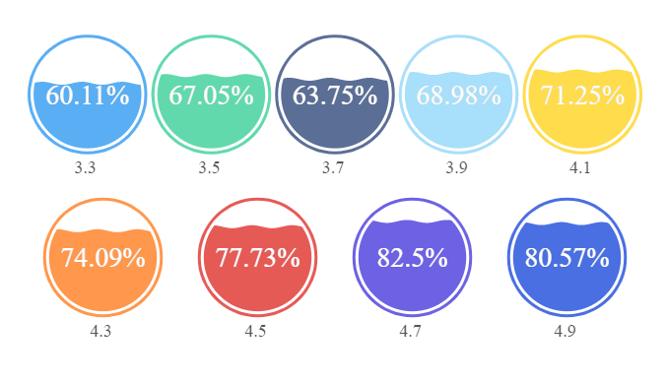
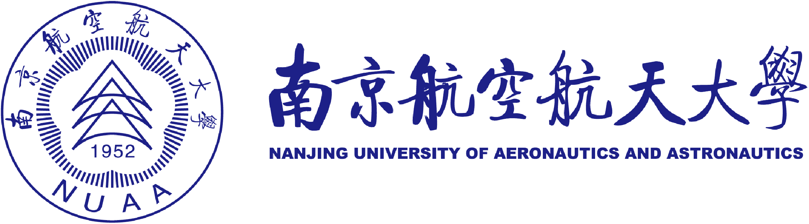
Assessment of the Cuttings Carrying Performance of Drilling Mud via Reelwell Drilling Method
Reelwell Drilling Method (RDM) is an innovative and energy-efficient approach to directional drilling. Particle tracing-based model has been developed to assess the well cleaning capacity of drilling mud when using RDM.
Fei Xiao¹, Lizhong Yang²
1. Nanjing University of Aeronautics and Astronautics
2. Nanyang Technological University (Singapore)
Abstract
A numerical model grounded in particle flow dynamics has been developed to assess the drilling mud's capacity to transport cuttings from the bottom when employing RDM. This model takes into account the effects of circulation flow rate, inclination angle, and mud temperature. The rheological features of the drilling mud were derived through laboratory testing. “Laminar Flow” and “Particle Tracing for Fluid Flow” modules were used for building the numerical model, where lift forces, drag forces and gravitational forces applied to particles were considered. Both simulation results and laboratory findings indicate that, in directional drilling, most cuttings move and gather below the pipe's central axis; the augmentation of cuttings transport capacity due to increased circulation flow rates not only exceeds the rate of increase in flow itself but also achieves superior performance under high-temperature conditions; what’s more, the weakest cuttings transport in drilling pipes typically happens at 30° and 60° inclinations, occasionally at 90°, aligning with experimental data across temperatures and flow rates.
Methology
A series of laboratory testings were conducted to investigate rheological properties of drilling mud, and the testing data were used to construct a 3D rheological surface, where the shear stress was expressed as a function of shear rate and temperature.
The capacity of drilling mud to carry out cuttings from drilling well of four types of inclination angles (0°, 30°, 60°, and 90°) were systematically analyed, considering the impact from circulation flow rate and temperature.
Particle size of cuttings were assumed to be randomly distributed between 3mm and 5mm to simulate the practical conditions.
FIGURE 1. Left: model configuration. Right: Drawing of cuttings being carried out out from the well bottom.
Results
The Xiao rheological surface model outperforms traditional models in predicting shear stress.
Prediction of cuttings transport behaviors aligns closely with empirical and experimental testing outcomes.
Carrying large particles relies largely on increasing circulation flow rate.
Forecast and testing data observe the weakest transport performance at 30° / 60° inclination.
High temperatures cut mud's cuttings capacity.
FIGURE 2. Fraction of particles that remain at well bottom (large font size, unit: %) labeled by size category (small font size, unit: mm)
1. Aleksandersen, J. and O. M. Vestavik (2015). Dual-Drillpipe Method Shows Success in PMCD Wells With Cuttings Return. Journal of Petroleum Technology 67(04): 32-35. 2. JPT staff (2012). Reelwell Drilling Method Makes Use of Dual-Conduit Drillstring. Journal of Petroleum Technology 64(08): 38-39. 3. Veisene, A. T. (2014). Well control during extended reach drilling-conventional drilling compared to the reelwell drilling method, University of Stavanger, Norway.

