Slide 1
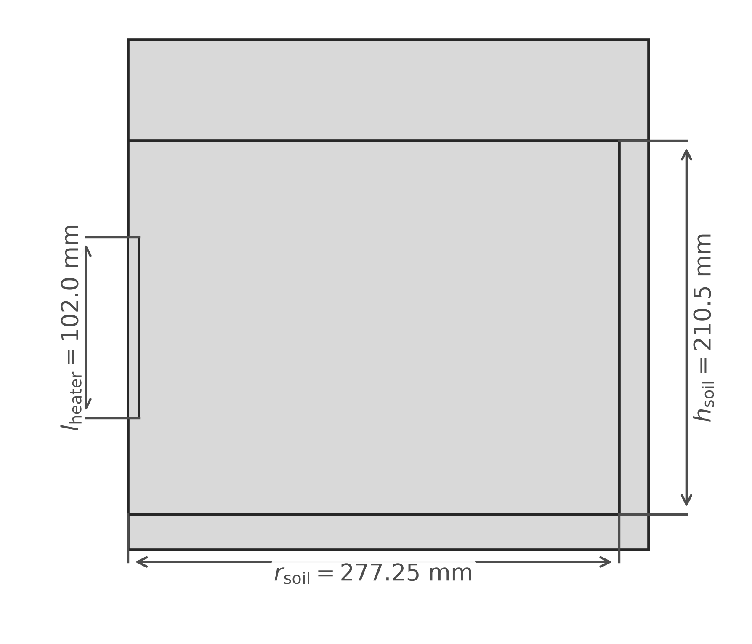
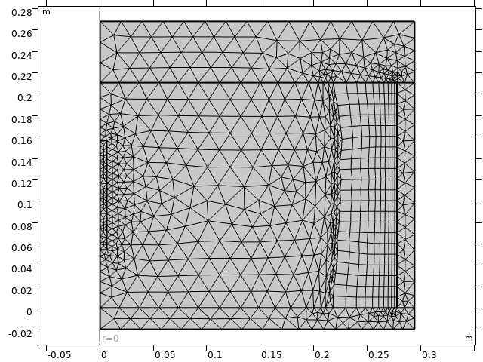
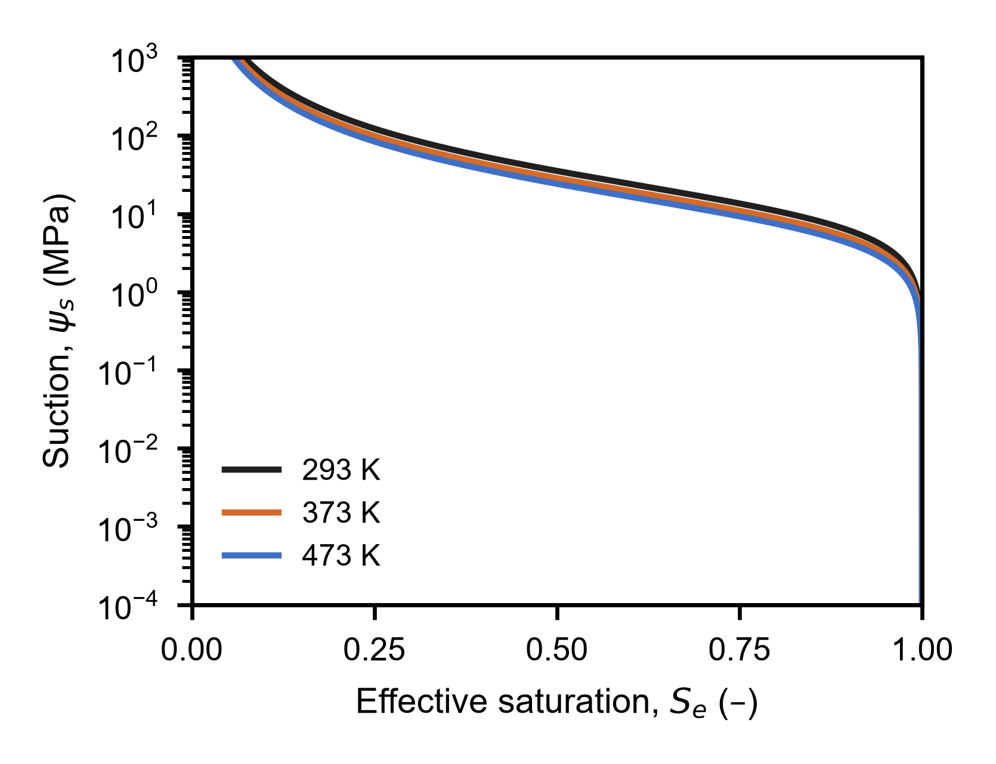
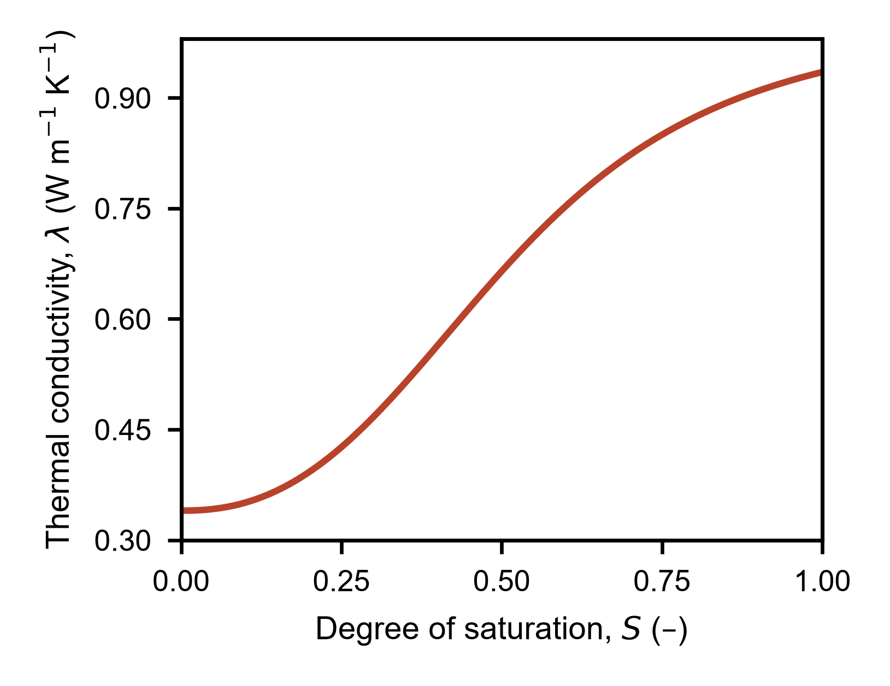
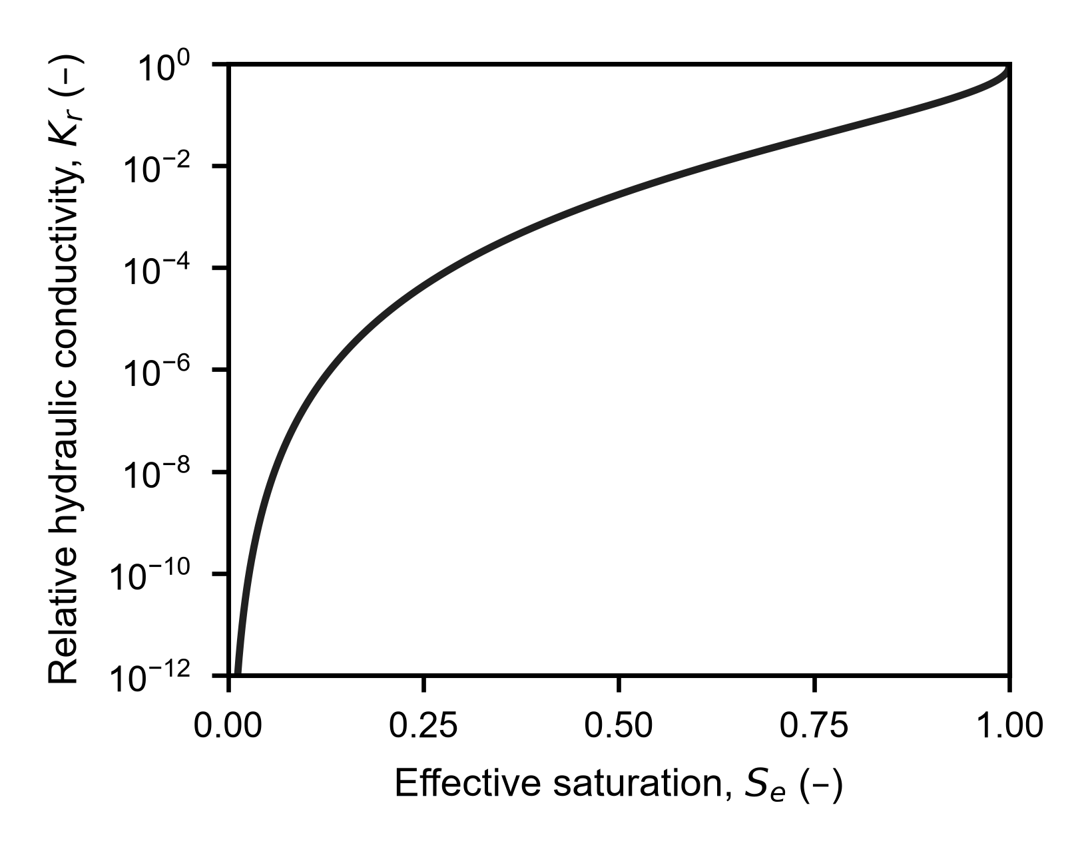
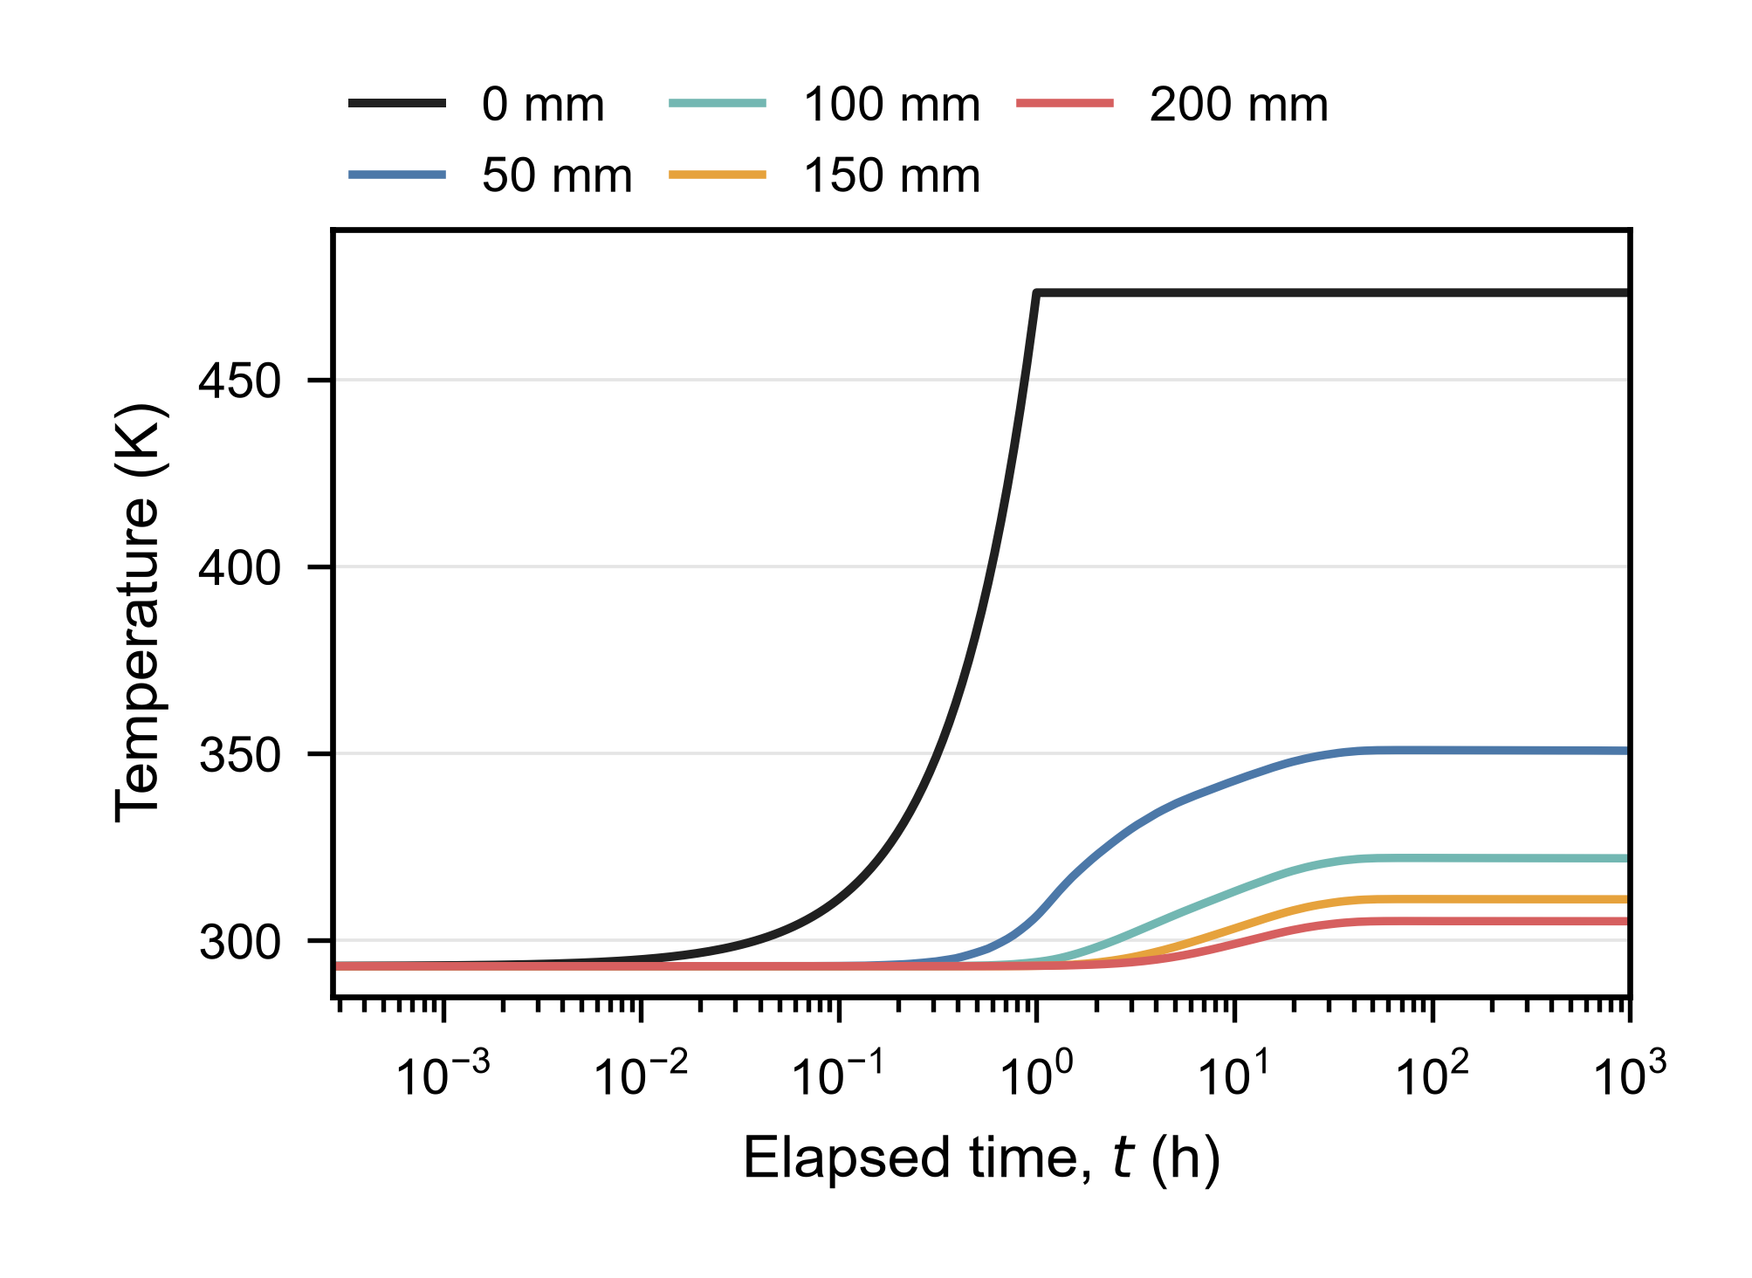
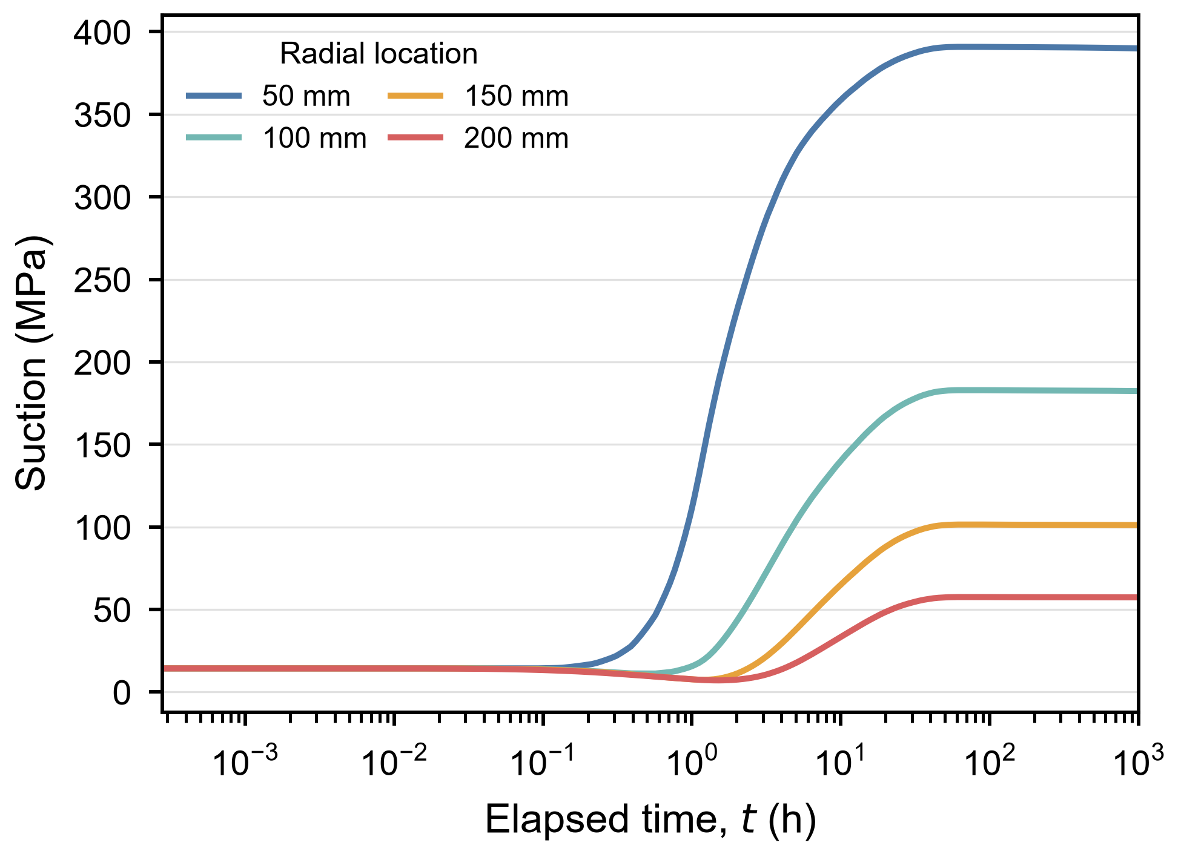
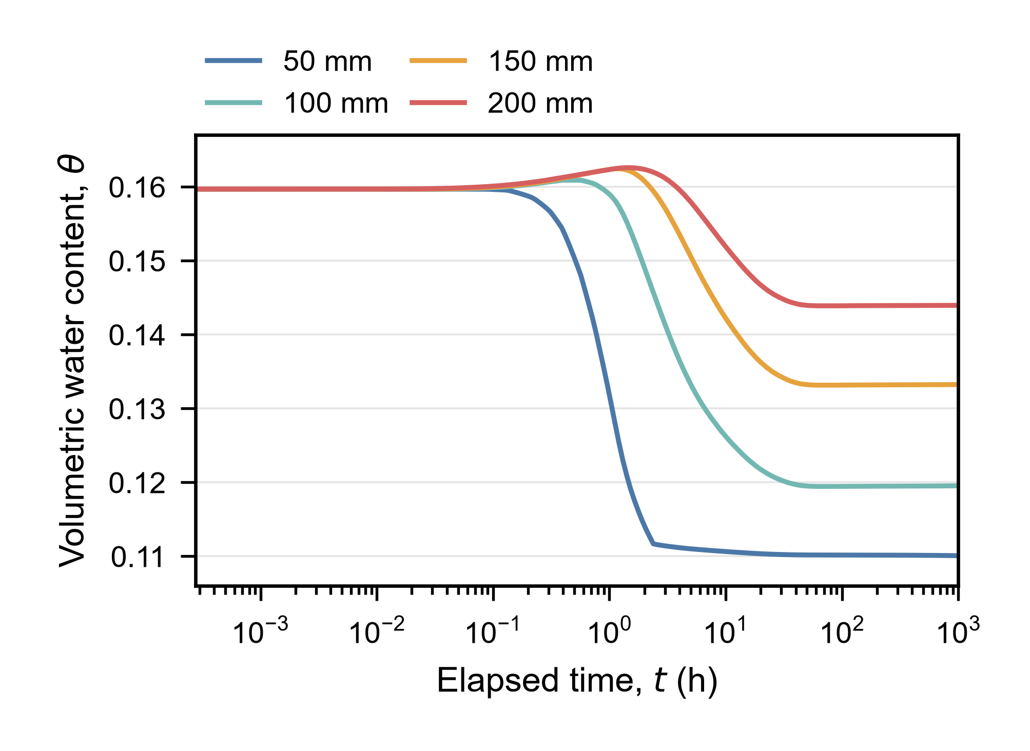
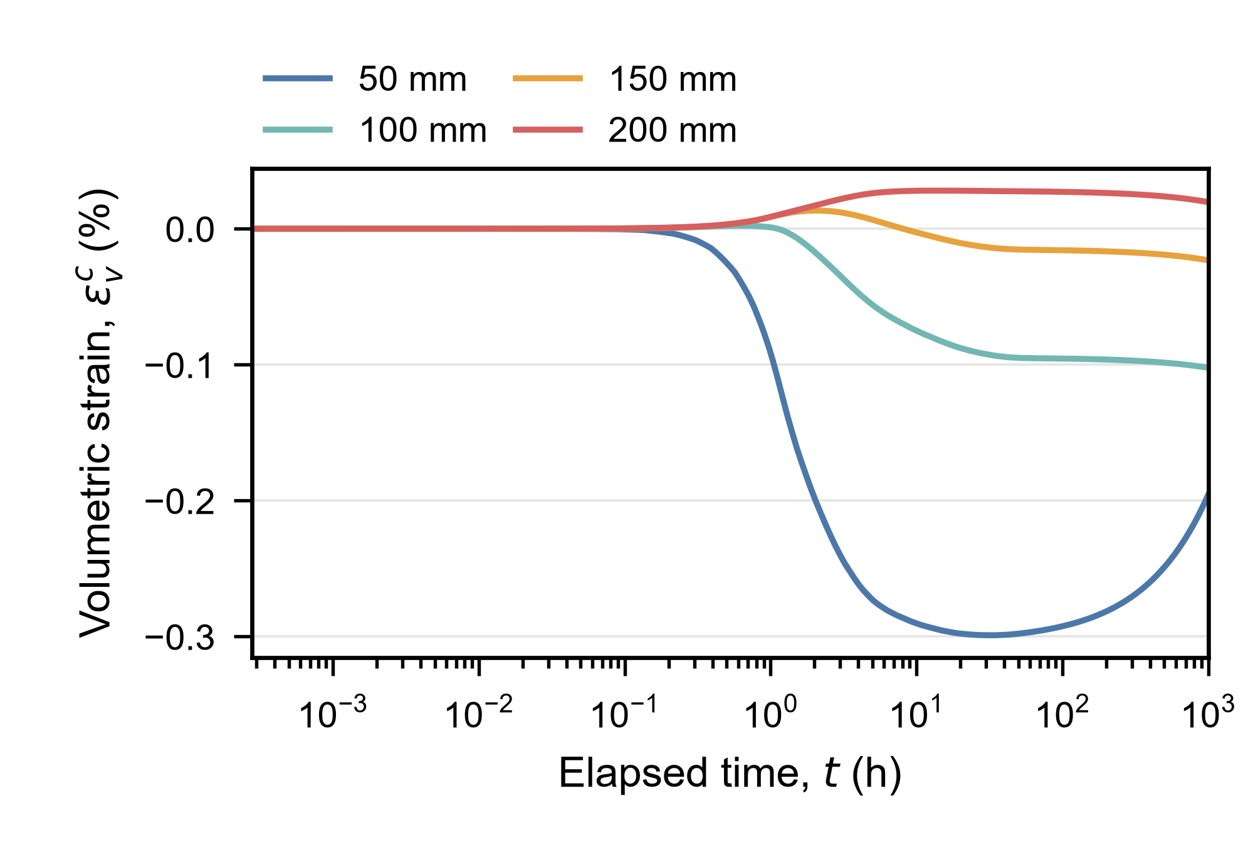
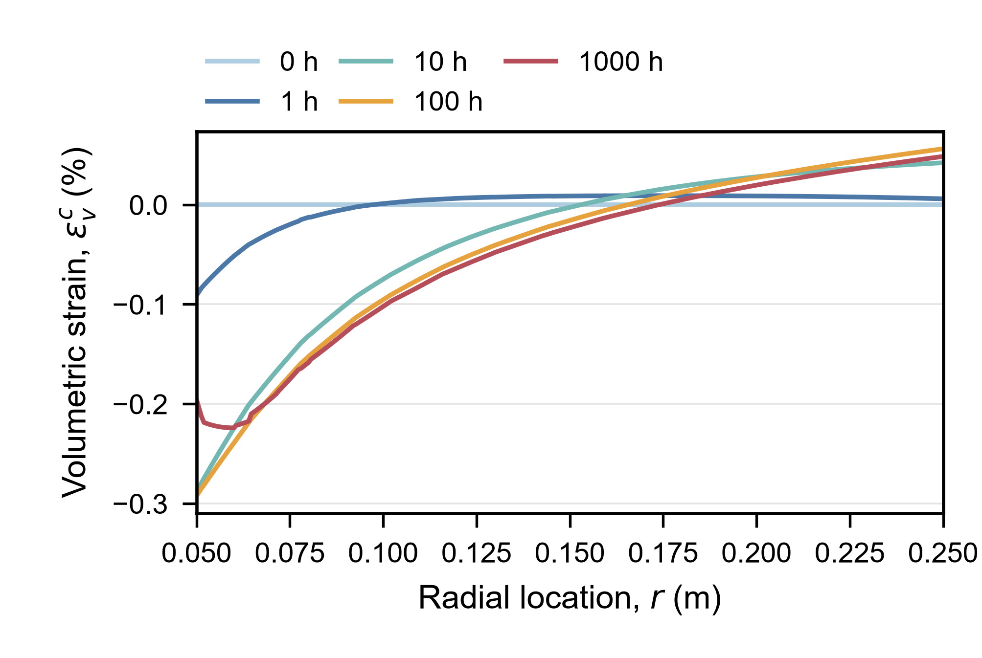
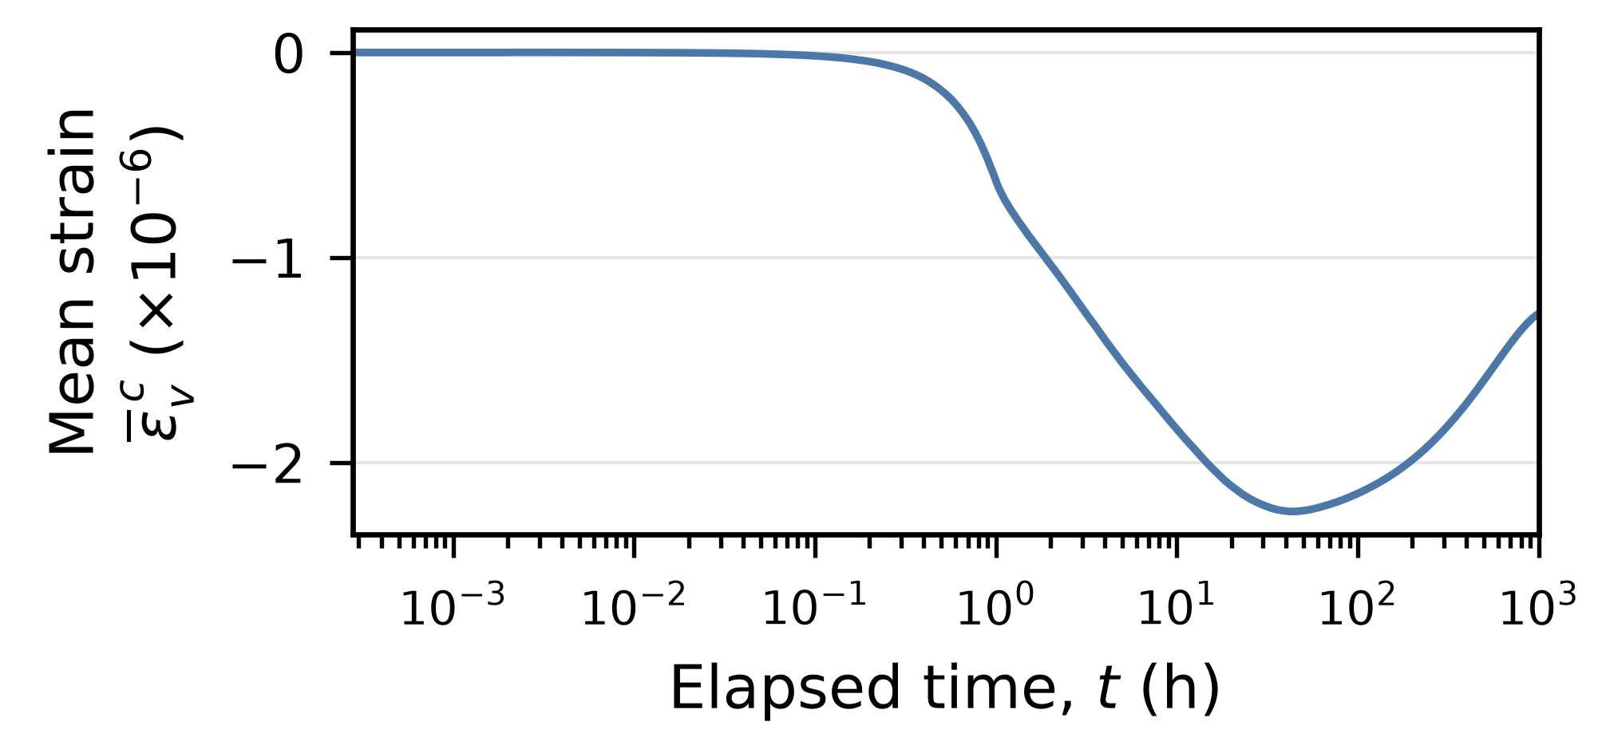

Thermo-Hydro-Mechanical Modeling
of Bentonite Heating in COMSOL
An axisymmetric model developed to example the coupled evolution of water content, suction and deformation in constrained MX80 bentonite during central heating.
X. Liu and J. S. McCartney
Structural Engineering, University of California San Diego, La Jolla, CA, USA
Model setup
Initial | 293.15 K; RH = 0.90 Zero displacement and velocity
Thermal | Heater: linear ramp to 473.15 K by 1 h, then constant; end time: 1000 h. Outer wall: h = 15 W/(m² K), ambient 295.75 K.
Transport | Zero liquid flux Prescribed vapor concentration
Mechanical | Outer wall: radial displacement fixed Top/base: vertical displacement fixed Axis: symmetry; other boundaries: traction free
T: temperature; θ: water content
Cᵥ: stored vapor; u: displacement
Isotropic elasticity with thermal expansion, prescribed creep and suction strains. Strain updates porosity and permeability.
Axisymmetric finite-element mesh.
Bentonite | ρ = 1700 kg/m³; Cₚ = 800 J/(kg K) E = 80 MPa; ν = 0.30 n₀ = 0.41; κ₀ = 10⁻¹⁶ m² α = 2.667 × 10⁻⁵ K⁻¹
Aluminum | E = 70 GPa; ν = 0.33
Soil-water retention curve (SWRC)
Thermal Conductivity Function (TCF)
Hydraulic Conductivity Function (HCF)
Heater radius: 6.25 mm
Bentonite height: 210.5 mm
Bentonite outer radius: 277.25 mm
Results
Point histories: r = 50, 100, 150 and 200 mm; radial profiles: r = 50–250 mm, at z = 105.25 mm.
Strain is compression-positive throughout; Figure 6 shows the mean over the bentonite domain.
Figure 1. Heater and soil temperature.
Figure 2. Kelvin-based suction.
Figure 3. Volumetric water content.
Figure 4. Local volumetric strain.
Figure 5. Radial volumetric-strain profiles.
Figure 6. Mean volumetric strain (approximately zero).
Soil temperature rises earlier and more strongly near the heater. At r = 100–200 mm, suction decreases then rises, while water content first increases and then falls below its initial value. Local expansion and compression coexist, while the average strain over the bentonite domain remains small.
References: Mualem, Water Resour. Res. (1976); van Genuchten, SSSA J. (1980); Lu and McCartney, Acta Geotechnica (2024).
Supported by U.S. DOE NEUP, award DE-NE008951.
Excerpt from the Proceedings of the COMSOL Conference 2026 Boston

