Slide 1
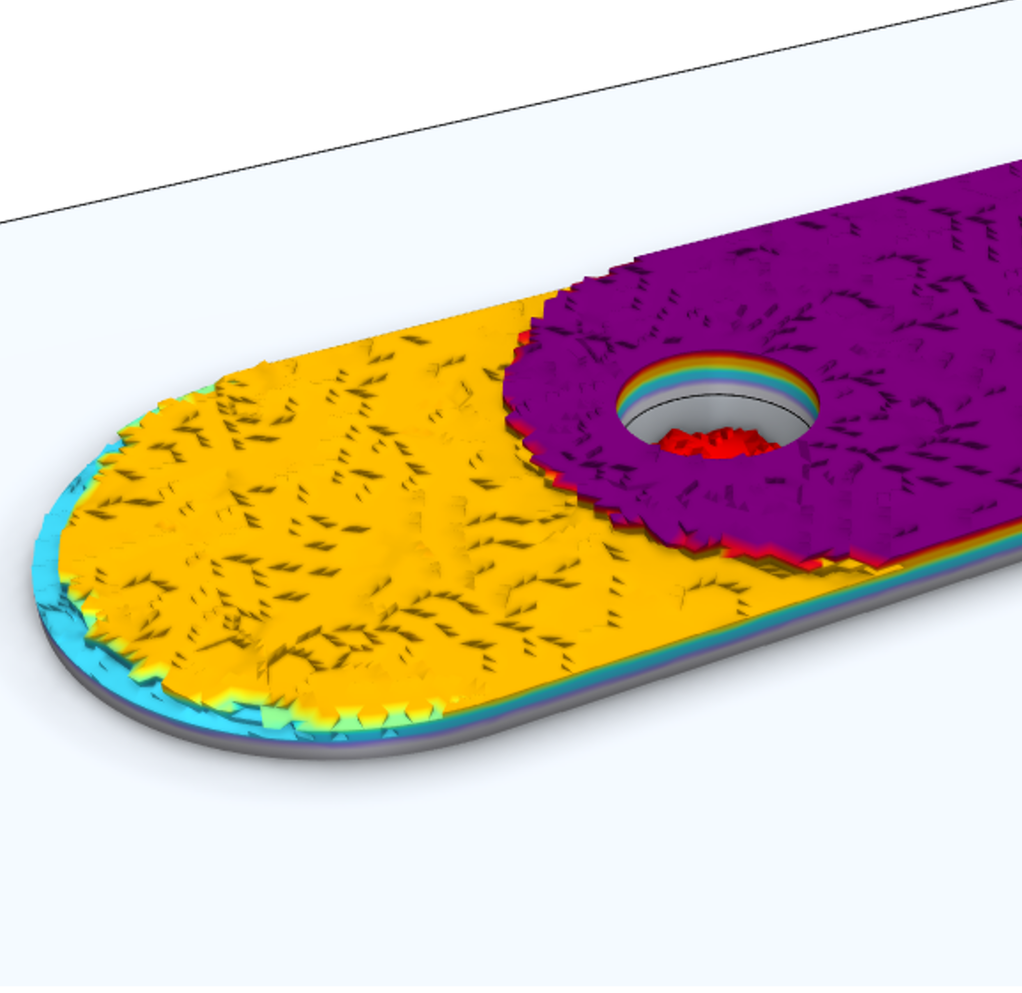
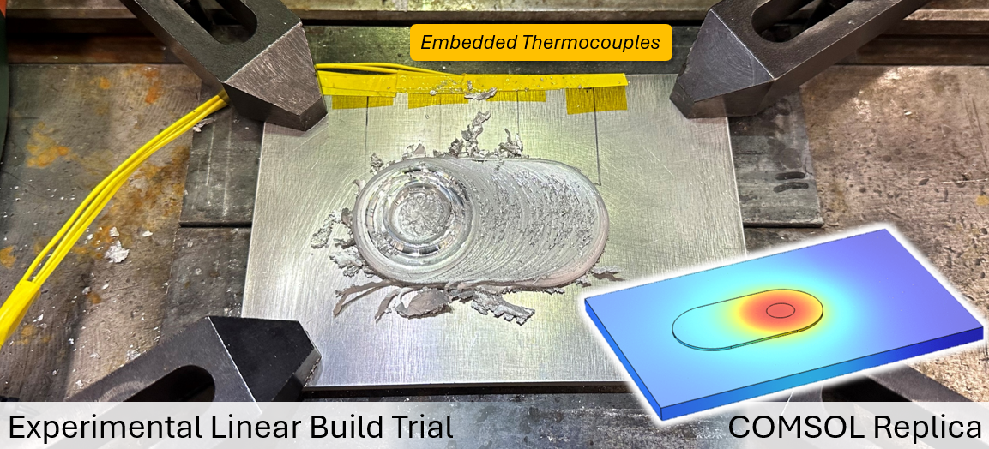
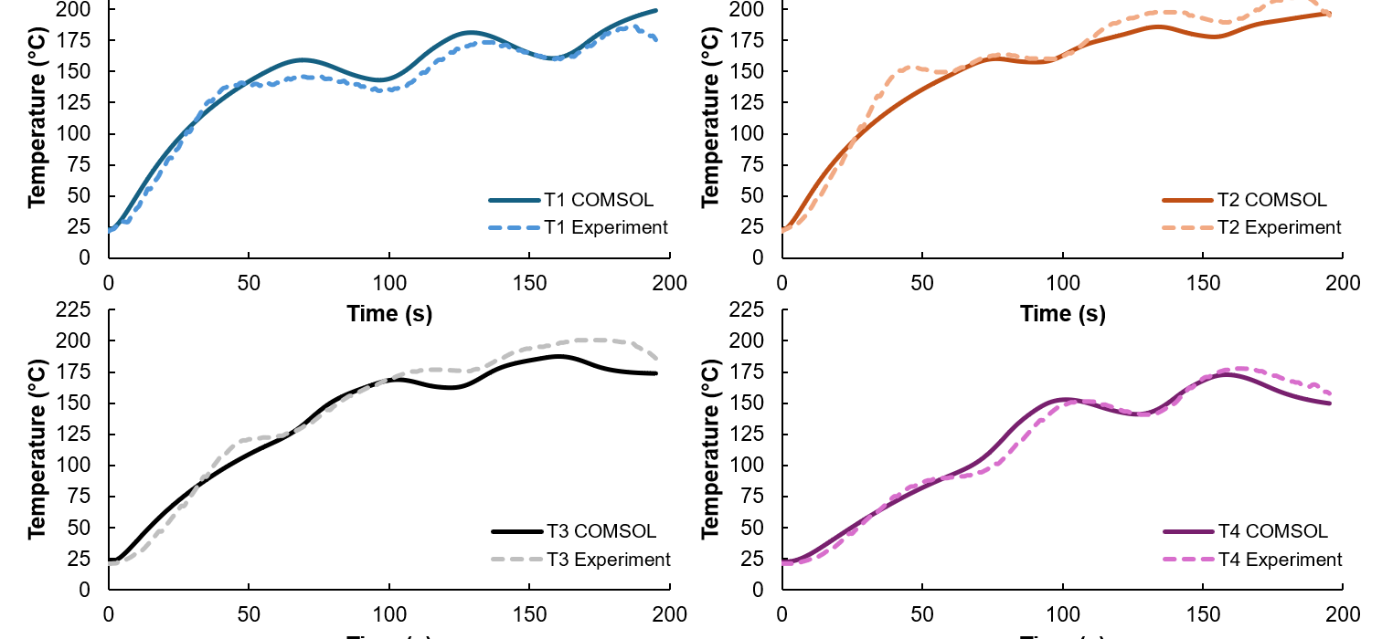

Seeing What Sensors Cannot:
An ICME Framework for AFSD Aluminum Hole Repair
COMSOL enables virtual thermocouple measurements at molten friction stir interface to determine microstructural evolution and strength of repair.
A. Taylor¹, J. Frankel¹, N. Tenorio¹, J. Grubbs², B. Sousa²
1. TRACE Simulation, a division of Triton Systems, Inc., Chelmsford, MA, USA. 2. Triton Systems, Inc., Chelmsford, MA, USA.
Introduction
Additive Friction Stir Deposition (AFSD) is a solid-state additive manufacturing process capable of producing structural repairs with mechanical properties approaching those of wrought material, making it attractive for restoring damaged aerospace components. However, strength predictions of AFSD repairs are challenging due to the influence of frictional heat accumulation on material properties and microstructural evolution.
TRACE Simulation developed a process model to inform Thermo-Calc simulations of precipitate evolution; enabling estimates of post-repair strength. These simulations were calibrated and validated by experimental hole repairs of AA7050-T7451 substrates, laying the groundwork for qualifying solid-state repair as a trusted technology for aerospace components.
Methodology
A high-fidelity AFSD process model was developed in COMSOL Multiphysics using the Heat Transfer Module, with the material activation feature employed to dynamically introduce deposited material into the simulation domain as the tool traversed, plasticized, and extruded feedstock into through-hole defects in AA7050-T7451 substrates.
Pre-defined layers of repair material were incrementally activated to replicate physical hole filling, enabling direct visualization of fill progression alongside the thermal field. Virtual probes were placed throughout the build geometry, including the toolhead to substrate interface, to extract time-resolved temperature data. Heat generation at the interface used a torque-based expression, leveraging measured spindle torque.
FIGURE #1. Photograph of experimental hole repair with 3 inch linear track build pattern. Thermocouples are wired into side of plate for validation.
Results
The COMSOL model was calibrated against embedded thermocouple measurements from experimental trials on various linear builds and repairs. COMSOL probes in identical positions to the experimental thermocouples showed great agreement, instilling confidence in the COMSOL virtual probe at the toolhead/substrate interface. This location is impossible to measure experimentally but is critical for understanding the strength and microstructural evolution of the repair. The COMSOL temperature history data from this probe was handed to Thermo-Calc, resolving how the precipitates dissolve, coarsen, and re-form during the repair.
The predicted microstructural evolution is coupled with a physics-based yield strength model and shows good agreement with experimentally estimated yield strength derived from hardness measurements.
FIGURE #2. COMSOL calibration plots comparing simulated and experimental thermocouple data for linear builds, where T1-T4 thermocouples show good agreement between the two.
[1] Hamza Jabbar, Abigail Taylor, Farid Biniyazan, Jack Grubbs, Bryer Sousa, Sadie Beck, Qiaofu Zhang, A process–structure–property ICME framework for additive friction stir deposition repair of aluminum alloys, Materials & Design, Volume 266,2026, 116168, ISSN 0264-1275, https://doi.org/10.1016/j.matdes.2026.116168.

