Slide 1
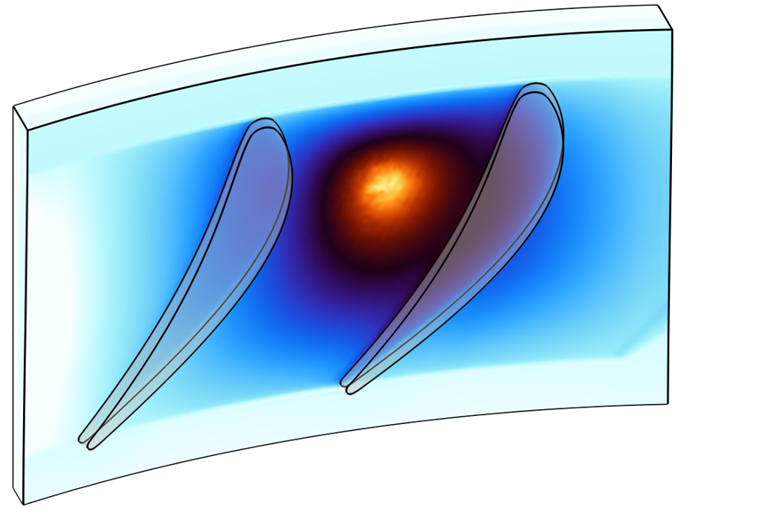

Rubbing-Induced Metal Ignition in Oxygen-Rich Turbomachinery
M. French, Z. Cordero
Gas Turbine Laboratory, MIT

Slide 2
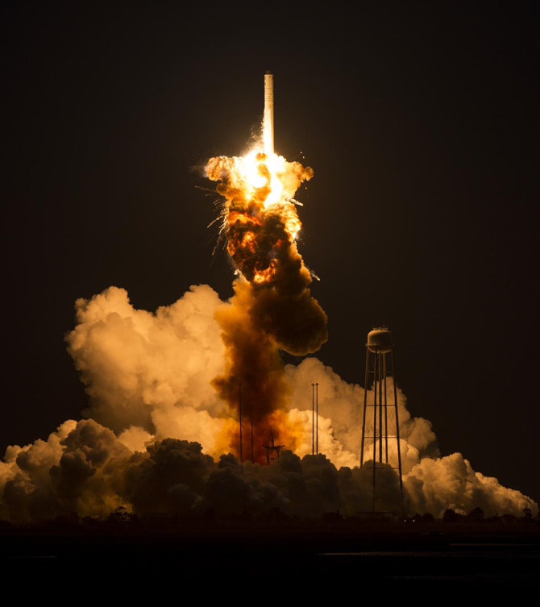
Rubbing in turbomachinery can escalate to loss of entire spacecraft.
2
Antares Orb-3: ISS Resupply Mission
outcome - explosion from metal fire destroyed entire spacecraft and cargo within seconds
metal fire origin - friction from rubbing in turbopump with oxygen-rich environment
ongoing risk - oxygen-rich turbomachinery is necessary to achieve performance goals for next-generation rocketry
Reference [1]
Antares Orb-3 Launch Failure — NASA/Joel Kowsky, 2014

Slide 3
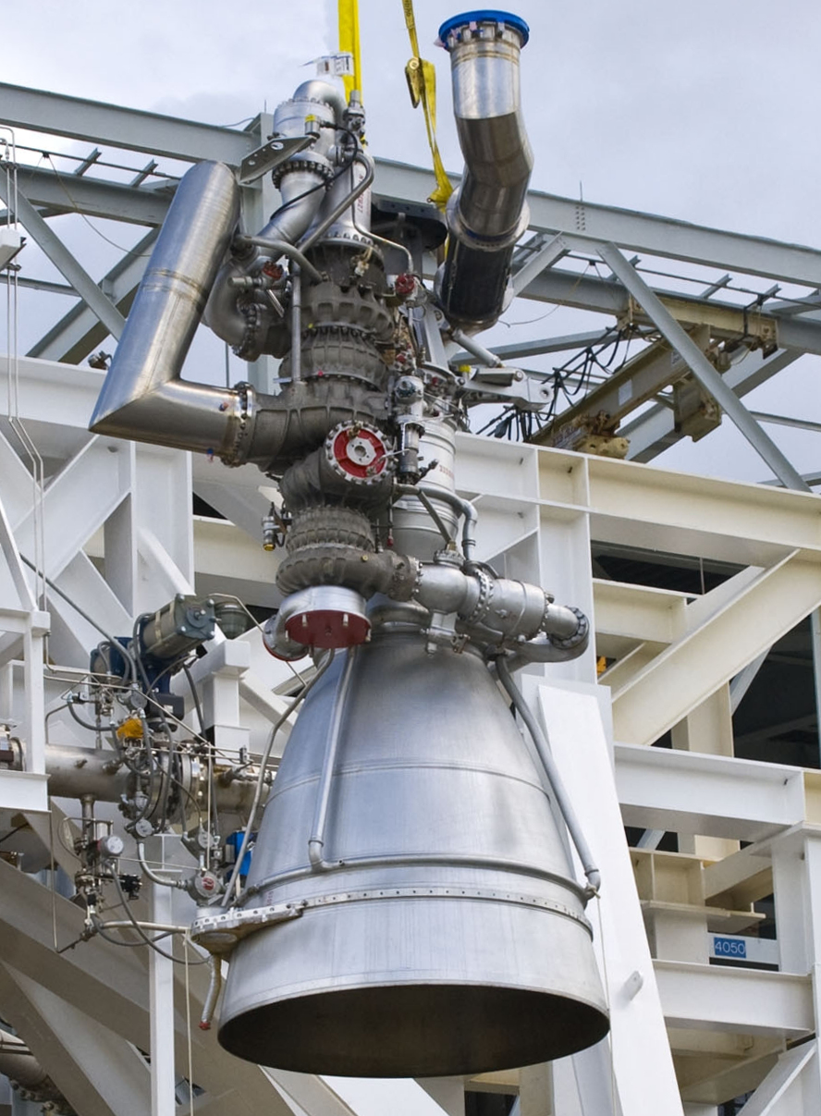
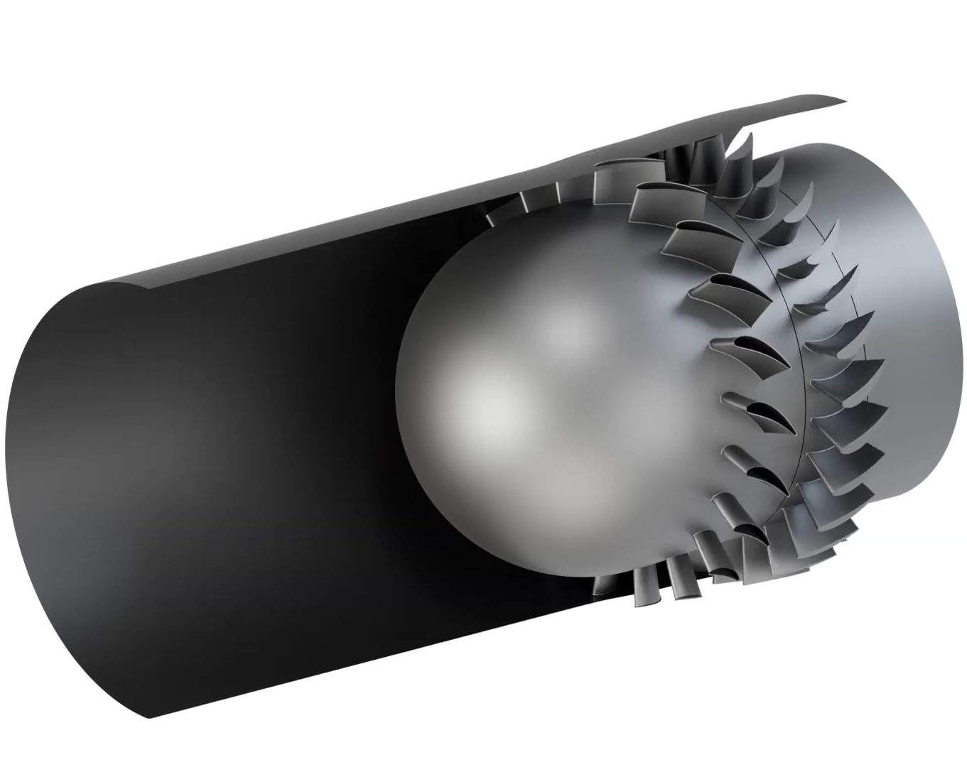
Why are oxygen-rich turbopumps vulnerable to frictional ignition?
3
model turbine
rotor
turbopump
stator
casing
blades
Aerojet AJ26 Rocket Engine - NASA
hot, high pressure O₂
+
turbine
rub
=
ignition
risk

Slide 4
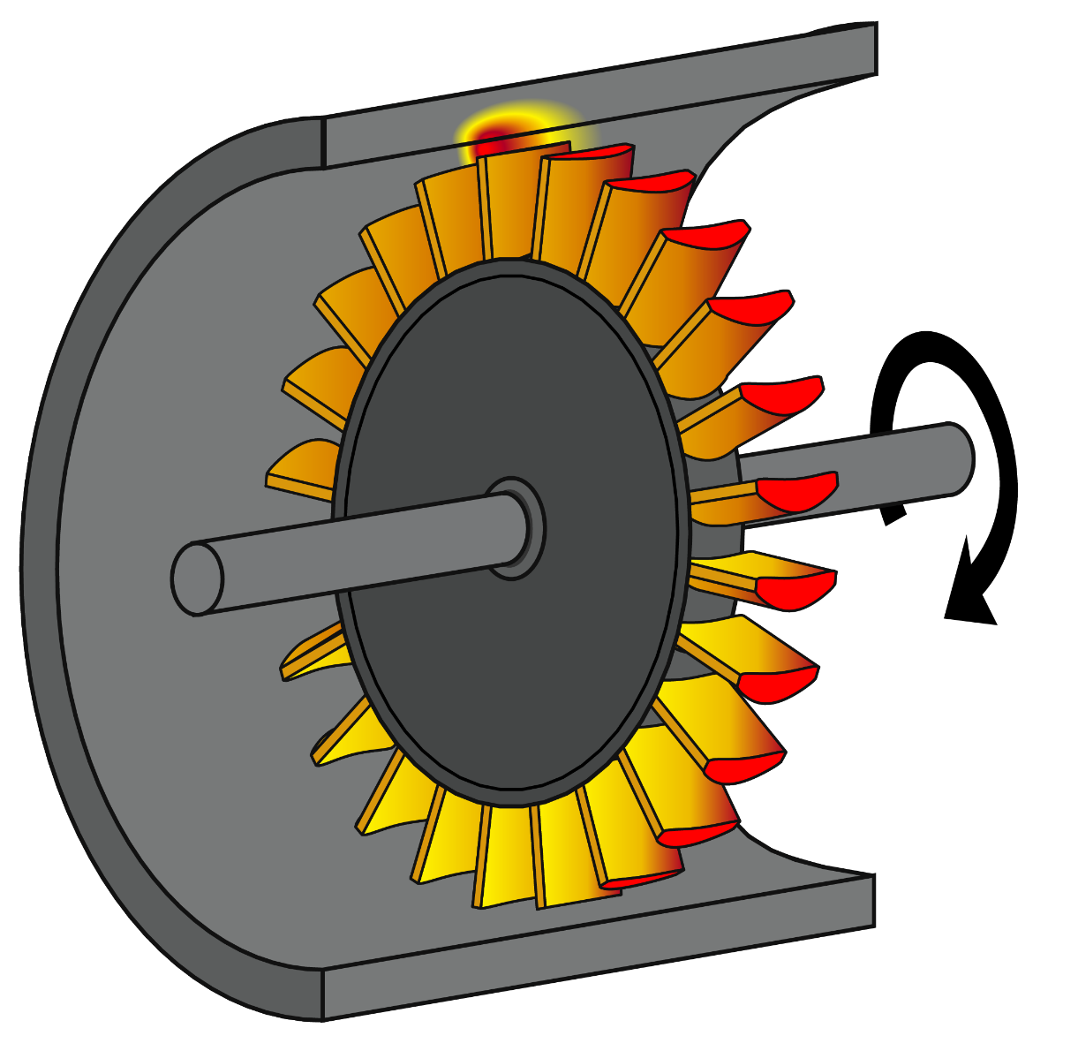
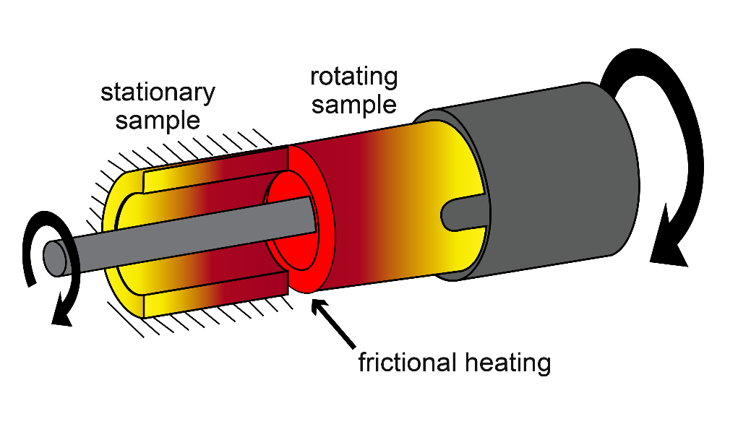
Simulations bridge the gap between testing and reality.
4
frictional heating
casing
COMSOL
blades
References [2, 6]
laboratory testing
turbomachinery
T = 300 K P = 25 MPa V = 22 m/s
T = 750 K P = 60 MPa V = 250 m/s

Slide 5
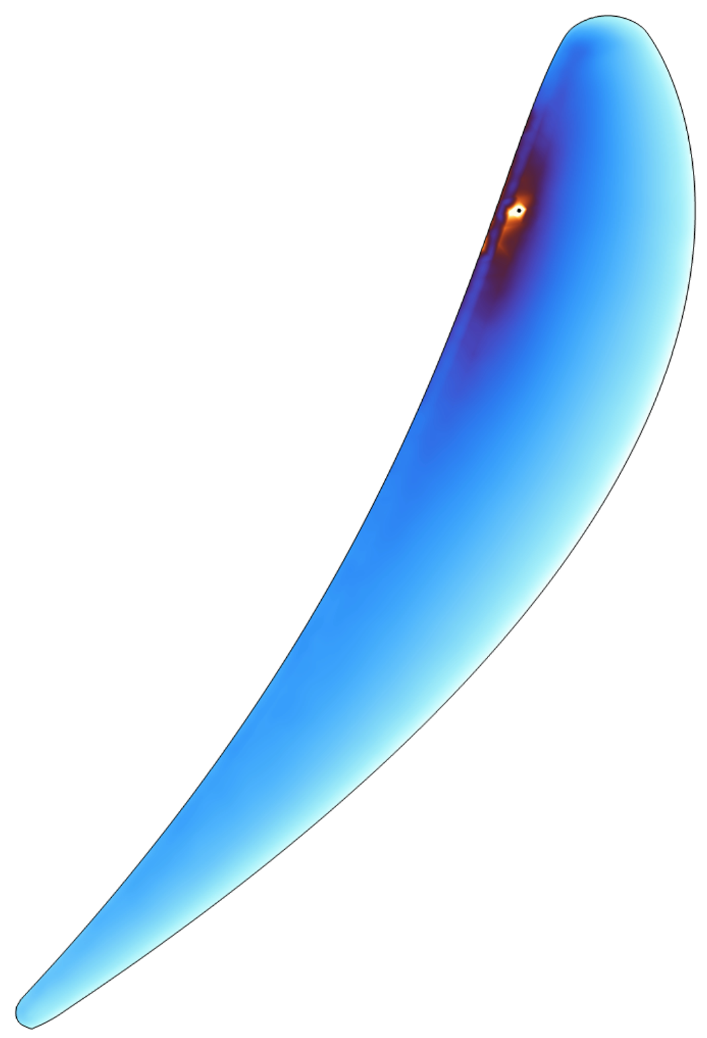
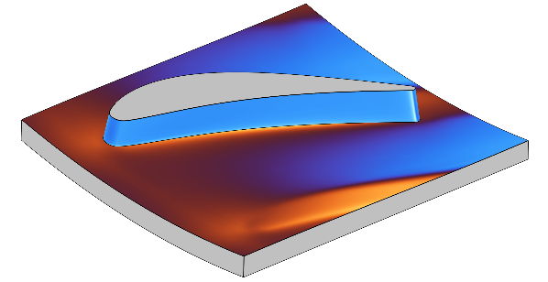
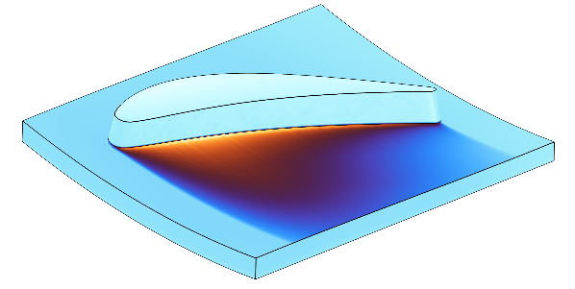
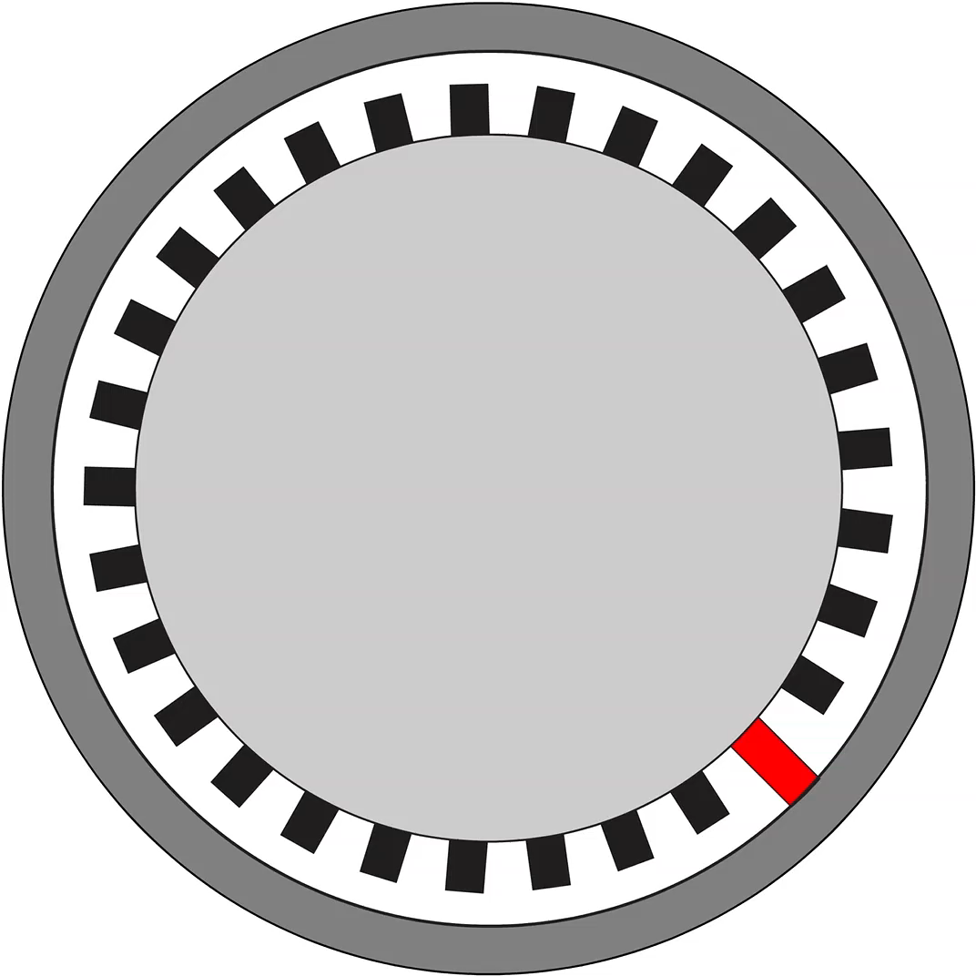
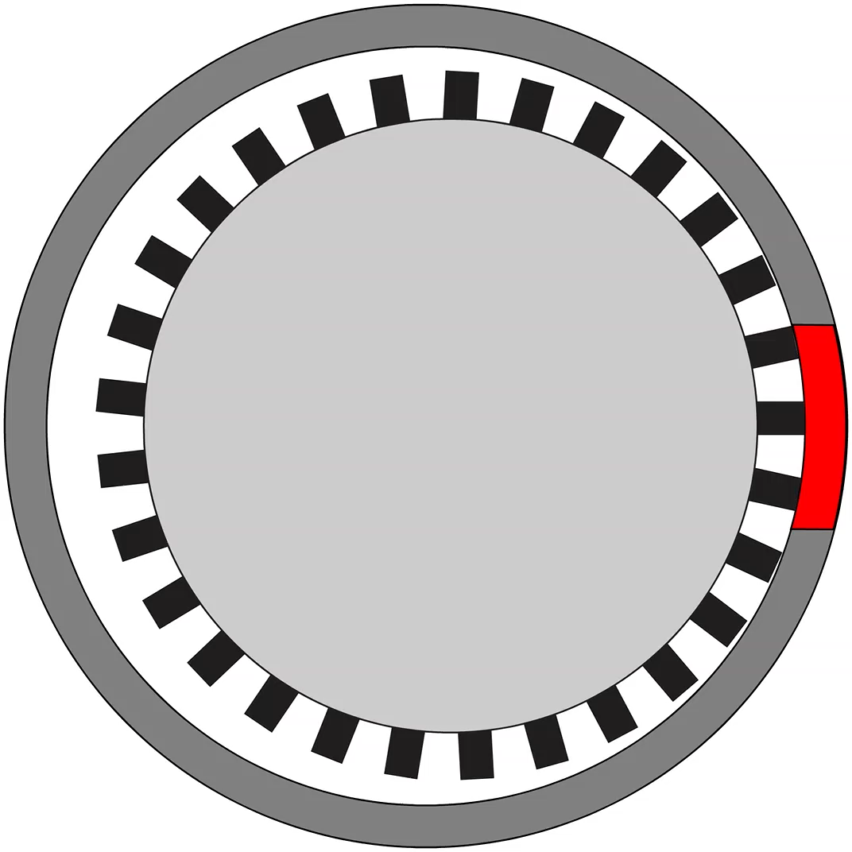
Model simulates ignition and implements mitigation strategies
5
workflow
imported CFD fields
frictional ignition model
ignition prediction
limiting cases
blade ignition
casing ignition
mitigation strategies
material selection, operating conditions, tip geometry

Slide 6

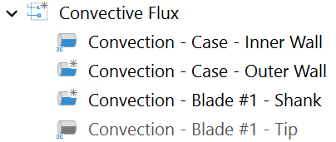


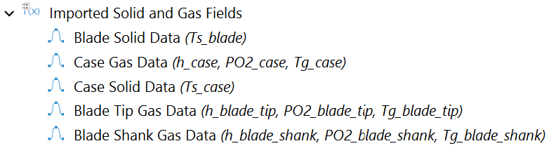


COMSOL model implements transient frictional heating
6
convection
casing
$$v_{tip}$$
blade
friction
oxidation
local CFD fields
initial conditions
References [3]-[7]
Heat Transfer in Solids (ht)

Slide 7
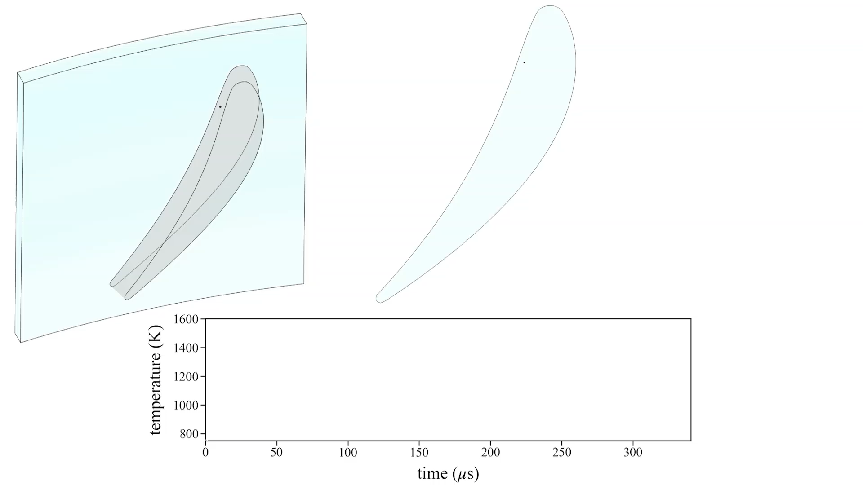

Blade heating from continuous rub
7
1600 K
1400 K
1200 K
1000 K
800 K
temperature (K)
time (μs)
$q_{fric}^{′′}=1.0 GW m^{−2} \left| Q_{ad}=75 kJ mol^{−1} \right| IN718−IN718$

Slide 8
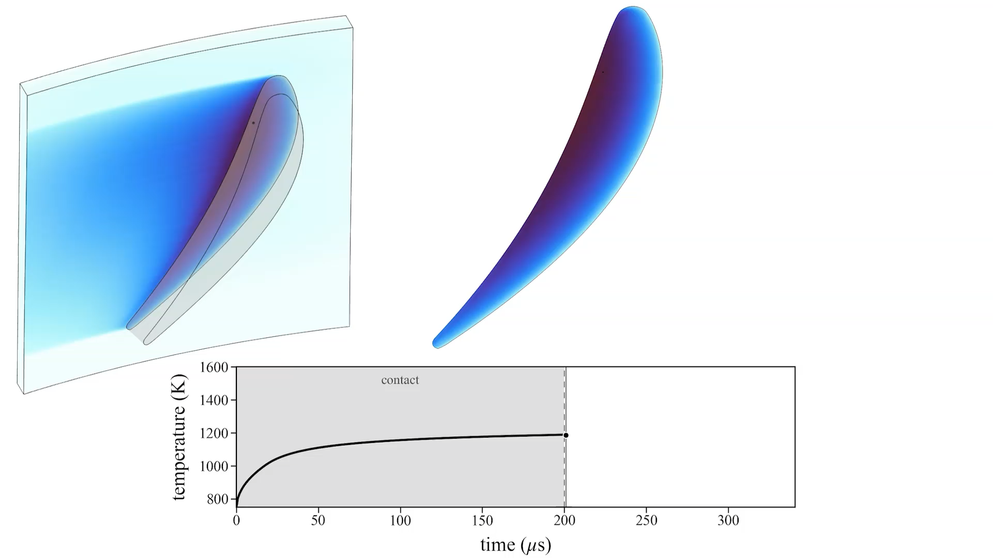
Blade ignition from continuous rub
8
1600 K
1400 K
1200 K
1000 K
800 K
temperature (K)
time (μs)
$q_{fric}^{′′}=1.0 GW m^{−2} \left| Q_{ad}=75 kJ mol^{−1} \right| IN718−IN718$

Slide 9
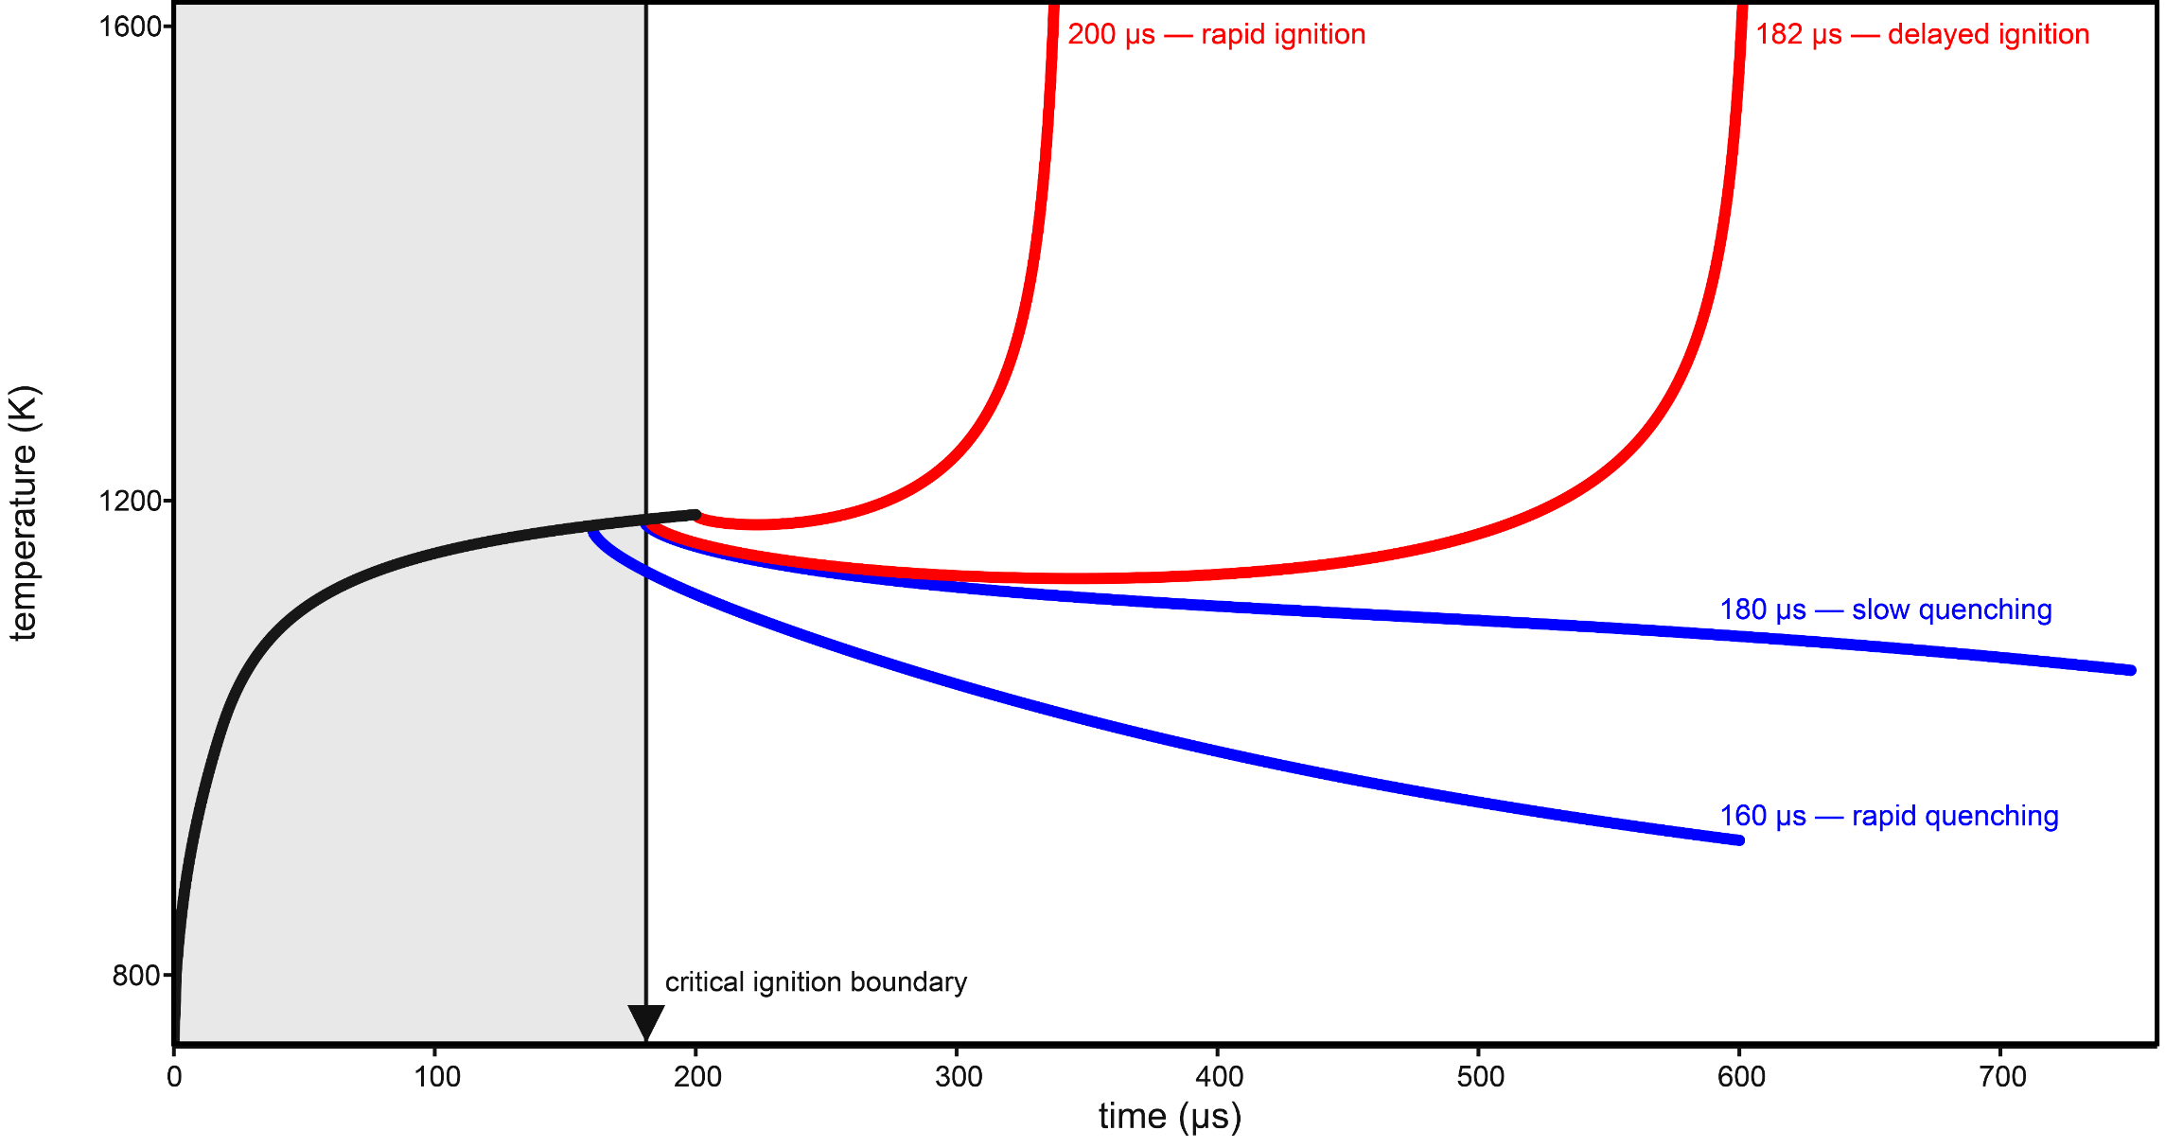
Using ignition threshold as a design tool
9
quenching
ignitable
rapid ignition
marginal ignition
marginal quenching
rapid quenching
ignition threshold
$$q_{fric}^{′′}=1.0 GW m^{−2} \left| Q_{ad}=75 kJ mol^{−1} \right| IN718−IN718$$

Slide 10
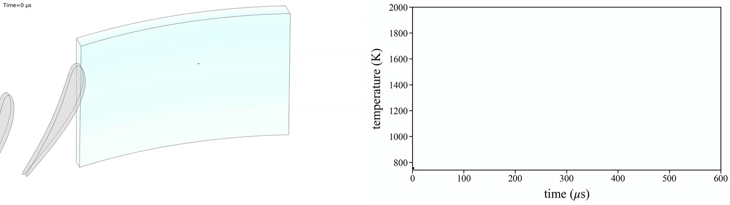
Casing ignition from periodic rubbing
10
temperature (K)
at indicated point
time (μs)
800 K
1000 K
1200 K
1400 K
1600 K
$q_{fric,max}^{′′}=0.7 GW m^{−2} \left| Q_{ad}=75 kJ mol^{−1} \right| IN718−IN718$

Slide 11
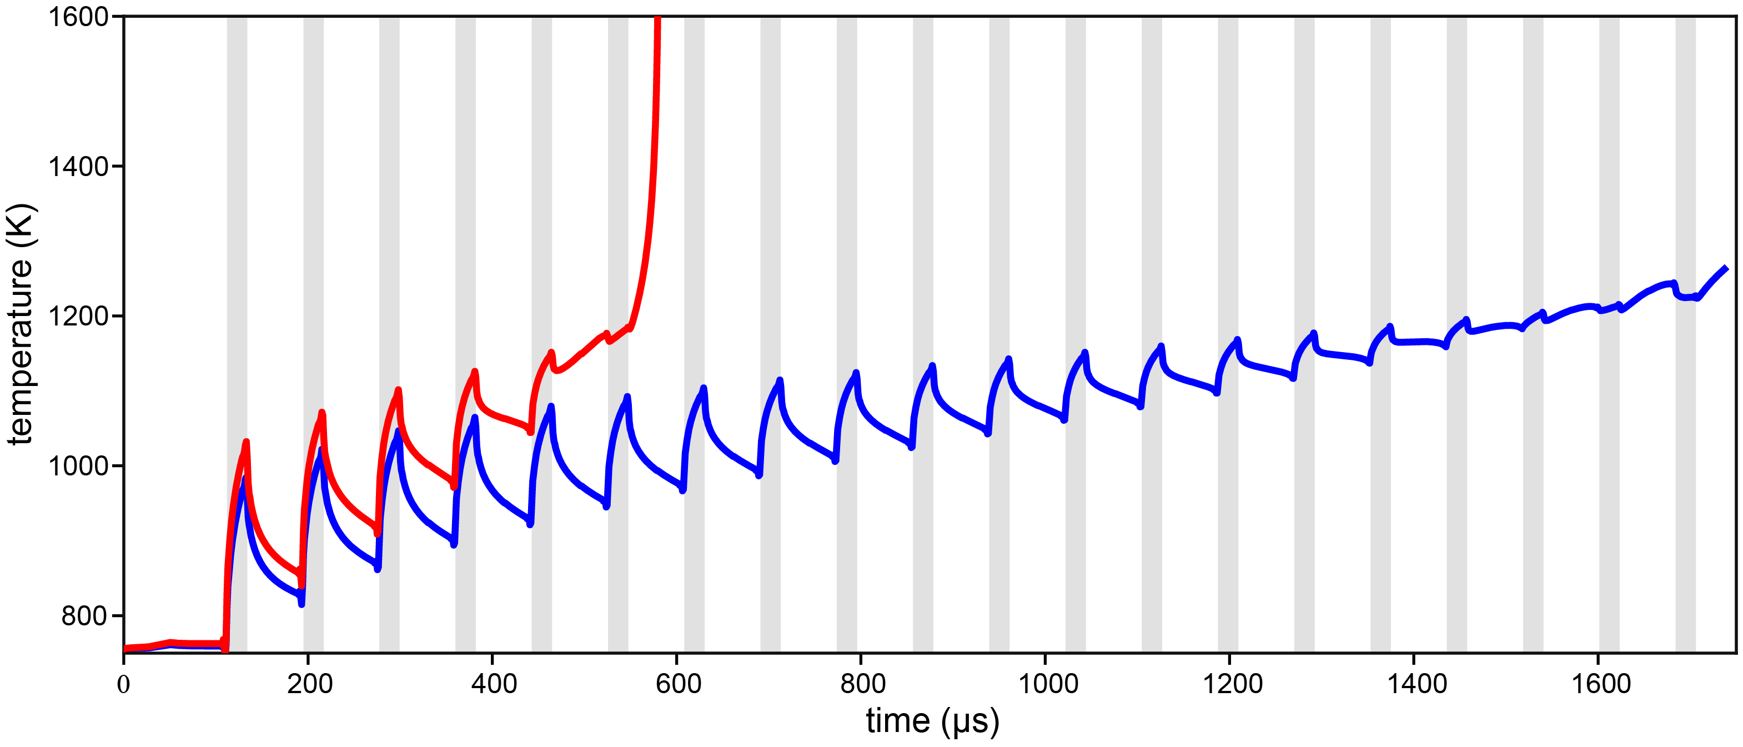
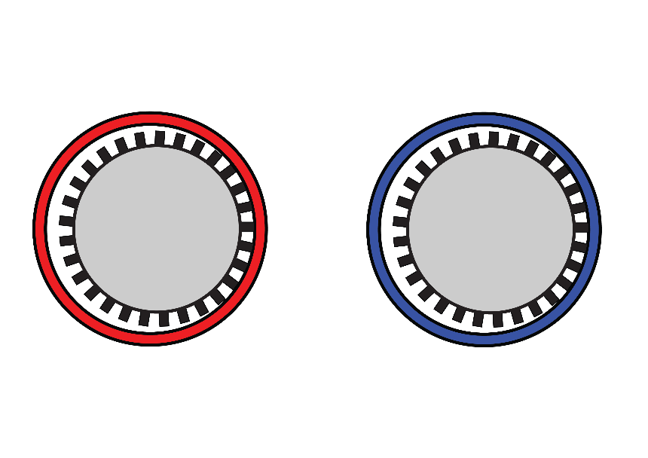
Preventing ignition through materials selection
11
IN718
MK500
References [6], [8]-[10]
$q_{fric,max}^{′′}=0.7 GW m^{−2} | Q_{ad}=75 kJ mol^{−1}$

Slide 12
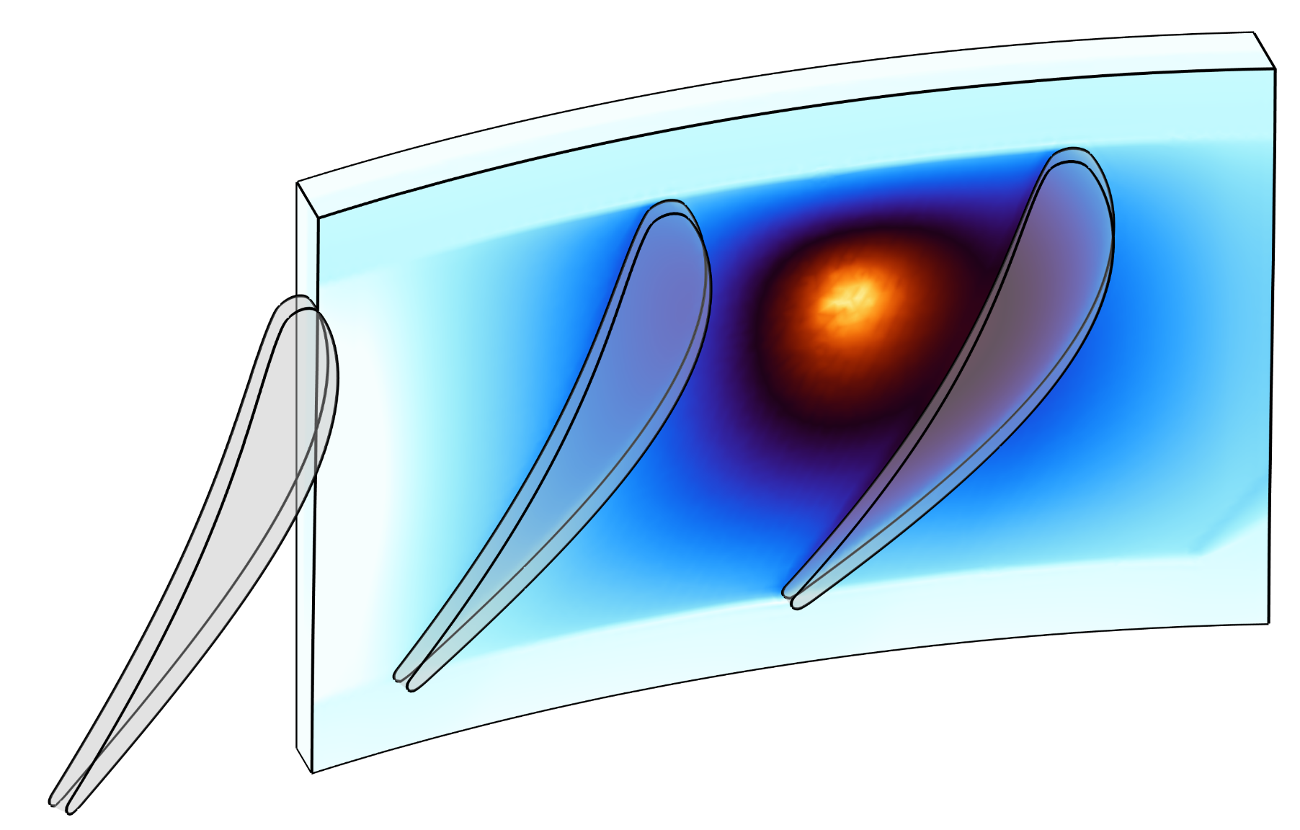
Moving from failure to iterative design
12
represent in-engine conditions
predict when and where ignition occurs
screen mitigations prior to destructive testing
design rub-tolerant, ignition-resistant engines

Slide 13
Acknowledgements
Selected References
13
We thank Roger Hou (MIT) for initial development of the turbine design used in the CFD simulations.
We thank our collaborators Tobias Brandvik (Turbostream Norway) for contributions to turbine design and CFD, and Andres Garcia Jimenez (The Aerospace Corporation) for contributions to frictional-ignition modeling.
High-fidelity CFD simulations used resources provided by Sigma2 — the National Infrastructure for High-Performance Computing and Data Storage in Norway.
[1] NASA Independent Review Team, Orb-3 Accident Investigation Report, 2015.
[2] Wabel, T. M., et al., “Frictional Ignition Testing of Metals in Oxygen up to 24.1 MPa,” AIAA 2023-1491, 2023.
[3] Kennedy, T. C., et al., Wear 261, 932–936, 2006.
[4] Bosman, R. & de Rooij, M. B., J. Tribol. 132, 021401, 2010.
[5] Bos, J. & Moes, H., J. Tribol. 117, 171–177, 1995.
[6] Garcia Jimenez, A., Tribochemistry of Frictional Ignition in High Pressure Oxygen, Ph.D. thesis, MIT, 2025.
[7] Davis, G. A. & Clough, R. C., Blade Tip Rubbing Stress Prediction Final Report, Rocketdyne, 1991.
[8] Pottlacher, G., et al., Scand. J. Metall. 31, 161–168, 2002.
[9] Agazhanov, A. Sh., et al., “Thermophysical Properties of Inconel 718 Alloy,” XXXV Siberian Thermophysical Seminar, 2019.
[10] Special Metals Corp., MONEL® Alloy K-500, Publication SMC-062, 2004.

Slide 14
Moving from failure to iterative design
14
represent in-engine conditions
predict when and where ignition occurs
screen mitigations prior to destructive testing
design rub-tolerant, ignition-resistant engines

Slide 15
BACKUP SLIDES

Slide 16
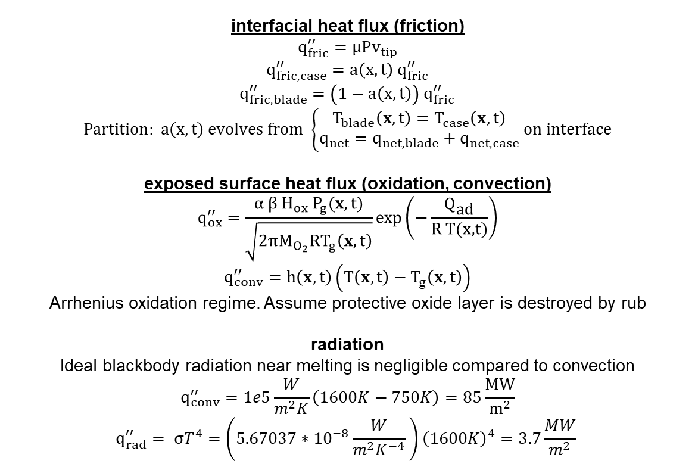
Boundary Heat Flux
interfacial heat flux (friction)
$q_{fric}^{′′}=μPv_{tip}$
$q_{fric,case}^{′′}=a\left(x,t\right) q_{fric}^{′′}$
$q_{fric,blade}^{′′}=\left(1−a\left(x,t\right)\right) q_{fric}^{′′}$
$$Partition: a\left(x,t\right) evolves from \left\{\begin{aligned}T_{blade}\left(x,t\right)=T_{case}\left(x,t\right) \\ q_{net}=q_{net,blade}+q_{net,case}\end{aligned} on interface\right.$$
exposed surface heat flux (oxidation, convection)
$$q_{ox}^{′′}=\frac{α β H_{ox} P_{g}(x,t)}{\sqrt{2πM_{O_{2}}RT_{g}\left(x,t\right)}}\exp\left(\text{−}\frac{{\text{Q}}_{\text{ad}}}{\text{R T(}\text{x}\text{,t)}}\right)$$
$$q_{conv}^{′′}=h\left(x,t\right)\left(T\left(x,t\right)−T_{g}\left(x,t\right)\right)$$
Arrhenius oxidation regime. Assume protective oxide layer is destroyed by rub
radiation
Ideal blackbody radiation near melting is negligible compared to convection
$$q_{conv}^{′′}=1e5\frac{W}{m^{2}K}\left(1600K−750K\right)=85\frac{MW}{m^{2}}$$
$$q_{rad}^{′′}= σT^{4}=\left(5.67037∗{10}^{−8}\frac{W}{m^{2}K^{−4}} \right){\left(1600K\right)}^{4}=3.7\frac{MW}{m^{2}}$$

Slide 17
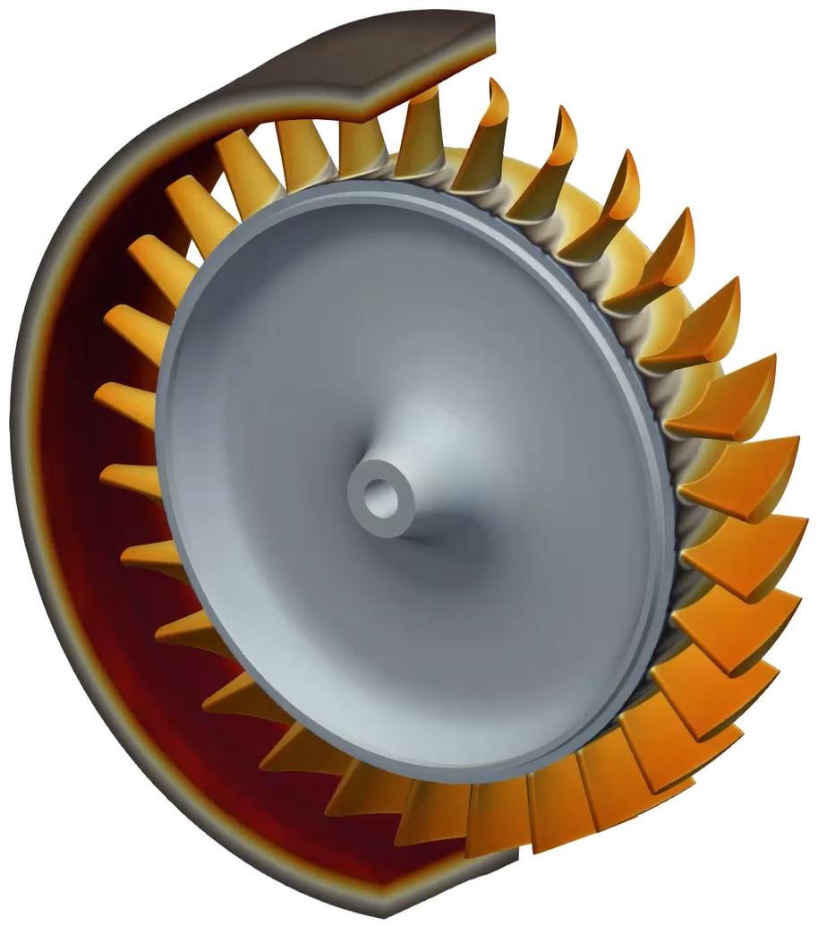
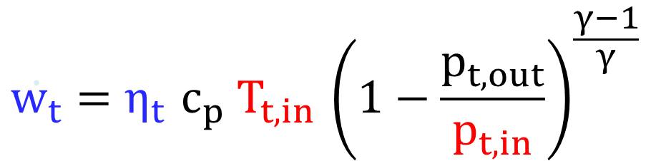
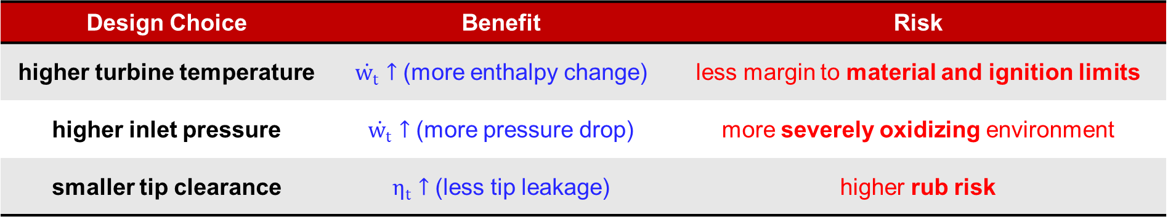
Higher performance turbomachinery reduces ignition margin
$$\dot{w_{t}}=η_{t}{ c}_{p}{ T}_{t,in} {\left(1−\frac{p_{t,out}}{p_{t,in}}\right)}^{\frac{γ−1}{γ}}$$
Design Choice | Benefit | Risk
higher turbine temperature | $\dot{w_{t}}↑$ (more enthalpy change) | less margin to material and ignition limits
higher inlet pressure | $\dot{w_{t}}↑$ (more pressure drop) | more severely oxidizing environment
smaller tip clearance | $η_{t}↑$ (less tip leakage) | higher rub risk

Slide 18
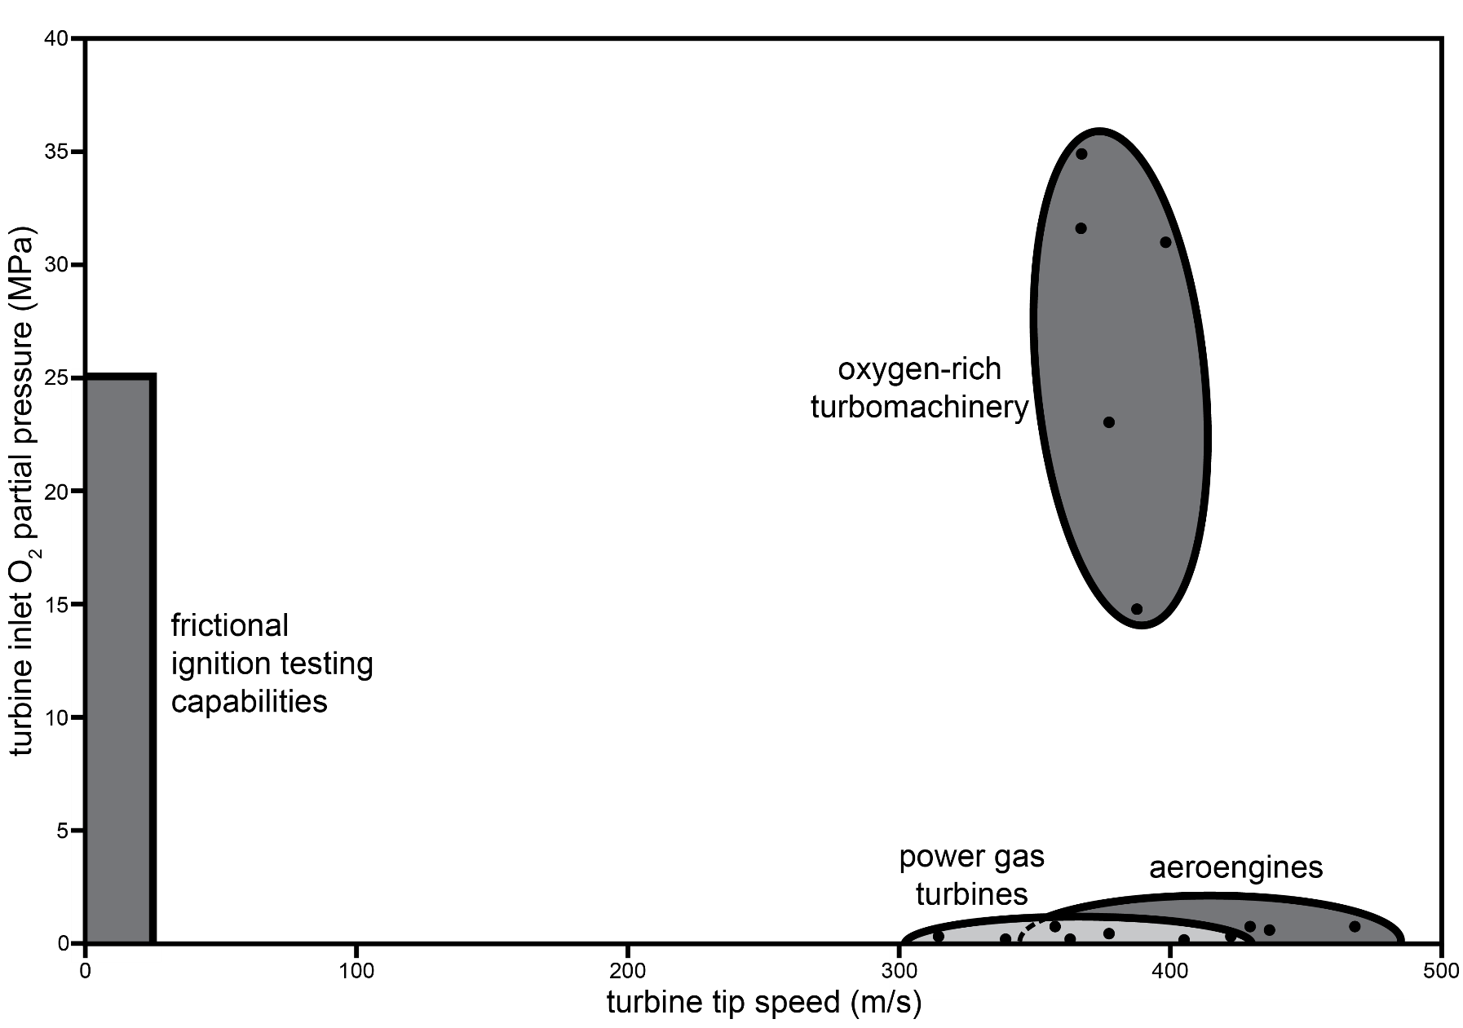
Simulation bridges the gap between testing and in-engine conditions

Slide 19

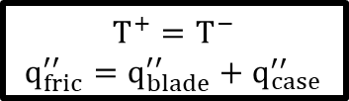



Coupled model implements transient frictional heating
convection
Heat Transfer in Solids (ht)
interfacial constraints
$T^{+}=T^{−}$
$q_{fric}^{′′}=q_{blade}^{′′}+q_{case}^{′′}$
$$v_{tip}$$
blade
$$q_{conv}^{′′}=h (T−T_{g})$$
friction
cv
casing
$q_{fric}^{′′}=μP_{tip}v_{tip}$
oxidation
local CFD fields
$$q_{ox}^{′′}∝H_{ox}P_{g}T_{g}^{−\frac{1}{2}}\exp\left(\text{−}\frac{{\text{Q}}_{\text{ad}}}{\text{R}T_{surf}}\right)$$
initial conditions
References [3]-[6]

Slide 20
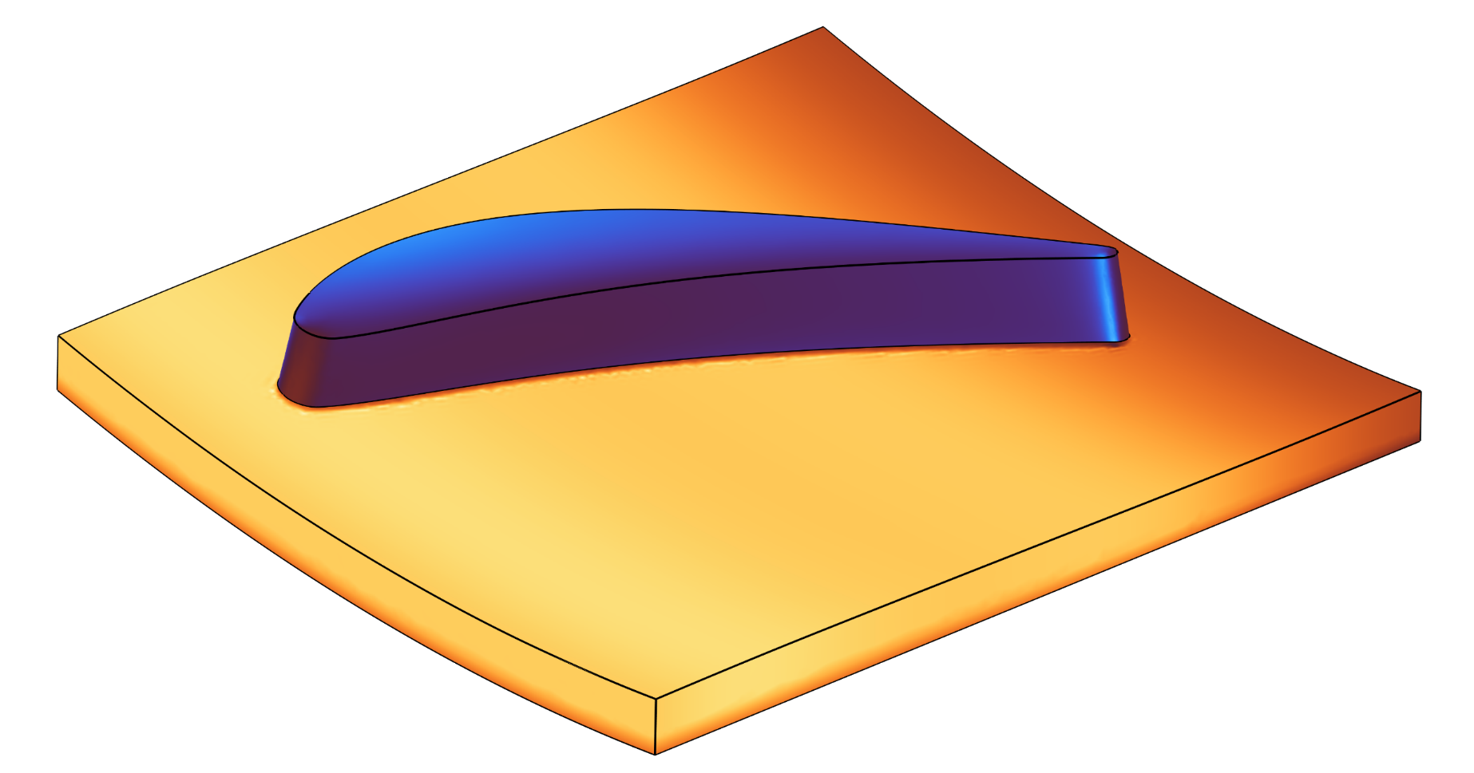

Initial conditions set from CFD
Heat Transfer in Solids (ht)
imported CFD fields
K
$$v_{tip}$$
initial conditions
References [3]-[6]

Slide 21
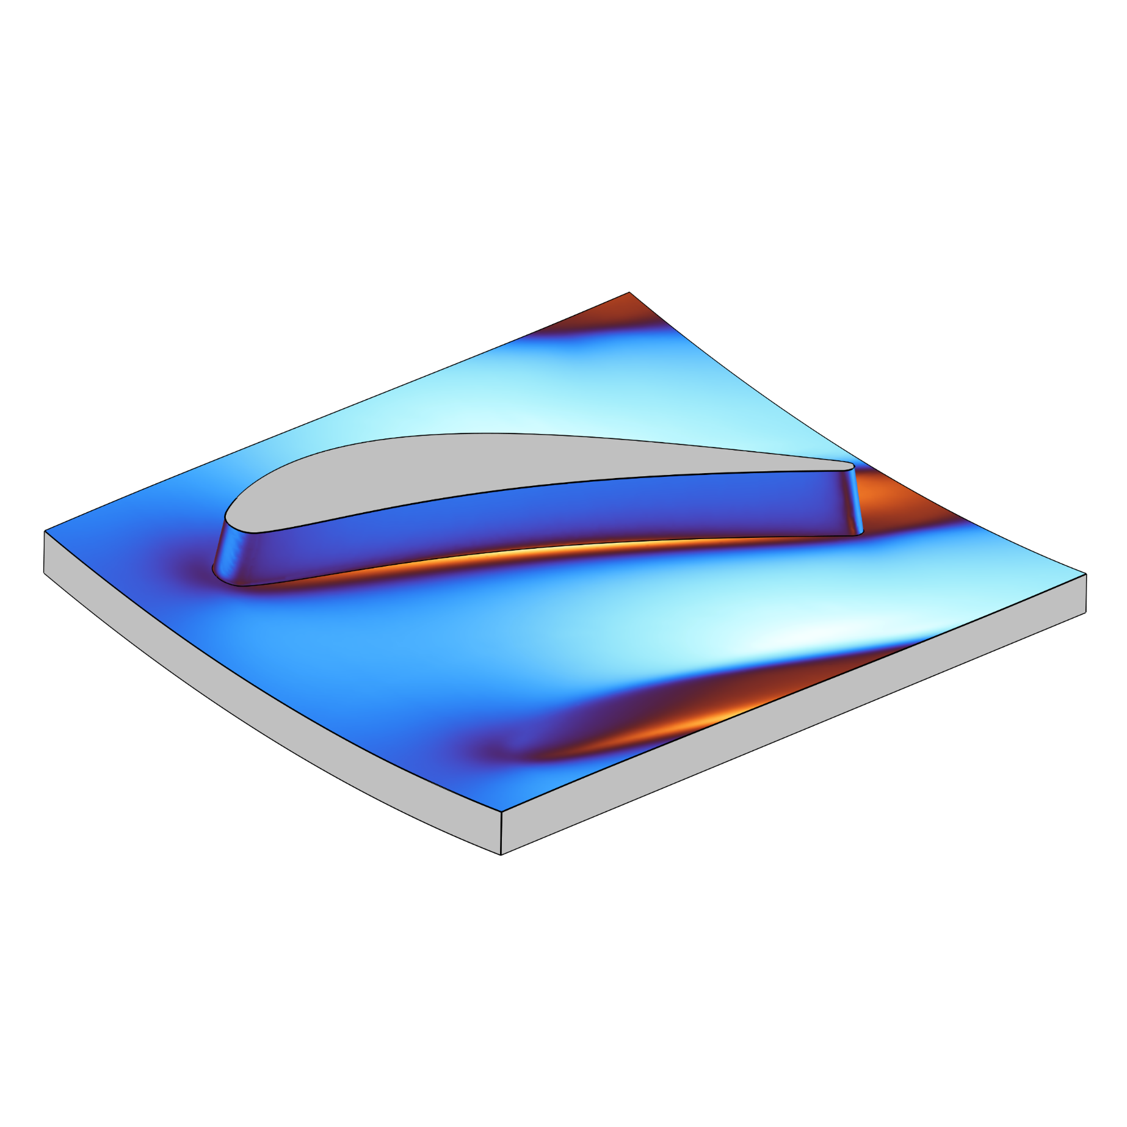




CFD results drive local boundary conditions
Heat Transfer in Solids (ht)
$$\frac{W}{m^{2}K}$$
imported CFD fields
$$v_{tip}$$
boundary conditions
$$q_{ox}^{′′}∝H_{ox}P_{g}T_{g}^{−\frac{1}{2}}\exp\left(\text{−}\frac{{\text{Q}}_{\text{ad}}}{\text{R}T_{surf}}\right)$$
$$q_{conv}^{′′}=h (T−T_{g})$$
$q_{fric}^{′′}=μP_{tip}v_{tip}$
References [3]-[6]

Slide 22
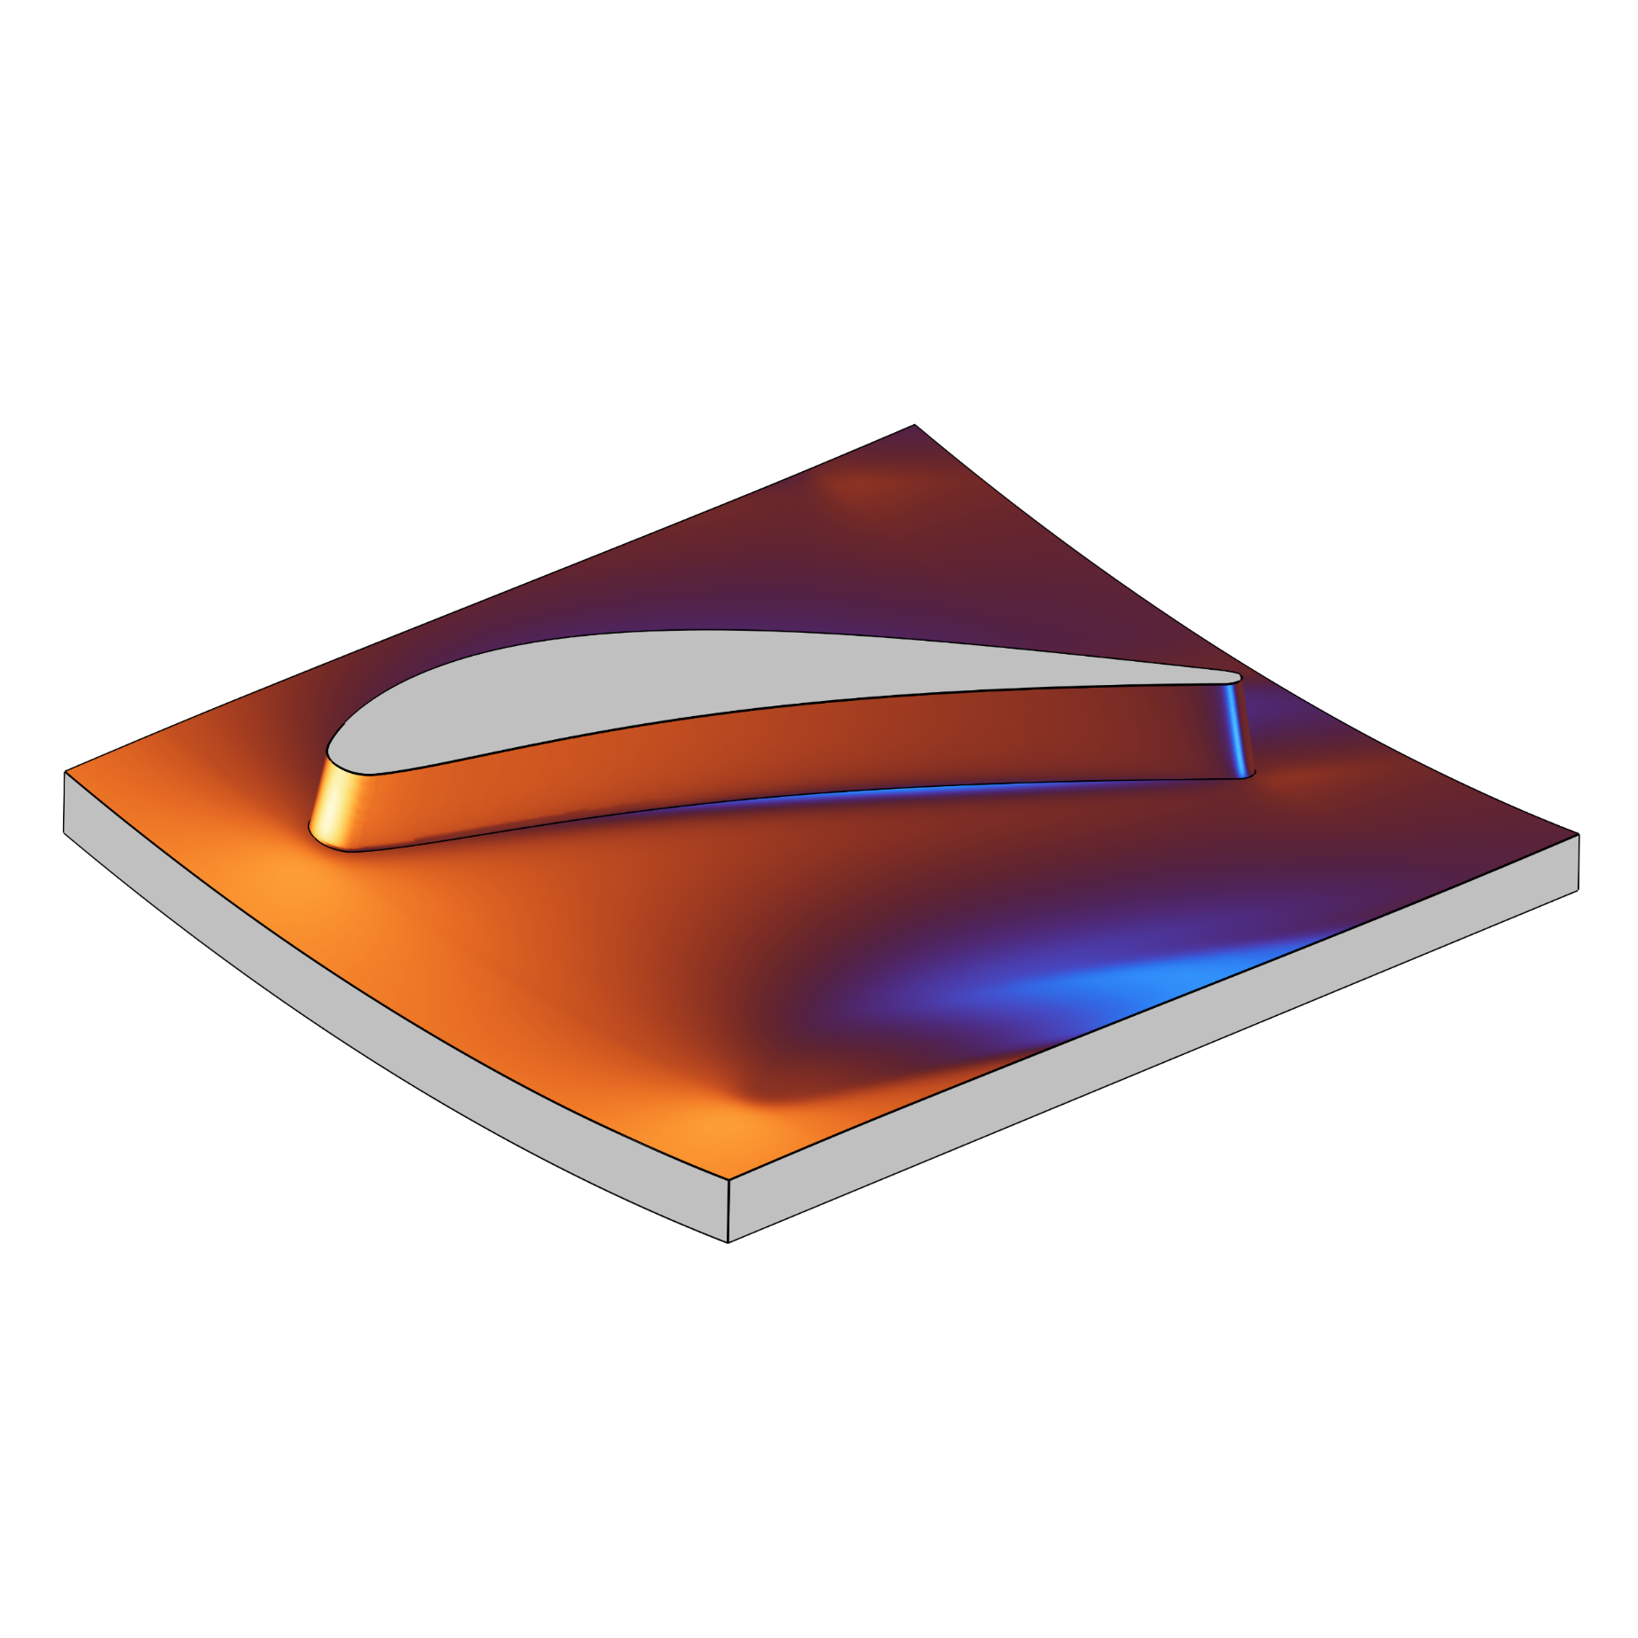


CFD results drive local boundary conditions
Heat Transfer in Solids (ht)
imported CFD fields
Pa
$$v_{tip}$$
boundary conditions
$$q_{ox}^{′′}∝H_{ox}P_{g}T_{g}^{−\frac{1}{2}}\exp\left(\text{−}\frac{{\text{Q}}_{\text{ad}}}{\text{R}T_{surf}}\right)$$
$$q_{conv}^{′′}=h (T−T_{g})$$
$q_{fric}^{′′}=μP_{tip}v_{tip}$
References [3]-[6]

Slide 23

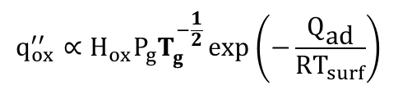



CFD results drive local boundary conditions
imported CFD fields
K
Heat Transfer in Solids (ht)
$$v_{tip}$$
boundary conditions
$$q_{ox}^{′′}∝H_{ox}P_{g}T_{g}^{−\frac{1}{2}}\exp\left(\text{−}\frac{{\text{Q}}_{\text{ad}}}{\text{R}T_{surf}}\right)$$
$$q_{conv}^{′′}=h (T−T_{g})$$
$q_{fric}^{′′}=μP_{tip}v_{tip}$
References [3]-[6]

Slide 24
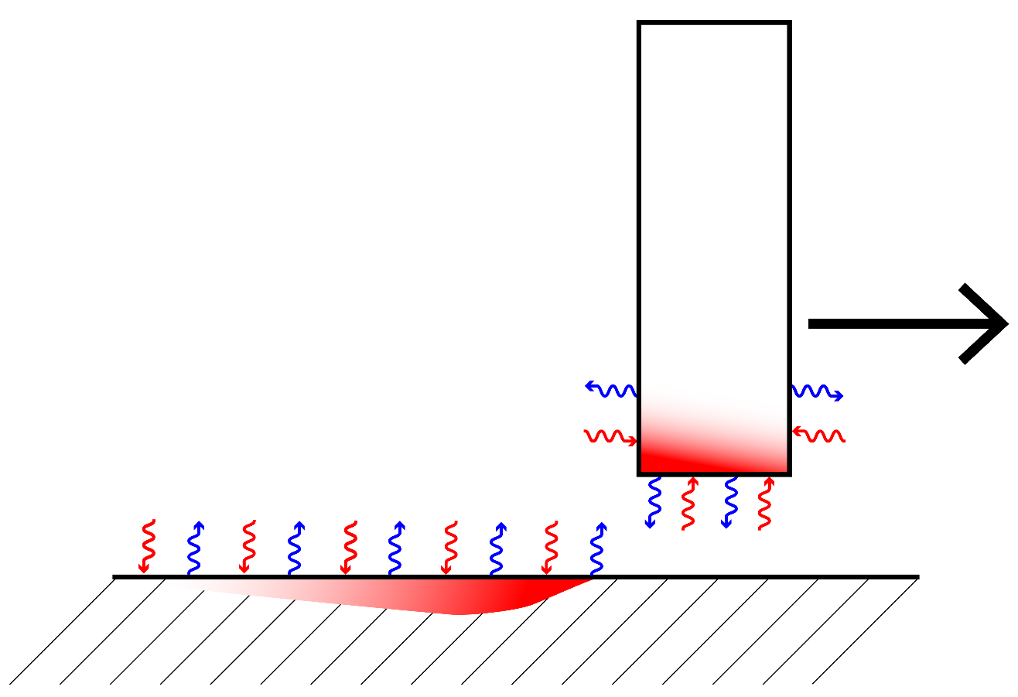
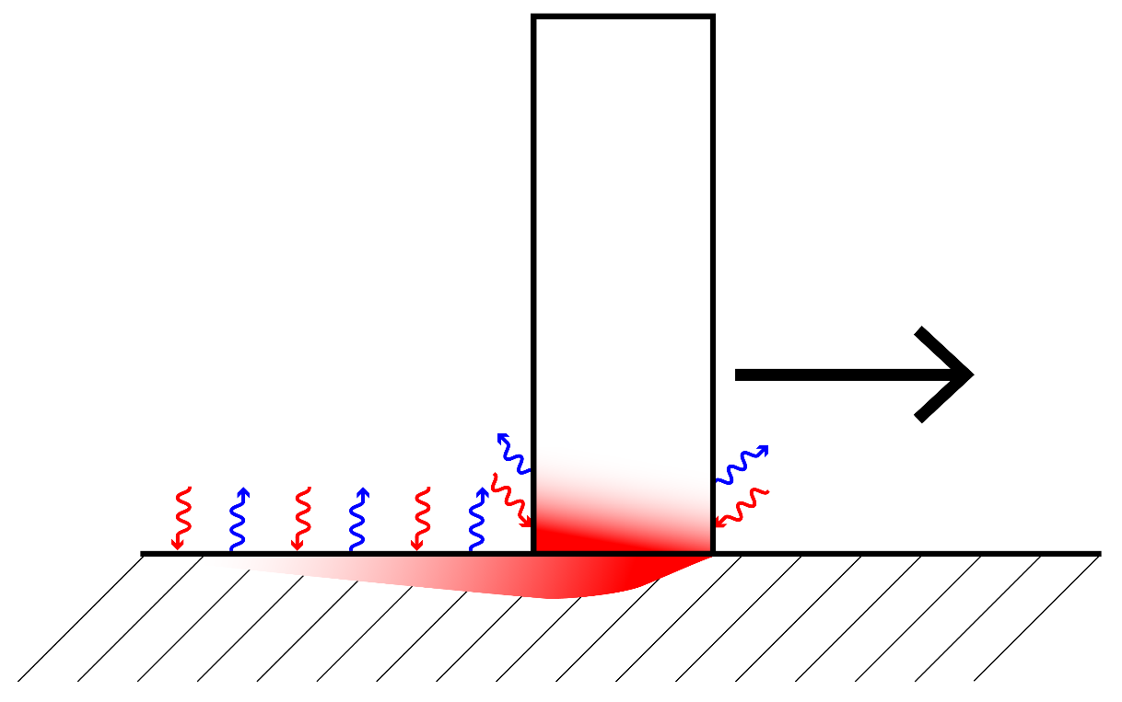

Two-step approach to predict ignition
1. heatup
2. ignition test
rubbing establishes thermal history.
blade lifts. oxidation and convection at exposed surfaces.
blade
blade
$$v_{tip}$$
convection
and
oxidation
convection
and
oxidation
$$v_{tip}$$
casing
casing
friction
References [3]-[6]

Slide 25
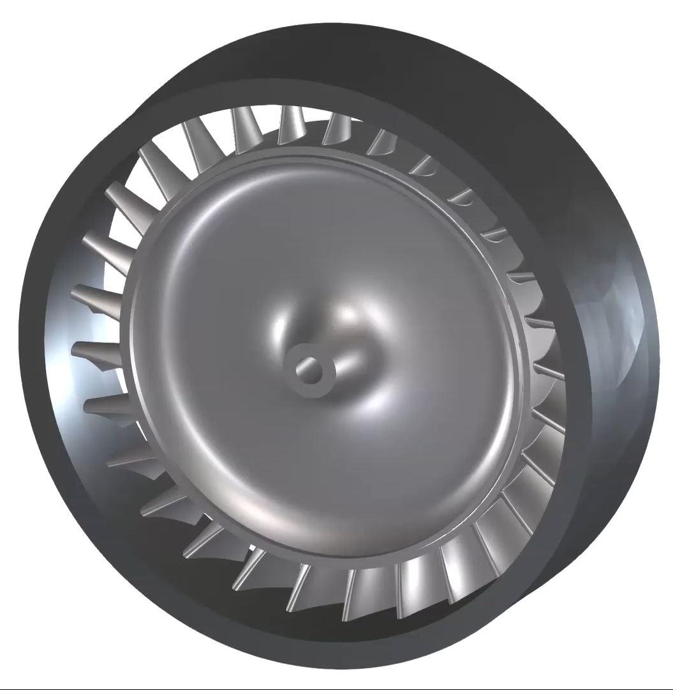
Why are oxygen-rich turbopumps vulnerable to frictional ignition?
25
model turbine
casing
turbopump
blades
rotor
Aerojet AJ26 Rocket Engine - NASA
hot, high pressure O₂
+
turbine
rub
=
ignition
risk

