Slide 1
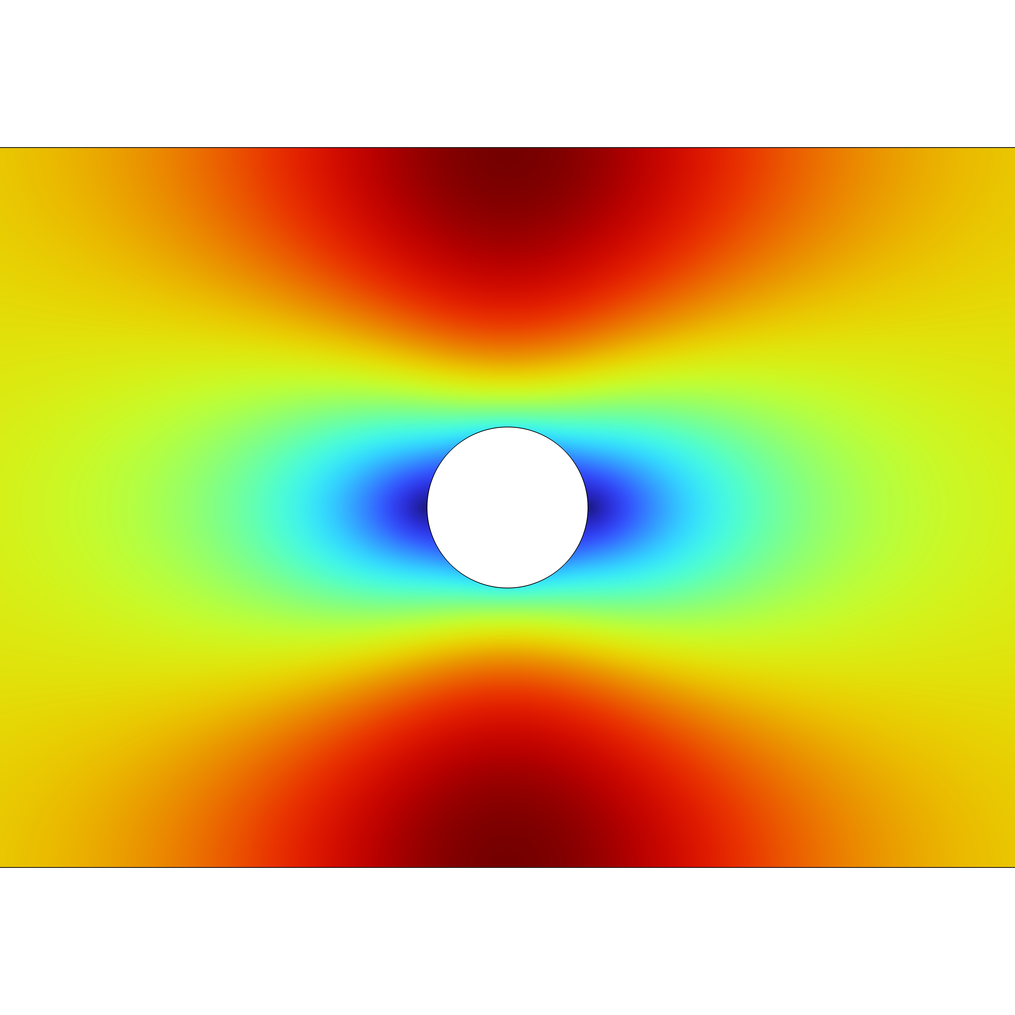
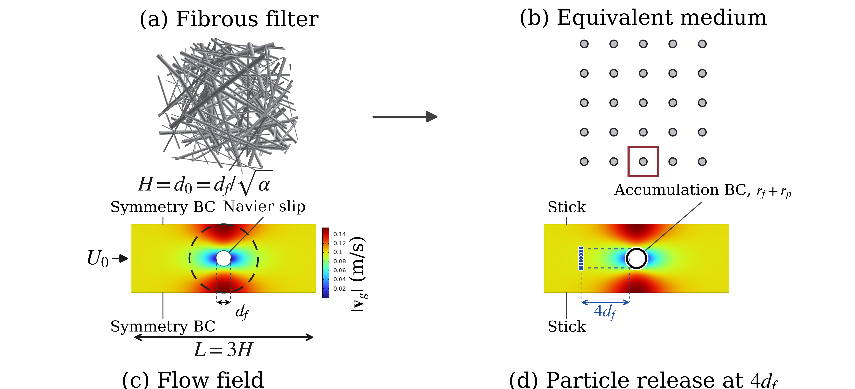
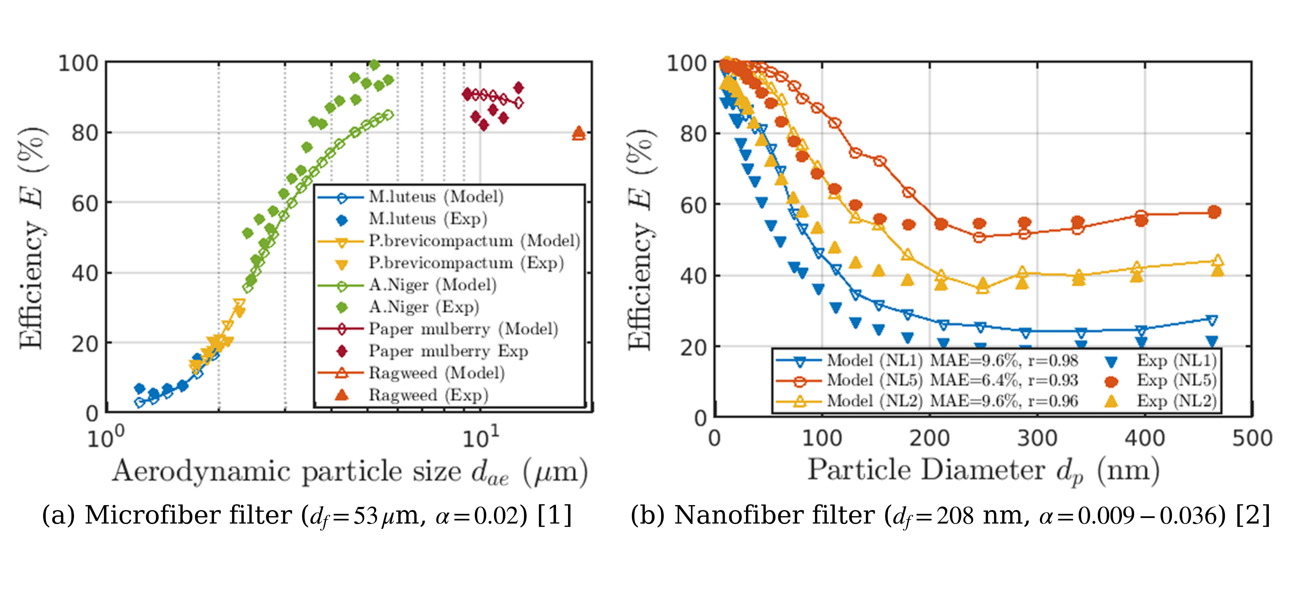

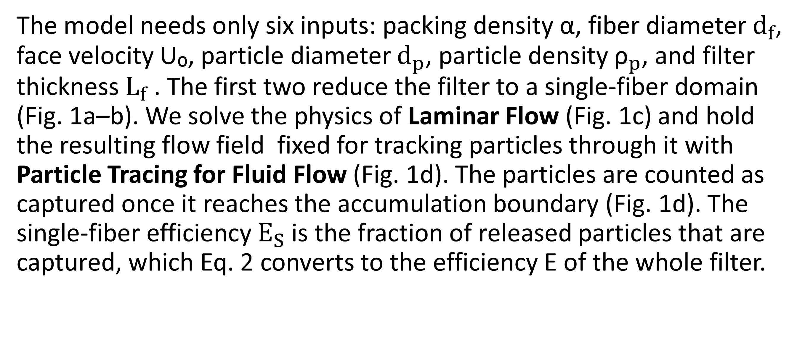
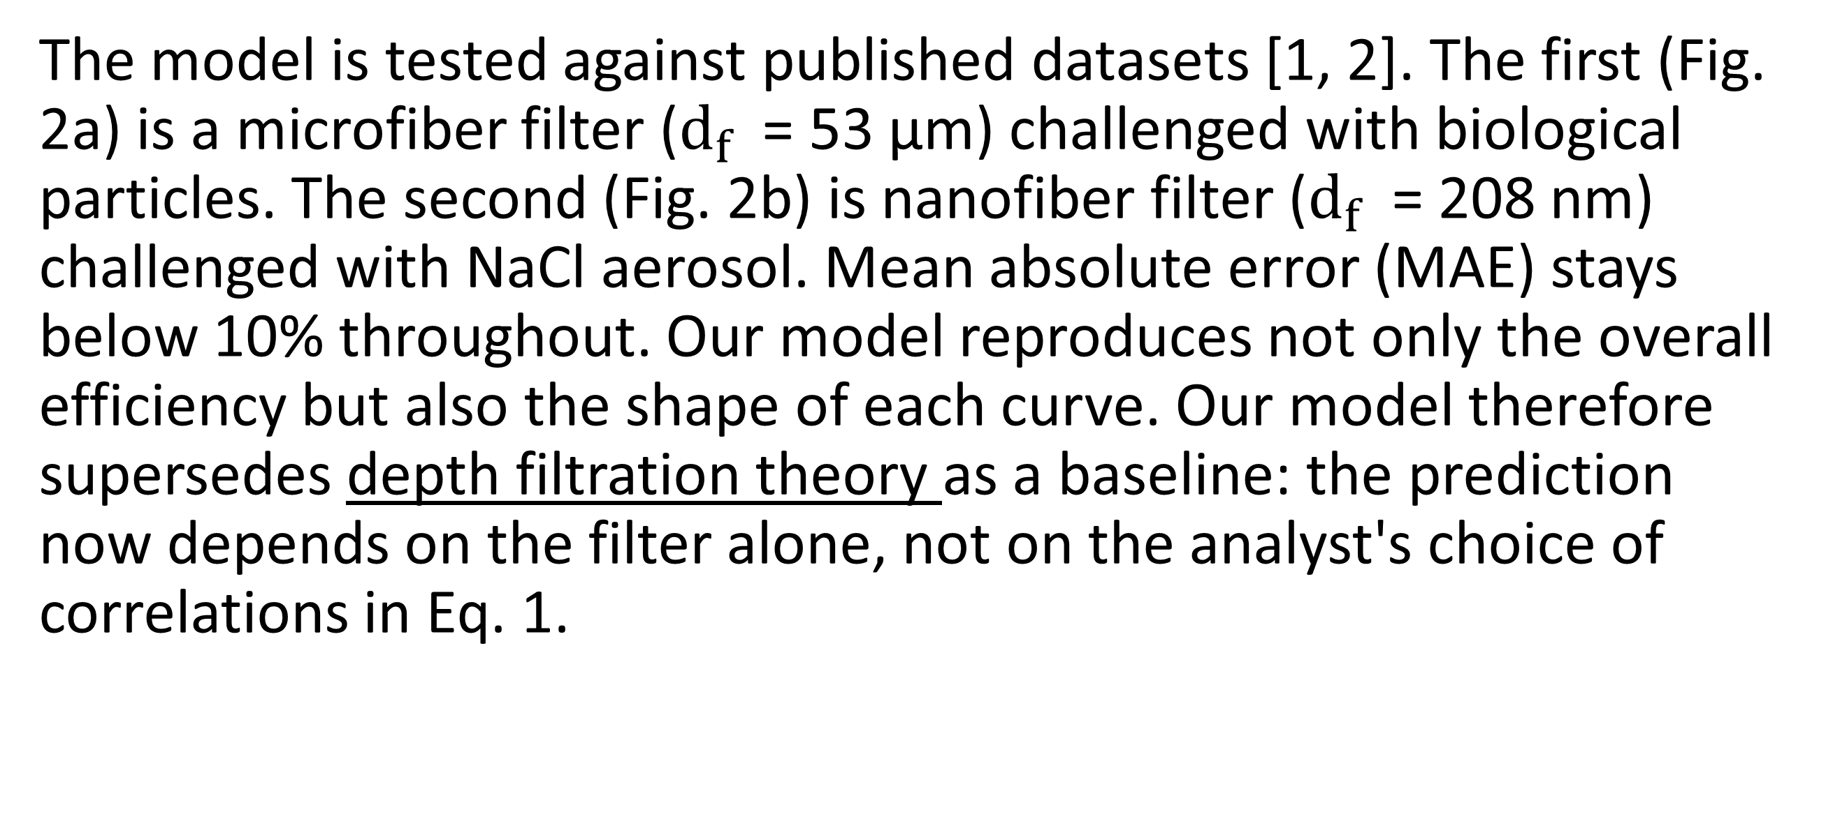
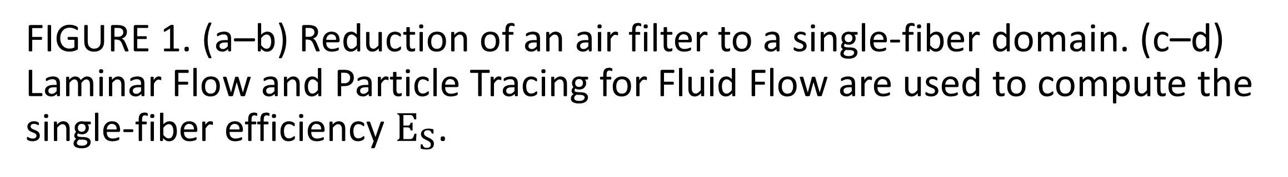
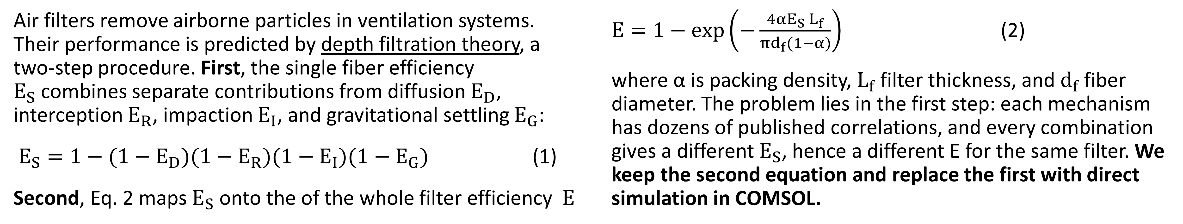
Predictive Model of Air Filter Efficiency Using Single-Fiber Model
Air filter efficiency is normally predicted from competing empirical correlations that give different answers for the same filter. We replace them with a COMSOL model that resolves the flow around a single fiber and tracks particles through it.
R. Ullah¹, A. M. Ardekani¹
1. School of Mechanical Engineering, Purdue University, West Lafayette, IN, USA
Introduction
Air filters remove airborne particles in ventilation systems. Their performance is predicted by depth filtration theory, a two-step procedure. First, the single fiber efficiency $E_{S}$combines separate contributions from diffusion$E_{D}$, interception $E_{R}$, impaction $E_{I}$, and gravitational settling $E_{G}$:
$E_{S}=1−(1−E_{D})(1−E_{R})(1−E_{I})(1−E_{G})$ (1)
Second, Eq. 2 maps $E_{S}$onto the of the whole filter efficiency $E$
$E=1−exp\left(−\frac{4αE_{S }L_{f}}{πd_{f}(1−α)}\right)$ (2)
where α is packing density, $L_{f}$filter thickness, and $d_{f}$​ fiber diameter. The problem lies in the first step: each mechanism has dozens of published correlations, and every combination gives a different $E_{S}$​, hence a different E for the same filter. We keep the second equation and replace the first with direct simulation in COMSOL.
Methodology
The model needs only six inputs: packing density α, fiber diameter $d_{f}$​, face velocity U₀, particle diameter ${\text{d}}_{p}$, particle density ${\text{ρ}}_{p}$, and filter thickness $L_{f}$. The first two reduce the filter to a single-fiber domain (Fig. 1a–b). We solve the physics of Laminar Flow (Fig. 1c) and hold the resulting flow field fixed for tracking particles through it with Particle Tracing for Fluid Flow (Fig. 1d). The particles are counted as captured once it reaches the accumulation boundary (Fig. 1d). The single-fiber efficiency $E_{S}$is the fraction of released particles that are captured, which Eq. 2 converts to the efficiency E of the whole filter.
FIGURE 1. (a–b) Reduction of an air filter to a single-fiber domain. (c–d) Laminar Flow and Particle Tracing for Fluid Flow are used to compute the single-fiber efficiency $E_{S}$.
Results
The model is tested against published datasets [1, 2]. The first (Fig. 2a) is a microfiber filter ($d_{f}$ = 53 μm) challenged with biological particles. The second (Fig. 2b) is nanofiber filter ($d_{f}$ = 208 nm) challenged with NaCl aerosol. Mean absolute error (MAE) stays below 10% throughout. Our model reproduces not only the overall efficiency but also the shape of each curve. Our model therefore supersedes depth filtration theory as a baseline: the prediction now depends on the filter alone, not on the analyst's choice of correlations in Eq. 1.
FIGURE 2. Model predictions (open symbols, lines) against published experiments (filled symbols) for (a) a microfiber filter [1] and (b) nanofiber media at three coating levels [2].
R. Maus and H. Umhauer, "Collection efficiencies of coarse and fine dust filter media for airborne biological particles", Journal of Aerosol Science, vol. 28, pp. 401–415, 1997.
W. W. Leung, C. Hung and P. Yuen, "Effect of face velocity, nanofiber packing density and thickness on filtration performance of filters with nanofibers coated on a substrate", Separation and Purification Technology, vol. 71, pp. 30–37, 2010

