Slide 1
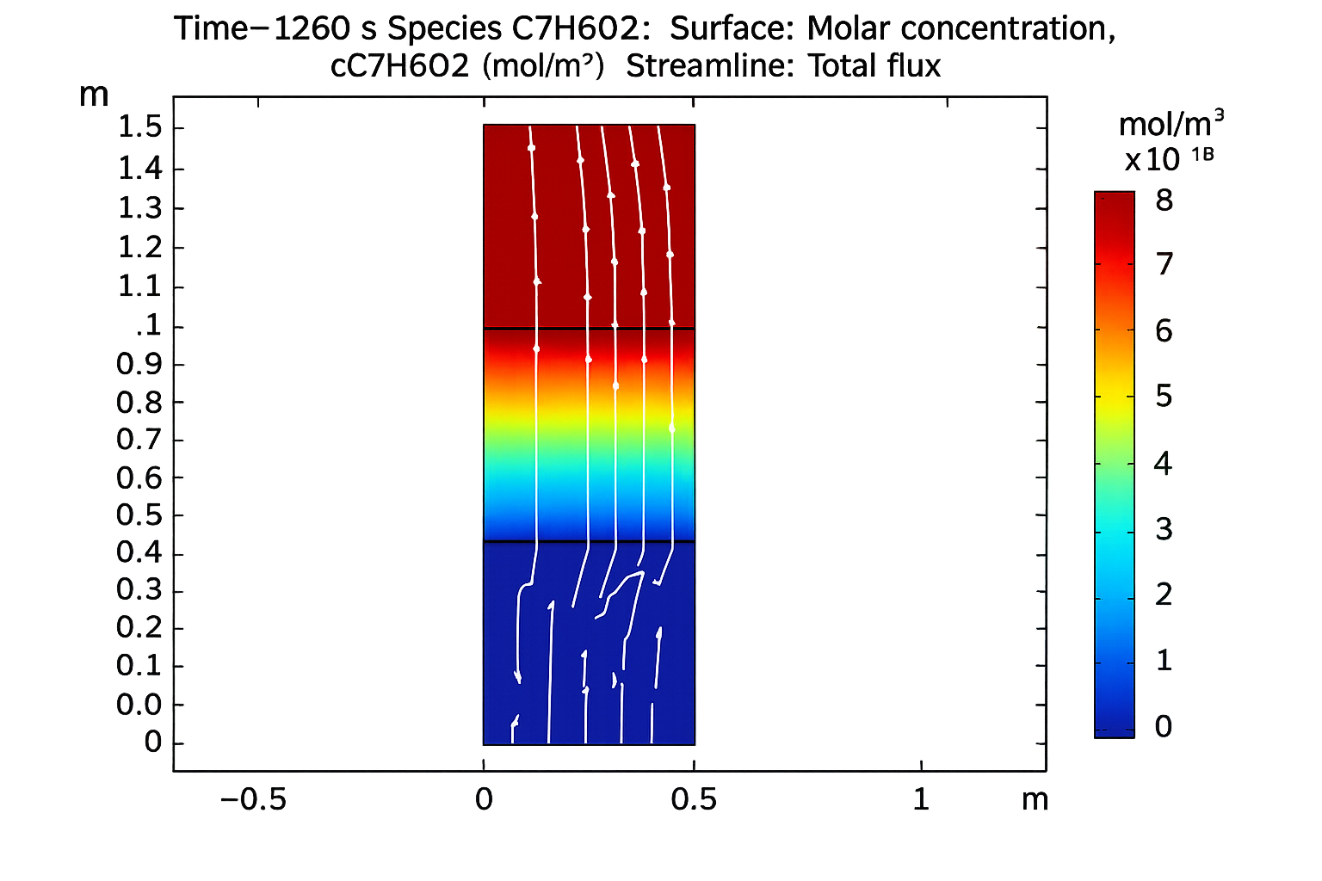
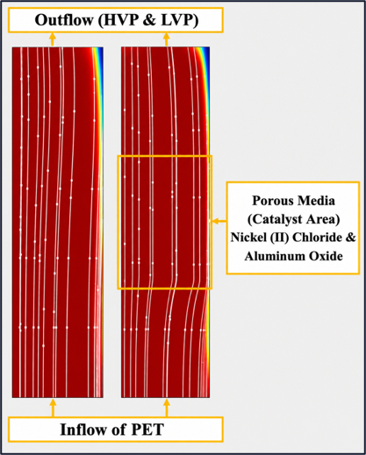
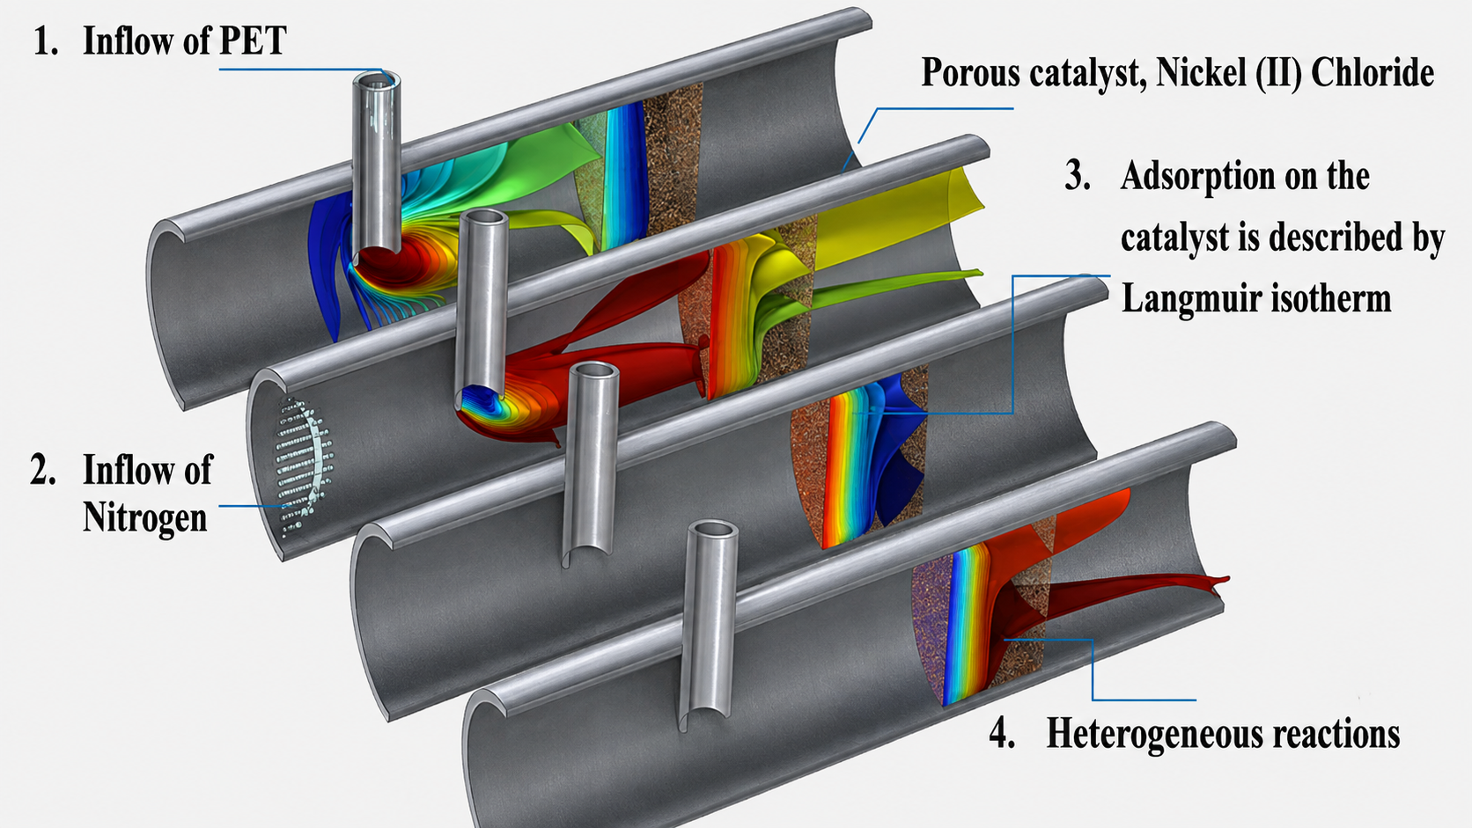
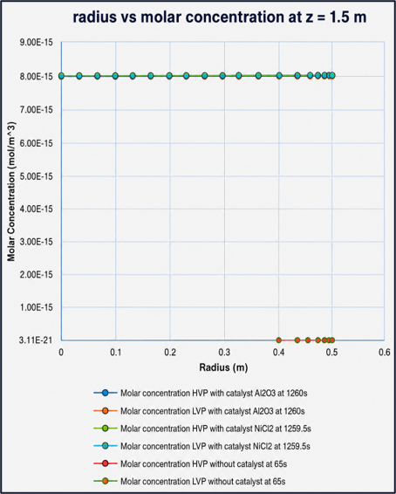
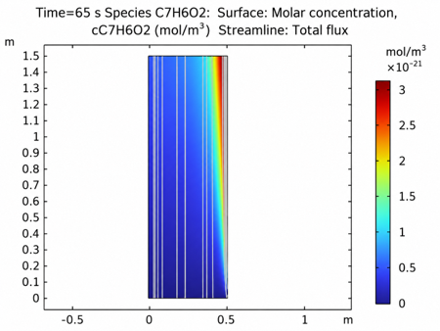
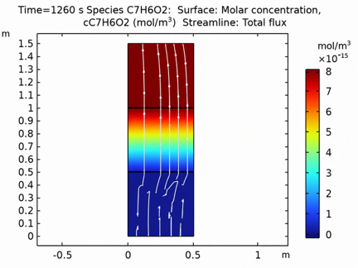

Optimization of Liquid Phase Generation by Catalyzed Pyrolysis of PET Plastic Waste
Enhancing PET pyrolysis efficiency through catalytic modeling to improve liquid fuel production.
A. Marrero¹, H. Pelaez²
1. Graduate School – Mechanical Engineering, Polytechnic University of Puerto Rico, San Juan Puerto Rico
2. Graduate School – Mechanical Engineering, Polytechnic University of Puerto Rico, San Juan Puerto Rico.
Abstract
This study evaluates the potential of a Nickel (II) Chloride (NiCl₂) catalyst toward a target 10% increase in liquid-phase production from PET pyrolysis. A 2D axisymmetric model was developed in COMSOL Multiphysics® to compare non-catalytic, Al₂O₃, and NiCl₂ configurations. NiCl₂ and Al₂O₃ exhibited similar predicted behavior, with less than 1% difference and maximum concentrations of approximately 8.0 × 10⁻¹⁵ mol/m³. The validated parameters will support future implementation in a 3D reactor model and experimental comparison[1].
Introduction & Objectives:
• Plastic waste is a global environmental issue
• PET is widely used and difficult to recycle
• Pyrolysis enables conversion into fuel
• Objective: Evaluate the potential of NiCl₂ toward a target 10% increase in liquid-phase production.
Methodology:
3D porous catalytic reactor used as the reference configuration.
2D axisymmetric model developed for validation.
Chemical Reaction Engineering Module.
Physics: Laminar Flow, Brinkman Equations, Transport of Diluted Species in Porous Catalysts, and Chemistry.
Cases: non-catalytic, Al₂O₃, and NiCl₂.
Catalyst loading: 5 wt% relative to PET.
Governing Model:
Arrhenius reaction kinetics
Convection–diffusion–reaction transport.
Surface reactions and Langmuir adsorption.
PET → HVP (C₇H₆O₂) + LVP (C₂H₆).
Figure 1. COMSOL 3D porous catalytic reactor reference configuration adapted for PET pyrolysis and NiCl₂ modeling [2].
Figure 2. 2D axisymmetric validation models without and with a porous catalytic region.
Results & Conclusions
Results:
Non-catalytic case: steady state at 65 s.
Catalytic cases: steady state at ~1260 s.
Catalysts increased concentrations to ~8.0 × 10⁻¹⁵ mol/m³.
NiCl₂ produced ~0.33% higher outlet cross-sectional average concentration than Al₂O₃.
Higher temperature increased concentration; higher velocity decreased it.
Conclusions:
Catalytic cases produced substantially higher predicted HVP/LVP concentrations.
NiCl₂ and Al₂O₃ showed similar predicted performance (<1% difference).
Results are based on a comparative model with simplified catalyst kinetics.
Future work: 3D modeling, liquid-phase yield evaluation, and experimental validation.
Figure 3. Non-catalytic HVP and LVP concentration fields at 65 s and 0.1 m/s.
Figure 4. Catalytic HVP and LVP concentration fields for Al₂O₃ at 1260 s and NiCl₂ at 1259.5 s.
Figure 5. Molar concentration of HVP and LVP versus radius at z = 1.5 m for the non-catalytic, Al₂O₃, and NiCl₂ cases.
[1] Cepeliogullar & Putun, 2013
[2] COMSOL Multiphysics®, 2023
[3] Vijayakumar & Sebastian, 2018
[4] H. Jia et al., 2020.
[5] Kabeyi & Olanrewaju, 2023

