Slide 1
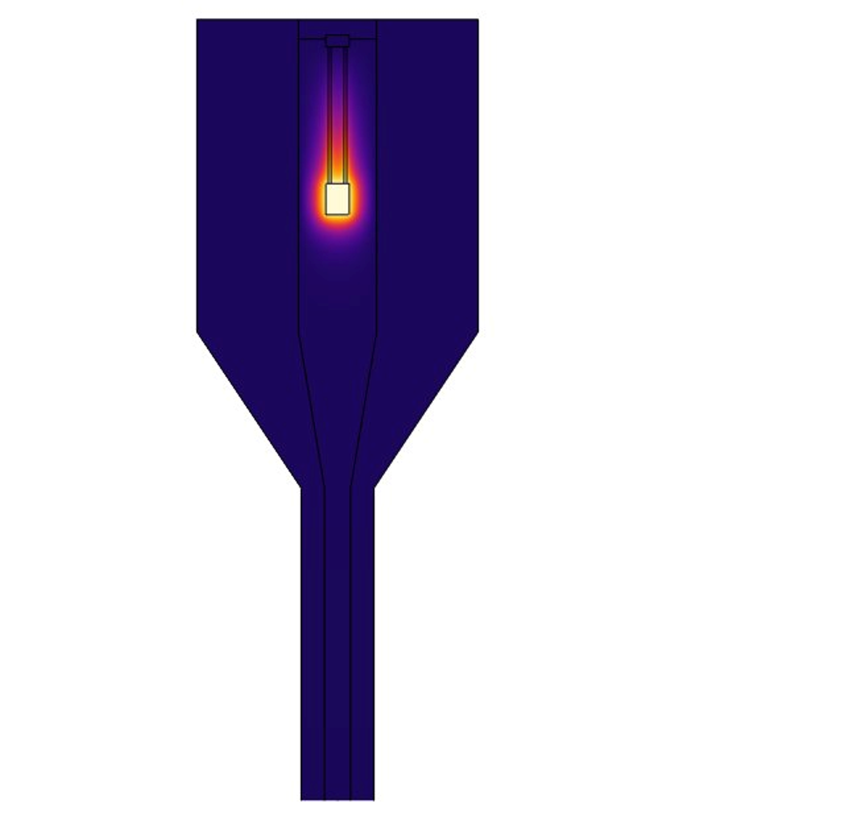
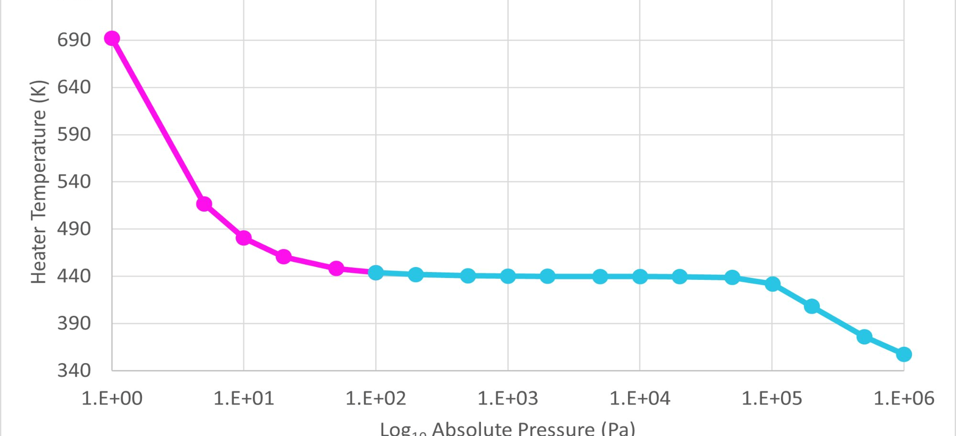
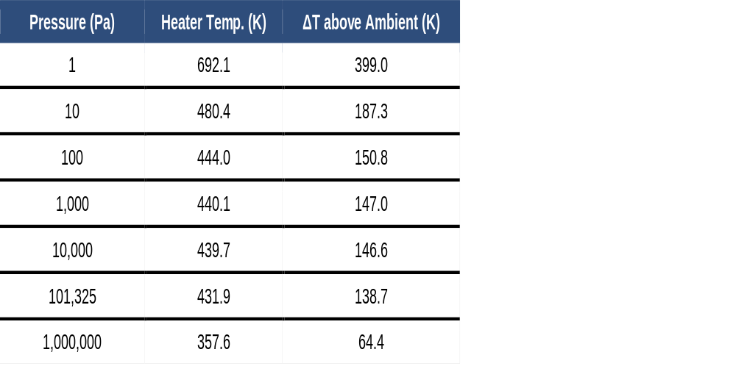

Multiphysics Simulation of a
Pirani Vacuum Gauge
Support-wire thermal conductivity governs Pirani gauge performance. Replacing structural steel supports with Ti-6Al-4V increases heater-temperature response from ~11 K to 335 K across six decades of pressure in COMSOL simulations.
Jess Rosenberg, Kyle Koppenhoefer, Luke Gritter, and Mark Varady
AltaSim Technologies, LLC | Columbus, Ohio
Background
A Pirani gauge measures pressure through the pressure dependence of gas thermal conductivity. Heat generated by a resistively heated filament is removed by the surrounding gas, causing filament temperature to vary with pressure. As pressure decreases, the molecular mean free path increases, reducing effective gas thermal conductivity and increasing filament temperature. The onset of this behavior is governed by the Knudsen number, Kn = λ / d
where λ is the molecular mean free path and d is the filament-to-wall gap. For the present geometry (d = 3.825 mm), the pressure-dependent response occurs in the transition between continuum and molecular heat-transfer regimes. Based on Knudsen-number analysis, the transition spans approximately 0.3 Pa to 3,000 Pa.
Methodology
The model uses a rotationally symmetric 3D geometry with a structural steel housing, tungsten heater element, and Ti-6Al-4V support wires. A symmetry plane reduces computational cost.
Two geometric ratios govern the thermal physics:
• Filament-to-wall gap (d = 3.825 mm) sets the Knudsen transition pressure
• Support wire aspect ratio (100:1) determines parasitic conductive heat loss
Support wire material is the dominant design variable. Structural steel wires (k ≈ 44.5 W/(m·K)) create a thermal short-circuit yielding only ~11 K sensitivity. Ti-6Al-4V (k ≈ 6.7 W/(m·K)) reduces parasitic conductance 6.6×, enabling gas-phase heat transfer to dominate.
Pirani Calibration Curve for transition regime (p < 180 Pa) and viscous regime (p > 180 Pa)
Knudsen Correction
An effective thermal conductivity expression approximates transition regime behavior:
k_eff = k_gas(T) / (1 + 2λ / d_gap)
where λ = k₈T / (√2 π d_m² p) is the mean free path from kinetic theory.
At atmospheric pressure, λ ≈ 0.068 μm and the correction is negligible. At 1 Pa, λ ≈ 6.9 mm and k_eff drops to ~0.006 W/(m·K), a 4.6× reduction from bulk nitrogen, correctly reproducing rarefied gas insulation behavior.
Note: The Navier-Stokes formulation is formally invalid in the transition regime (p < 180 Pa), but convective velocities are negligible at these pressures and thermal results are dominated by the corrected conductivity, not the flow solution.
Total sensitivity range: 335 K across six decades of pressure

Slide 2

Guidelines
General Notes for Using the Template
Do not adjust the template; work within it. See the examples provided.
Left align text within textboxes, and do not justify your text.
Titles are the largest font on the slide (90–120 pt.), then subtitles (70–80 pt.). Captions, references, and affiliation are the smallest text (18–40 pt.).
Titles and subtitles are bold; any other use of bold should be for emphasis.
Text is either black or grey and should only be adjusted for diagrams.
Images can be adjusted and fitted into the boxes using the Crop feature. (In PowerPoint: Format tab → Size section on the right → Crop.)
Please keep in mind:
The solid red lines are the 3 mm that will be cut off during printing.
The dotted lines represent a small margin that may or may not be cut off during printing.
Exporting an Image for the Header
The settings shown on the right export the highest quality image with a transparent background.
The most important settings to use are the two outlined in pink. This will export an image that can be placed in the blue space of the header.

Slide 3
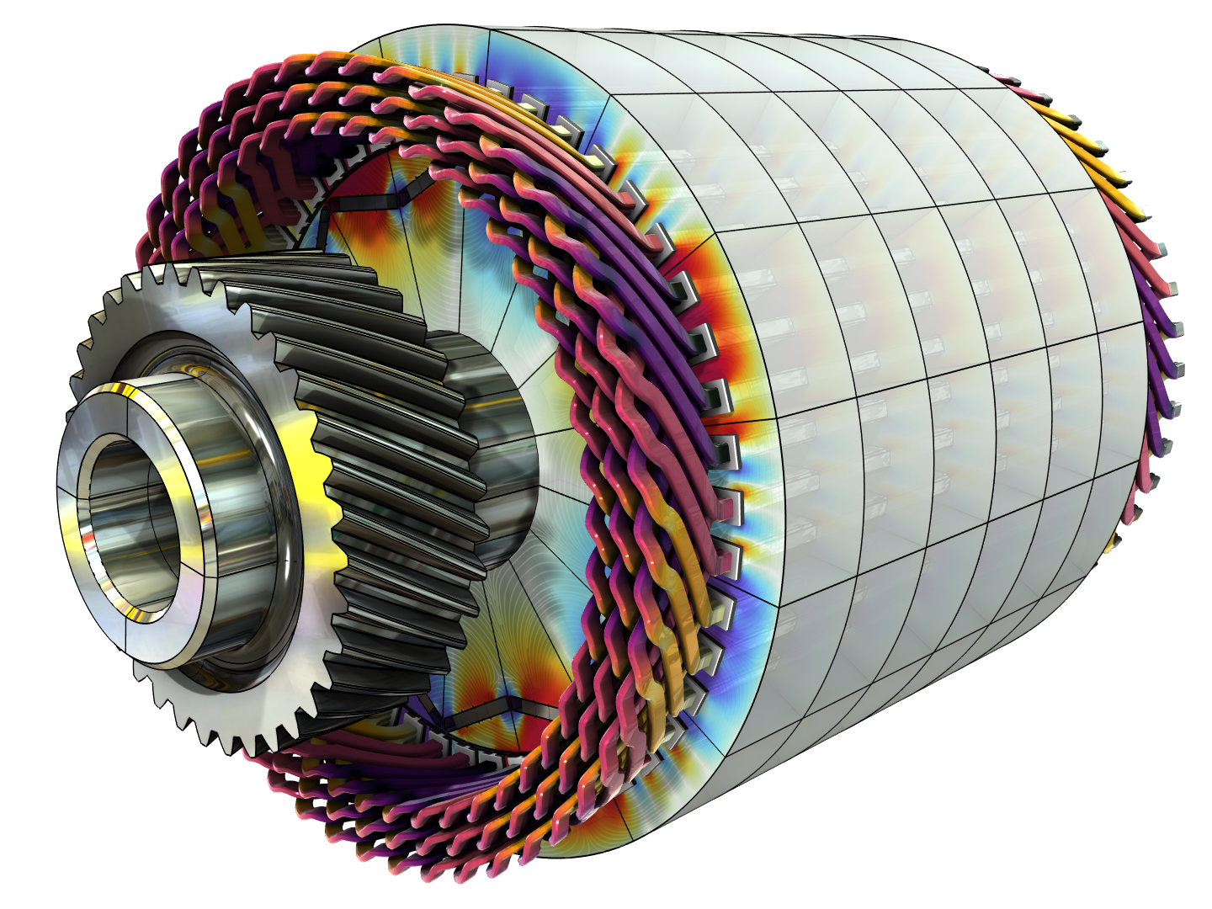
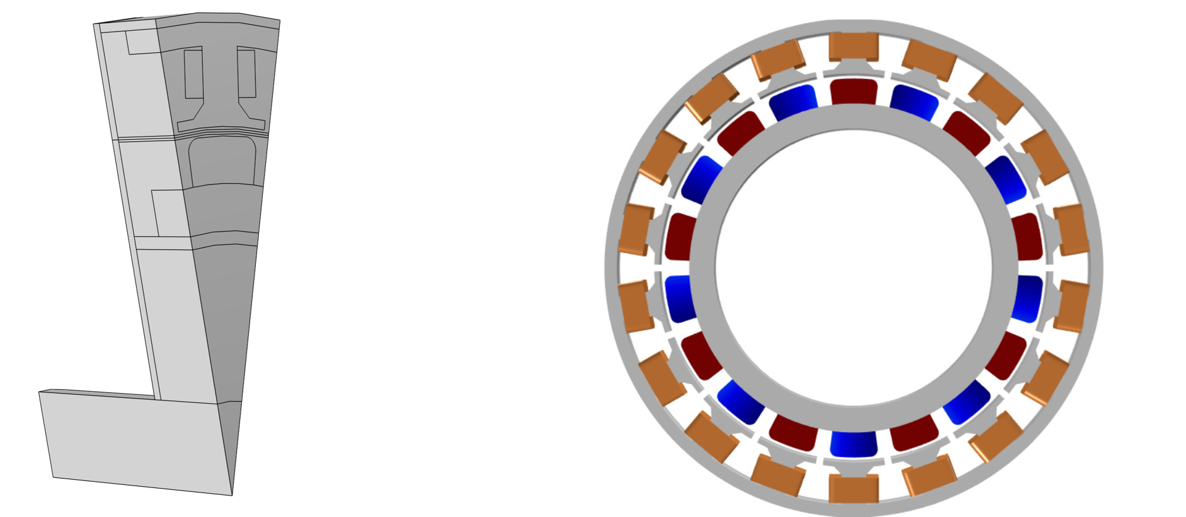
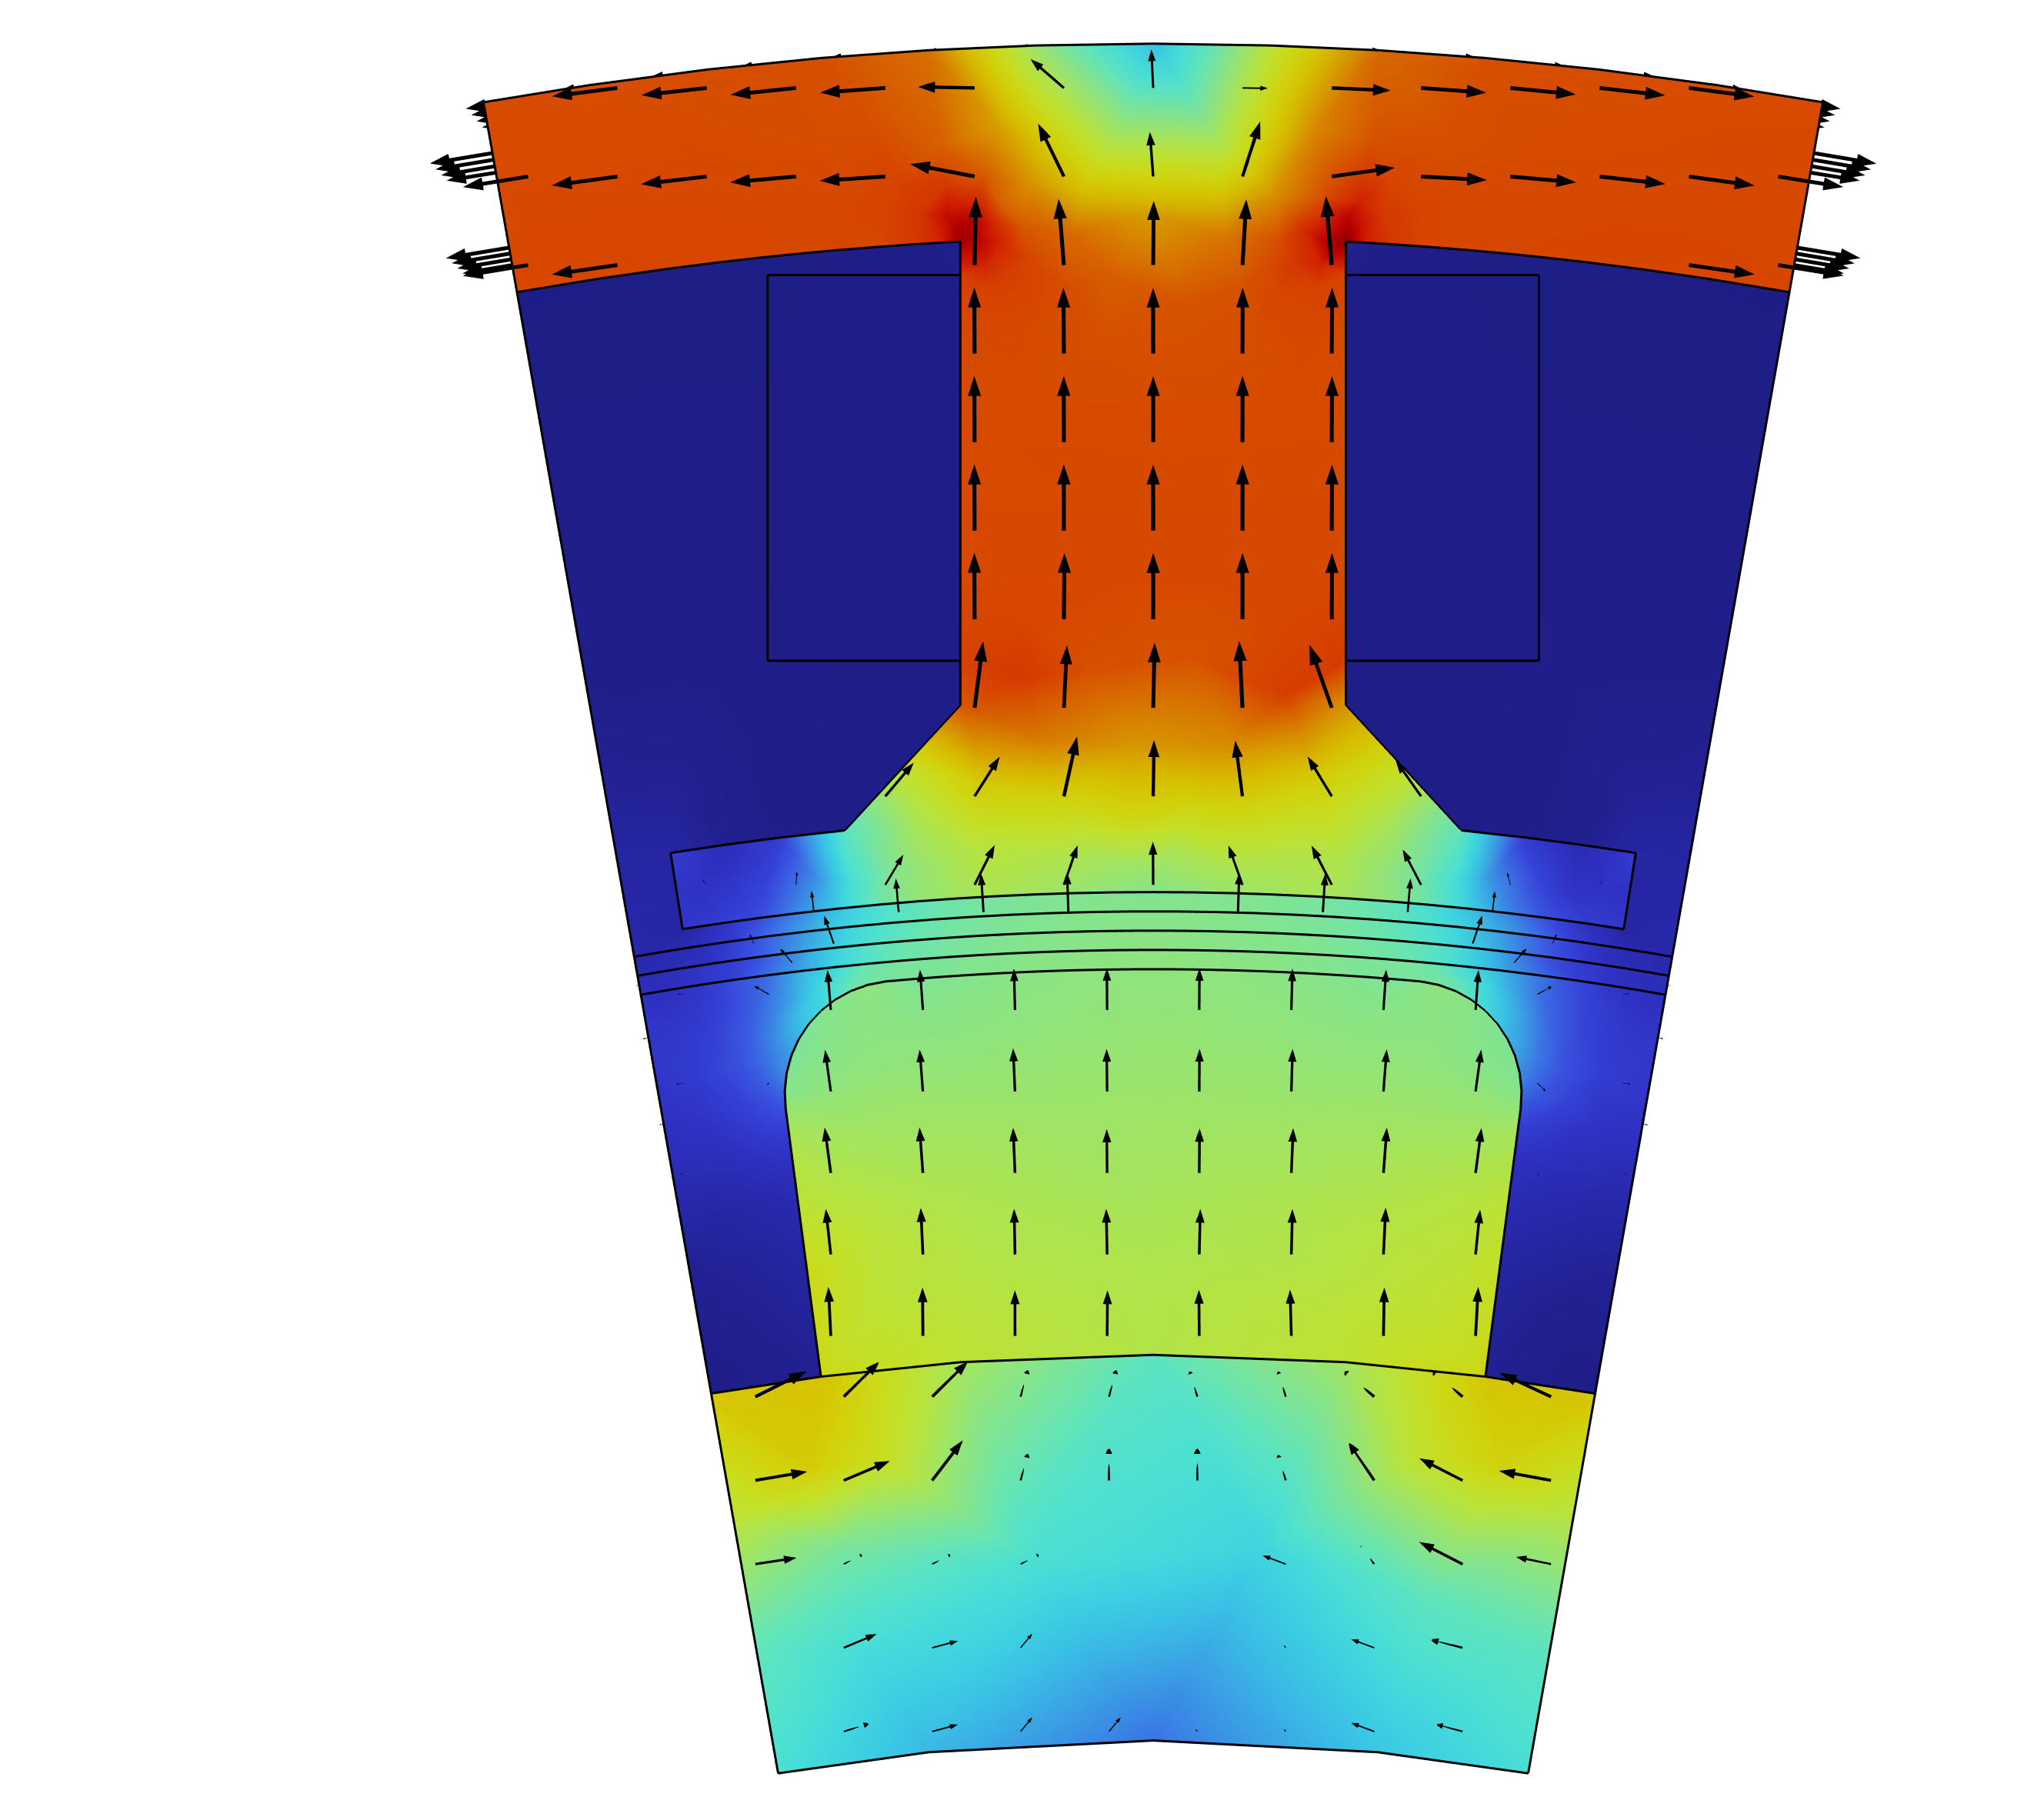
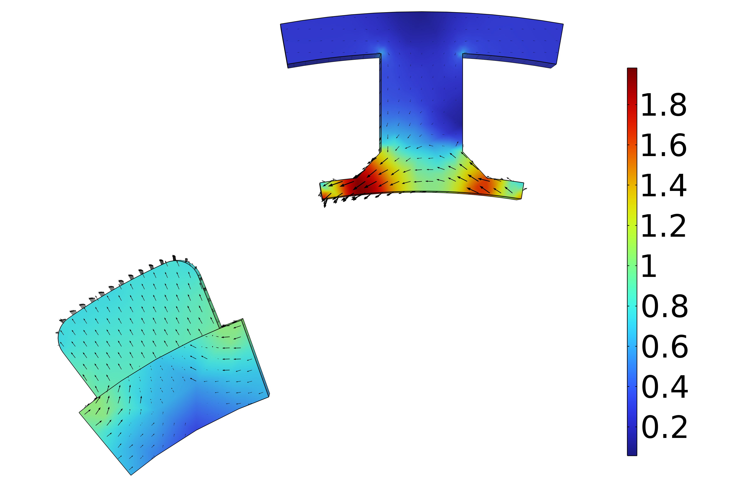

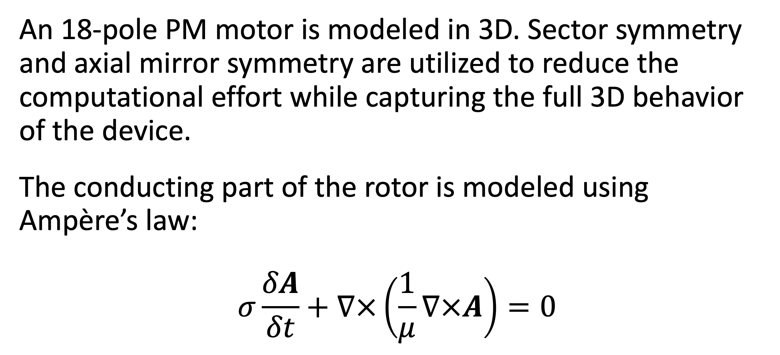
Analysis of a Permanent Magnet Motor in 3D
Optimize permanent magnet (PM) motor performance by understanding their full behavior, including sensitivity to high temperatures.
J. A. Smith¹, M. B. Smith²
1. Department (if applicable), Organization, City, Country.
2. Department (if applicable), Organization, City, Country.
Abstract
While PM motors are valued for the energy savings that they provide, there are some design limitations to address. For example, permanent magnets are sensitive to high temperatures. Such temperatures can occur when currents, particularly eddy currents, generate heat losses.
The findings offer greater insight into the behavior of PM motors, particularly by capturing the eddy current losses that occur within the magnets. This information serves as a useful resource for improving the design of PM motors, and therefore the technology they help power.
Methodology
An 18-pole PM motor is modeled in 3D. Sector symmetry and axial mirror symmetry are utilized to reduce the computational effort while capturing the full 3D behavior of the device.
The conducting part of the rotor is modeled using Ampère’s law:
$$σ\frac{δA}{δt}+∇×\left(\frac{1}{μ}∇×A\right)=0$$
FIGURE 1. Left: Permanent motor sector. Right: Drawing of the PM motor.
Results
The results can be seen in Figure 2, which shows the magnetic flux density for the motor in it’s stationary state, that is, the initial conditions for the time-dependent simulation. In this state, the coil current is zero. It also shows the magnetic flux density for the motor after revolving one sector angle. In this plot, the air and coil domains are excluded in order to get a better view.
FIGURE 2. Left: Magnetic flux density from the permanent magnets with only the rotor at rest. Right: Magnetic flux density after revolving one sector angle.
1. Author first initial and last name, “Article Title”, Journal, Volume (vol.), Page numbers (pp.), Year.
2. Author first initial and last name, “Article Title”, Journal, Volume (vol.), Page numbers (pp.), Year.
3. Author first initial and last name, “Article Title”, Journal, Volume (vol.), Page numbers (pp.), Year.

Slide 4
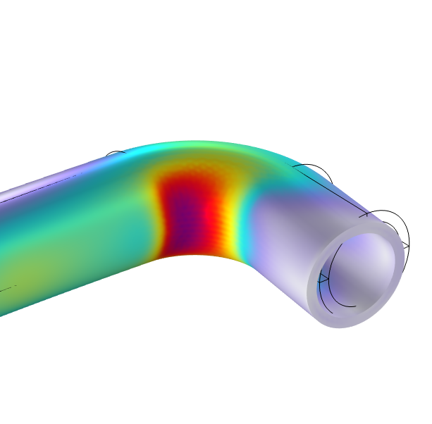
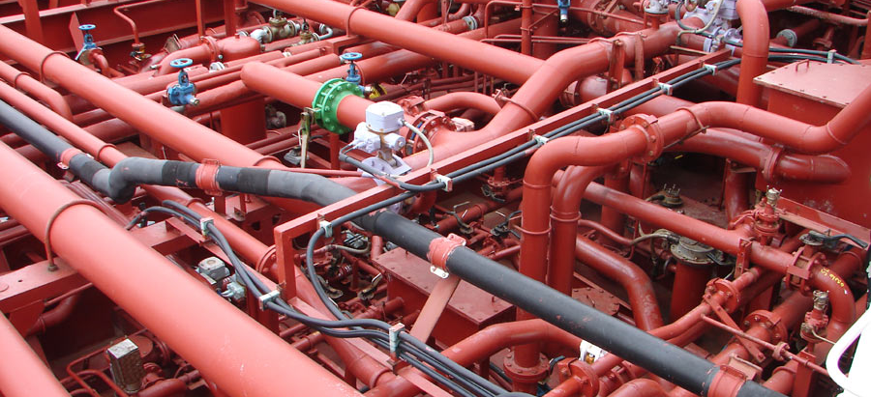
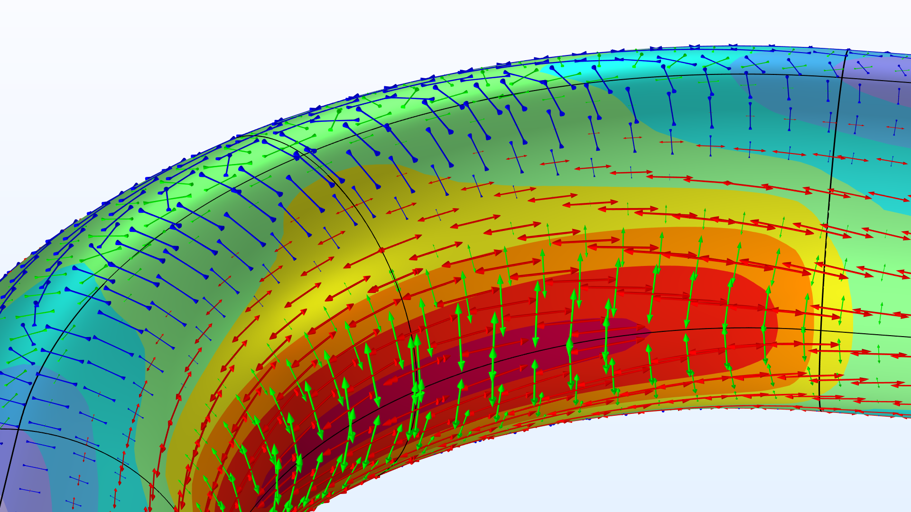
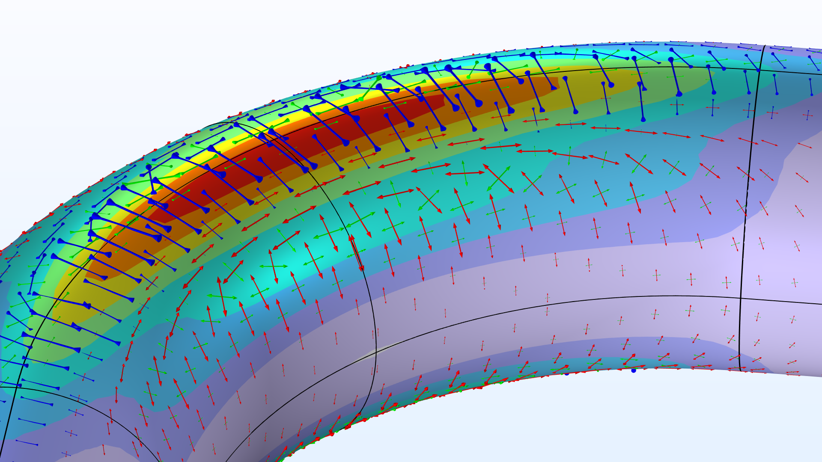
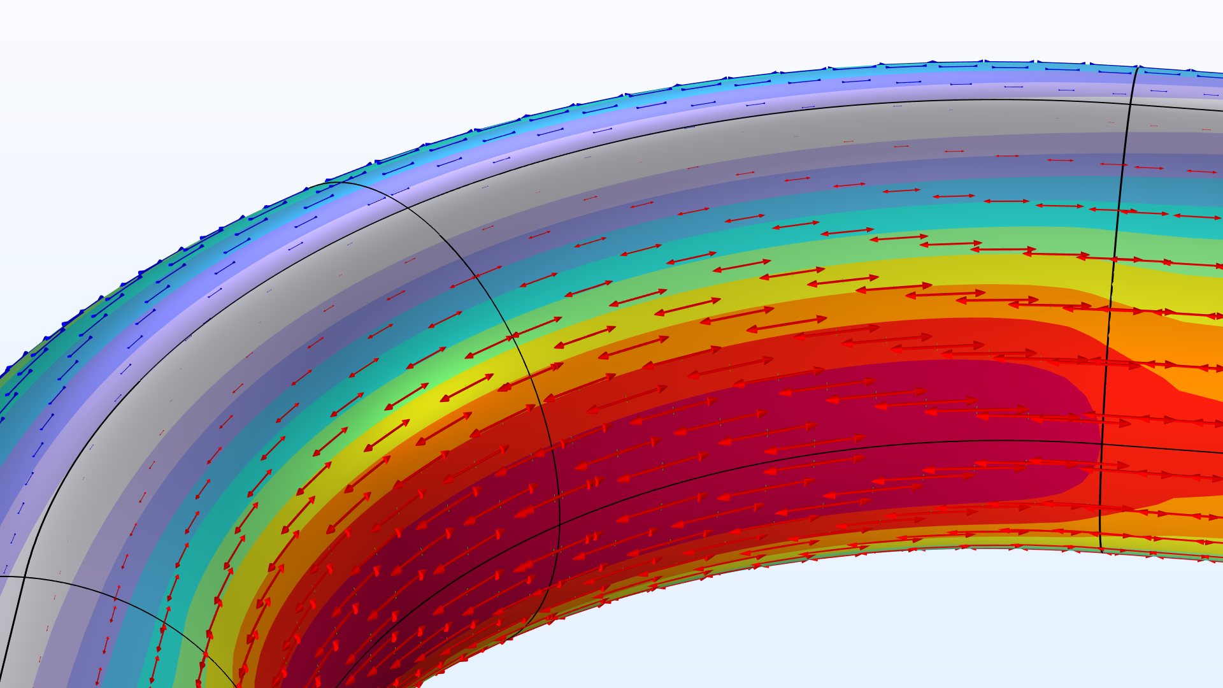
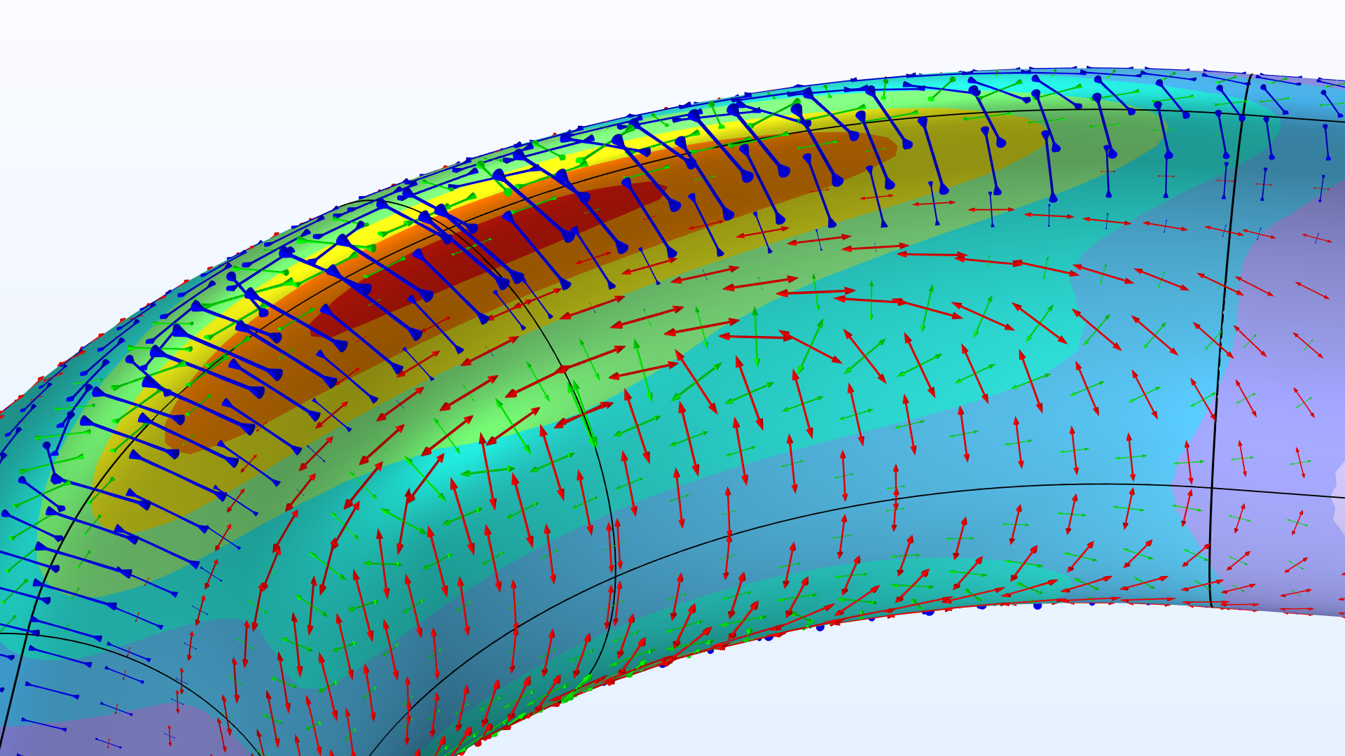
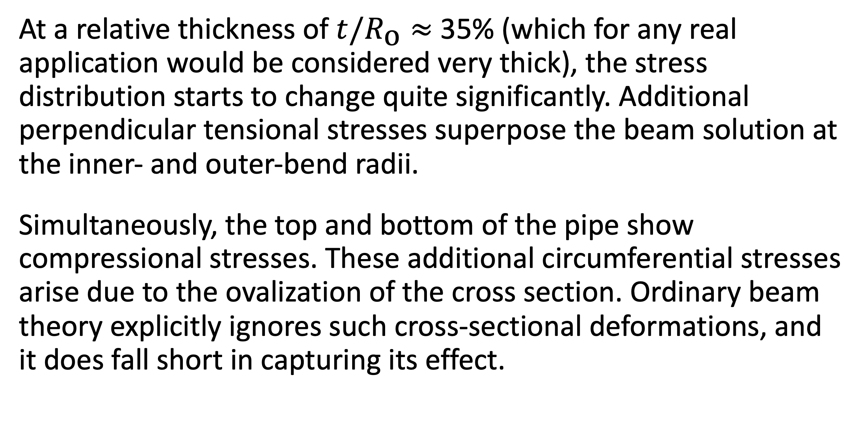
The Intriguing Stresses in Pipe Bends
For many structural engineers, beam theory is a popular analysis tool. Using the equations can be beneficial when considering structural behavior, as they are easy to apply and provide useful results. This work investigates one such case.
J. A. Smith¹, M. B. Smith²
1. Department (if applicable), Organization, City, Country.
2. Department (if applicable), Organization, City, Country.
Introduction & Goals
Pipe bends are common in piping systems, which typically transport liquids or gas, often under high pressure. One place where you may find a lot of pipes are oil tankers. The labyrinthine piping systems can look pretty fascinating.
Many piping standards (or codes) used for industrial applications are based on beam theory when it comes to the structural analysis. But, as we have already discovered, pipe bends generally do not behave like beams. When digging into piping standards, you will find a lot of information dedicated to pipe bends. In particular, piping standards recommend to apply correction factors to the stiffness and stresses for curved pipe sections. (Ref. 1)
Methodology
The pipe is slender with a constant cross section, so it would seem like a natural choice to treat such a structure as a beam in a simplified analysis. The bending moment is the only load acting on the structure, and it’s thus constant for any given section along the entire beam axis.
The maximum stress even occurs on the inside of the pipe. The cross section of the bend also deforms significantly, and, more specifically, it ovalizes with the major axis either being oriented in the bend plane or perpendicular to it depending on the direction of the bending moment.
FIGURE 1. Piping systems on an oil/chemical tanker. Image licensed under CC BY-SA 3.0 via Wikimedia Commons.
Results
At a relative thickness of $t/R_{\text{o}}≈$ 35% (which for any real application would be considered very thick), the stress distribution starts to change quite significantly. Additional perpendicular tensional stresses superpose the beam solution at the inner- and outer-bend radii.
Simultaneously, the top and bottom of the pipe show compressional stresses. These additional circumferential stresses arise due to the ovalization of the cross section. Ordinary beam theory explicitly ignores such cross-sectional deformations, and it does fall short in capturing its effect.
FIGURE 2. View of the pipe bend showing the von Mises stress (normalized) and principal stresses for different wall thicknesses.
E.A. Wais and E.C. Rodabaugh, “Background of SIFs and Stress Indices for Moment Loadings of Piping Components”, United States, 2005; https://www.osti.gov/biblio/841246
“Stress Intensification Factors (i-Factors), Flexibility Factors (k-Factors), and Their Determination for Metallic Piping Components”, ASME, 2017; https://www.asme.org/codes-standards/find-codes-standards/b31j-stress-intensification-factors-flexibility-factors-determination-metallic-piping-components/2017/drm-enabled-pdf

