Slide 1
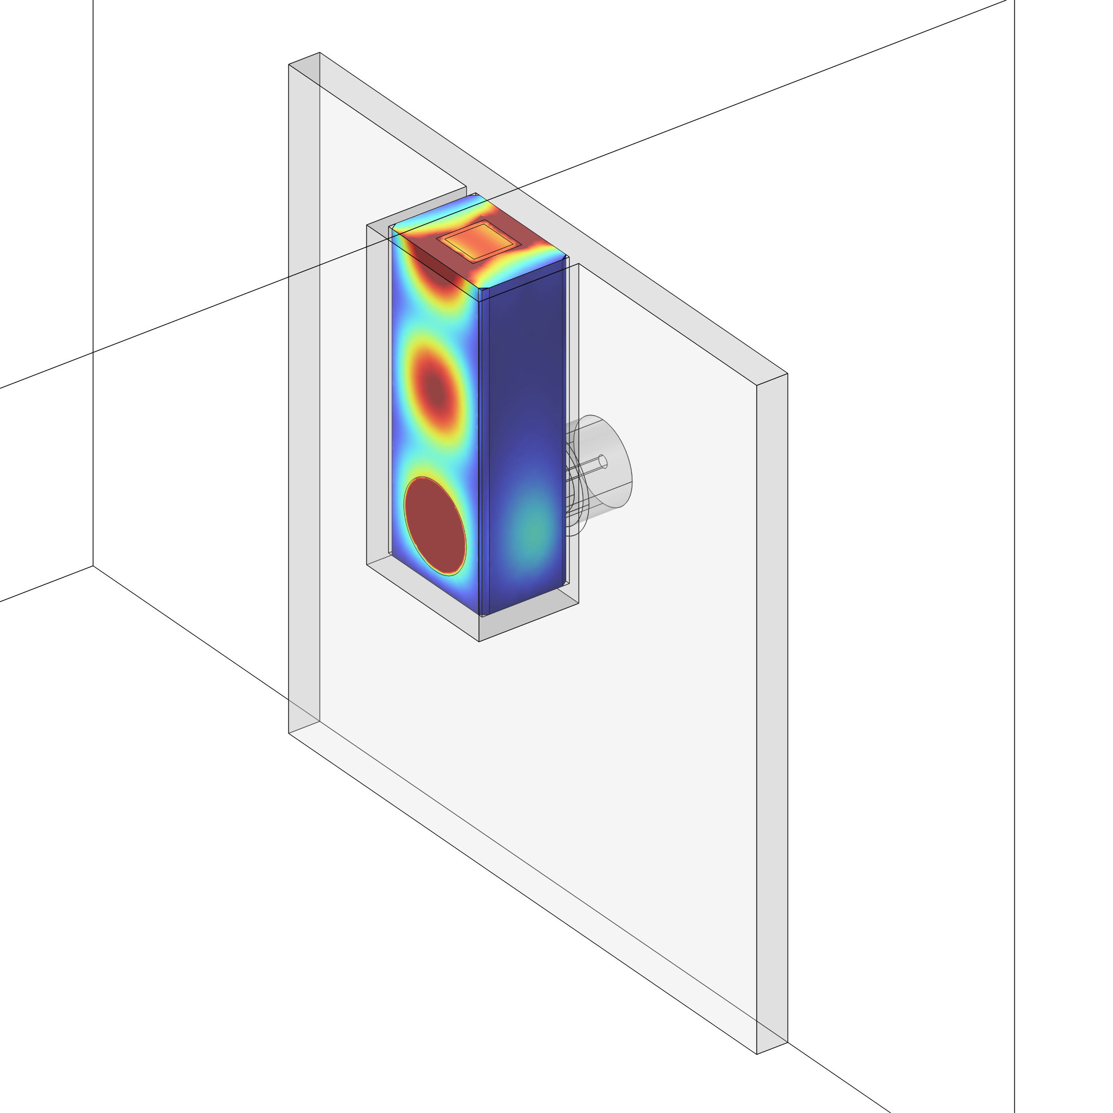
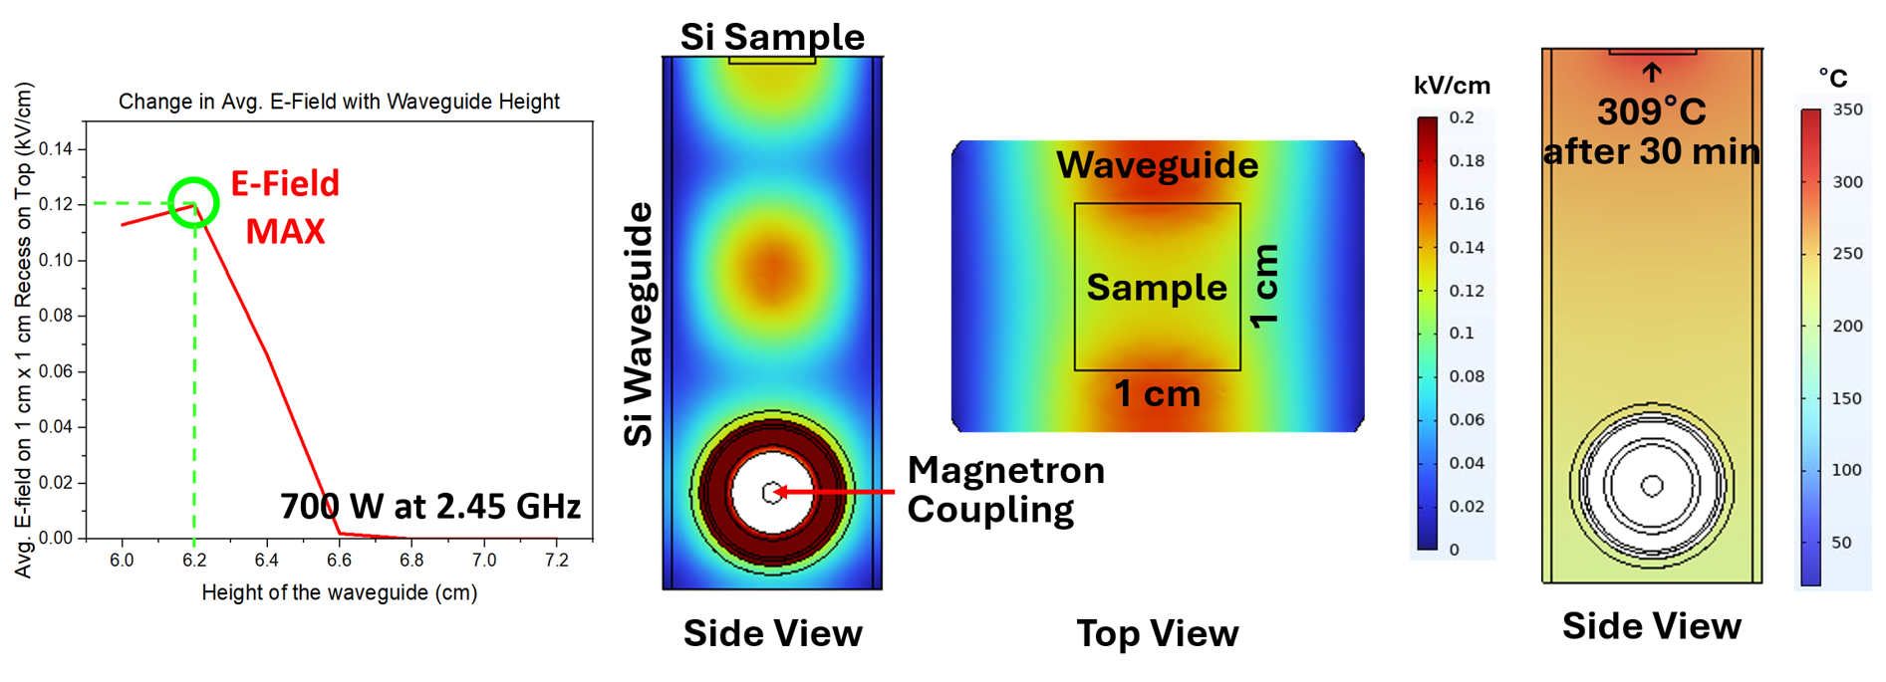
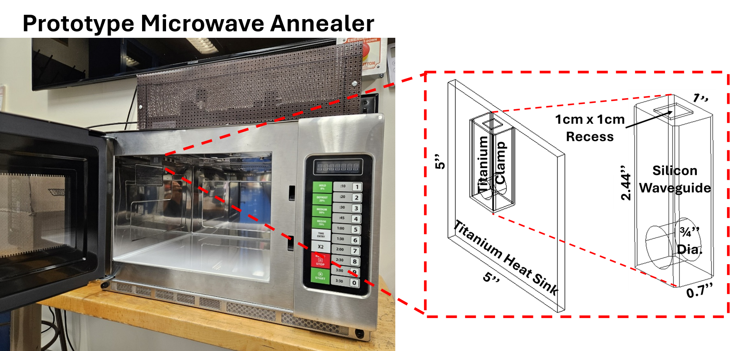

Microwave Annealer for Semiconductor Dopant Activation Above Solubility Limit
Efficient and abrupt dopant activation is critical but remains challenging in advanced semiconductor devices due to defect-cluster formation at high temperatures. Susceptor-free microwave annealing can overcome this by directly coupling microwave energy to those defects while minimizing lattice heating.
J. H. Joo¹, C. Savant¹, G. Fabi², J. C. M. Hwang^{1,2} 1. Department of Materials Science and Engineering, Cornell University, Ithaca, NY, USA. 2. Electrical and Computer Engineering, Cornell University, Ithaca, NY, USA.
Abstract
Efficient and abrupt dopant activation remains challenging in heavily doped semiconductors, particularly in nanoscale transistors. In silicon (Si) doped beyond the phosphorus solubility limit, vacancy-related dopant clusters can become mobile at elevated temperatures, reducing activation efficiency and profile abruptness.
We demonstrate a susceptor-free microwave annealer that directly couples microwave energy into Si. A Si waveguide was optimized using COMSOL Multiphysics® to achieve efficient and uniform microwave coupling. The optimized design produces an electric field of 100 V/cm with ± 5% uniformity while maintaining the sample temperature below 300°C.
Preliminary experiments with the designed prototype annealer show a 12% reduction in sheet resistance, indicating enhanced dopant activation. This approach provides a potential pathway for efficient and stable dopant activation with reduced thermal exposure.
Waveguide Design and Optimization
Using the RF Module with the Electromagnetic Waves, Frequency Domain (ewfd) interface, a rectangular Si waveguide was designed to directly couple microwave energy to the Si sample at 2.45 GHz. A broadside coaxial feed was used to transition from TEM propagation to the TE₁₀ mode. A parametric sweep of the waveguide dimensions, source position, and antenna protrusion was performed to maximize the electric field at the sample surface. The optimized design used w = 1.0 in., t = 0.7 in., and h = 2.44 in., with a 0.67-in.-diameter source opening positioned 0.43 in. above the bottom surface.
The RF model was coupled with the Heat Transfer in Solids (ht) interface to evaluate microwave-induced heating and thermal dissipation.
FIGURE 1. Left: Waveguide design optimization. Middle: Average electric field distribution. Right: Average temperature distribution.
Prototype Microwave Annealer Results
For a 1 cm × 1 cm Si sample with a 30-nm epitaxial layer doped to 3 × 10²¹ P/cm³ and a substrate resistivity of 17 Ω·cm, the simulation predicts an average electric field of 0.12 kV/cm with a ± 5.3% variation across the sample surface (middle, Figure 1). Under 700 W at 2.45 GHz for 30 min, the simulated sample temperature reaches a steady-state value of approximately 307 °C (right, Figure 1).
The optimized design was fabricated as a prototype microwave annealer and used to process the same Si samples (Figure 2). Preliminary experiments with approximately 1 h of microwave annealing, followed by four-point-probe measurements, showed a reduction in average sheet resistance from 163.9 to 143.6 Ω/□, corresponding to a 12.4% reduction.
FIGURE 2. Left: Overall view of the fabricated microwave annealer prototype. Right: Schematic of the machined silicon waveguide and titanium heat sink.
1. C.-H. Tsai, C. P. Savant, M. J. Asadi, Y.-M. Lin, I. Santos, Y.-H. Hsu, J. Kowalski, L. Pelaz, W.-Y. Woon, C.-K. Lee and J. C. M. Hwang, "Efficient and stable activation by microwave annealing of nanosheet silicon doped with phosphorus above its solubility limit," Applied Physics Letters, vol. 121, no. 5, 2022.
2. C. Tsai, Y. Hsu, I. Santos, L. Pelaz, J. Kowalski, J. Liou, W. Woon and C. K. Lee, "Achieving junction stability in heavily doped epitaxial Si:P," Materials Science in Semiconductor Processing, vol. 127, p. 105672, 2021.
3. J.C.M. Hwang, M. J. Asadi, G. Fabi, C. P. Savant, J. H. Joo, “Microwave annealer for semiconductor wafers”, Google Patents, WO2023212325A1, 2023.

