Slide 1

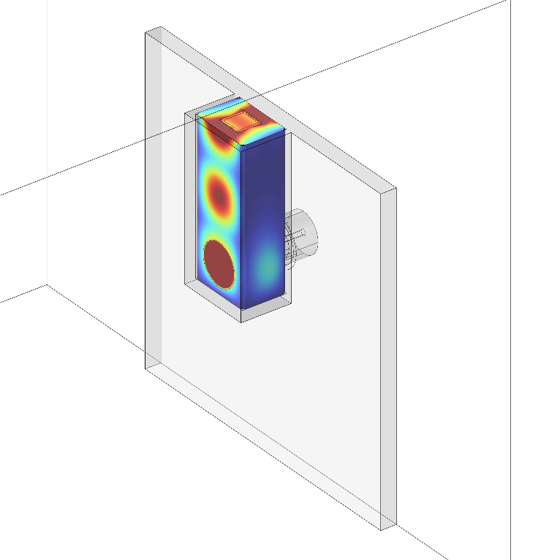

Microwave Annealer for
Dopant Activation Above Solubility Limit
Jin Hong Joo¹ and James C. M. Hwang^{1,2}
¹Department of Materials Science and Engineering, Cornell University
²School of Electrical and Computer Engineering, Cornell University
October 8th, 2026

Slide 2
Outline
Introduction
COMSOL Multiphysics® Modelling and Optimization
Simulation Results
Prototype Microwave Annealer
Conclusion

Slide 3
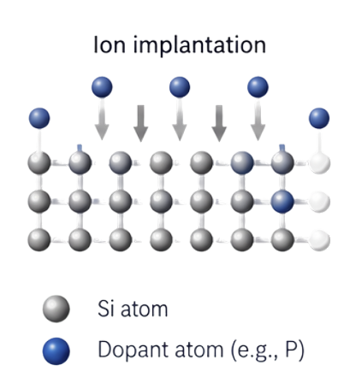
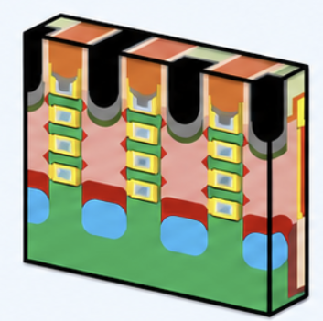
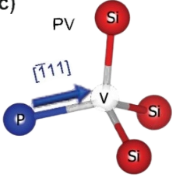

Semiconductor Microwave Annealing Using a Silicon Waveguide
Device Scaling and High Doping Level
Vacancy-Dopant Complexes
Dopant Activation
Microwave can dissociate dopant-defect complexes, releasing dopants and free electrons
Smaller device dimensions require higher dopant concentrations to maintain good electrical performance
Excess dopants form vacancy–dopant complexes, degrading electrical performance
MOSFET
PV → P⁺ + e⁻ + V
→
Vacancy-dopant complex
Source/Drain
(Si:P)
Microwave annealing can reduce defect complexes and enhance electrical performance

Slide 4
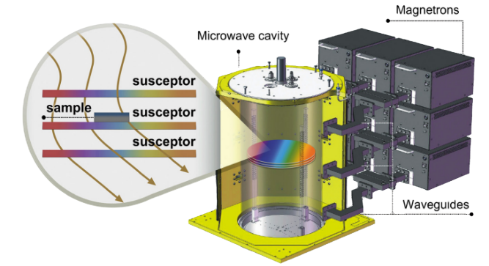
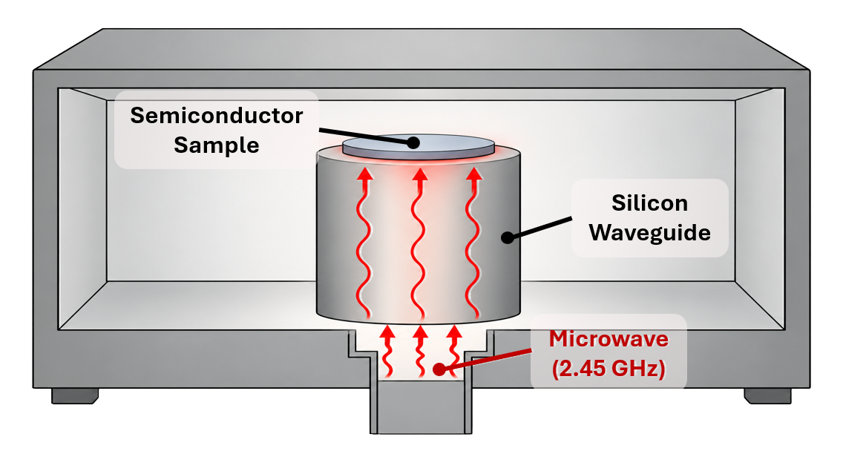
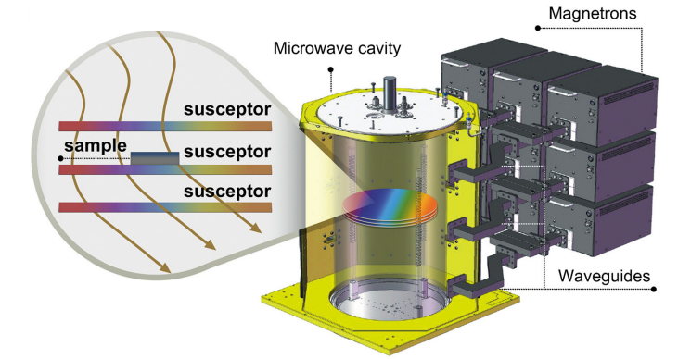


Semiconductor Microwave Annealing Using a Silicon Waveguide
Conventional Microwave Annealing
Annealing Through Silicon Waveguide
Indirect heating through a susceptor
Nonuniform electric field and temperature distribution
Inefficient energy loss
Direct microwave-semiconductor interaction
Localized and uniform energy transfer
Enhanced dopant activation (25% more efficient; 6x more stable)
Silicon waveguide enables direct microwave coupling for efficient semiconductor annealing

Slide 5


COMSOL Modelling of the Microwave-Silicon Waveguide
Coaxial to Si Waveguide Transition
Simulation Setup
Software | COMSOL Multiphysics® 6.2 and 6.3
Modules | RF module: Electromagnetic waves, Frequency Domain (ewfd) Heat Transfer Module: Heat Transfer in Solids (ht)
Frequency | 2.45 GHz (ISM Band)
* Coaxial-to-waveguide coupling in Application Gallery
Simulation Geometry
Waveguide Design
Rectangular Si waveguide to interface with the Si sample
Designed to match dielectric properties and enable continuous wave propagation
Key Simulation Features
Key Simulation Features
Mode transition: TEM in coaxial → TE₁₀ in rectangular Si waveguide
Electric field concentration: maximum at the open end (sample interface)
Coaxial
(TEM)
Transition
Si Waveguide
(TE₁₀)
Open end
(Max |E|)
Si Sample

Slide 6
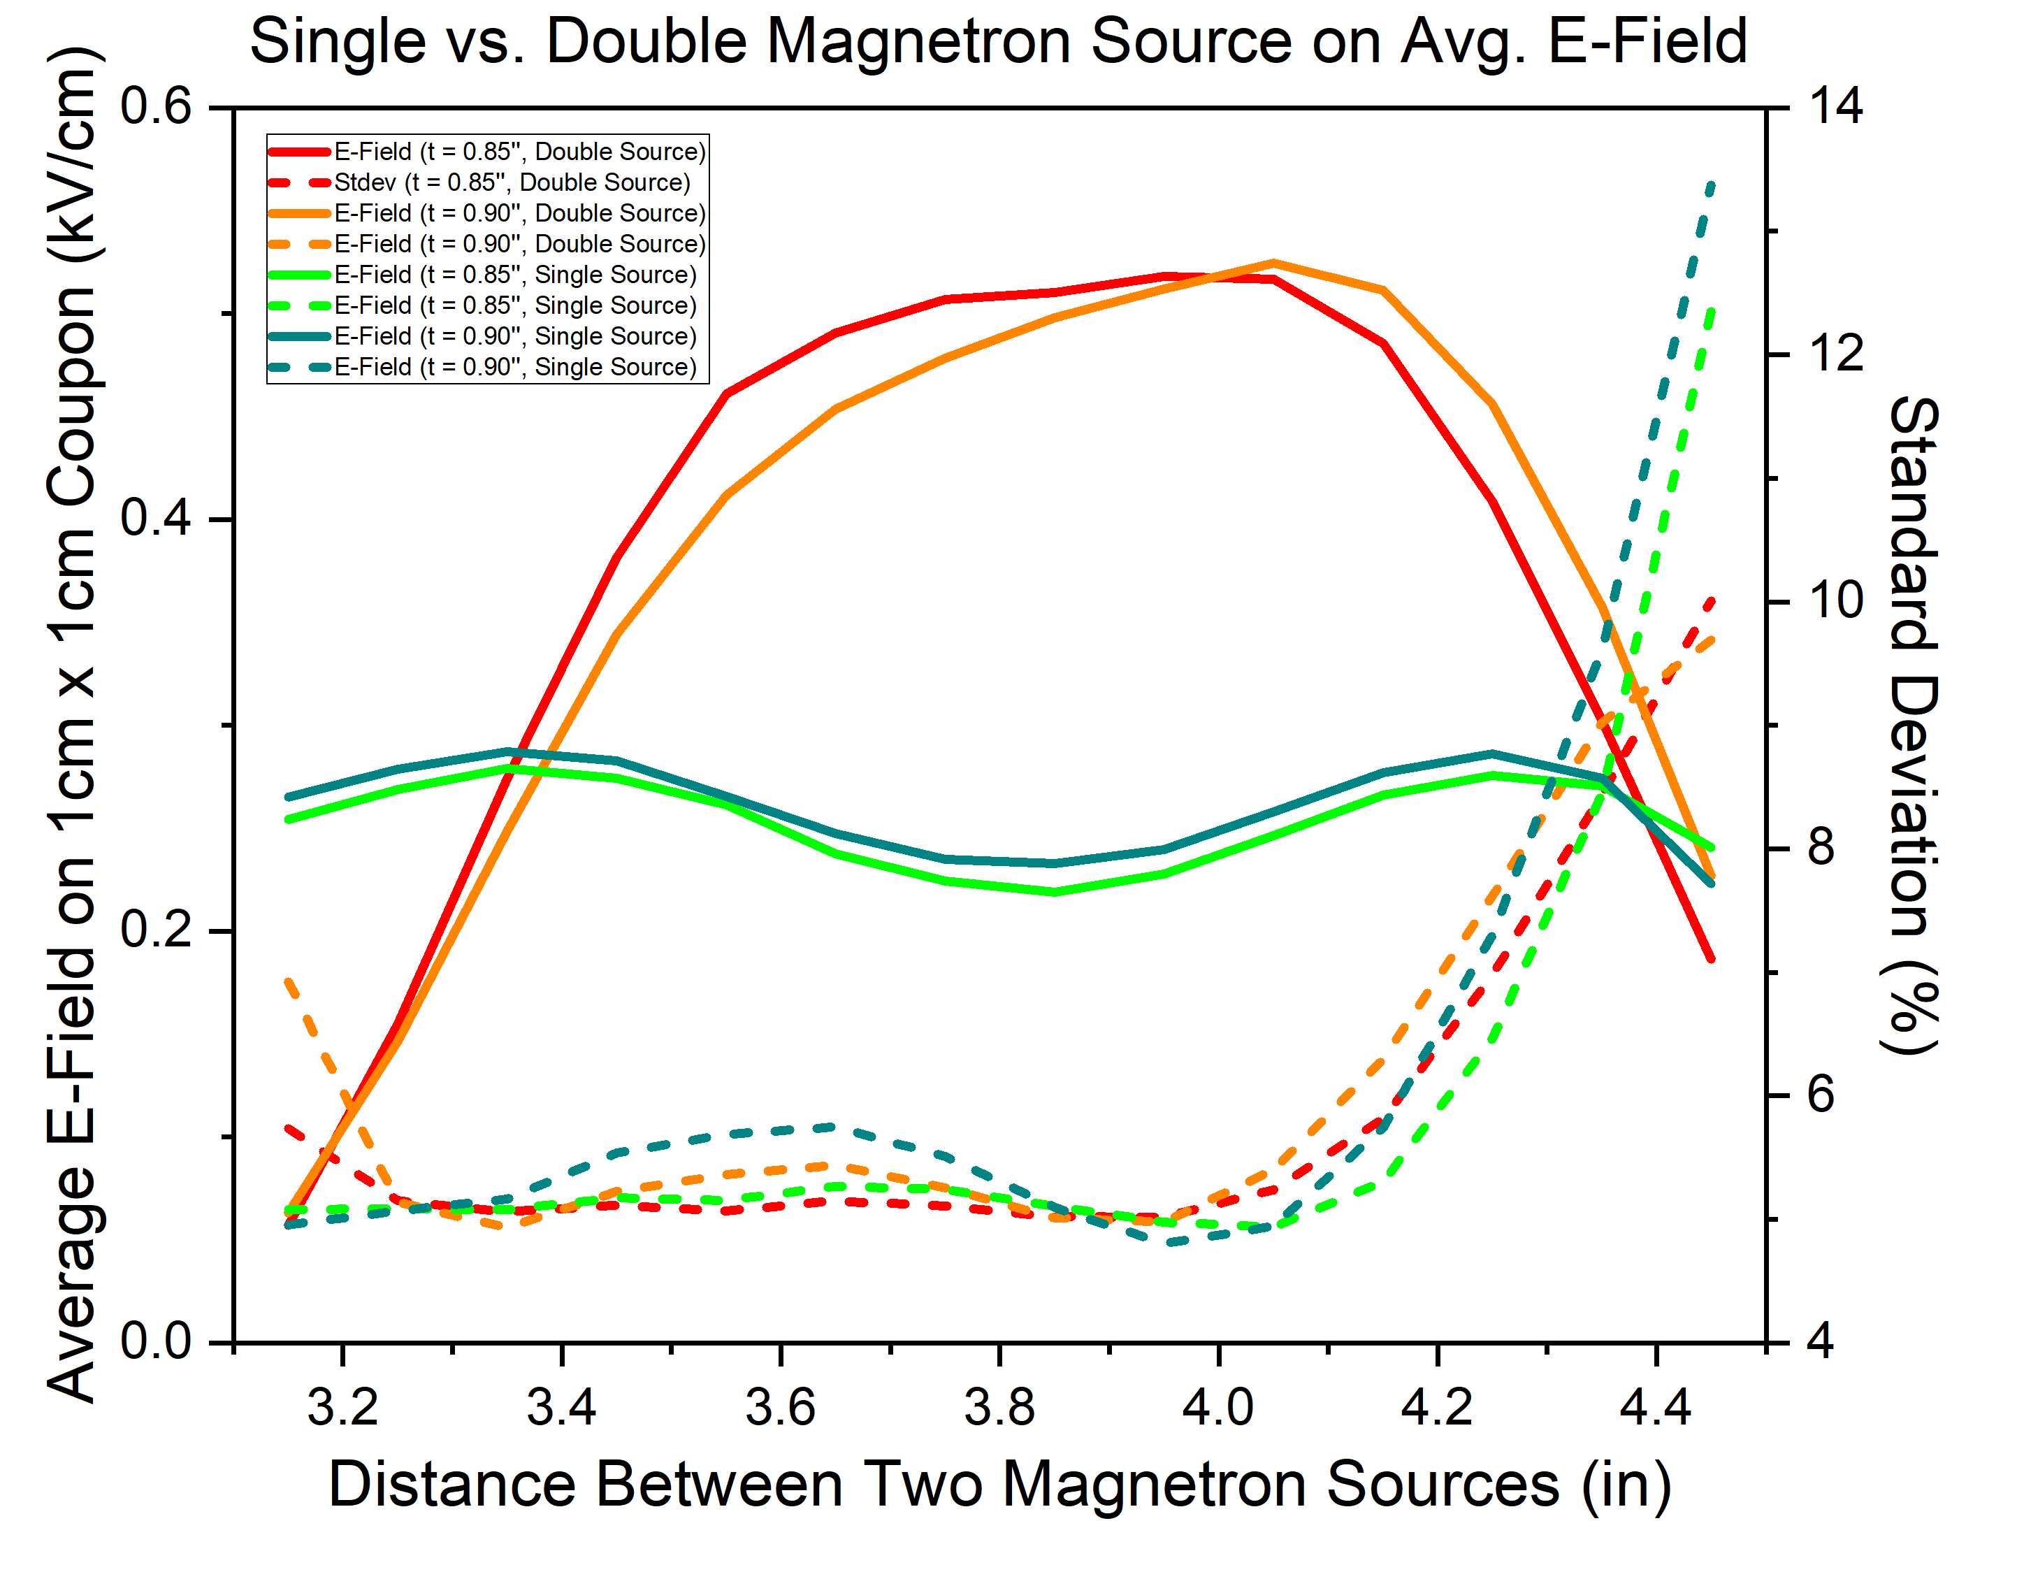
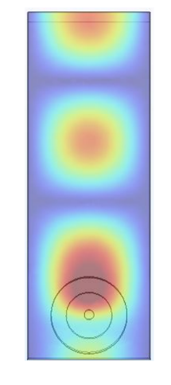
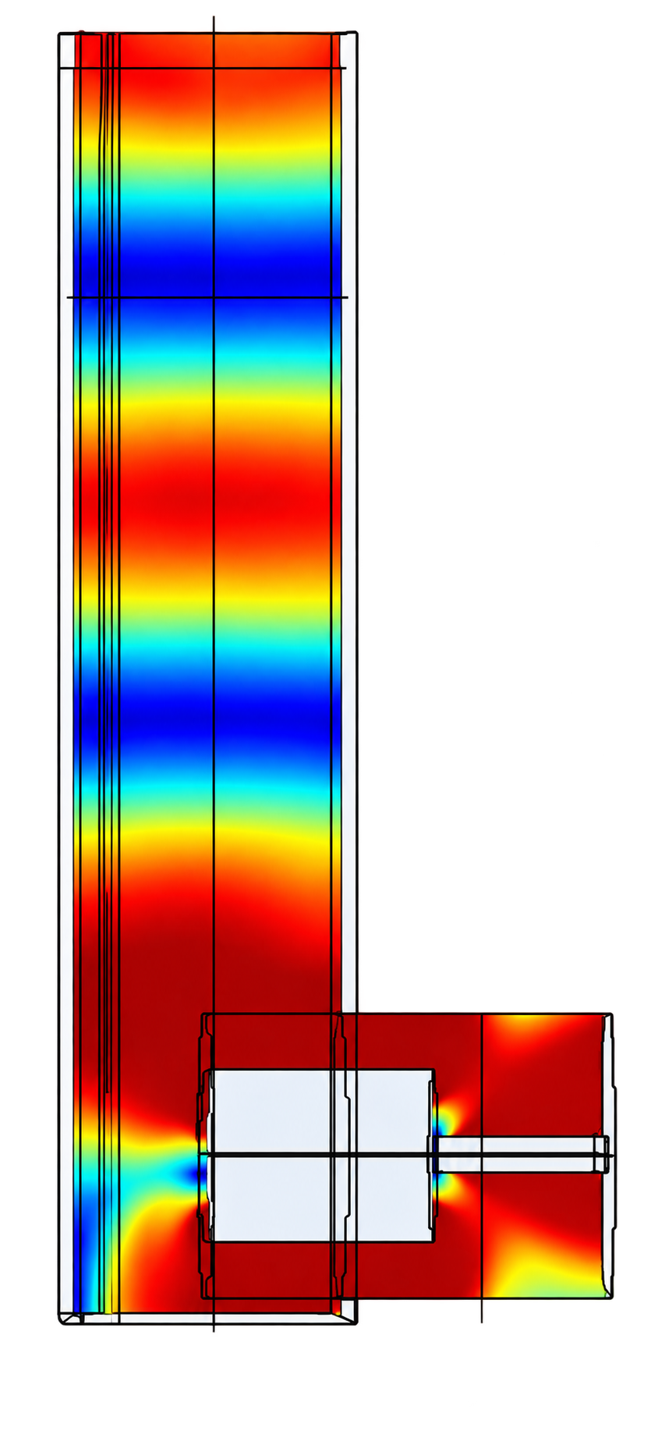
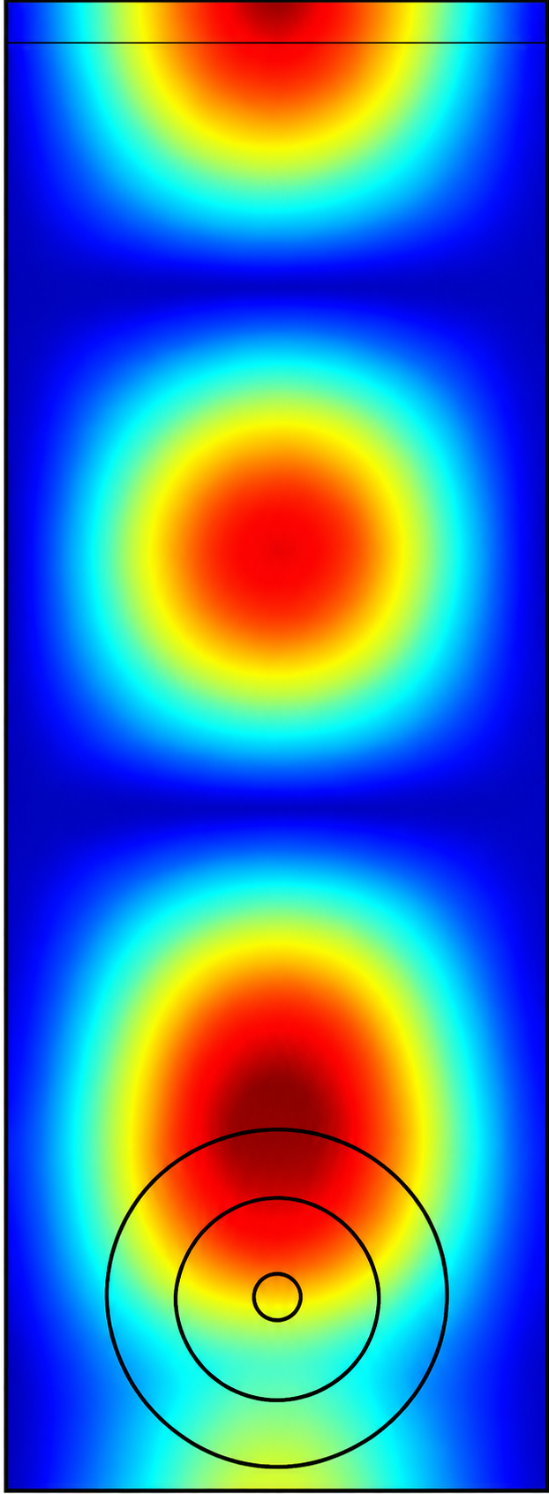
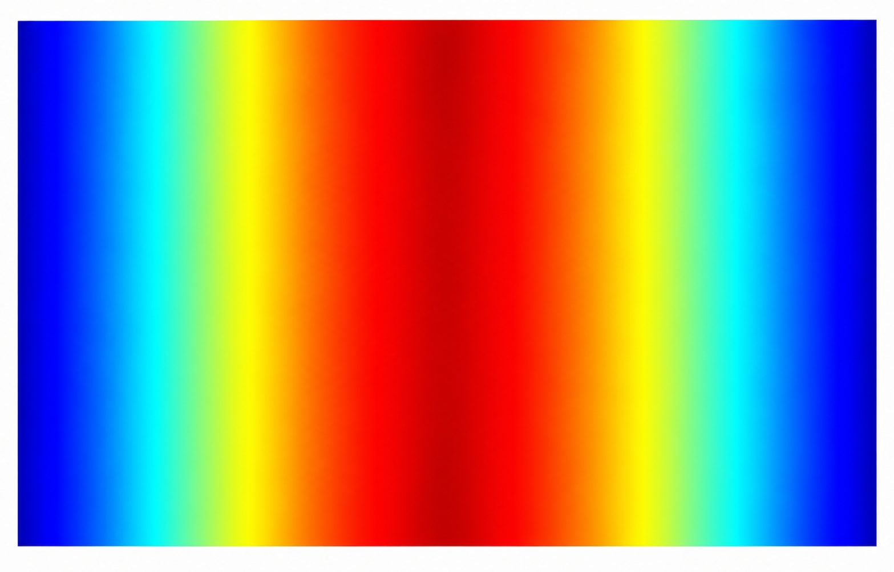

Design Optimization with COMSOL Multiphysics®
Phase Configuration
Design Optimization on Single- vs. Dual-Source
MAX
E-Field
STDEV
OPEN - 0°
(Same Phase)
Dual-Source
Si Waveguide
Top View
Si Waveguide
Si Waveguide
Single-Source
Source
Source
Sample
SHORT - 180°
(Out of Phase)
Each source w/ 1100W @ 2.45 GHz
MIN
Goal is to maximize the electric field at the sample (OPEN) while maintaining high uniformity
Maximum electric field occurs over a period of λ_{Si}/2
Swept key parameters, including source-coupling location and depth, and waveguide dimensions (width, height, thickness, etc.)

Slide 7
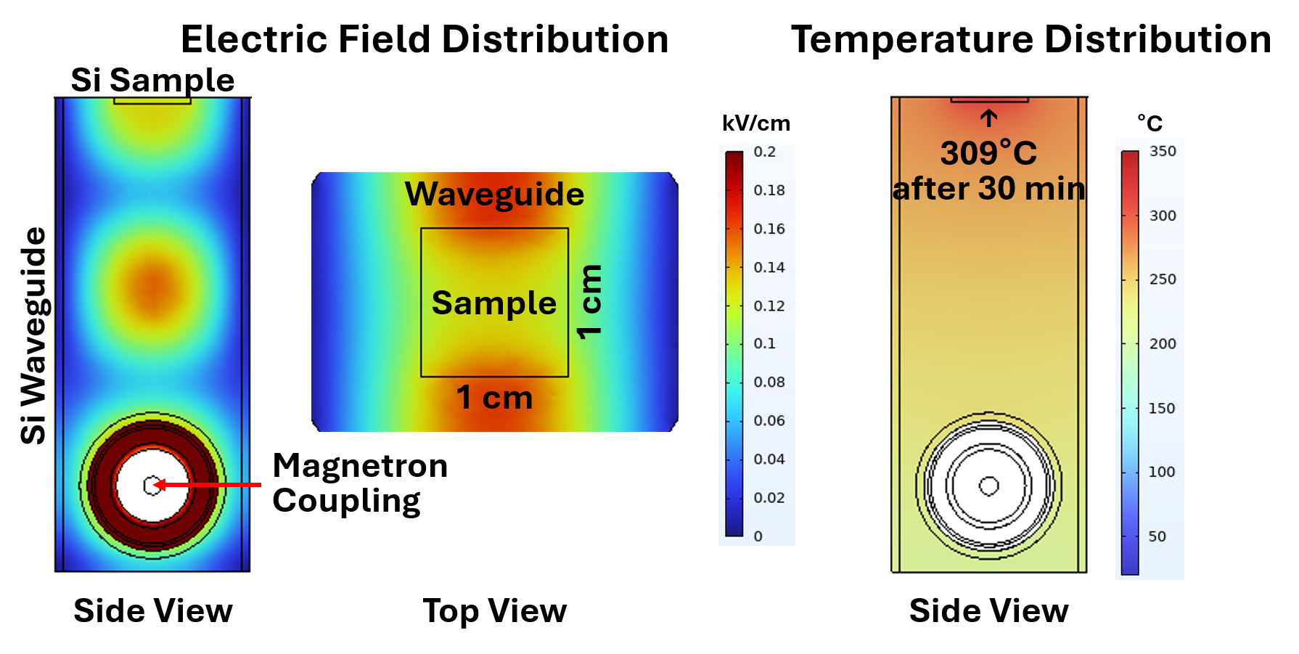
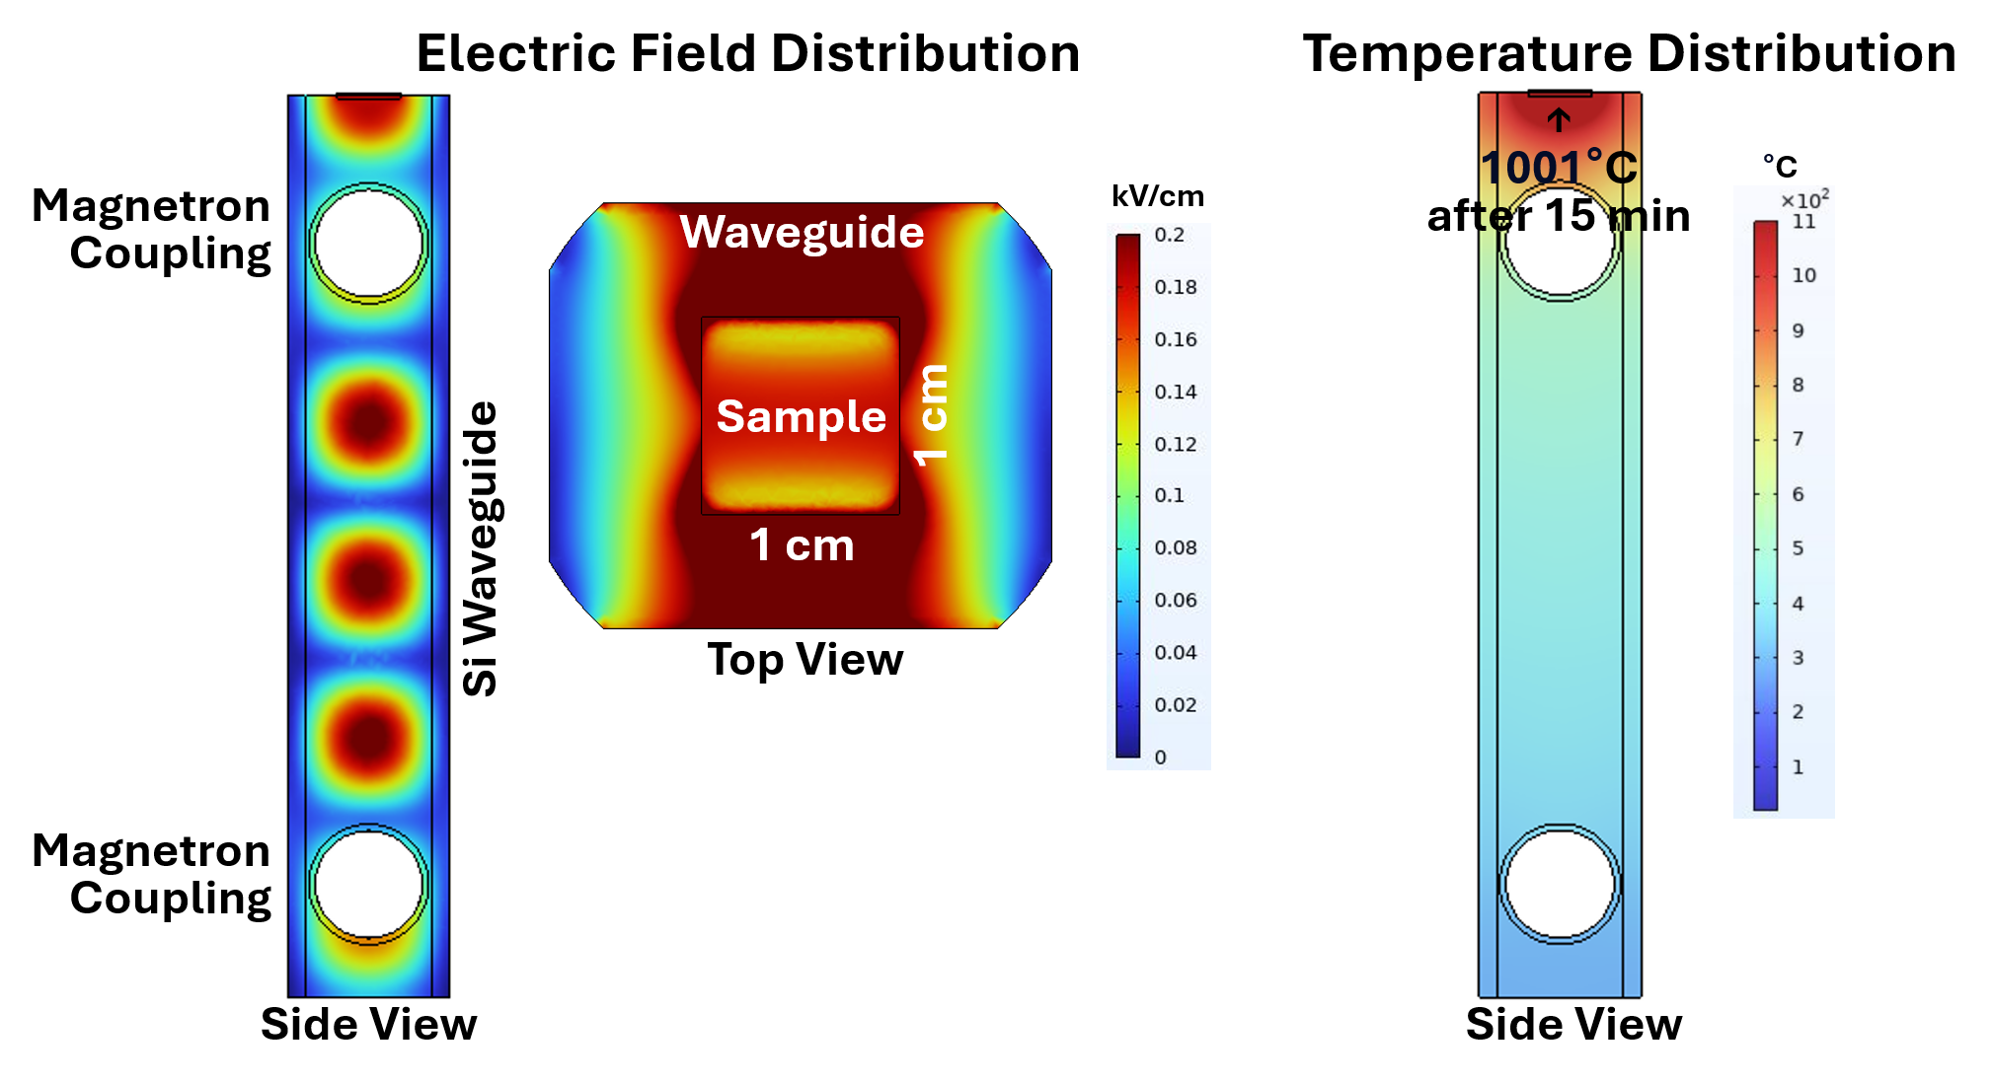

Simulation Results
Single-Source Design
Dual-Source Design
Average electric field = 120 V/cm ± 5%
Average electric field = 420 V/cm ± 5%
Single- and dual-source designs to vary electric field intensity
Both designs maintain electric field uniformity within ± 5%
Dual-source design achieves 3.5x higher electric field intensity (420 vs. 120 V/cm)
Single-source maintains temperature of ~ 300 °C while dual-source reaches ~ 1000 °C

Slide 8
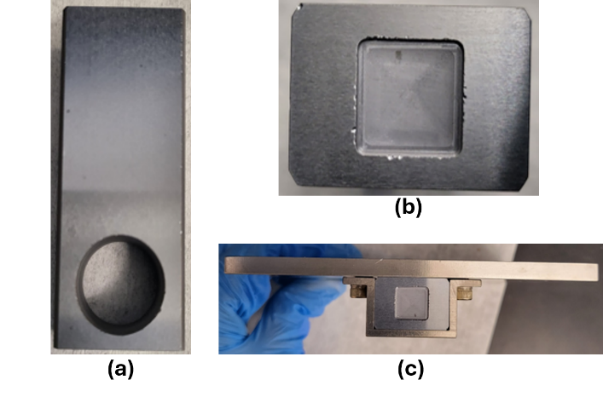
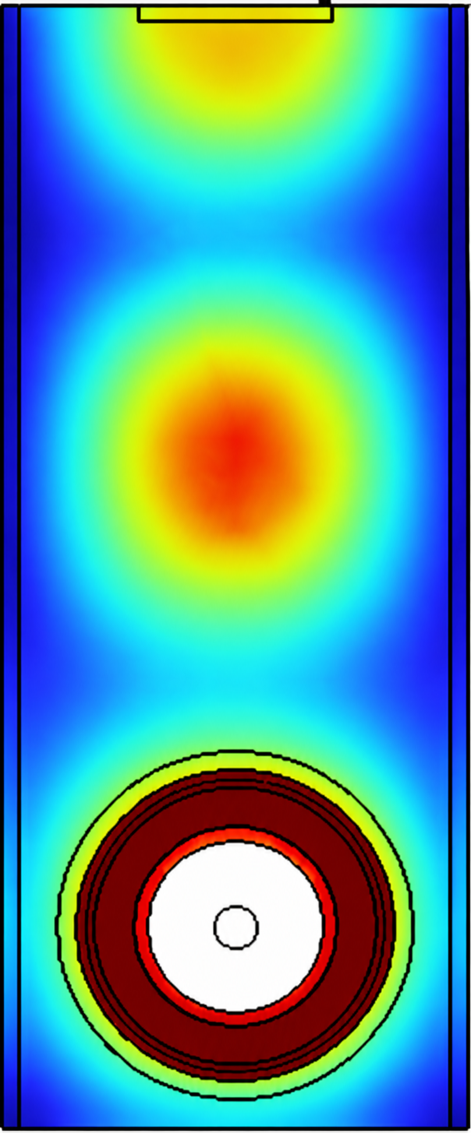
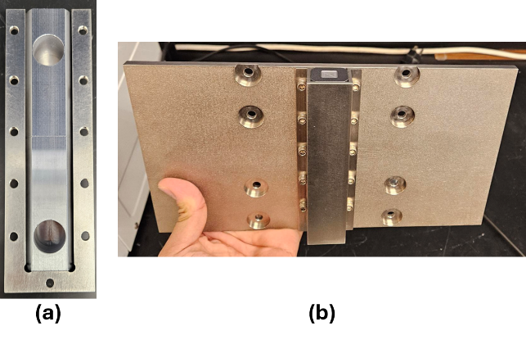
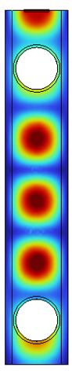
Prototype Microwave Annealer
Single-Source Si Waveguide
Prototype Microwave Annealer
Dual-Source Si Waveguide
Single-crystal Si boule machined into the designed rectangular waveguide
Household microwave oven modified to integrate the Si waveguide
Si waveguides enclosed by titanium (Ti) cladding and a heatsink for thermal management

Slide 9
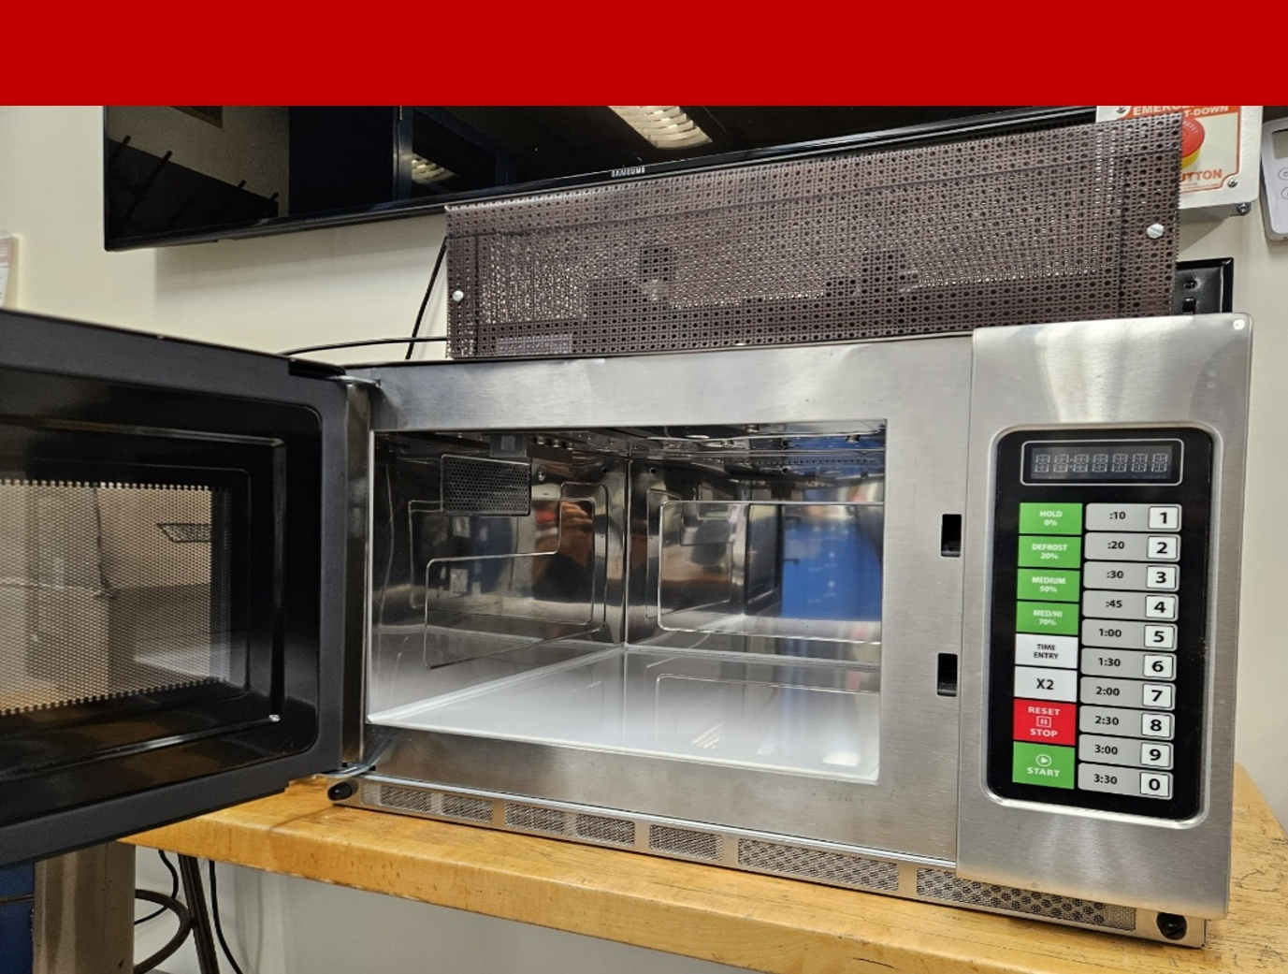
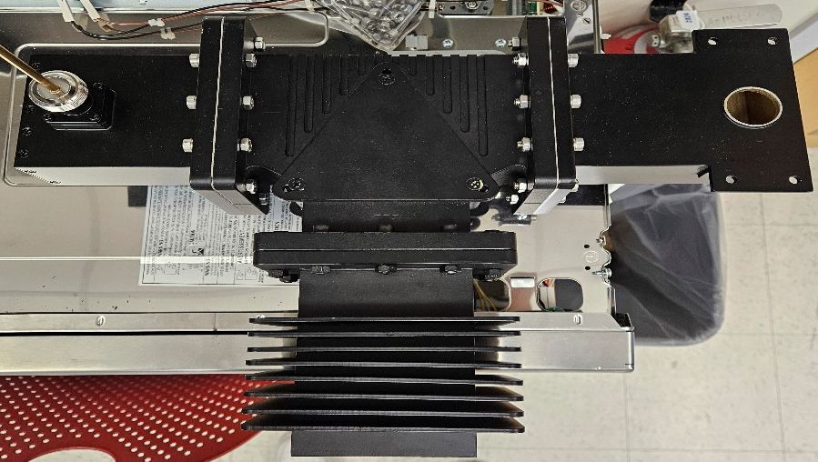
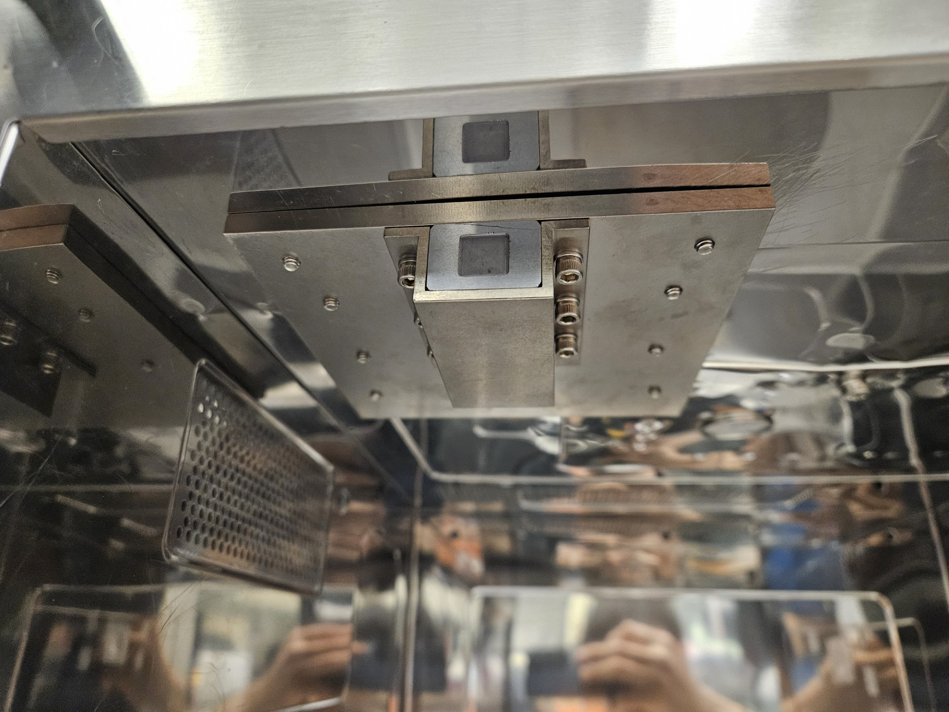
Prototype Microwave Annealer
Commercial Microwave Oven
Adaptor
Isolator
Source
Isolator Assembly
Si Sample
Si Waveguide
Ti Waveguide
Cladding
Upgraded to a higher-power commercial microwave oven
Incorporated an isolator to minimize reflected microwave power
Implemented precise duty-cycle control for improved annealing control

Slide 10

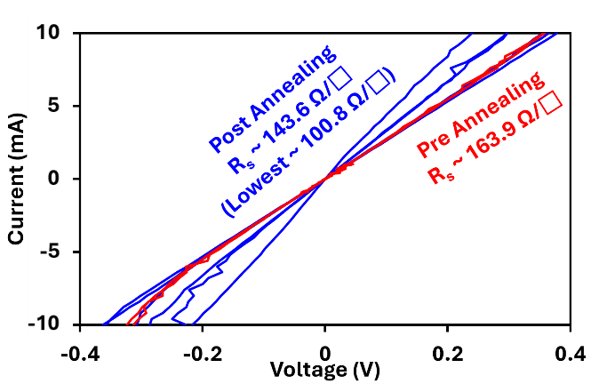




Conclusion
 | Optimized the Si waveguide design using the RF and Heat Transfer modules in COMSOL Multiphysics®
 | Achieved simulated average electric fields of ~ 0.12 kV/cm ± 5.3% for the single-source and ~ 0.42 kV/cm ± 5.2% for dual-source
 | Preliminary MWA of P-doped Si above the equilibrium solubility limit reduced the sheet resistance from ~ 164 to ~ 144 Ω/□, corresponding to ~ 12% reduction.
 | The waveguide architecture can be scaled to larger samples by adjusting the waveguide dimensions and operating frequency
 | The approach is also being extended to other semiconductor materials, including GaN and Ga₂O₃.
Sheet Resistance Measurement Before and After MWA
Enhanced electrical performance

Slide 11




Acknowledgement

Slide 12


Thank you for listening!
Questions?

