Slide 1
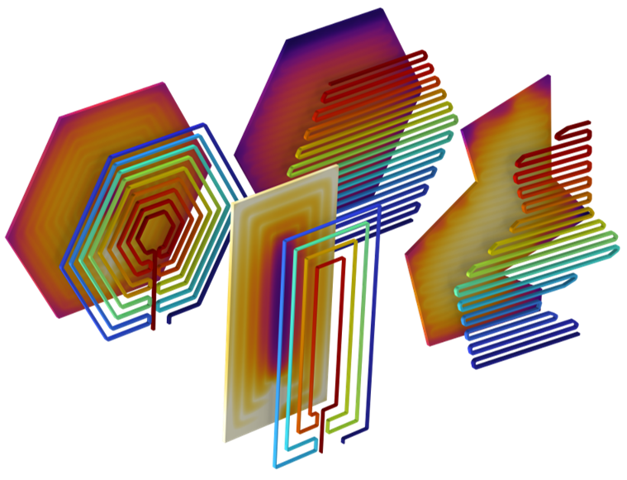
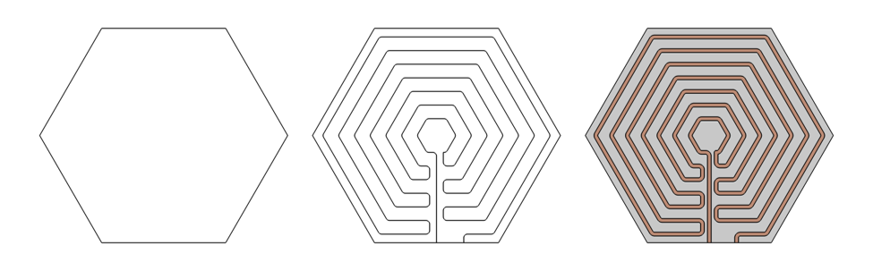
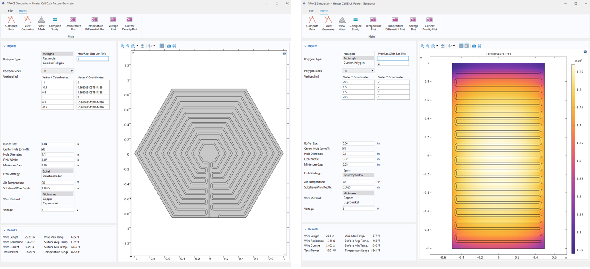

Extending COMSOL with Custom Code: A Plug-In for Heating and Cooling Element Design
COMSOL’s convenient Java API can be leveraged to automate space-filling path generation algorithms for applications such as resistive traces or coolant paths.
A. Taylor¹, J. Frankel¹, N. Tenorio¹
1. TRACE Simulation, a division of Triton Systems, Inc., Chelmsford, MA, USA.
Introduction
Resistive heating elements and conductive cooling networks are everywhere, from heated aircraft wings and spacecraft thermal panels, to electric vehicle battery films, microfluidic PCR chips, and refrigeration coils. Despite the breadth of these applications, they share a common challenge: achieving uniform temperature across complex two-dimensional surfaces and maximizing use of available area. The trace that snakes across the surface is the central design variable governing thermal behavior. Conventional designs frequently rely on manual or templated patterns that leave surface area underutilized and produce non-uniform thermal distributions.
To address this gap, Triton Systems’ TRACE Simulation division designed and implemented a custom subroutine as a plug-in extension to COMSOL Multiphysics, written with COMSOL's native Java API. COMSOL 6.3 introduced an interactive Java Shell window, streamlining this integration process. The plug-in accepts arbitrary input polygons of any shape or size, along with user-defined parameters to constrain aspects of the generated path.
Methodology
Our application utilizes COMSOL’s Java API to automate the etch pattern of a heating cell’s resistive element. This custom, compiled Java library requires only the outer vertices of the element, path/trace constraints, and the user’s choice of etch strategy to optimize area utilization and maximize resistivity for any shape. Handling is provided for both convex and concave polygons through implementation of two geometry-agnostic path planning algorithms.
The “Spiral” setting, best suited for convex polygons, uses an optimization algorithm that begins by generating concentric contours, calculating optimally-spaced connections between the two, then algorithmically determining how to anneal the polyline to ensure a safe path from source node to sink node. A second strategy, boustrophedon rastering, is used on convex or highly intricate element shapes, sectioning each polygon into well-conditioned subsections and dividing them into smooth rasters with full coverage.
FIGURE #1. From left – an arbitrary closed polygon is defined, an etch path is algorithmically generated and filleted, and lastly the path and base are thickened/solidified for meshing and simulation.
Results
Once generated, the optimized path is automatically passed back into COMSOL, populating a parametric geometry and launching a coupled multiphysics study. Studies combine the AC/DC and Heat Transfer modules for resistive heating cases or Heat Transfer with CFD for fluid-based cooling cases. Simulations evaluate temperature uniformity, peak and minimum temperatures, and overall thermal distribution. In a recent demonstration, the plug-in was used to refine etch patterns for hexagonal, circular, rectangular, and square heating elements, achieving etch length improvements of approximately 15% over baseline commercial designs.
By packaging algorithmic path optimization and COMSOL-based multiphysics validation into a single automated workflow, the plug-in reduces material usage, minimizes hot- and cold-spot risk, accelerates time-to-prototype, and supports the design of next-generation thermal management solutions across virtually every market that depends on precise surface-level heating or cooling.
FIGURE #2. Example application window allows for selection of path generation parameters, bounding polygon vertices (or regular hex/rectangle), and choice of algorithm/strategy to generate the etch path.

Slide 3
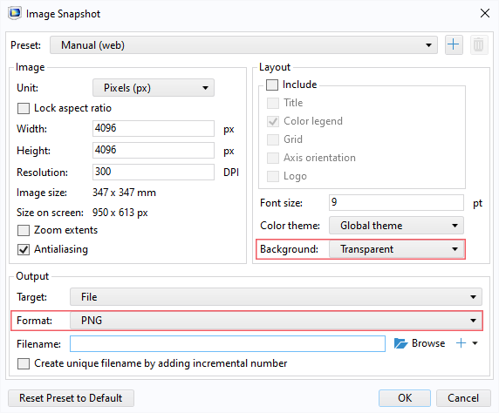
Guidelines
General Notes for Using the Template
Do not adjust the template; work within it. See the examples provided.
Left align text within textboxes, and do not justify your text.
Titles are the largest font on the slide (90–120 pt.), then subtitles (70–80 pt.). Captions, references, and affiliation are the smallest text (18–40 pt.).
Titles and subtitles are bold; any other use of bold should be for emphasis.
Text is either black or grey and should only be adjusted for diagrams.
Images can be adjusted and fitted into the boxes using the Crop feature. (In PowerPoint: Format tab → Size section on the right → Crop.)
Please keep in mind:
The solid red lines are the 3 mm that will be cut off during printing.
The dotted lines represent a small margin that may or may not be cut off during printing.
Exporting an Image for the Header
The settings shown on the right export the highest quality image with a transparent background.
The most important settings to use are the two outlined in pink. This will export an image that can be placed in the blue space of the header.

Slide 4
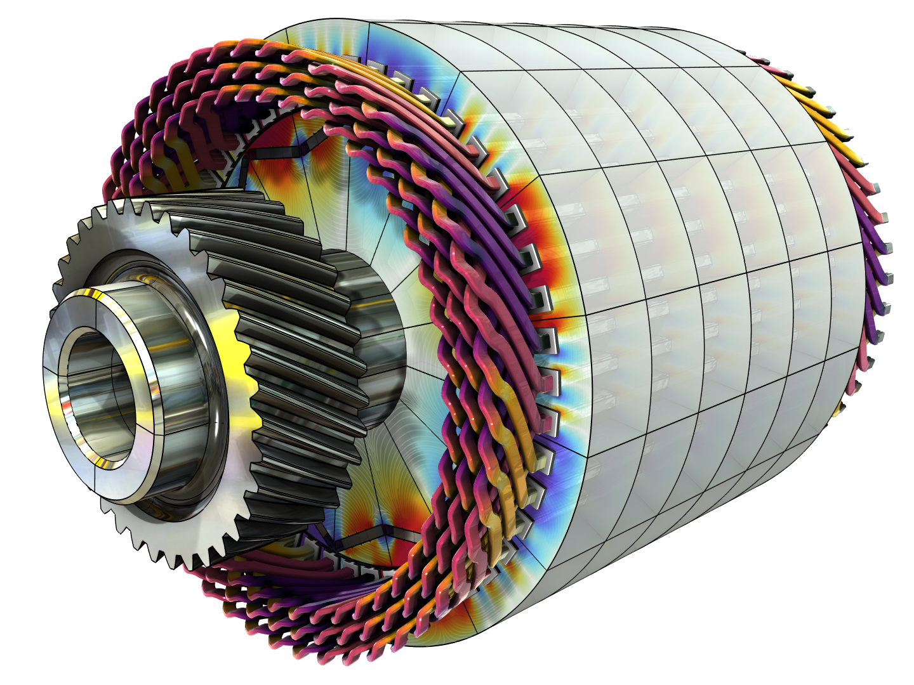
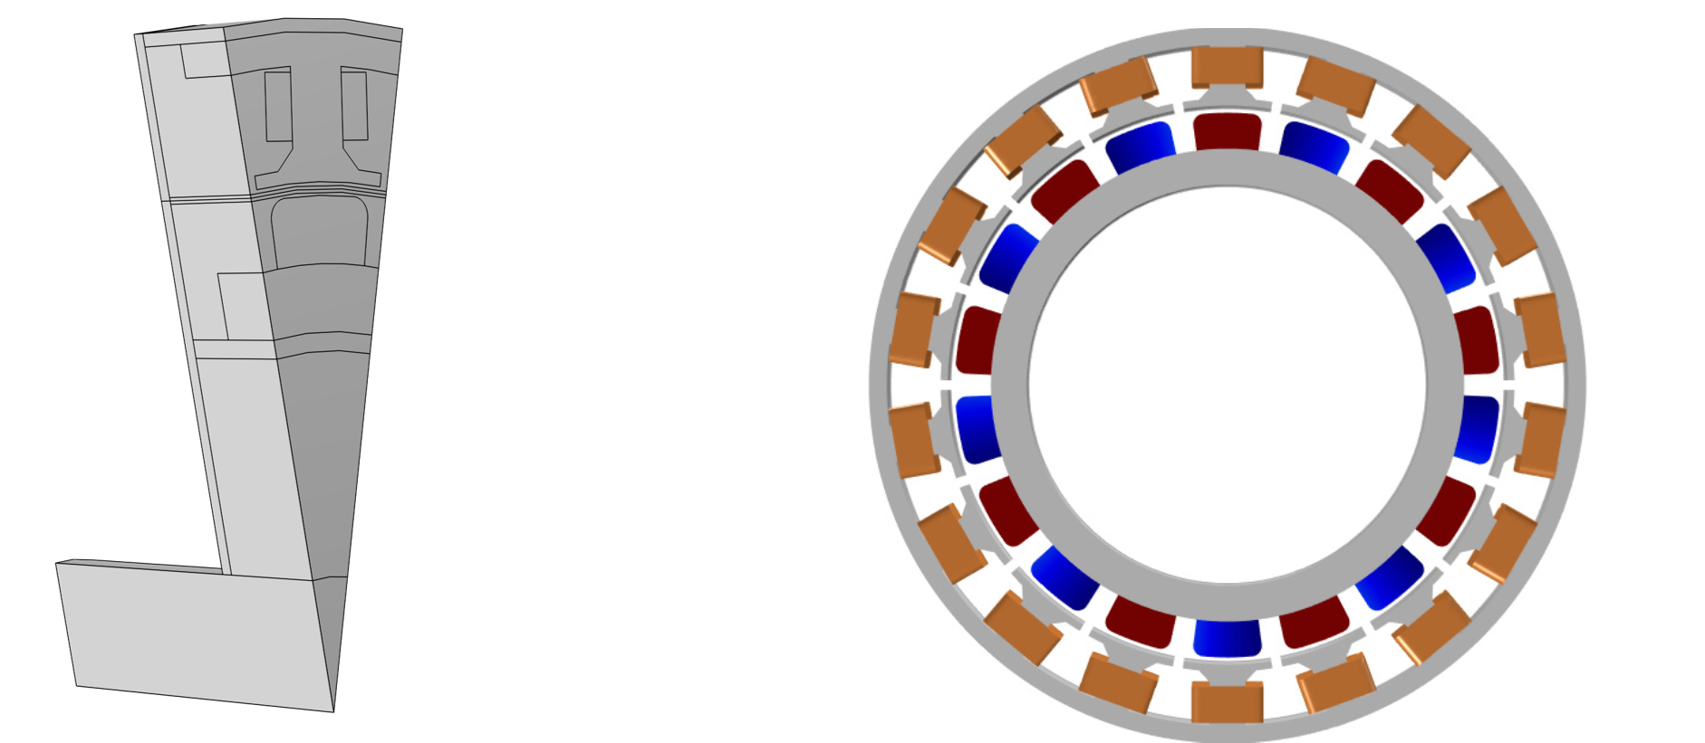
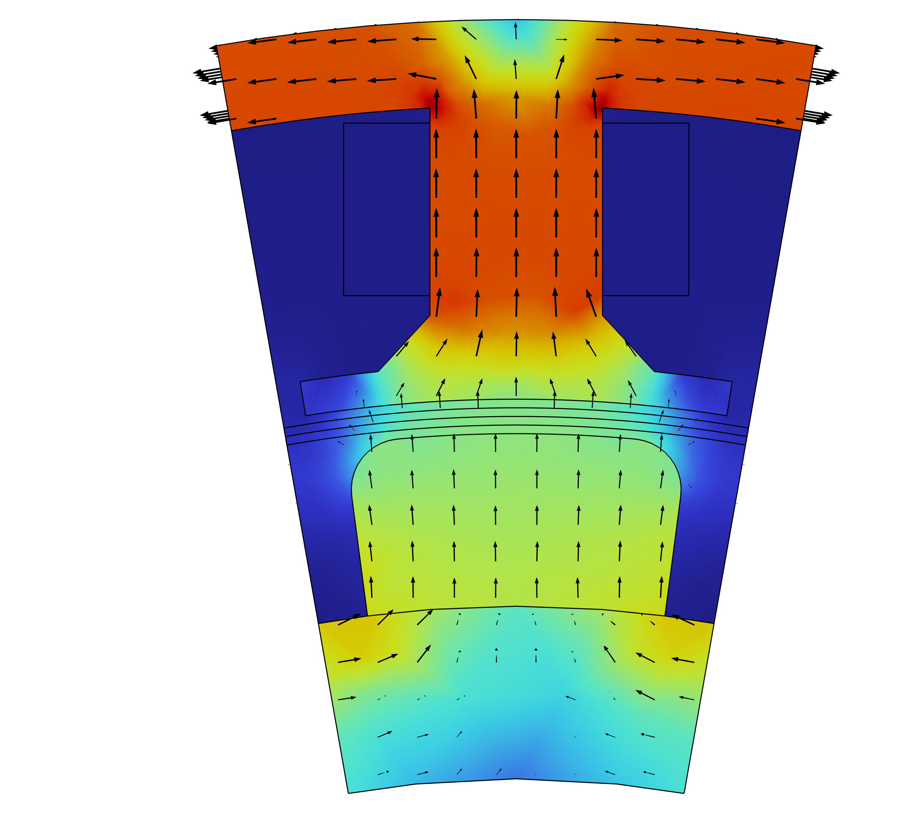
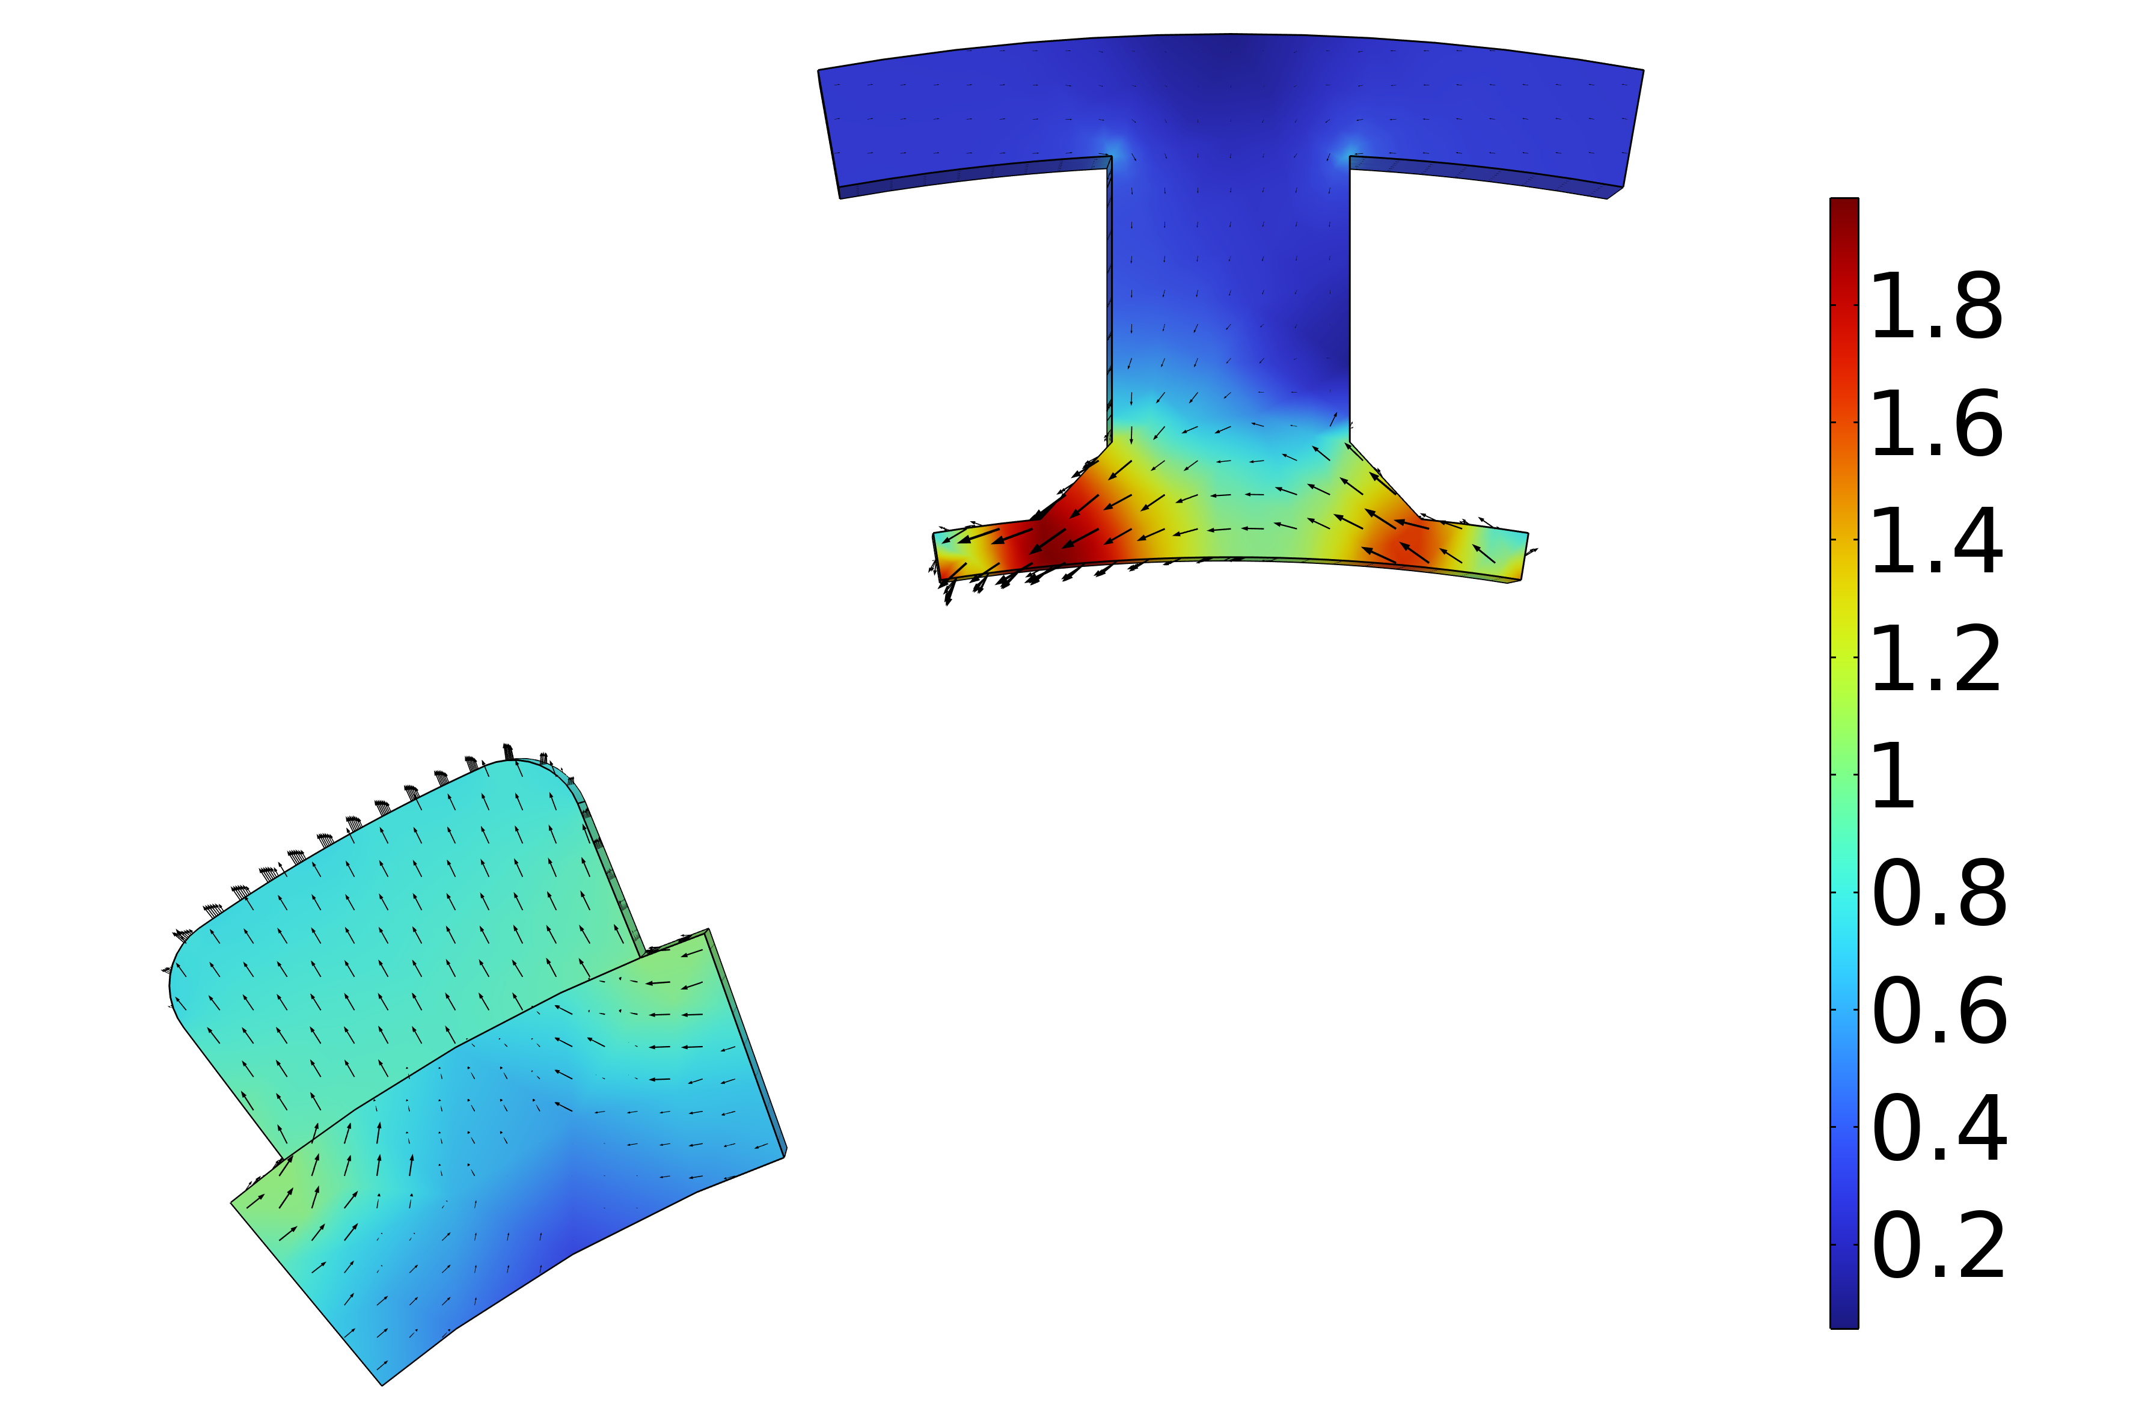

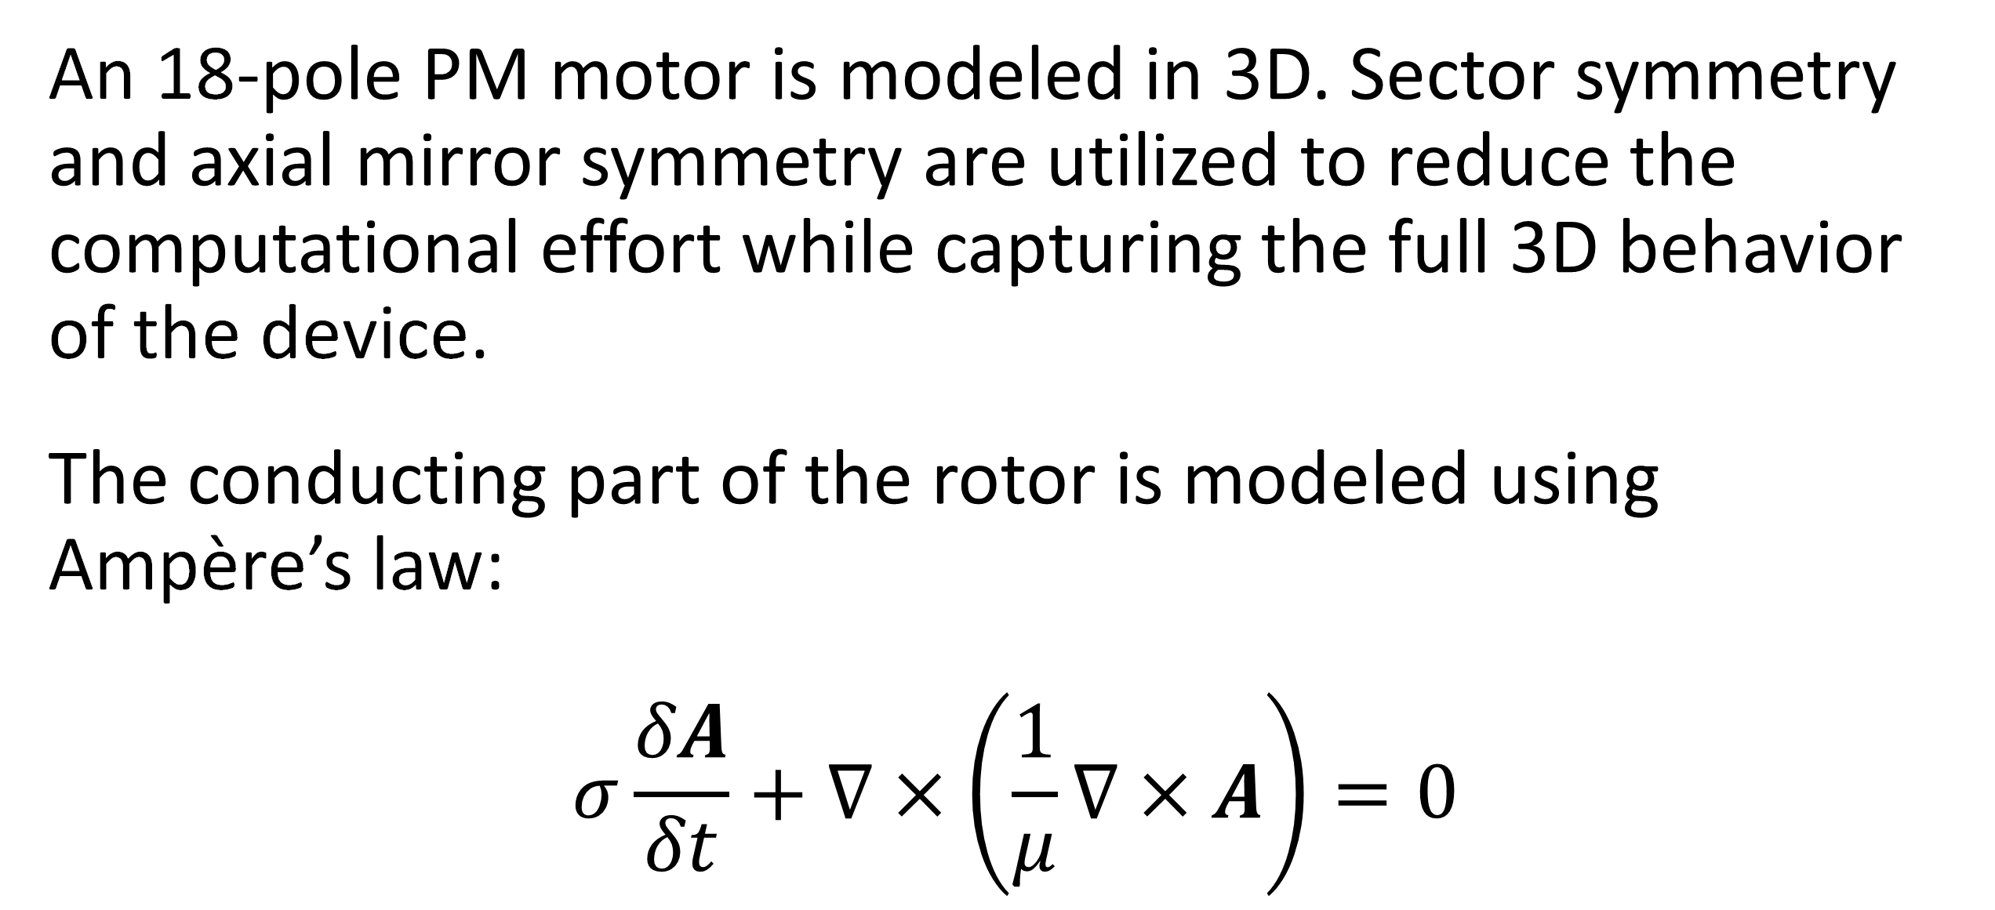
Analysis of a Permanent Magnet Motor in 3D
Optimize permanent magnet (PM) motor performance by understanding their full behavior, including sensitivity to high temperatures.
J. A. Smith¹, M. B. Smith²
1. Department (if applicable), Organization, City, Country.
2. Department (if applicable), Organization, City, Country.
Abstract
While PM motors are valued for the energy savings that they provide, there are some design limitations to address. For example, permanent magnets are sensitive to high temperatures. Such temperatures can occur when currents, particularly eddy currents, generate heat losses.
The findings offer greater insight into the behavior of PM motors, particularly by capturing the eddy current losses that occur within the magnets. This information serves as a useful resource for improving the design of PM motors, and therefore the technology they help power.
Methodology
An 18-pole PM motor is modeled in 3D. Sector symmetry and axial mirror symmetry are utilized to reduce the computational effort while capturing the full 3D behavior of the device.
The conducting part of the rotor is modeled using Ampère’s law:
$$σ\frac{δA}{δt}+∇×\left(\frac{1}{μ}∇×A\right)=0$$
FIGURE 1. Left: Permanent motor sector. Right: Drawing of the PM motor.
Results
The results can be seen in Figure 2, which shows the magnetic flux density for the motor in it’s stationary state, that is, the initial conditions for the time-dependent simulation. In this state, the coil current is zero. It also shows the magnetic flux density for the motor after revolving one sector angle. In this plot, the air and coil domains are excluded in order to get a better view.
FIGURE 2. Left: Magnetic flux density from the permanent magnets with only the rotor at rest. Right: Magnetic flux density after revolving one sector angle.
1. Author first initial and last name, “Article Title”, Journal, Volume (vol.), Page numbers (pp.), Year.
2. Author first initial and last name, “Article Title”, Journal, Volume (vol.), Page numbers (pp.), Year.
3. Author first initial and last name, “Article Title”, Journal, Volume (vol.), Page numbers (pp.), Year.

Slide 5
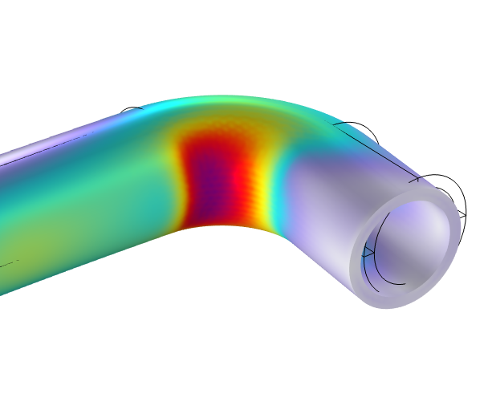
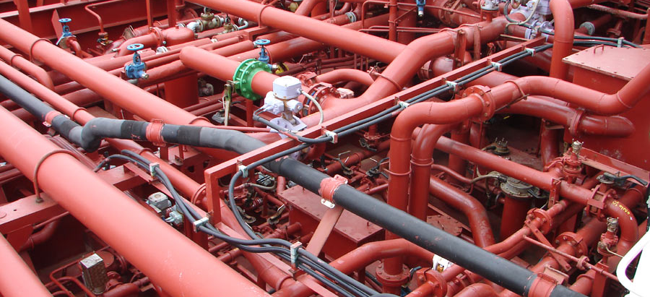
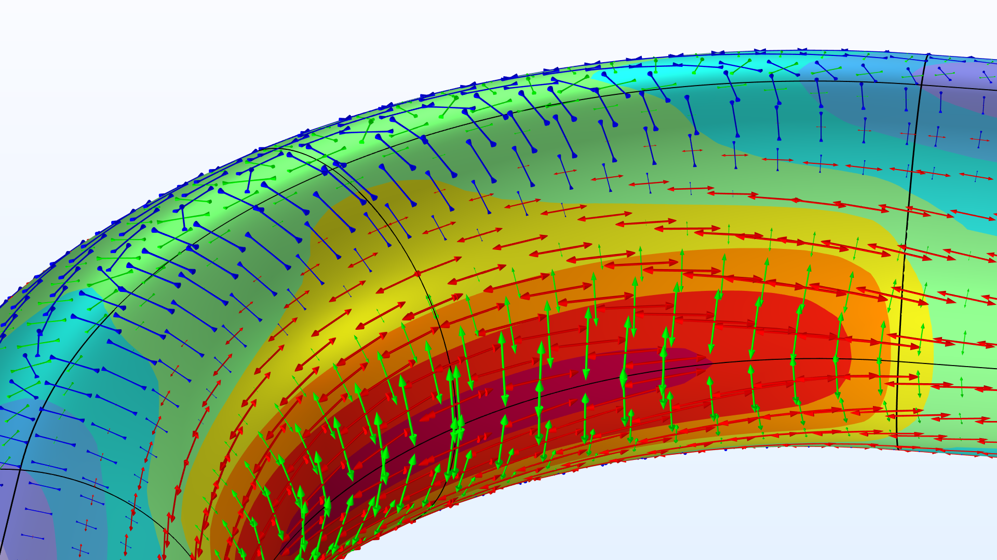
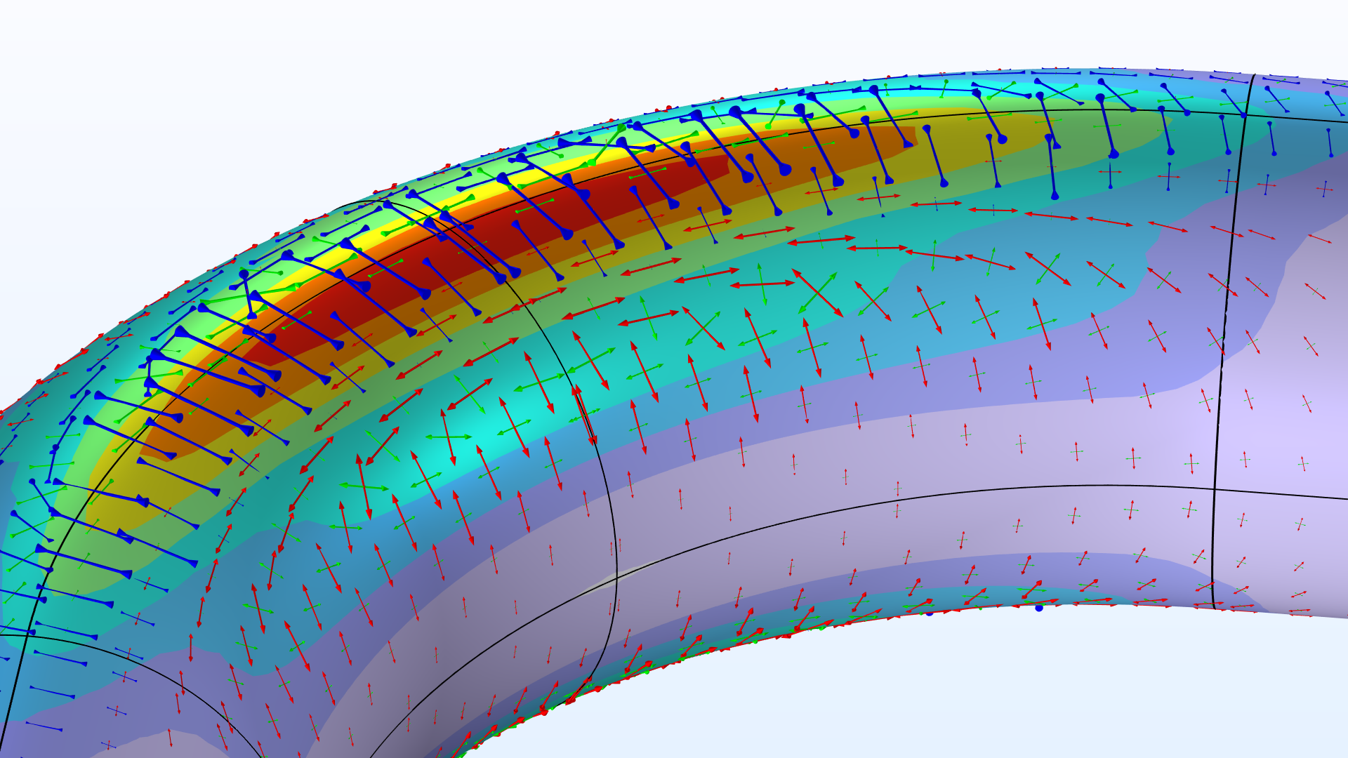
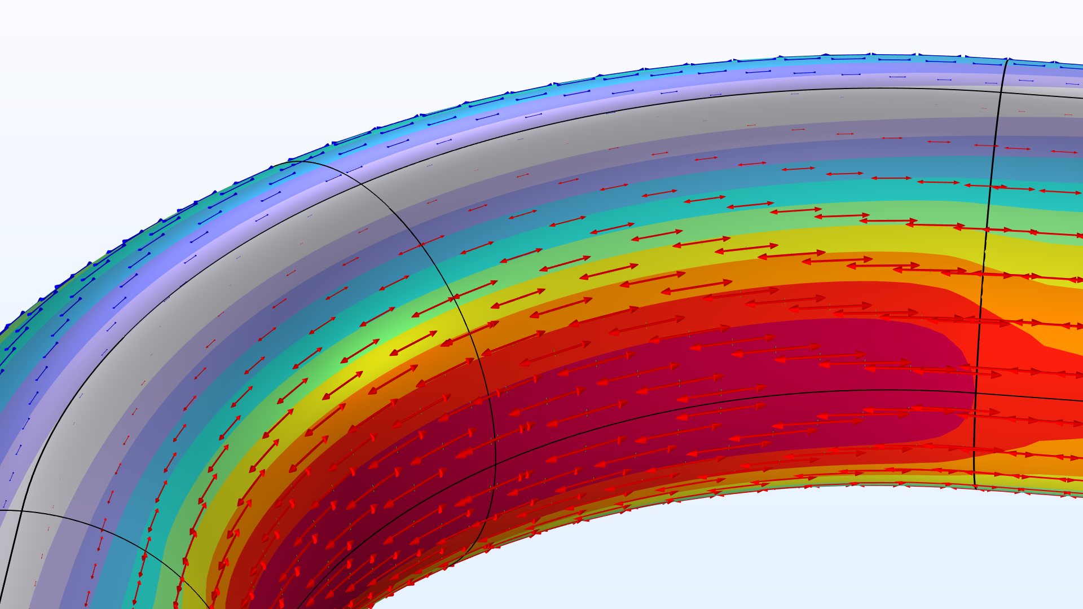
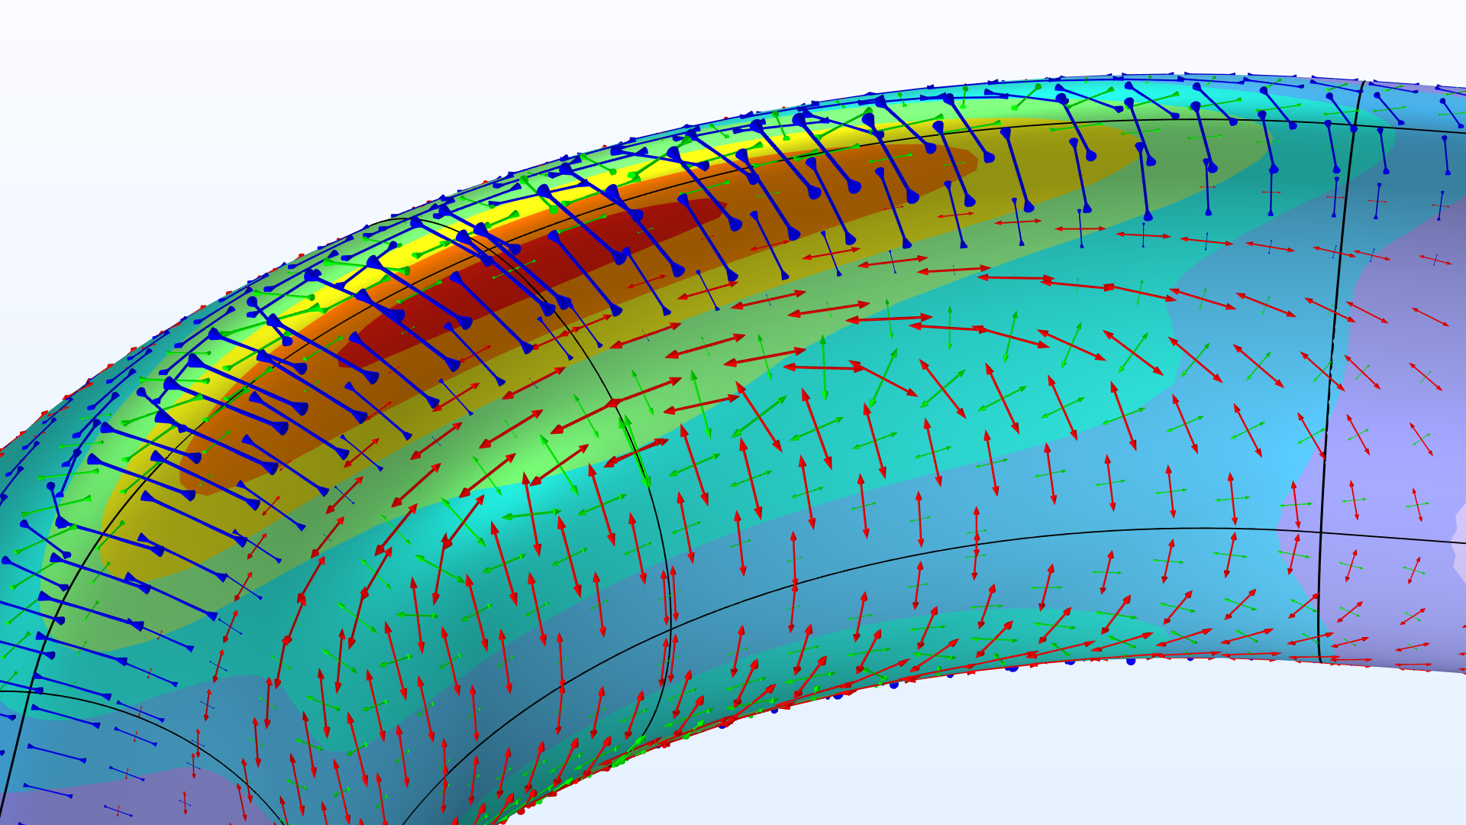
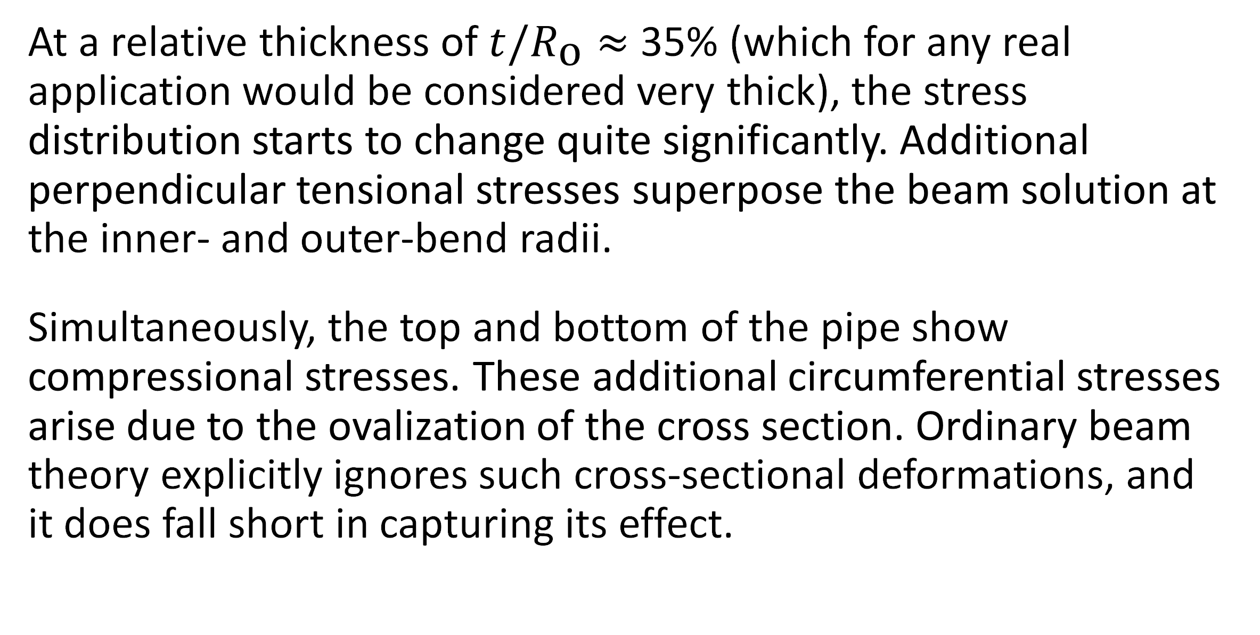
The Intriguing Stresses in Pipe Bends
For many structural engineers, beam theory is a popular analysis tool. Using the equations can be beneficial when considering structural behavior, as they are easy to apply and provide useful results. This work investigates one such case.
J. A. Smith¹, M. B. Smith²
1. Department (if applicable), Organization, City, Country.
2. Department (if applicable), Organization, City, Country.
Introduction & Goals
Pipe bends are common in piping systems, which typically transport liquids or gas, often under high pressure. One place where you may find a lot of pipes are oil tankers. The labyrinthine piping systems can look pretty fascinating.
Many piping standards (or codes) used for industrial applications are based on beam theory when it comes to the structural analysis. But, as we have already discovered, pipe bends generally do not behave like beams. When digging into piping standards, you will find a lot of information dedicated to pipe bends. In particular, piping standards recommend to apply correction factors to the stiffness and stresses for curved pipe sections. (Ref. 1)
Methodology
The pipe is slender with a constant cross section, so it would seem like a natural choice to treat such a structure as a beam in a simplified analysis. The bending moment is the only load acting on the structure, and it’s thus constant for any given section along the entire beam axis.
The maximum stress even occurs on the inside of the pipe. The cross section of the bend also deforms significantly, and, more specifically, it ovalizes with the major axis either being oriented in the bend plane or perpendicular to it depending on the direction of the bending moment.
FIGURE 1. Piping systems on an oil/chemical tanker. Image licensed under CC BY-SA 3.0 via Wikimedia Commons.
Results
At a relative thickness of $t/R_{\text{o}}≈$ 35% (which for any real application would be considered very thick), the stress distribution starts to change quite significantly. Additional perpendicular tensional stresses superpose the beam solution at the inner- and outer-bend radii.
Simultaneously, the top and bottom of the pipe show compressional stresses. These additional circumferential stresses arise due to the ovalization of the cross section. Ordinary beam theory explicitly ignores such cross-sectional deformations, and it does fall short in capturing its effect.
FIGURE 2. View of the pipe bend showing the von Mises stress (normalized) and principal stresses for different wall thicknesses.
E.A. Wais and E.C. Rodabaugh, “Background of SIFs and Stress Indices for Moment Loadings of Piping Components”, United States, 2005; https://www.osti.gov/biblio/841246
“Stress Intensification Factors (i-Factors), Flexibility Factors (k-Factors), and Their Determination for Metallic Piping Components”, ASME, 2017; https://www.asme.org/codes-standards/find-codes-standards/b31j-stress-intensification-factors-flexibility-factors-determination-metallic-piping-components/2017/drm-enabled-pdf

