Slide 1
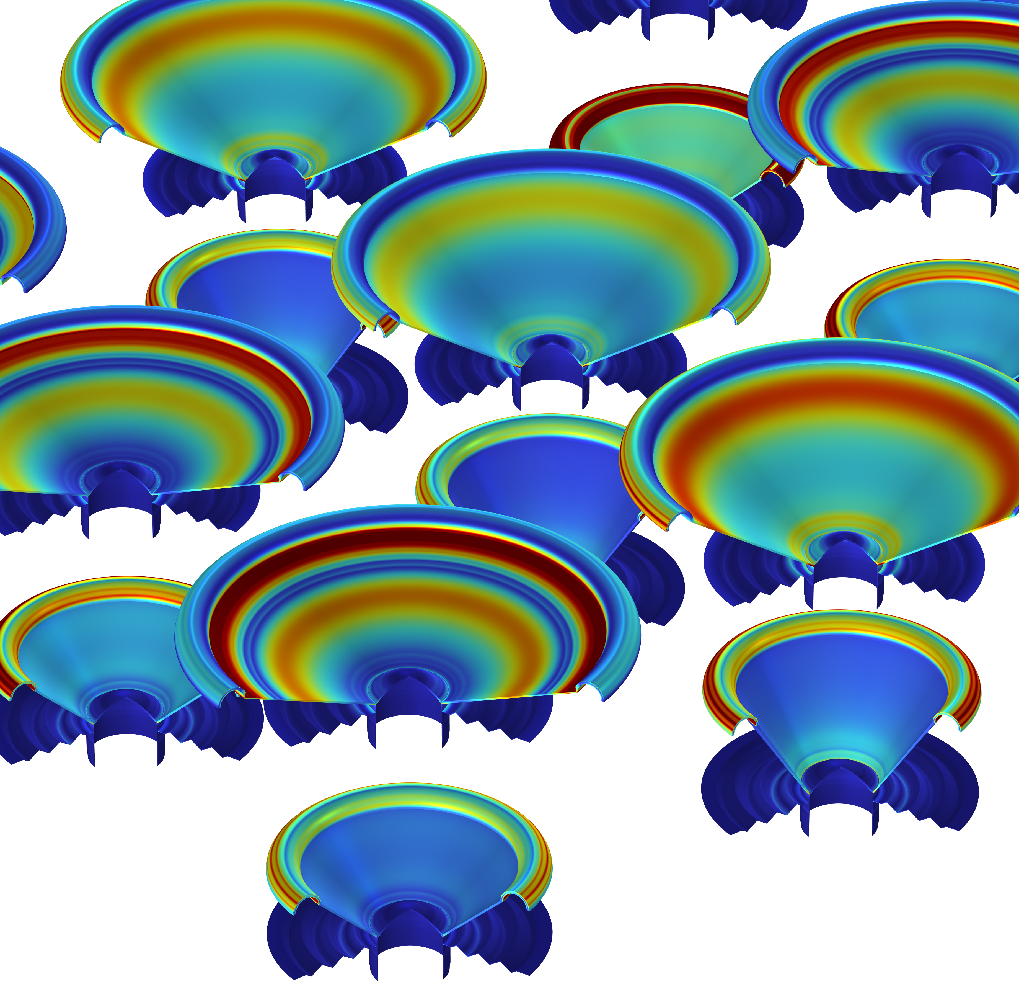
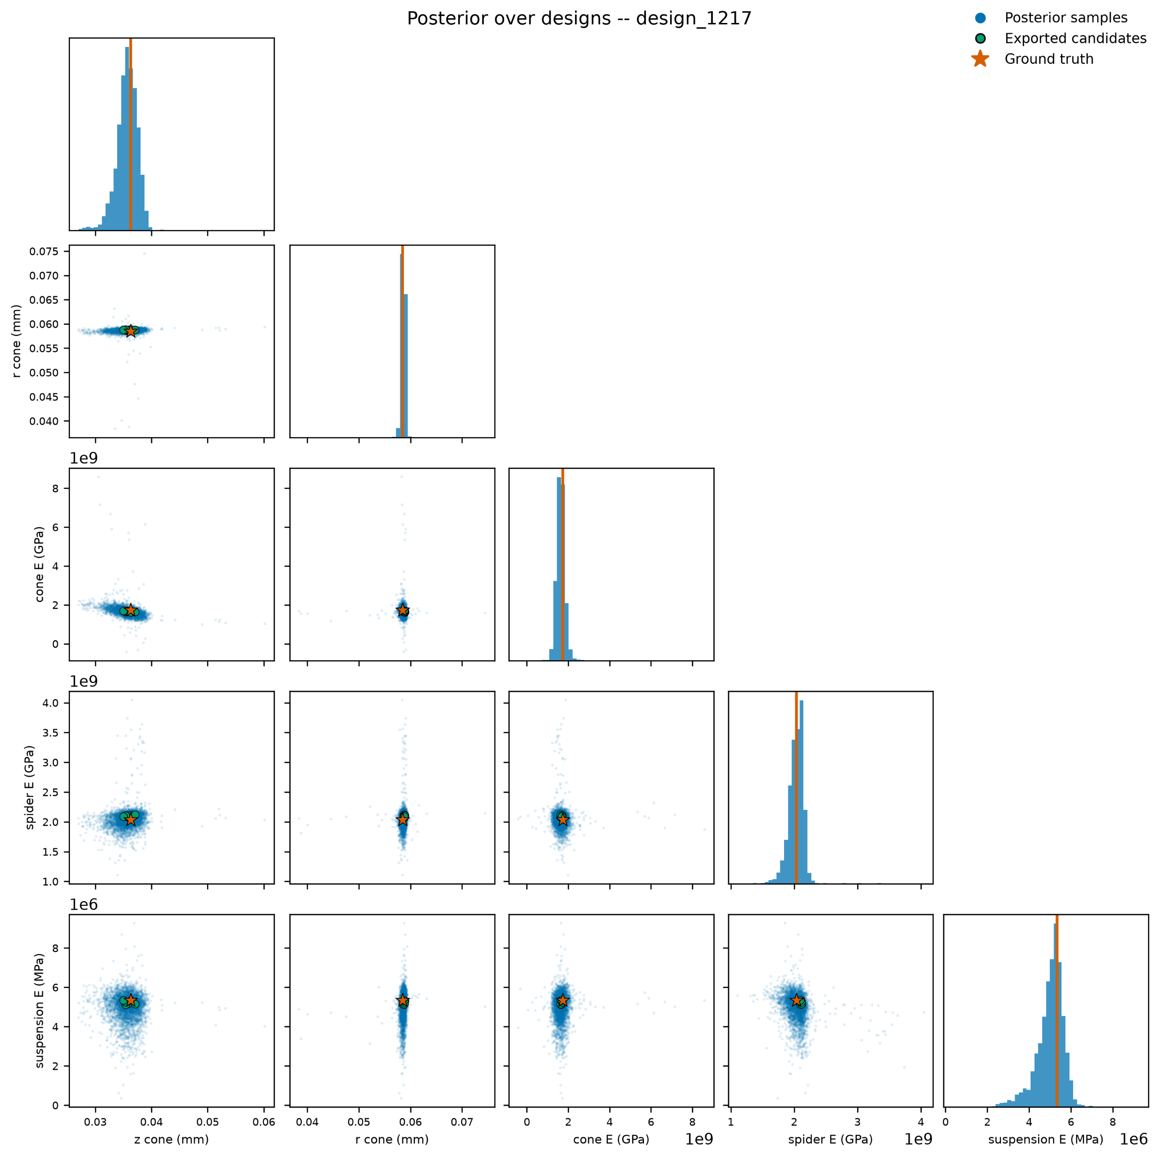
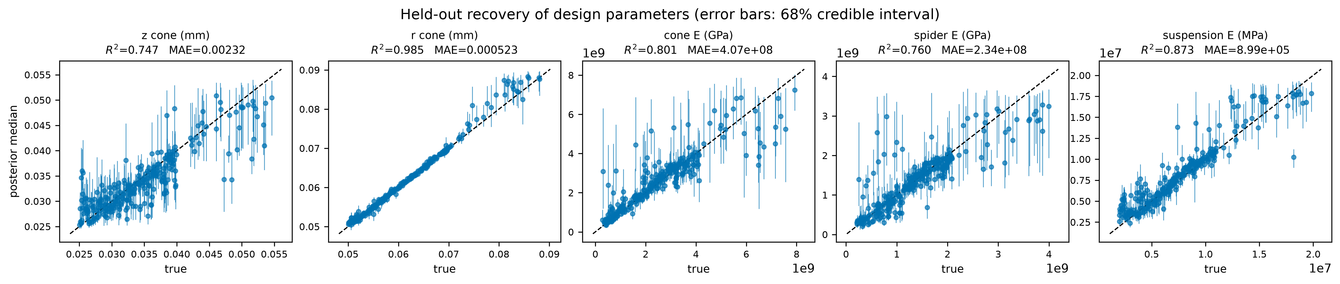
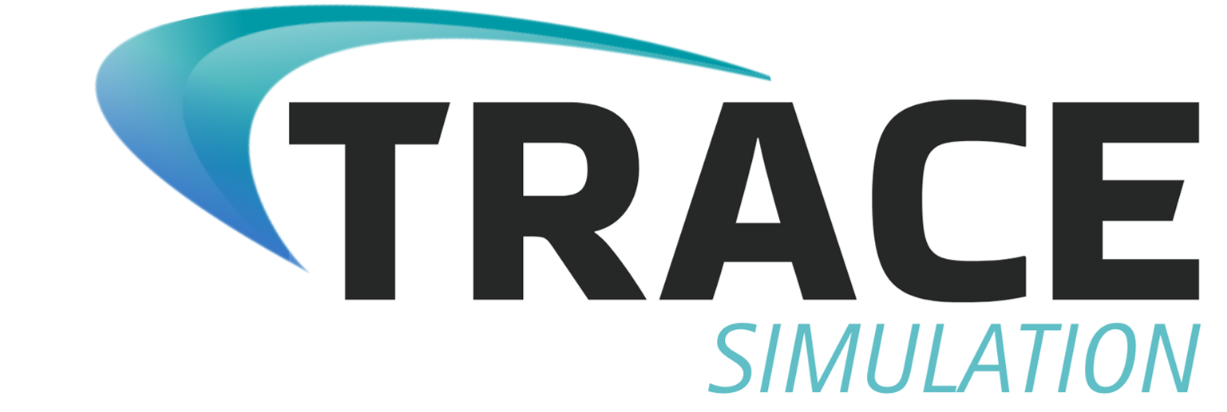
DesignSpace AI:
Mapping Every Solution to Your Multiphysics Design Problem
Conventional optimization techniques recommend one optimal design solution. This custom AI maps the entire landscape of optimal design combinations given a target performance using parametric sweep data.
Nate Tenorio¹, Abby Taylor¹, Josh Frankel¹
1. TRACE Simulation, a division of Triton Systems, Inc., Chelmsford, MA, USA. ​
Introduction
Engineering design is an inverse problem. A designer knows the performance they need and wants to know which combinations of design parameters will deliver it. Conventional optimization answers a narrower question: given constraints and an objective, what is the single best design? That formulation collapses a rich, multimodal solution space into one point estimate, hiding numerous equally valid alternatives that may better suit downstream constraints on cost or manufacturability.
COMSOL Multiphysics is an excellent tool for exploring this space, but generating a continuous set of all possible input-output mappings is not tractable by parametric sweeps alone.
DesignSpace AI closes that gap. It is a generative machine learning tool purpose-built for inverse engineering design, returning the full feasible design manifold for a multiphysics system in seconds rather than a single optimum.
Methodology
DesignSpace AI uses a modern, multimodal machine learning architecture optimized for challenging regressions using deep learning and generative techniques.
Loudspeakers are an ideal multiphysics testbed, coupling structural, electromagnetic, and acoustic behavior. COMSOL ran a parametric sweep across key mechanical performance parameters: cone diameter, cone depth, spider stiffness, cone stiffness, and support stiffness. The Acoustics, Structural Mechanics, and AC/DC Modules predicted sensitivity, low-frequency cutoff, frequency response flatness, and total harmonic distortion for each configuration. The resulting dataset trained DesignSpace AI.
FIGURE #1. Graphic showing “sampling tree” of learned representations of the co-interaction of design variables for a system with prescribed performance. Smaller, well-centered “clouds” indicate effective understanding of variable co-interaction. This suggests that small perturbations (for example, if z_cone is fixed slightly away from the “nominal”) can be mitigated, as the model can effectively reconstruct equivalent performance through shifting other variables.
Results
Trained on the loudspeaker dataset, DesignSpace AI prescribes designs that recreate sensitivity, -3 dB frequency cutoffs across selected octave bands corresponding to bass, tenor, and treble, and effective directivity within 2% mean absolute error. Training reduces estimation standard deviation by up to 90% relative to the untrained prior. Across thousands of sampled designs, fewer than 0.1% fall outside predicted uncertainty bounds.
The methodology is domain-agnostic. DesignSpace AI has been validated in chemical filter design, robotic path planning and trajectory analysis, and antitamper detection in additive manufacturing. The same workflow extends to antenna arrays, heat exchangers, battery cells, MEMS resonators, biomedical implants, aerodynamic surfaces, and any multiphysics system where designers must navigate a competing-constraint trade-space.
FIGURE #2. Recovery of design parameters from “Test” data set. Perfect recreation of design parameters would be represented as a straight line along the diagonal. The effect of speaker cone radius is easiest for the model to map to speaker performance metrics, while cone depth and spider stiffness present effective mean predictions with higher uncertainty bounds. Of thousands of sampled designs, only 1-2 design permutations fall outside of uncertainty bounds, and these typically represent unusual/uncommon desired performance metrics.

