Slide 1
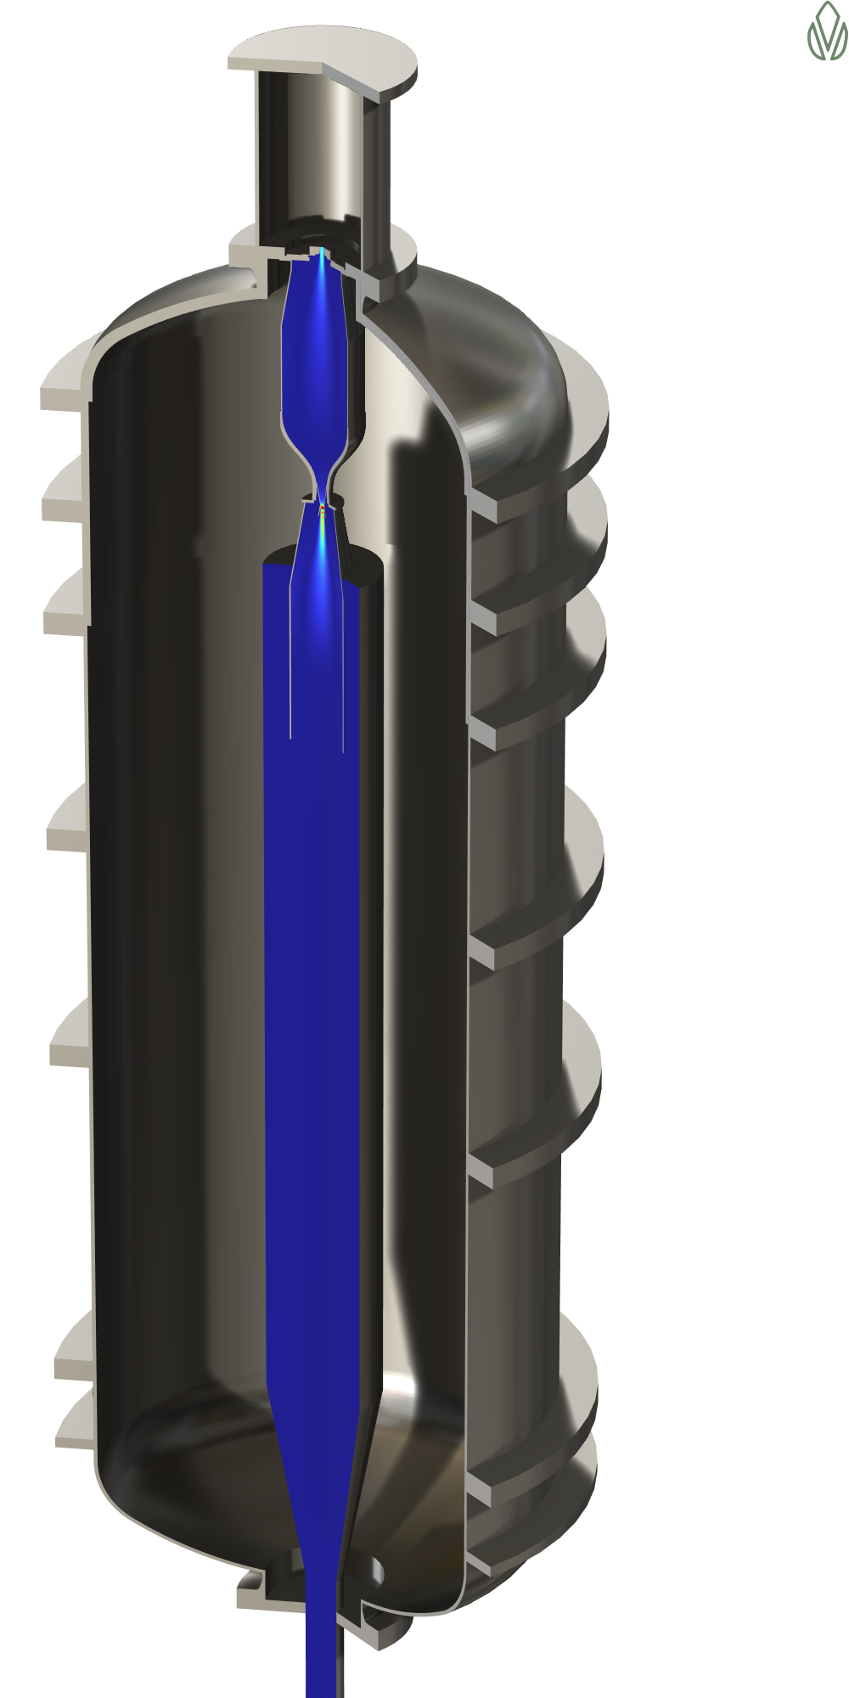
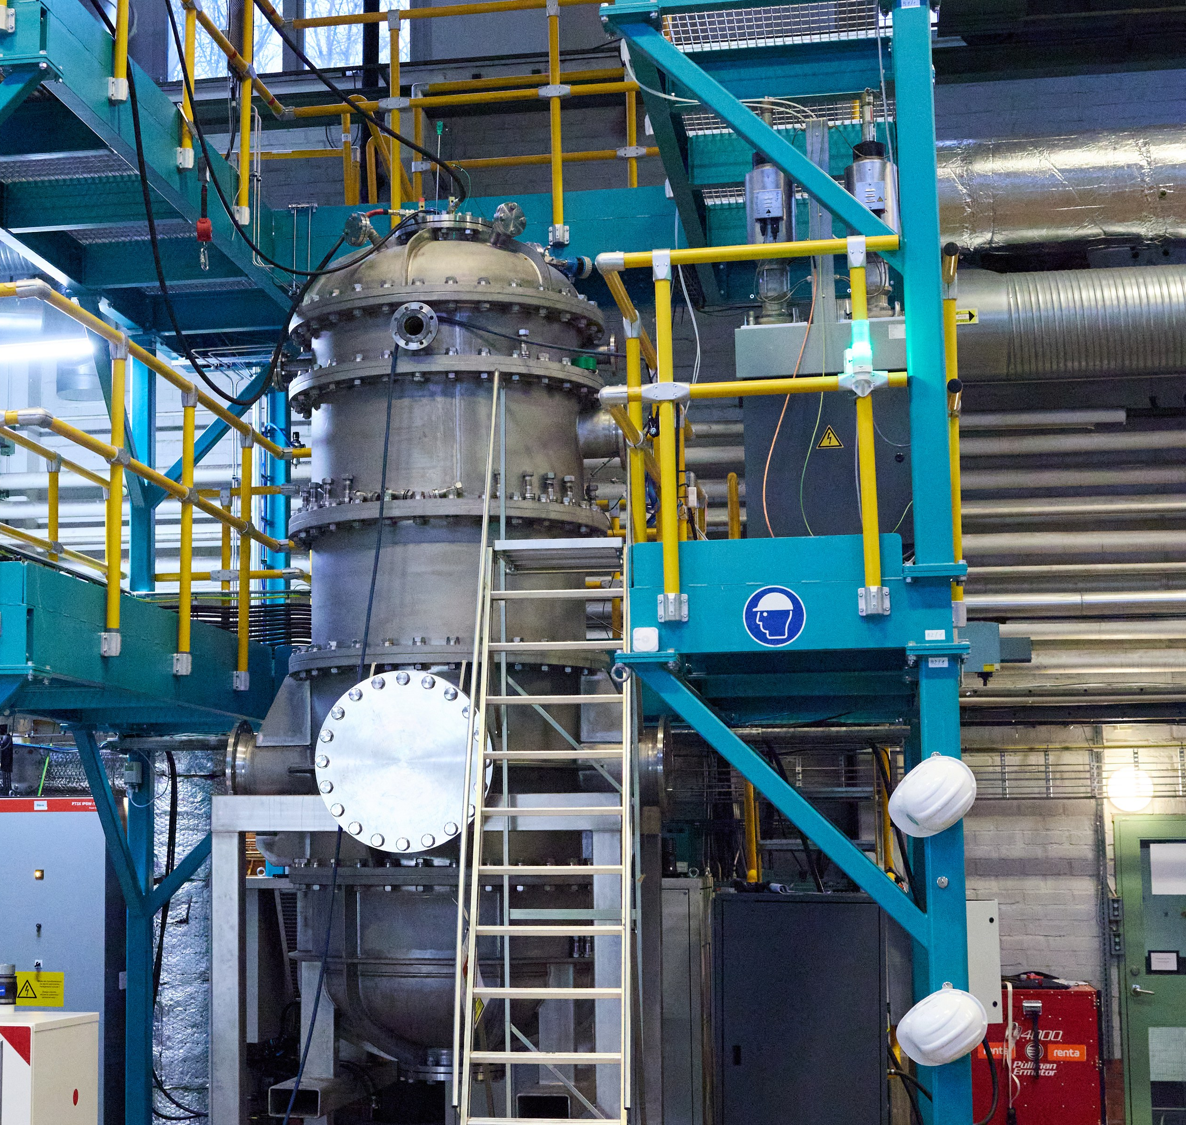

GREEN14
COMSOL CONFERENCE 2026 · CAMBRIDGE
Digital Twin of an Argon–Hydrogen Plasma Reactor
Bixente Artola
Senior Simulation Engineer
GREEN14 AB, Stockholm, Sweden

Slide 2
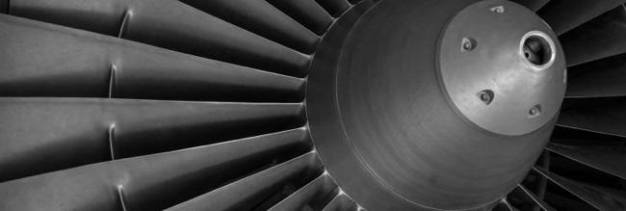

GREEN14
INTRODUCTION · THE CHALLENGE
Europe's titanium leaves the continent as scrap
20 kt / yr
100 %
of Ti64 scrap exported from Europe or downcycled in 2025 — ~€160M of lost value
of Europe's virgin titanium sponge is imported — full dependence on Russia, China, Japan, Kazakhstan
1920s
30–50 %
when today's gas-atomization technology was designed — it only works with virgin feedstock
of conventional Ti64 powder production never makes Additive Manufacturing spec
Aerospace takes ~70 % of EU titanium demand — ~90 % of it is Ti64
Ti-6Al-4V — the aerospace workhorse alloy — is high value, tightly specified, and almost entirely imported.
2

Slide 3
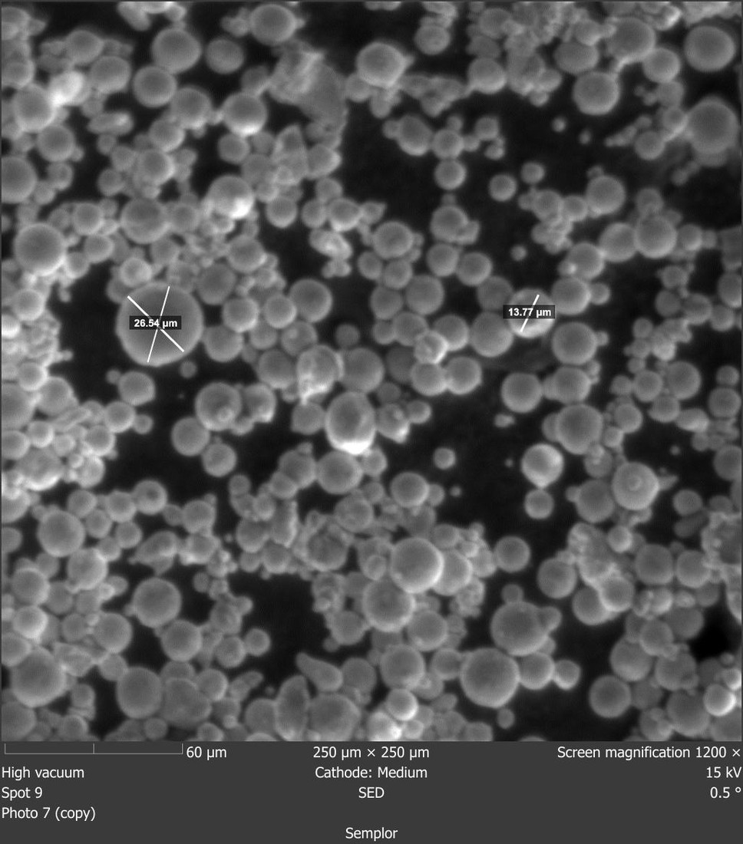
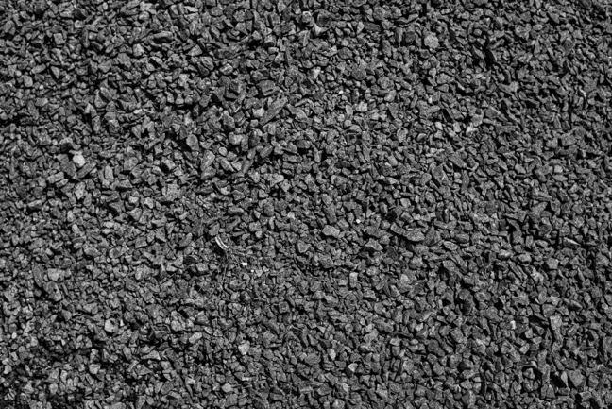
GREEN14
INTRODUCTION · THE PROJECT
One reactor: melt, reduce, atomize, quench
— Hydrogen plasma reactor. An arc-heated Ar/H₂ jet melts and chemically reduces scrap and out-of-spec powder — the only by-product is H₂O.
— Single step. Reduction, spheroidization and re-atomization happen in one pass: the supersonic nozzle breaks molten droplets and quenches them into spheres.
— Circular by design. Off-spec output and fines simply go back into the next run — zero waste powder, and ~5× lower CO₂ than conventional routes.
— Physical AI. Every run feeds our models and the models improve with every run — simulation and experiment sharpen each other. That loop is the rest of this talk.
→
IN — Ti64 scrap / out-of-spec
OUT — spherical Ti64
SEM of powder produced in the G14 reactor
3

Slide 4
GREEN14
INTRODUCTION · GOALS
You cannot instrument a 12,000 K core
1
2
3
THE BLIND SPOT
THE TWIN
THE FLYWHEEL
No in-situ diagnostics
COMSOL is the core solver
Every run sharpens the next
At ~10,000 K you cannot put a probe in the reaction zone — sensors sit far from the core, so simulation is the only way to reconstruct what each run actually did.
A multiphysics model of the chamber and nozzle rebuilds the full state of every run — temperature, flow, particles — from what the sensors can see at the walls.
Simulate widely, run the most informative experiments, calibrate the twin on the results. Two hardware generations have already come out of this loop.
4

Slide 5
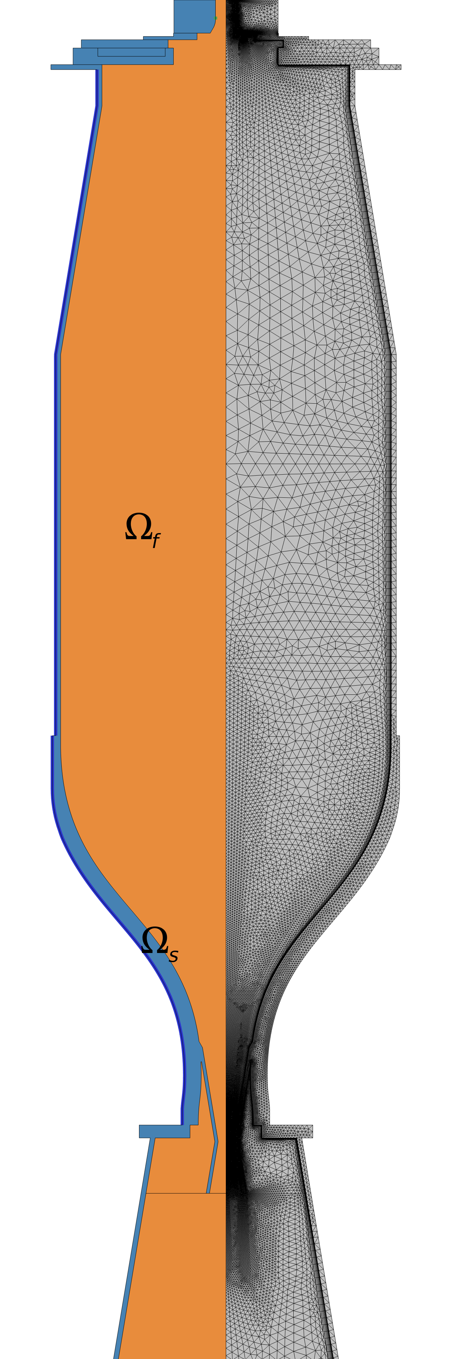
GREEN14
METHODS · USE OF COMSOL MULTIPHYSICS
Three physics on one axisymmetric domain
Powder radial injection
— High Mach Number Flow, Turbulent SST. The Ar/H₂ plasma as a single LTE fluid, with properties tabulated from Cantera between 300 and 30,000 K, radiation as a net-emission sink, and Mach 0 to 3 in one domain.
— Conjugate heat transfer. The steel reaction chamber is resolved as a solid, and the helical cooling coil becomes a 1-D coolant equation along its curve — its contact conductance is the key unknown.
— Particle Tracing. Ti64 powder is traced through the frozen flow field — one-way coupling, justified because the loading is dilute.
— Small on purpose. About 65k elements, wall-resolved (Δw⁺ < 1); a transient solve takes ~20 min — fast enough to run thousands of times.
Reaction chamber
Water-cooled walls
Converging-Diverging nozzle
Axisymmetric domain: fluid + water-cooled walls, mesh refined at throat and walls
5

Slide 6
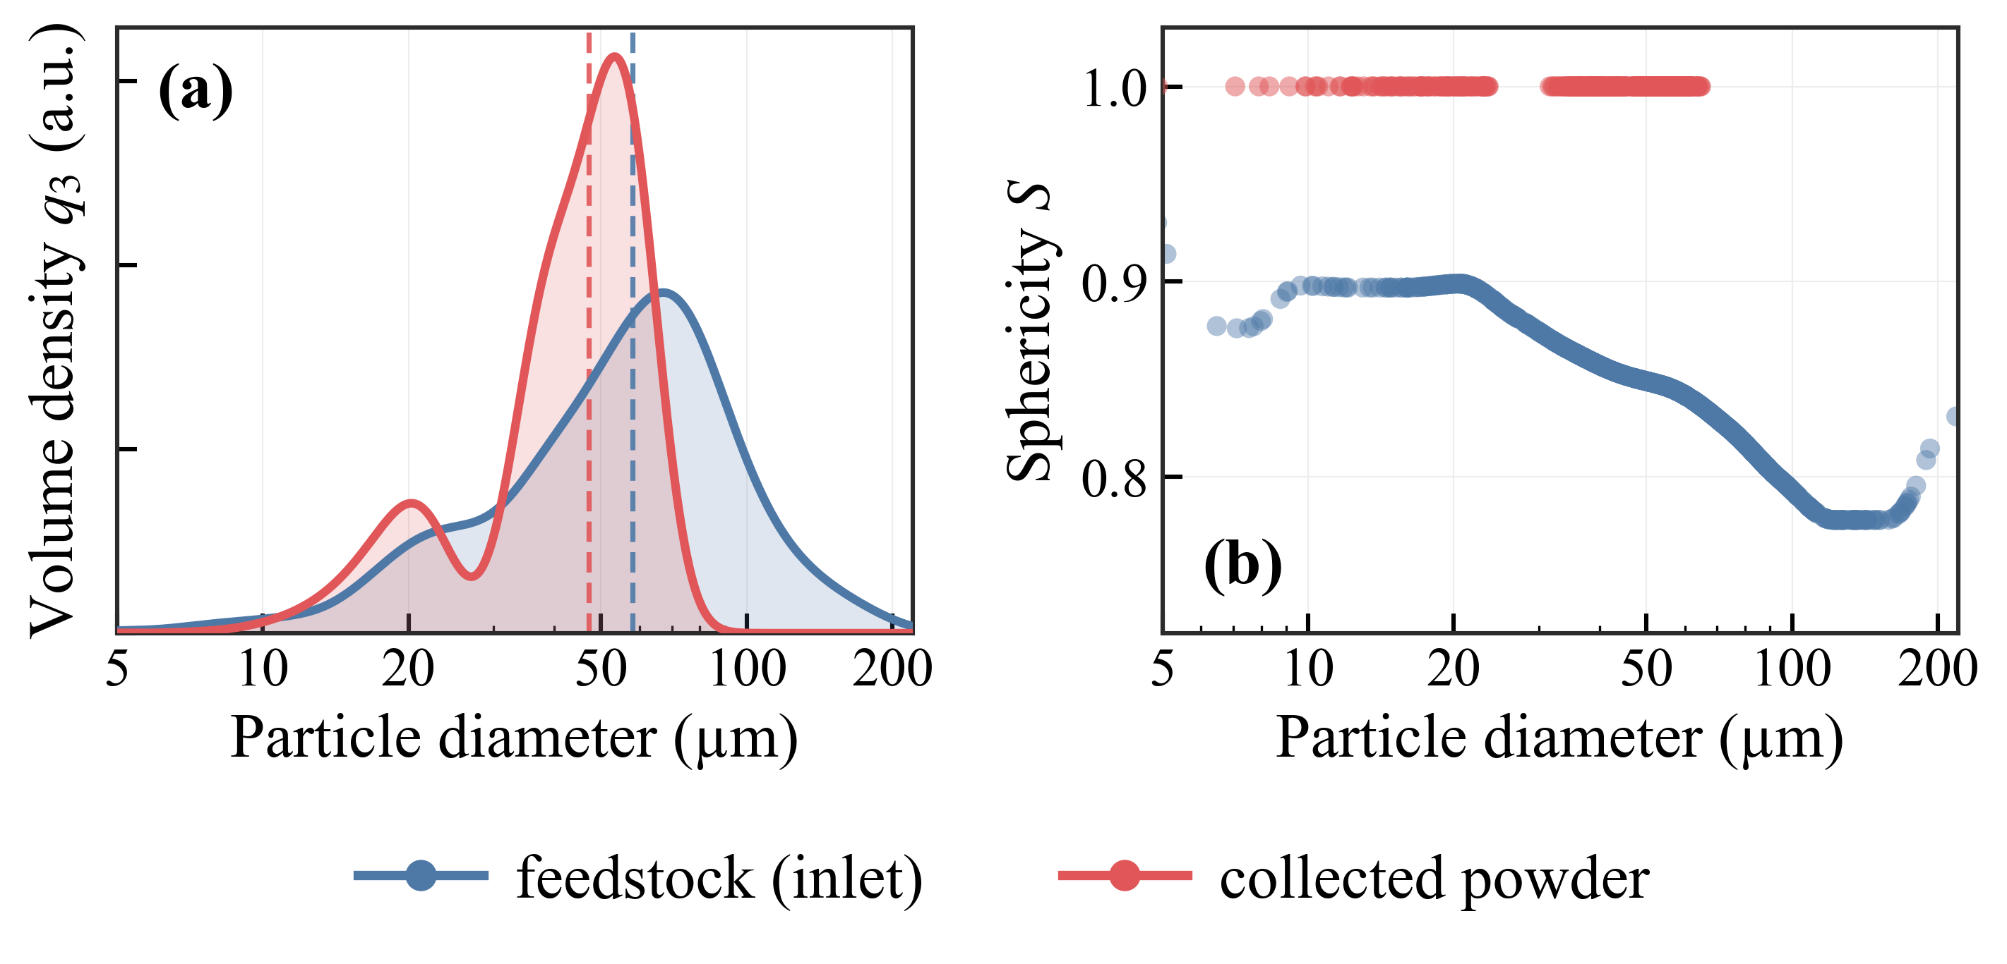
GREEN14
METHODS · BEYOND THE BUILT-IN MODULES
A custom phase-change particle layer
— Full solid–liquid–vapor. Particle Tracing only ships with evaporation — we added melting through an effective heat capacity that carries the latent heat of fusion.
— Mach-dependent drag. Haider–Levenspiel below slip Mach 0.3 and Loth's compressible law above it, with the measured feedstock sphericity as the initial particle shape.
— KH/RT breakup. Molten droplets break up in the supersonic nozzle when the gas Weber number is large.
— Predicted product. Evaporation eats away the coarse tail — the median size drops from 58 to 47 µm — and irregular feedstock leaves as spheres.
Feedstock vs collected: volume PSD (left), sphericity vs diameter (right)
8

Slide 7
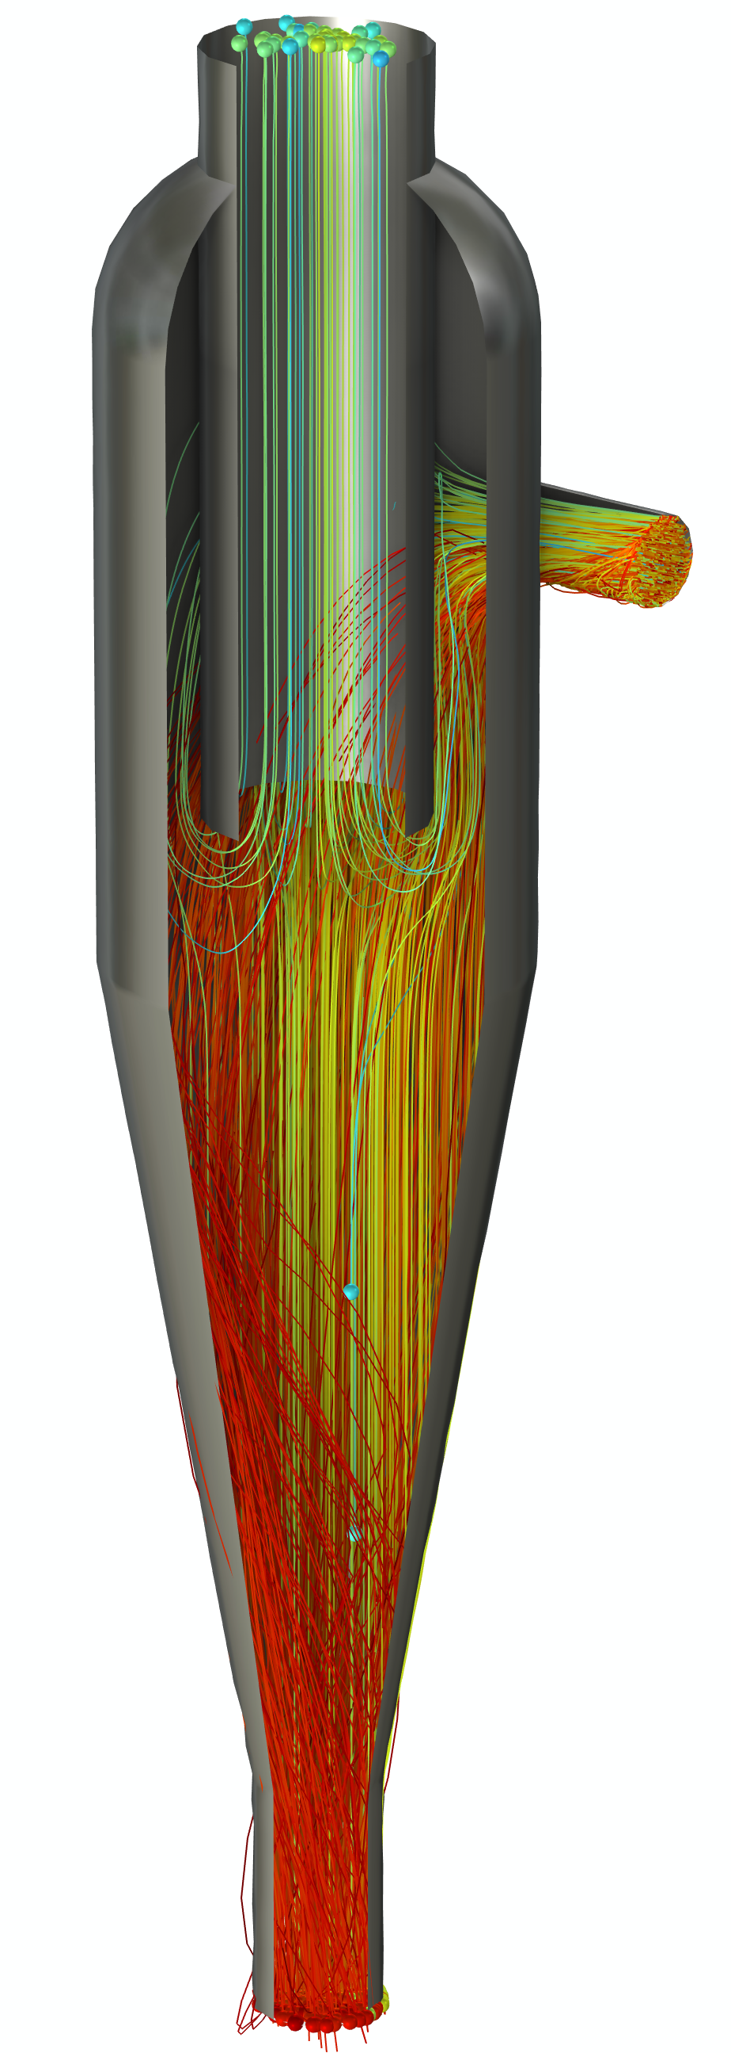
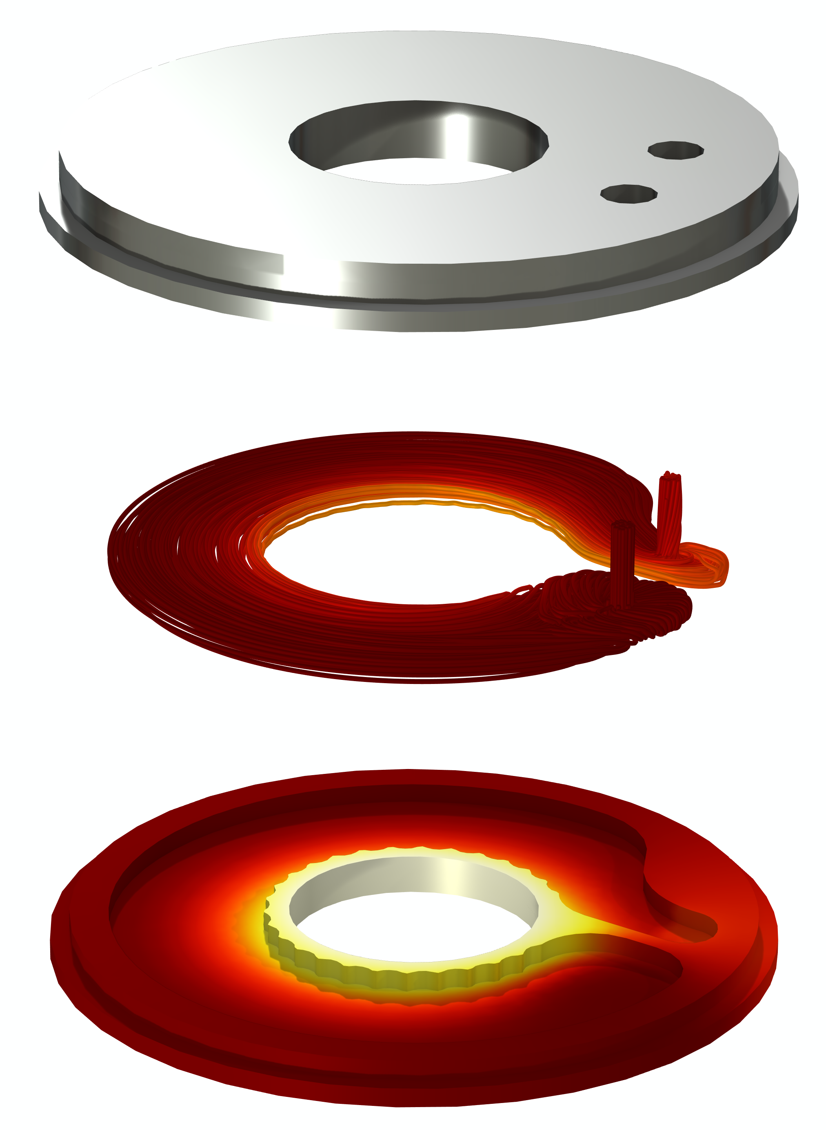
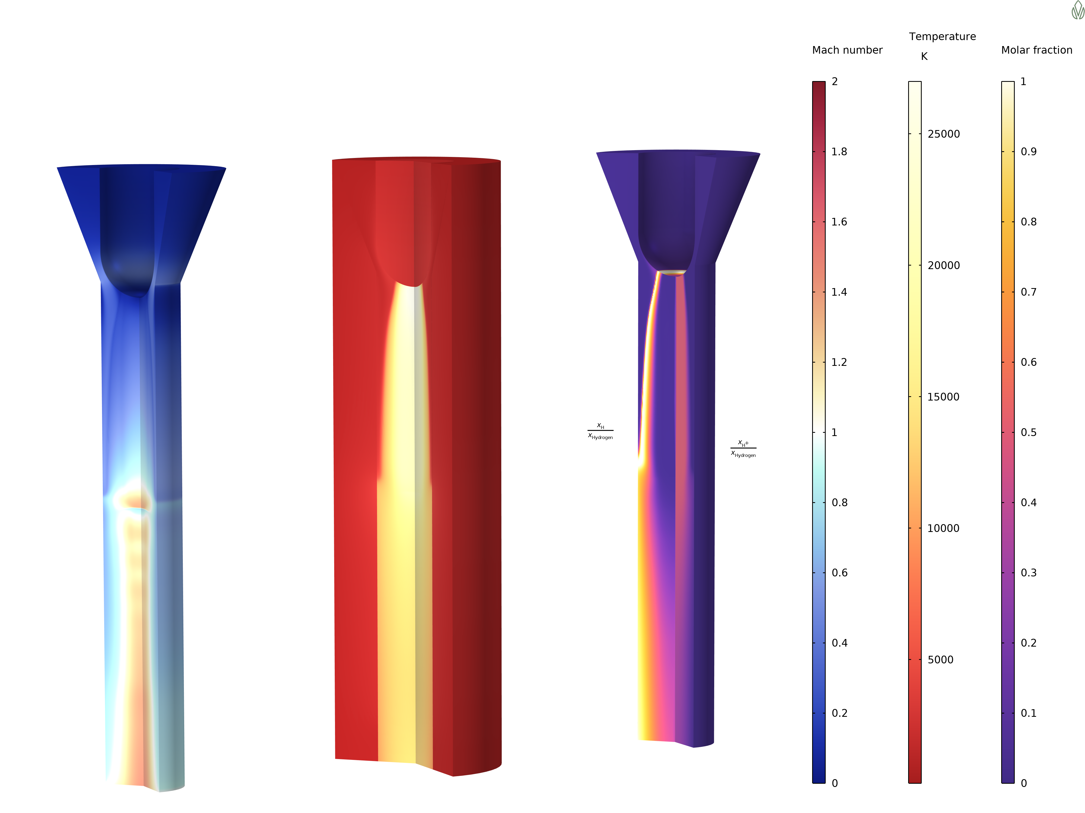
GREEN14
METHODS · COMSOL ACROSS GREEN14
One platform, many models
1
2
3
PLASMA SOURCE
COLLECTION
HARDWARE
DC plasma torch
Cyclone separator
Water-cooled flange
The gun itself is a separate COMSOL model — multifluid MHD in the Plasma Module.
A particle-laden swirling-flow model used to design the cyclone that collects the product powder downstream of the nozzle.
Conjugate heat-transfer models of individual components — used to size the cooling channels so every flange survives its local heat load.
Shared foundations: every model is versioned in COMSOL Model Manager Server and built from our own parametric geometry-part library.
Workflow accelerated by AI: Claude drives COMSOL's Java API
6

Slide 8
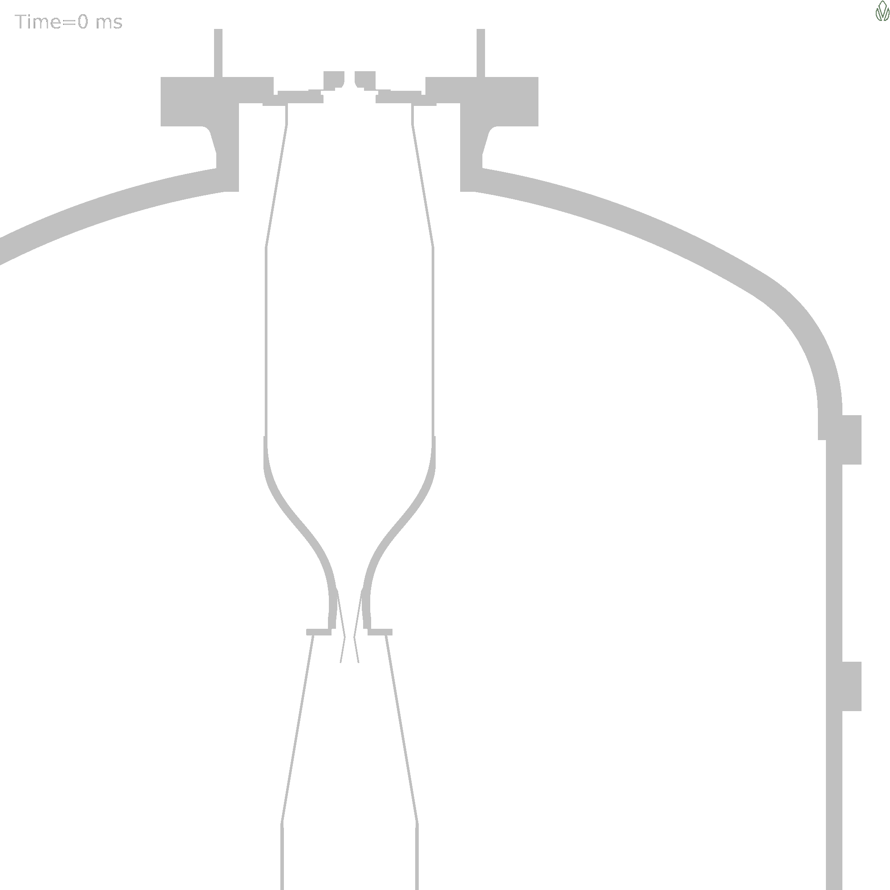
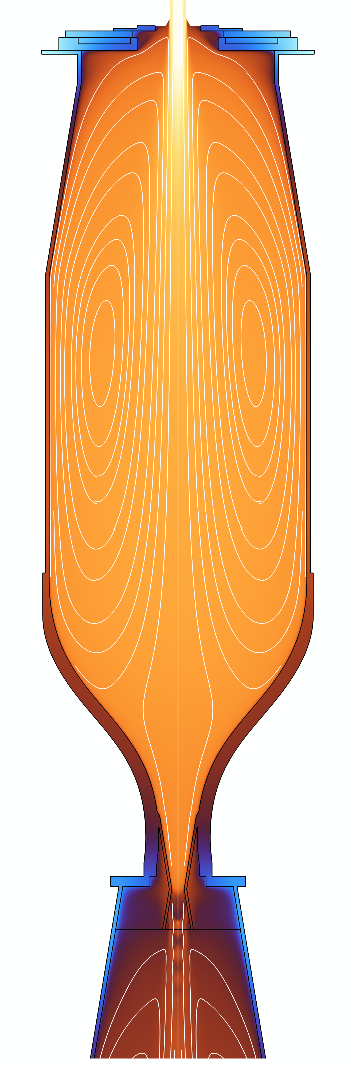
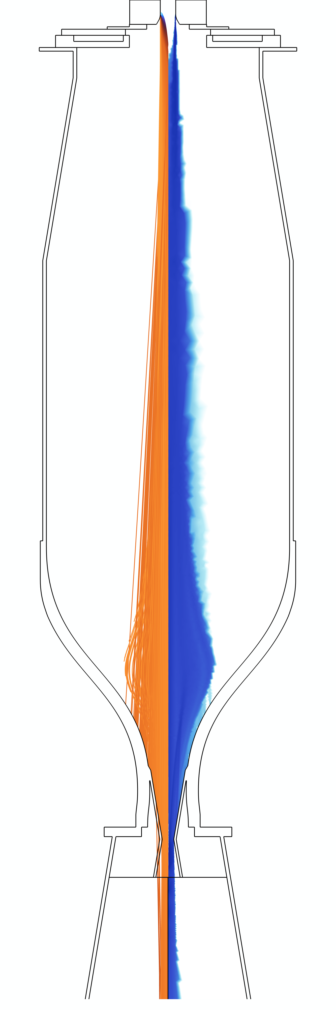
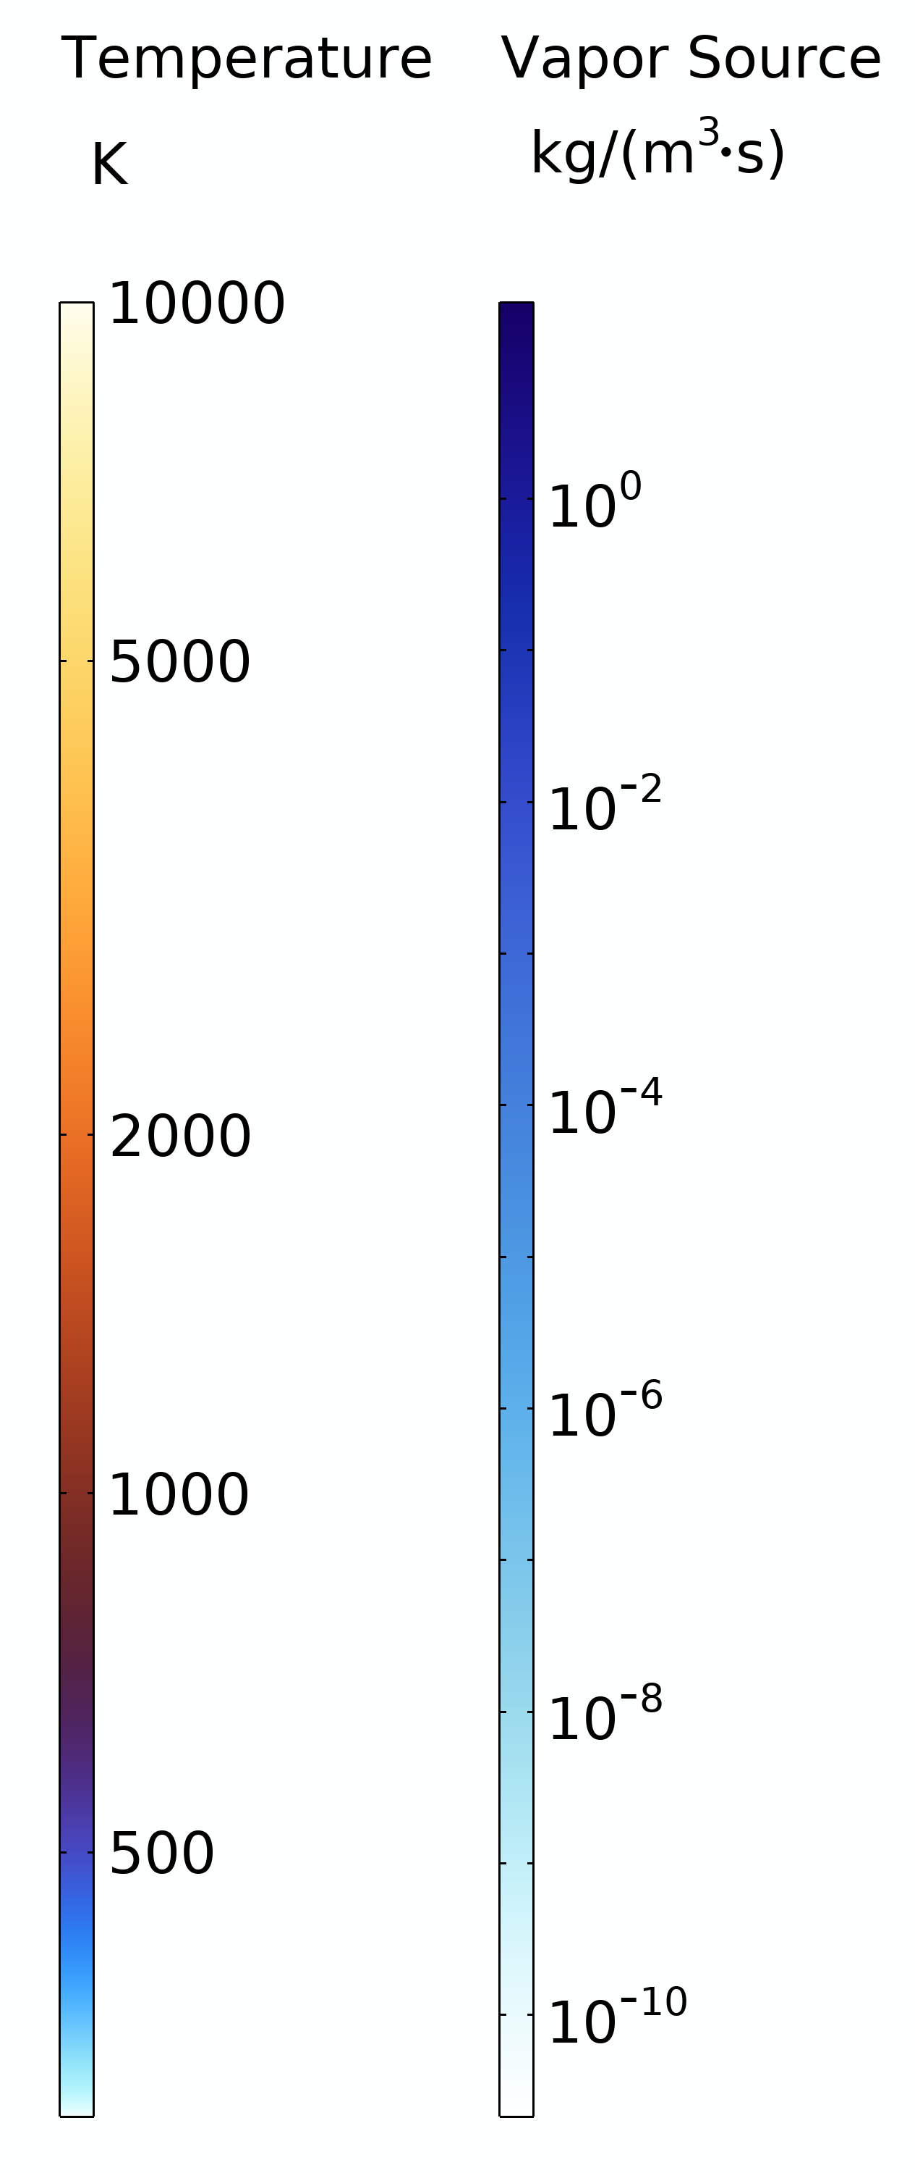
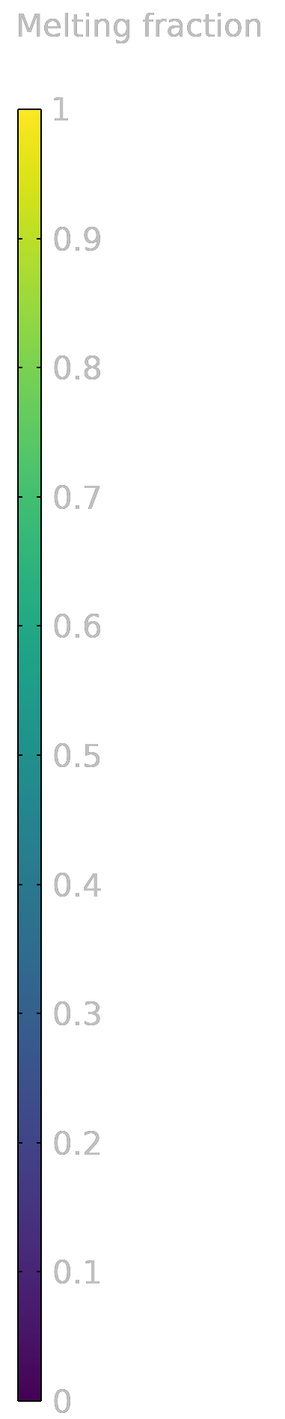
RESULTS · THE TWIN RUNNING
Gas temperature with streamlines (left) · Ti64 trajectories and the vapor source they release (right) — Ar 100 / H₂ 2.5 NLPM, ~22 kW
7
Particle injection through chamber and nozzle — colored by melting fraction (animation)

Slide 9
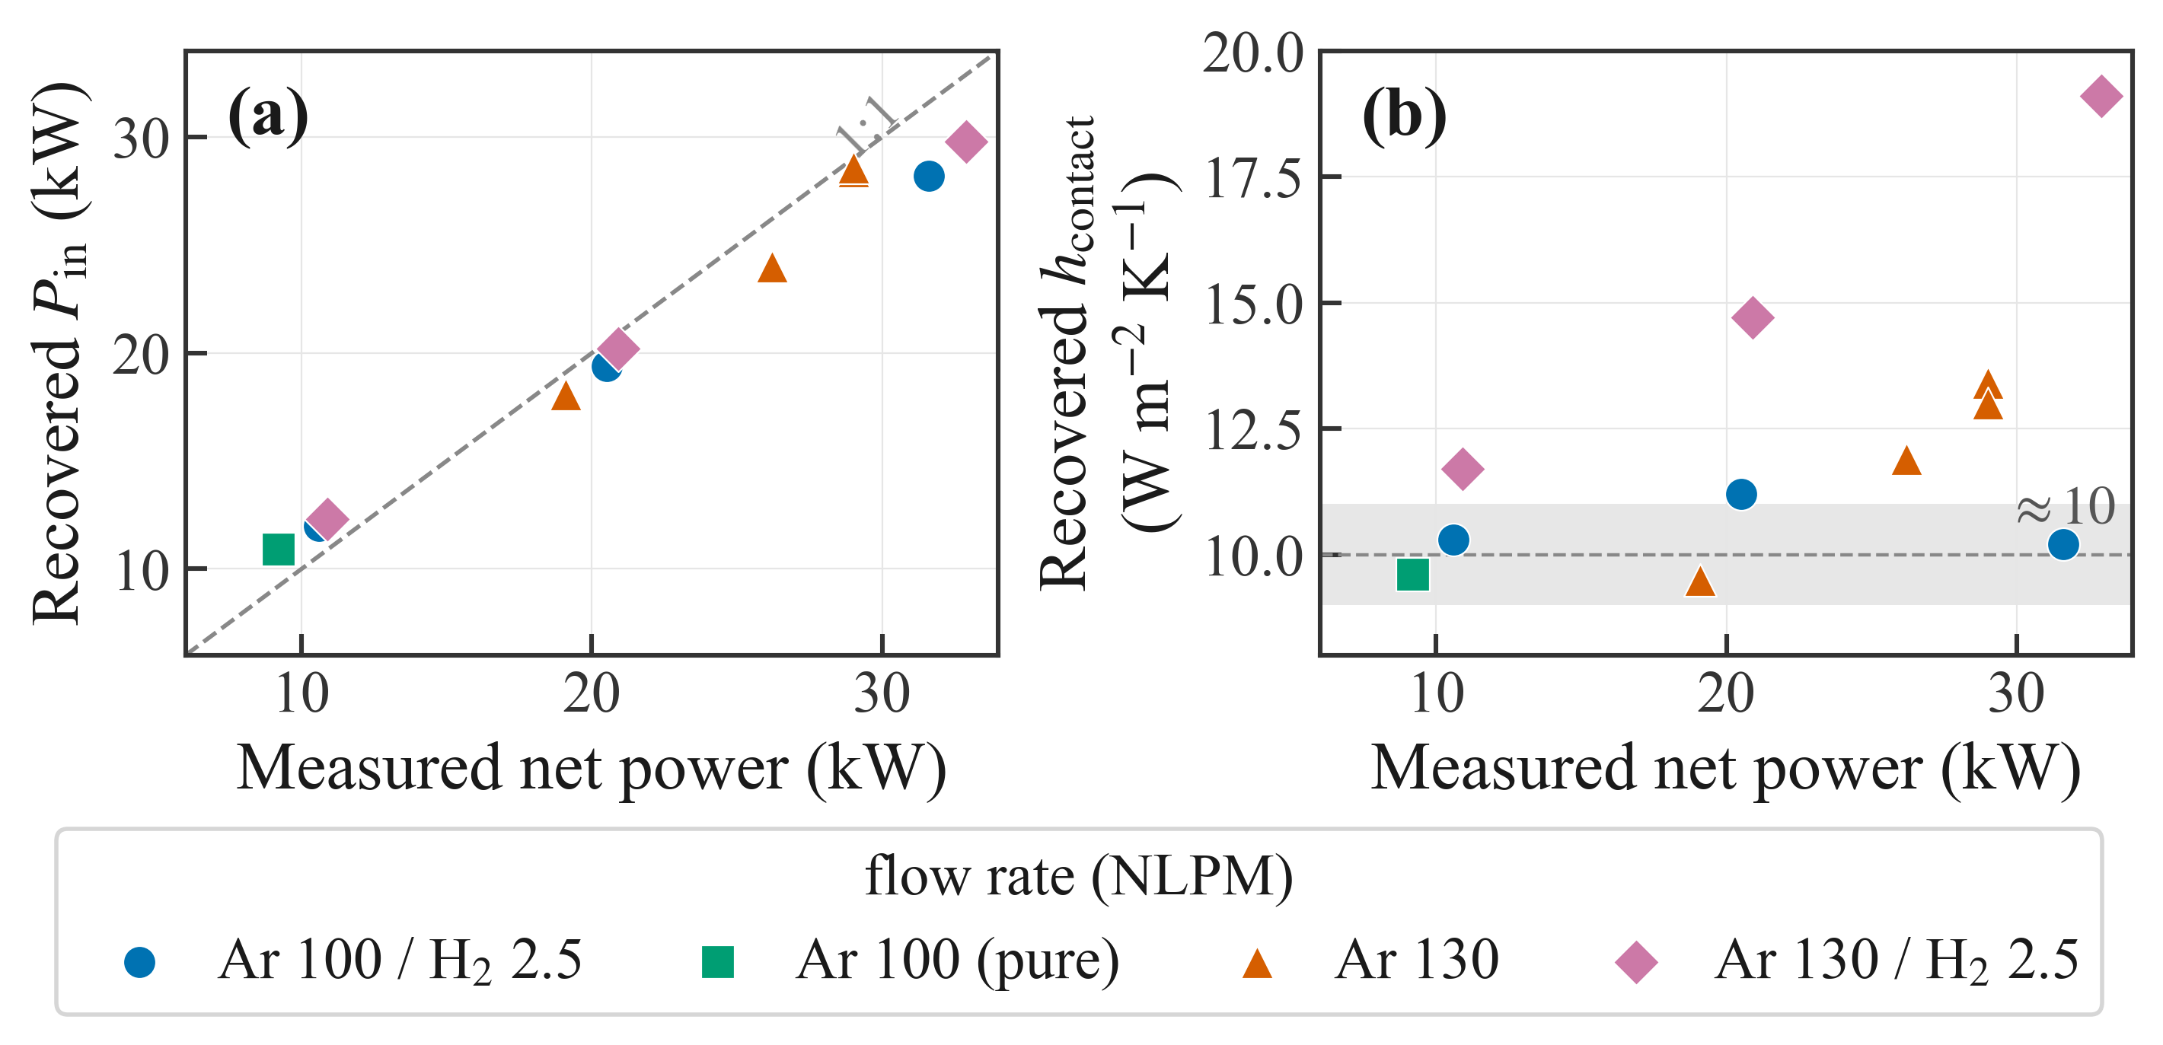
GREEN14
RESULTS · OUR AI MACHINERY, EXPECTED VS. OBTAINED
Experimental data finds the unknowns
— Two unknowns — one example. The delivered inlet power and the coil-to-wall contact conductance — quantities no sensor can reach. The same machinery applies to any uncertain physical parameter.
— Two global observables. We match chamber pressure and coil heat — global, nearly independent quantities. Local thermocouples sit in gradients of ~15,000 K per cm, so they depend too much on exact placement.
— AI inverse solver. Unscented Kalman Inversion with Levenberg–Marquardt-style regularization — it treats COMSOL as a black box and runs cases in parallel on our server.
pressure 0.10 % · coil power 0.42 %
average match over 11 experiments — and the recovered inlet power tracks the measured net power even though it was never a fit target
9
Recovered inlet power vs measured net power (left); contact conductance ≈ 10 W/m²K across mixtures (right)

Slide 10
GREEN14
CONCLUSIONS · IMPACT ON THE PROJECT
A calibrated twin is an instrument
1
2
3
OPERATING MARGINS
DESIGN
AI LAYER
See what sensors cannot
Optimize in software first
Toward live control
The throat condensation state and the wall deposition rate warn of nozzle clogging before the throat actually narrows; the conjugate solution turns wall hot spots into a real safety margin for the chamber.
Geometry and operating points are screened in the twin before we build anything — two hardware generations have already come out of this loop.
Learned source terms recover the missing physics as simple analytic expressions, and a neural surrogate wraps the calibrated twin so it answers in milliseconds — the path to self-supervised experiments.
10

Slide 11
We take what the industry discards and upgrade it into its most valuable product by unlocking the value already embedded in the material.

