Slide 1

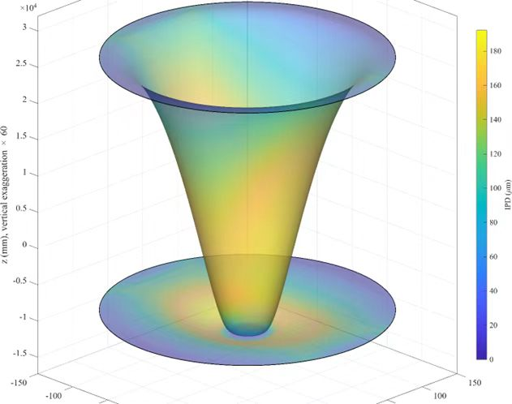
Uncertainty Quantification of
Bond-Front Velocity in
Direct Wafer Bonding
COMSOL Conference 2026 Shenzhen
Sichen Liang
School of Materials Science and Engineering, Sun Yat-sen University

Slide 2
Presentation roadmap
Background
Bonding experiment and a three-layer device
04–05
Model and input domain
Coupled equations, adhesion and 12 inputs
07–09
Transient results
Mean front speed, height, displacement and pressure
11–13
Sensitivity analysis
Morris screening, Sobol indices and priorities
15–16
Conclusions
Main findings and acknowledgements
18
2

Slide 3
Presentation roadmap
Background
Bonding experiment and a three-layer device
04–05
Model and input domain
Coupled equations, adhesion and 12 inputs
07–09
Transient results
Mean front speed, height, displacement and pressure
11–13
Sensitivity analysis
Morris screening, Sobol indices and priorities
15–16
Conclusions
Main findings and acknowledgements
18

Slide 4
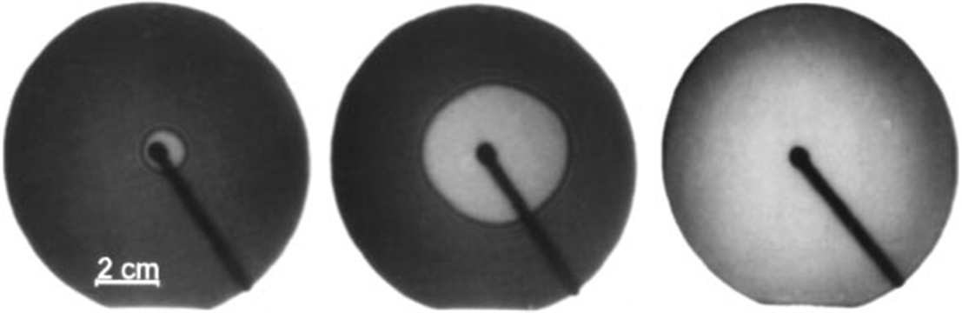
Background
Wafer bonding in experiment
Contact growth
A local contact grows into a bonded region as the front advances.
Why speed matters
Mean front speed measures how fast bonded contact spreads across the wafer.
What controls mean bonding-front speed?
Q.Y. Tong and U. Gösele, Semiconductor Wafer Bonding: Science and Technology, 1998.

Slide 5
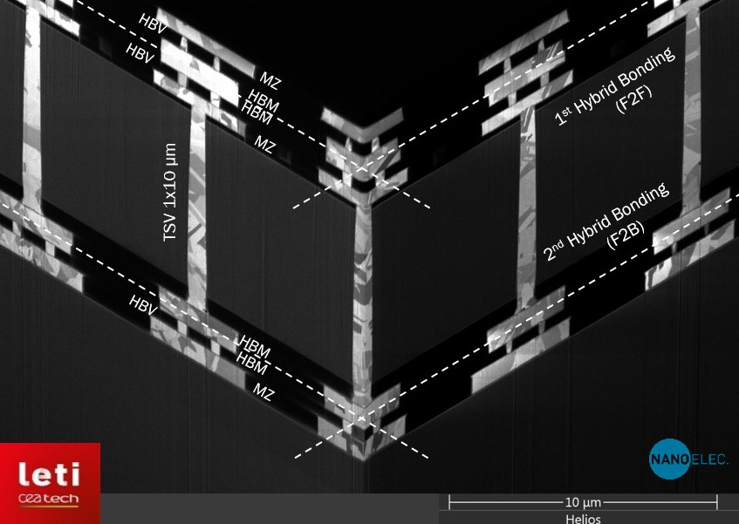
Background
CEA-Leti demonstrator reported at IEEE ECTC 2024
3 layers
Two hybrid-bond interfaces
Face-to-face and face-to-back
4 and 6 µm pitch
Interface control becomes central as device layers accumulate.
S. Nicolas et al., 3-layer Fine Pitch Cu-Cu Hybrid Bonding Demonstrator With High Density TSV For Advanced CMOS Image Sensor Applications, ECTC, 2024.

Slide 6
Presentation roadmap
Background
Bonding experiment and a three-layer device
04–05
Model and input domain
Coupled equations, adhesion and 12 inputs
07–09
Transient results
Mean front speed, height, displacement and pressure
11–13
Sensitivity analysis
Morris screening, Sobol indices and priorities
15–16
Conclusions
Main findings and acknowledgements
18

Slide 7
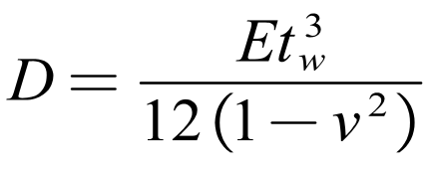



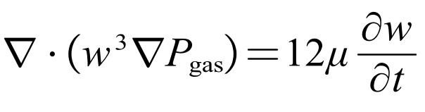



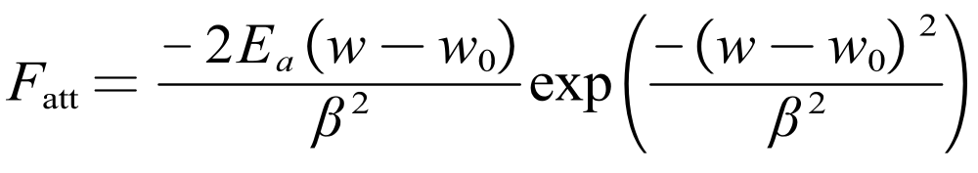
Model and input domain
Governing relation and outputs
Thin plate deformation
:wafer displacement [m]
: local gap [m]
: relative pressure [Pa]
: adhesive traction [Pa]
: gas viscosity [Pa·s]
Reynolds lubrication
Adhesion interaction
Damien Radisson, Direct Bonding of Patterned Surfaces, Grenoble university, PhD thesis, 2014.
Notes:
The two small boxes at the lower right are reserved for the project-specific COMSOL bonding-wave propagation clip and overall bonding-process clip. An external infrared bonding-wave sequence appears beside the coupled model. Governing equations shown in the first version include plate flexural rigidity D = E t_w^3 / [12(1 - ν^2)] and v_bond = d r_bond / dt over stable propagation.

Slide 8
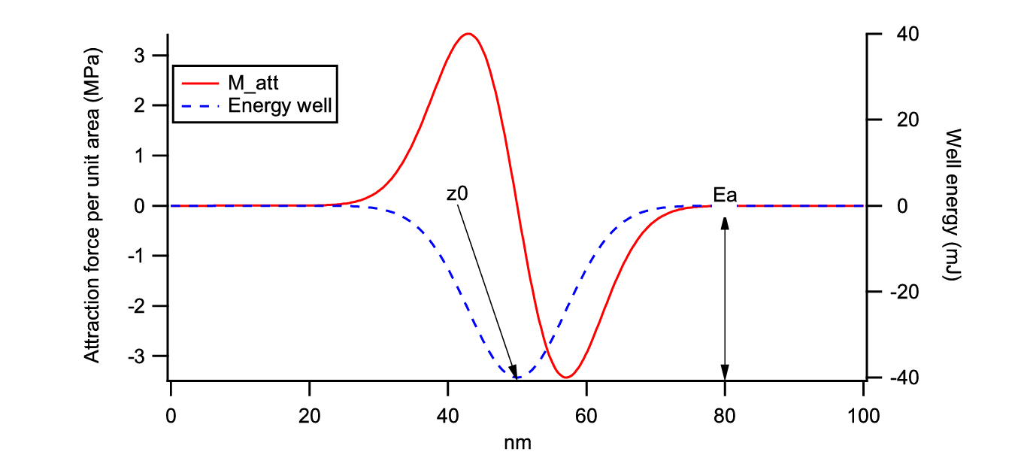




Model and input domain
Adhesion potential well
Well depth
sets the adhesion energy per unit area.
Equilibrium separation
is the gap at the energy minimum.
Interaction range
: well depth [J/m²]
: interaction length [m]
: equilibrium gap [m]
determines how quickly the force changes with separation.
Damien Radisson, Direct Bonding of Patterned Surfaces, Grenoble university, PhD thesis, 2014.
Notes:
Figure basis: Damien Radisson, Direct Bonding of Patterned Surfaces, PhD thesis (2014), Figure 3, captioned “Plot of the potential energy well and its derived conservative attraction force.” The source figure is listed at https://www.researchgate.net/figure/Plot-of-the-potential-energy-well-and-its-derived-conservative-attraction-force_fig3_279534609 . This editable redraw is qualitative and is not digitized from the thesis. F = -dU/dh is the conservative-force relation; positive force is defined here as increasing the surface gap. The sketch has no numeric scales or fitted potential law.

Slide 9
Twelve material, interface and cavity inputs define the study domain
Input domain and uncertainty workflow
Mechanics & material
Interface & gap
Cavity design
Wafer
thickness
t
w
Adhesion energy Eₐ
Cavity
depth
d
200–775 µm
0.02–0.10 J/m²
0.1–10 µm
Young’s modulus E
Interaction range β
Inner
radius
r
in
110–180 GPa
5–30 nm
0–20 mm
Poisson’s ratio ν
Gas viscosity μ
Outer
radius
r
out
0.28–0.35
1.6–2.1 × 10⁻⁵ Pa·s
80–100 mm
Density ρ
Blade
thickness
t
b
Cavity
angular
width
Δφ
g
2330–3000 kg/m³
50–300 µm
2–15°
1
2
3
4
5
Input domain
MOAT screening
Select key inputs
Train surrogate
Sobol analysis
12 inputs
Rank effects
Reduce input
Selected surrogate
SI and ST effects
Notes:
Author confirmation needed: define β and t_b physically; cite the source and probability distribution for each uncertain input; confirm whether inputs are independent.

Slide 10
Presentation roadmap
Background
Bonding experiment and a three-layer device
04–05
Model and input domain
Coupled equations, adhesion and 12 inputs
07–09
Transient results
Mean front speed, height, displacement and pressure
11–13
Sensitivity analysis
Morris screening, Sobol indices and priorities
15–16
Conclusions
Main findings and acknowledgements
18

Slide 11
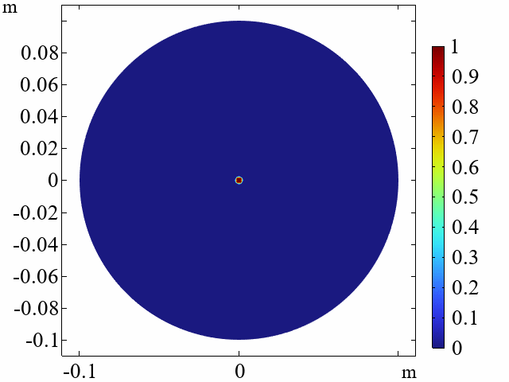
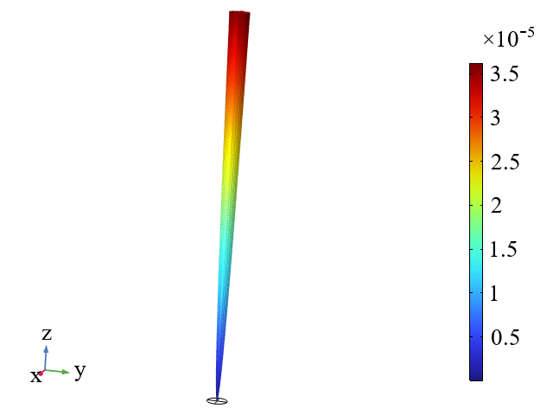
Transient results
Bonding dynamics and front speed
Bonding front propagation
Upper wafer deformation

Slide 12
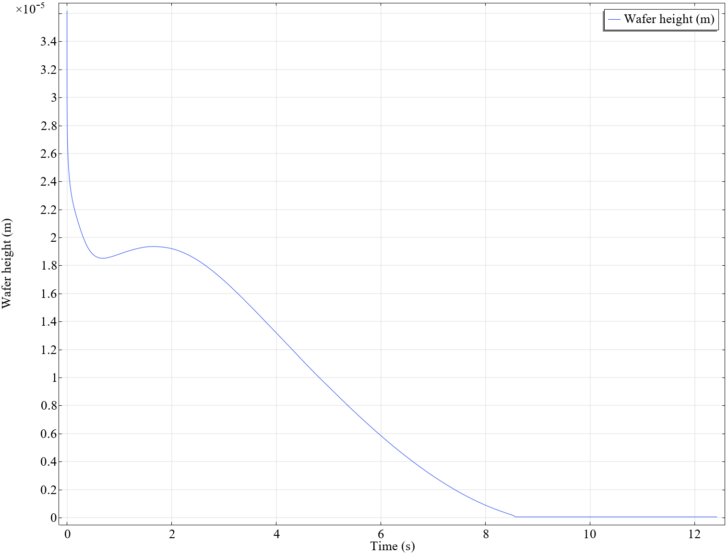
Transient results
Upper-wafer closure dynamics
Observed evolution
Fast initial decrease, a small rebound near 1.5–2 s, then a near-zero tail by about 8.5 s.
Fast initial decrease, a small rebound near 1.5–2 s, then a near-zero tail by about 8.5 s.
Local bonding velocity
v_{bonding}(t) = dS_{f}/dt
S_{f} is the moving front position.
Notes:
The source plot labels its ordinate as dependent variable u (m). Confirm whether this is vertical displacement u_z at the stated upper-wafer probe before relabeling it.

Slide 13
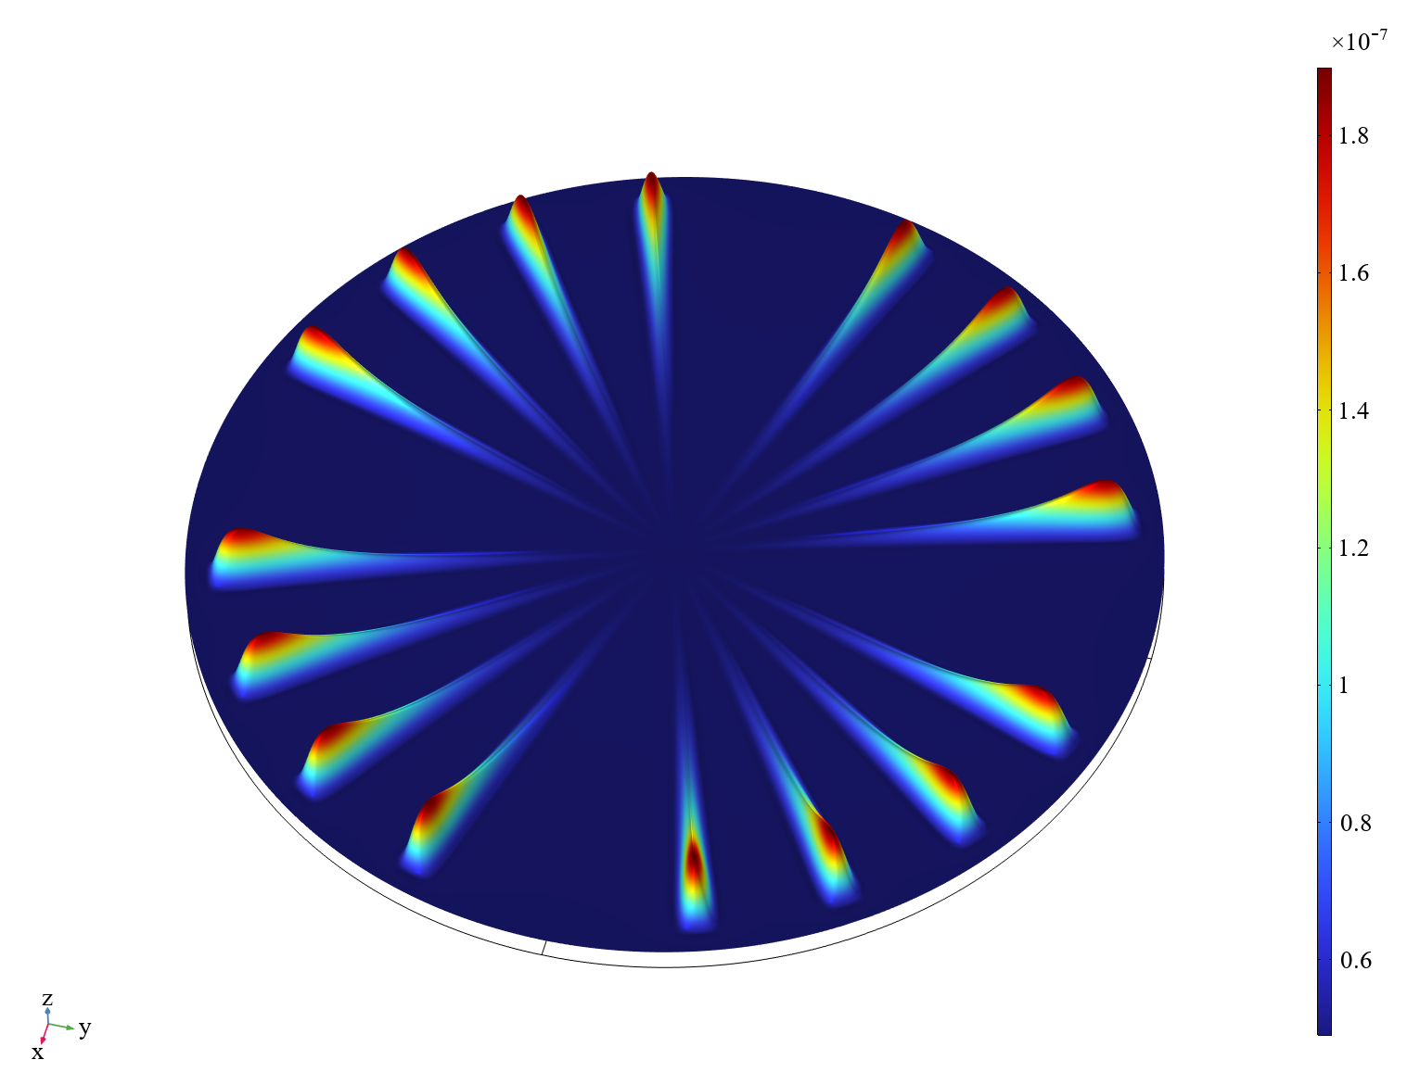
Transient results
Deformation of the cavitied wafer
Bonding-face displacement
The bright radial lobes mark regions with larger displacement of the upper bonding face.
Physical meaning
Localized vertical deformation changes wafer separation and affects gas drainage.
Notes:
Author confirmation required: displacement component, physical unit, time point, and groove orientation. The embedded color scale shows ×10⁻⁷ but has no unit.

Slide 14
Presentation roadmap
Background
Bonding experiment and a three-layer device
04–05
Model and input domain
Coupled equations, adhesion and 12 inputs
07–09
Transient results
Mean front speed, height, displacement and pressure
11–13
Sensitivity analysis
Morris screening, Sobol indices and priorities
15–16
Conclusions
Main findings and acknowledgements
18

Slide 15
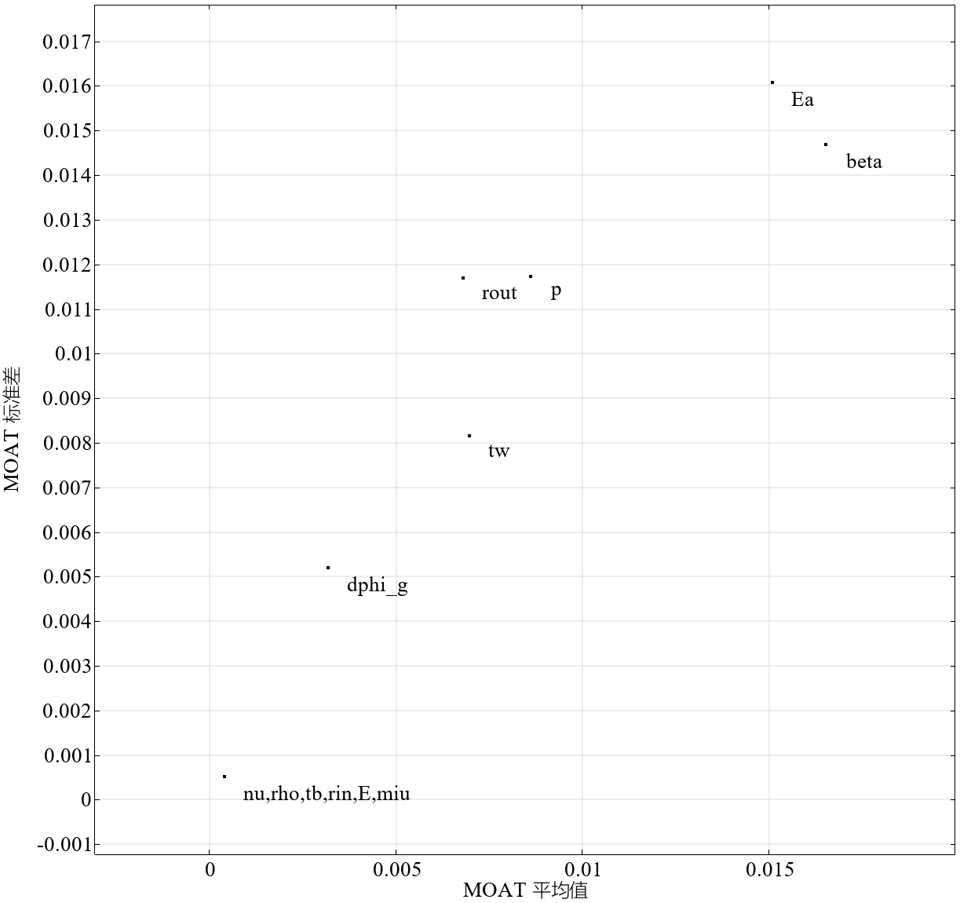
Sensitivity analysis
Morris sensitivity screening
Largest effects
Adhesion energy Eₐ and interaction range β lie in the upper-right part of the plot.
Intermediate effects
Cavity depth, outer radius, wafer thickness and groove angle show moderate effects.
Smaller effects
The remaining inputs have smaller elementary effects within this input domain.
Notes:
Add numerical μ* and σ values or uncertainty bounds if available. Define the aggregation used for “others.”

Slide 16
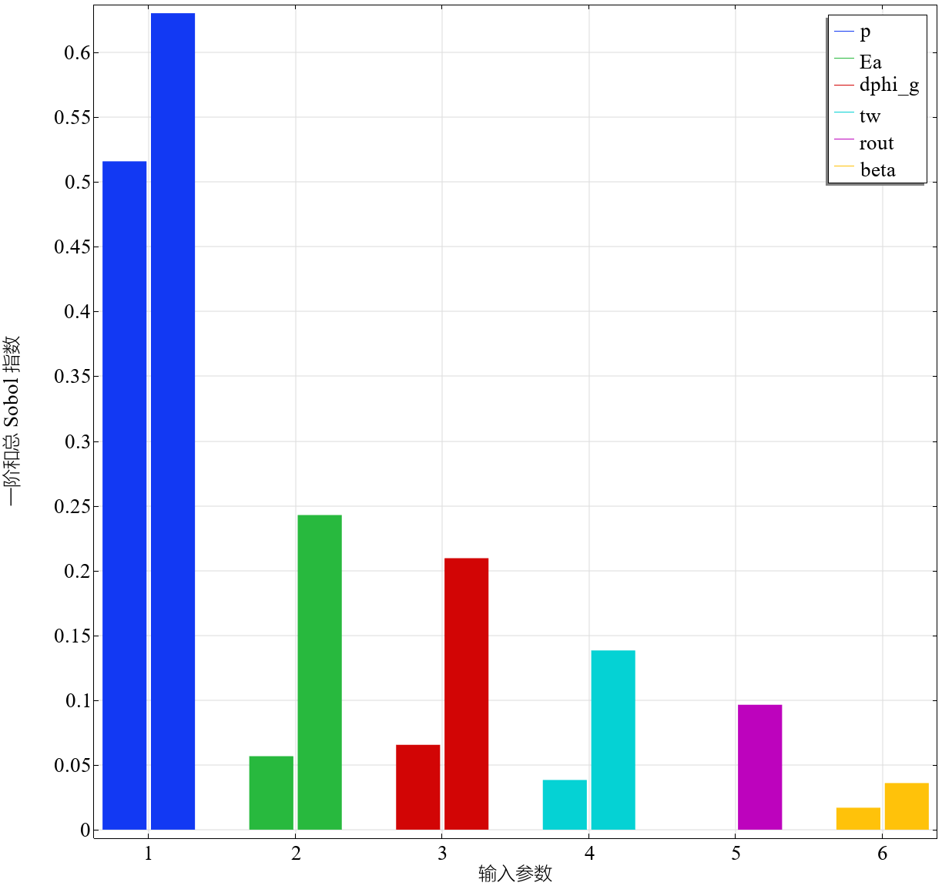
Sensitivity analysis
Sobol sensitivity results
0.63
ST for cavity depth
0.24
ST for adhesion energy
0.21
ST for angular width
Notes:
Add confidence intervals or bootstrap ranges, surrogate validation error, and exact Monte Carlo/Sobol sample counts.

Slide 17
Presentation roadmap
Background
Bonding experiment and a three-layer device
04–05
Model and input domain
Coupled equations, adhesion and 12 inputs
07–09
Transient results
Mean front speed, height, displacement and pressure
11–13
Sensitivity analysis
Morris screening, Sobol indices and priorities
15–16
Conclusions
Main findings and acknowledgements
18

Slide 18
Results
Sobol sensitivity results
Morris screening
Sobol total effect
Wafer mechanics
Eₐ, β
0.63
Thickness
Adhesion energy and interaction range show the largest screening effects.
Cavity depth has the largest reported total effect.
Wafer thickness shows an intermediate Morris effect.

Slide 19
This work was financially supported by the National Natural Science Foundation of China under grant number 51832002 and the National Science and Technology Major Project of China under grant number 2024ZD0607800. The authors also gratefully acknowledge Dr. G. Wang of COMSOL China for technical support.
Thanks for Your Attention!
Sichen Liang
Contact email: liangsch5@mail2.sysu.edu.cn
Notes:
Validation status: the supplied deck reports no mesh/time-step convergence results or independent physical validation data. Keep this limitation visible when presenting predictive claims.

