Slide 1

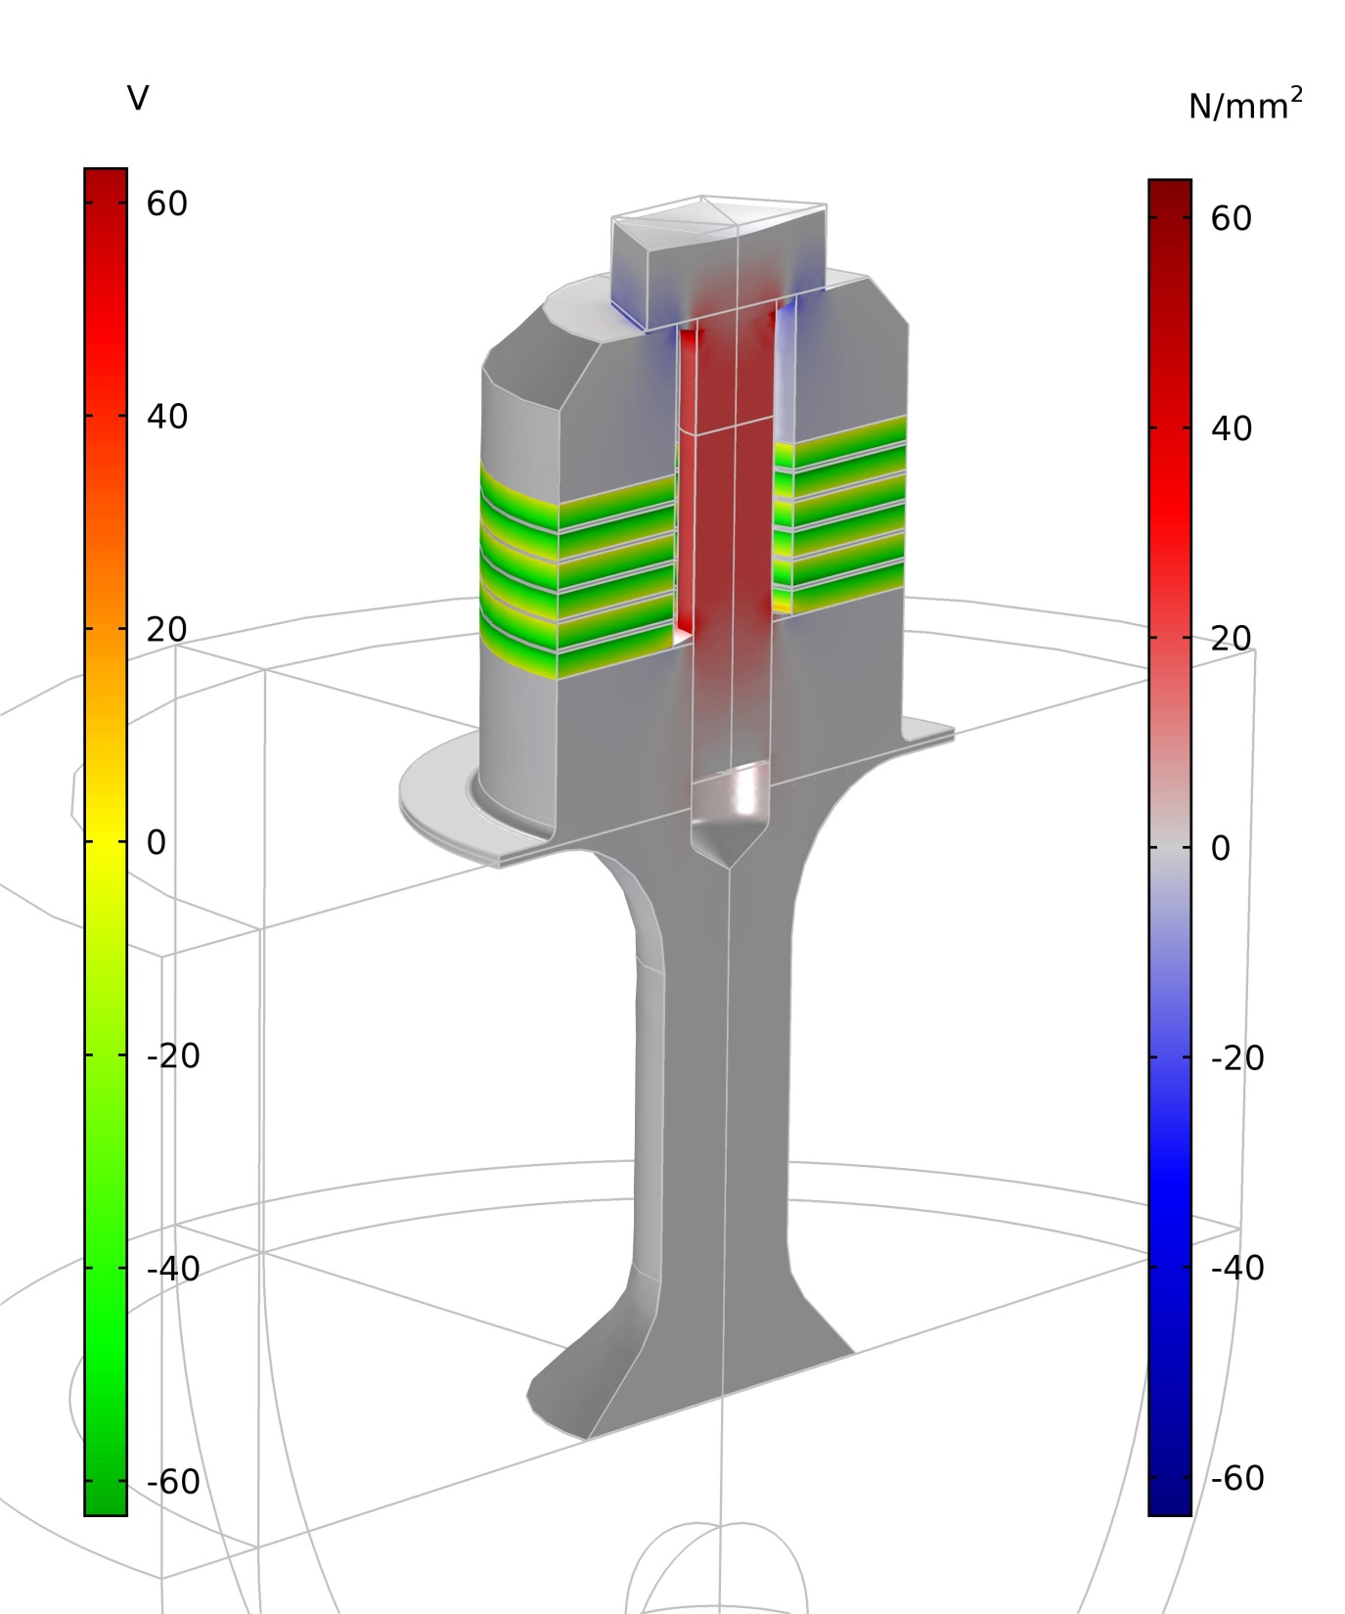
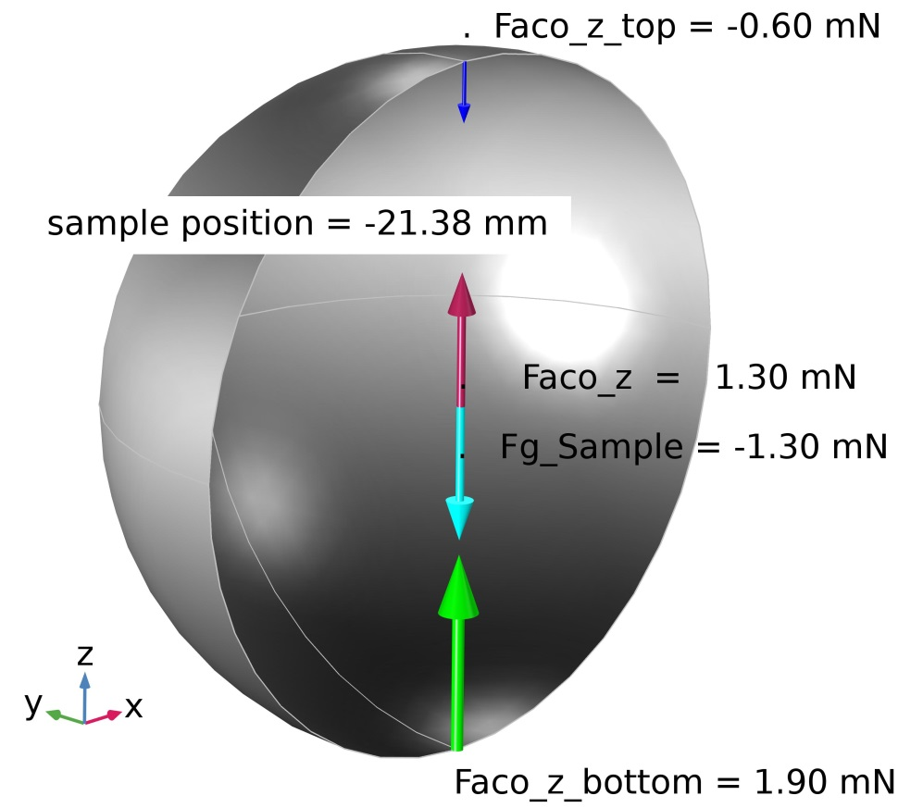
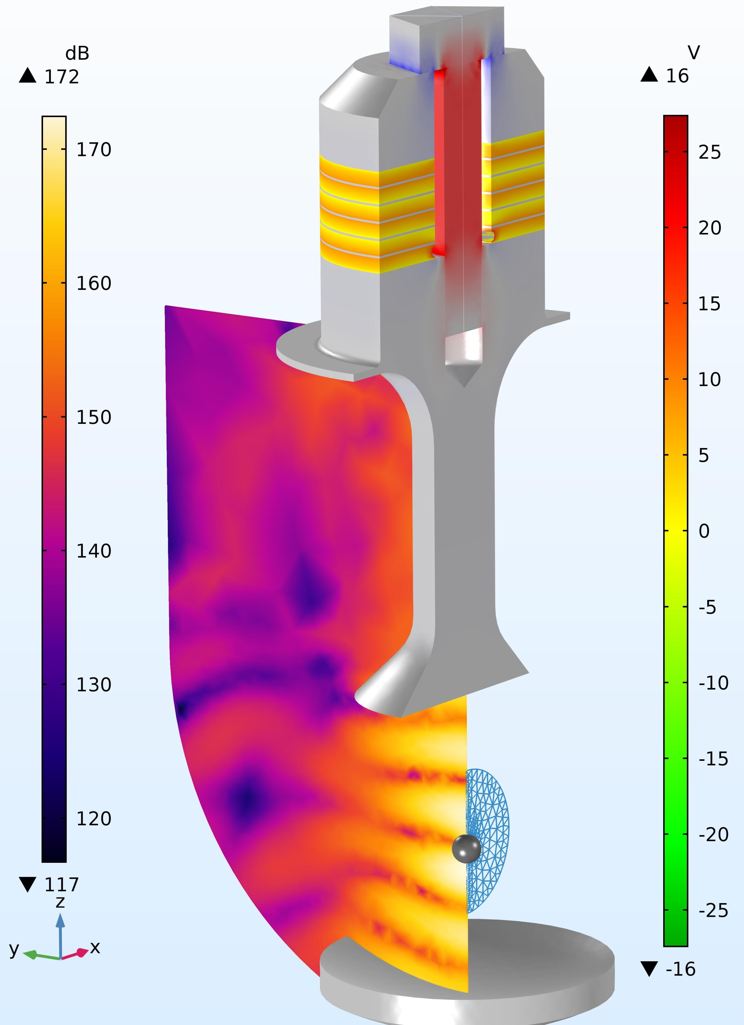
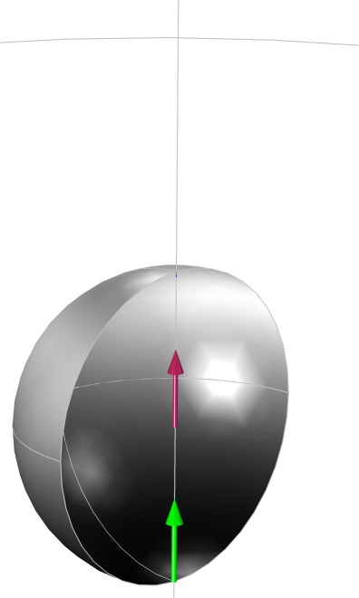
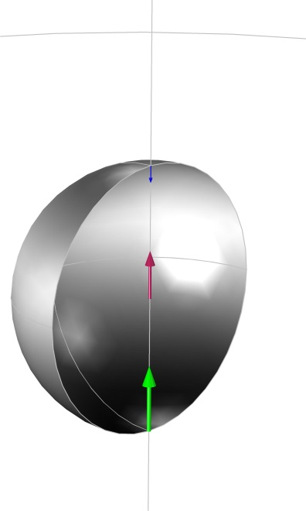
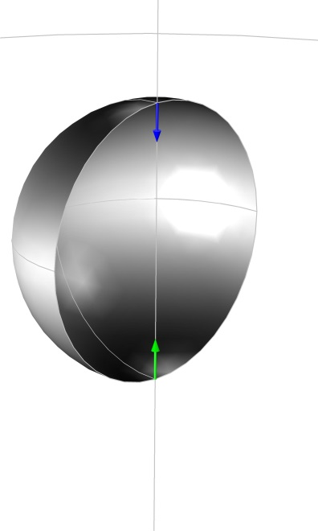
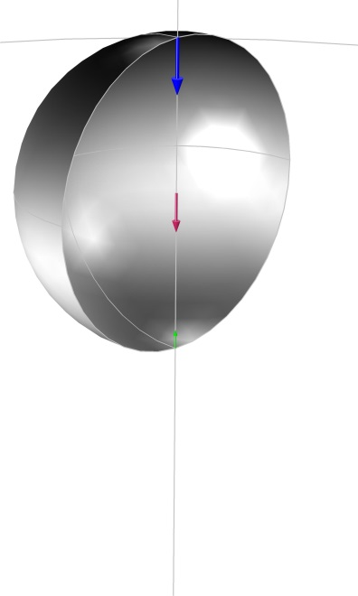
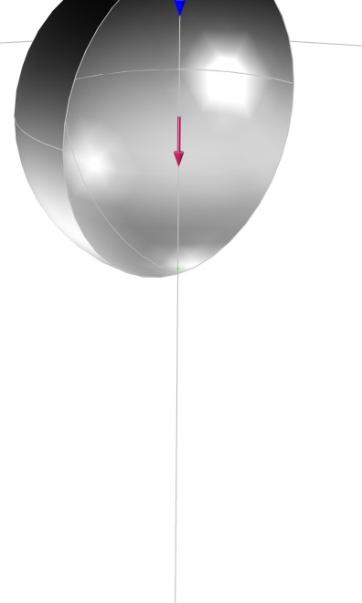
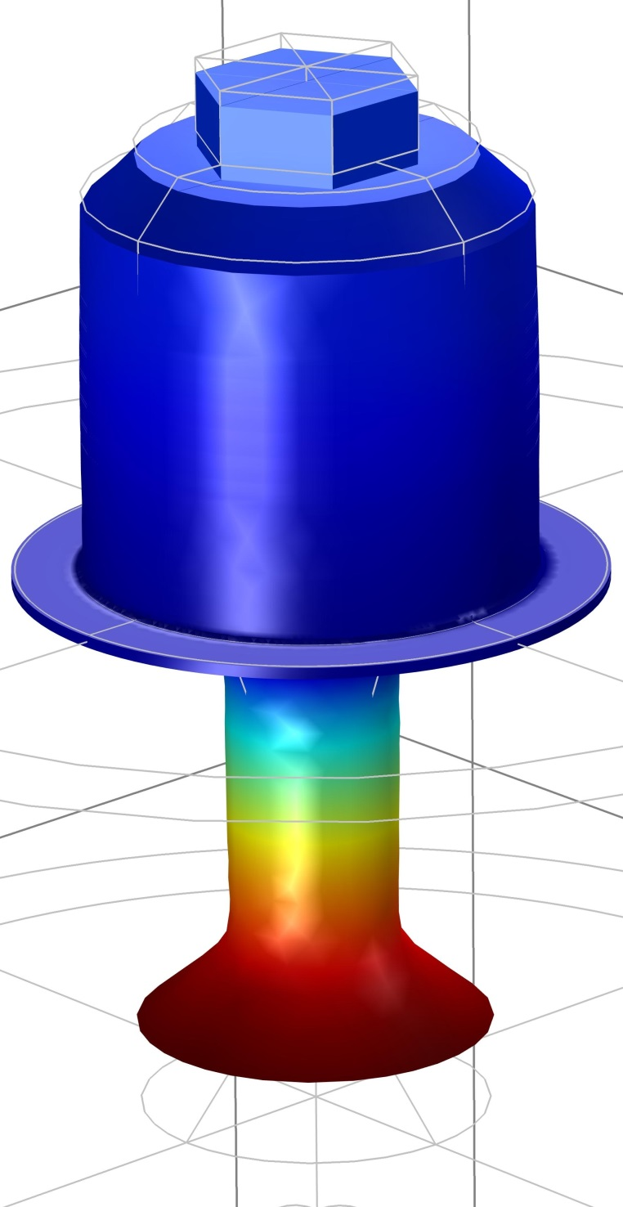
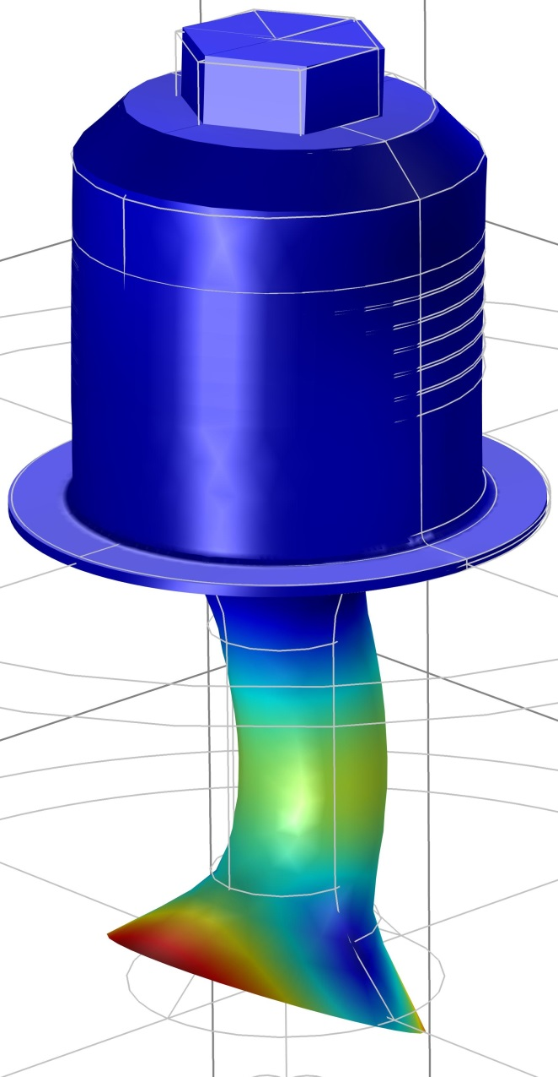
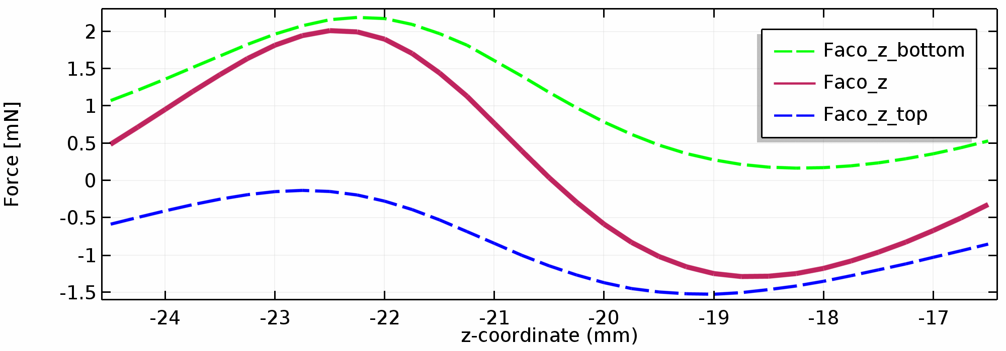
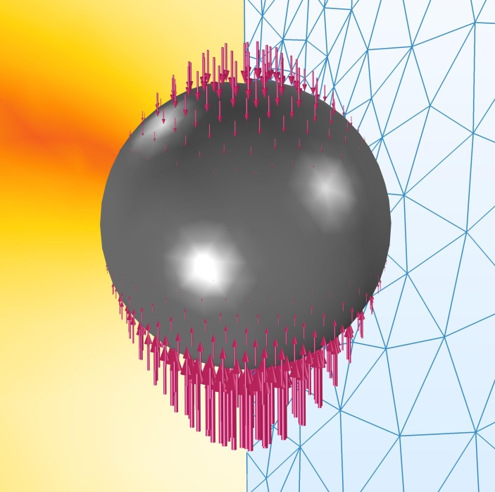
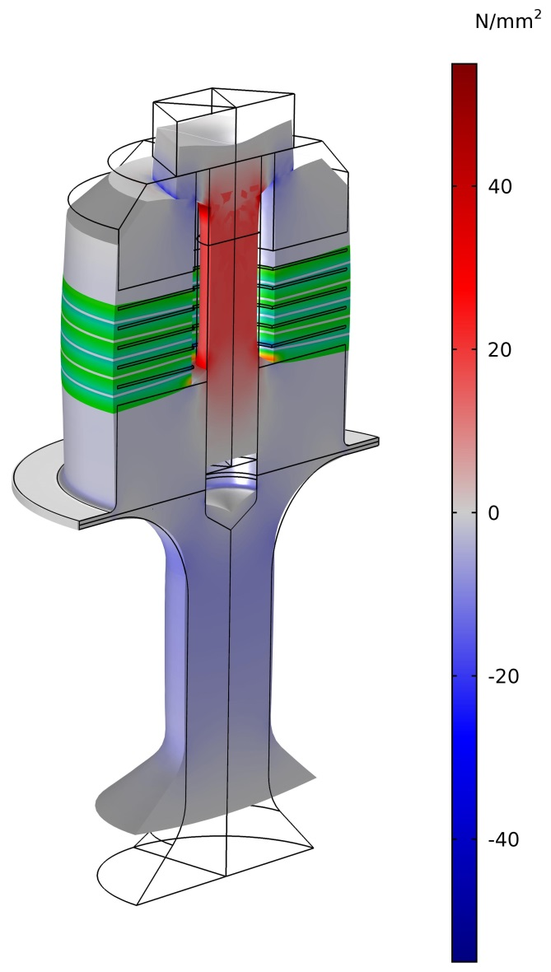
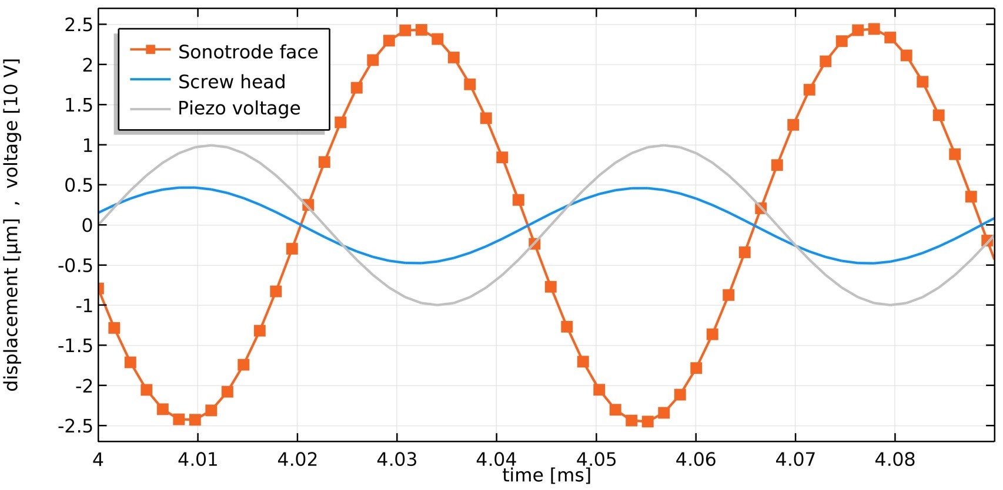
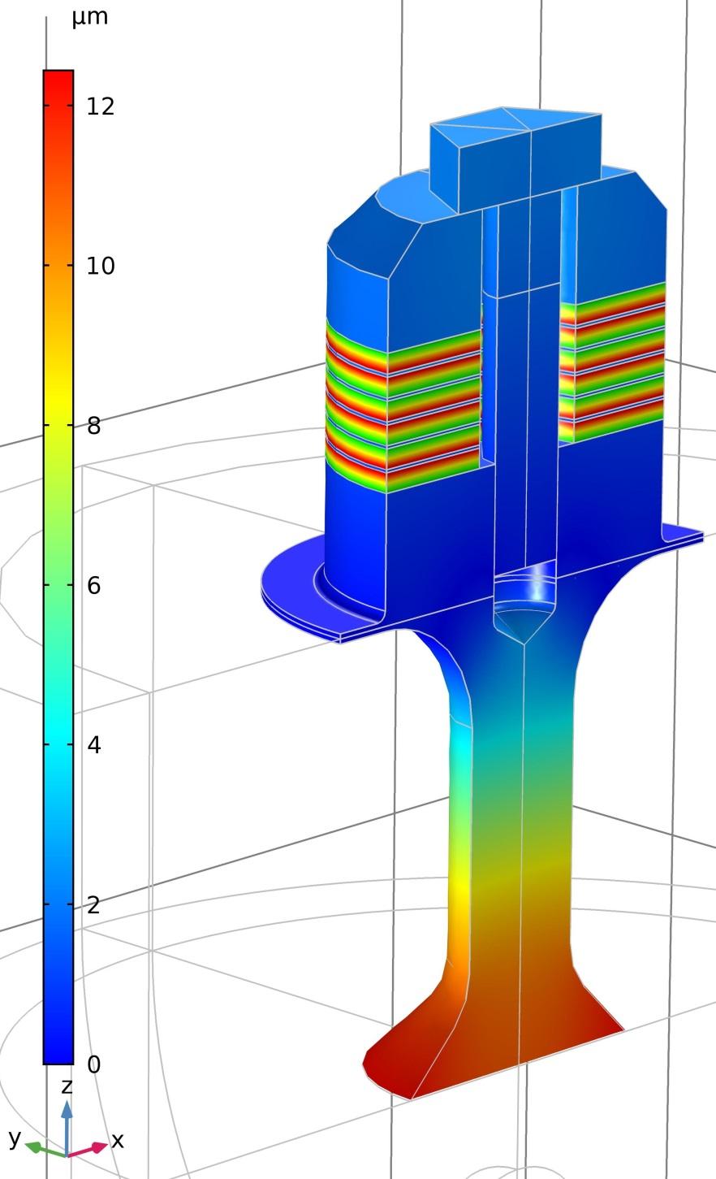
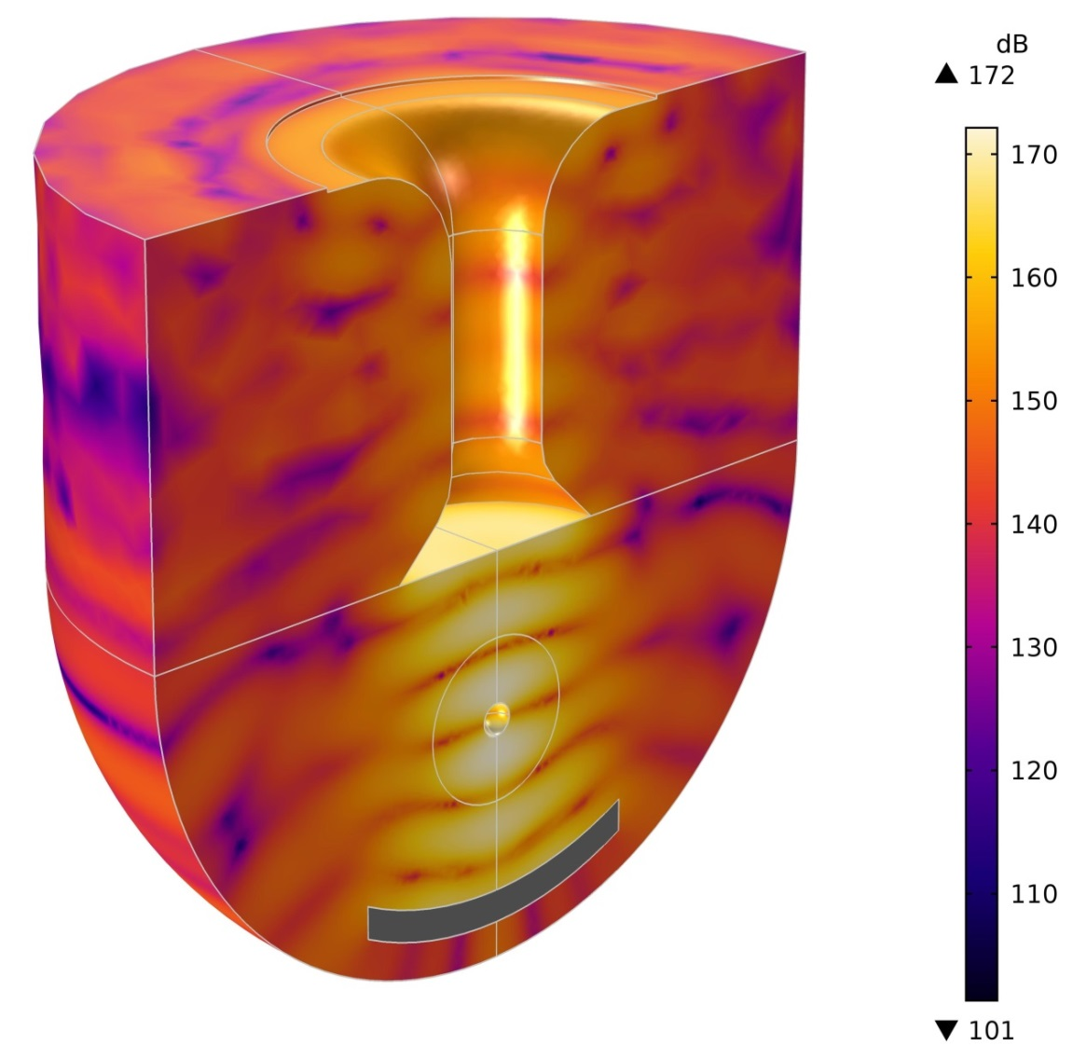
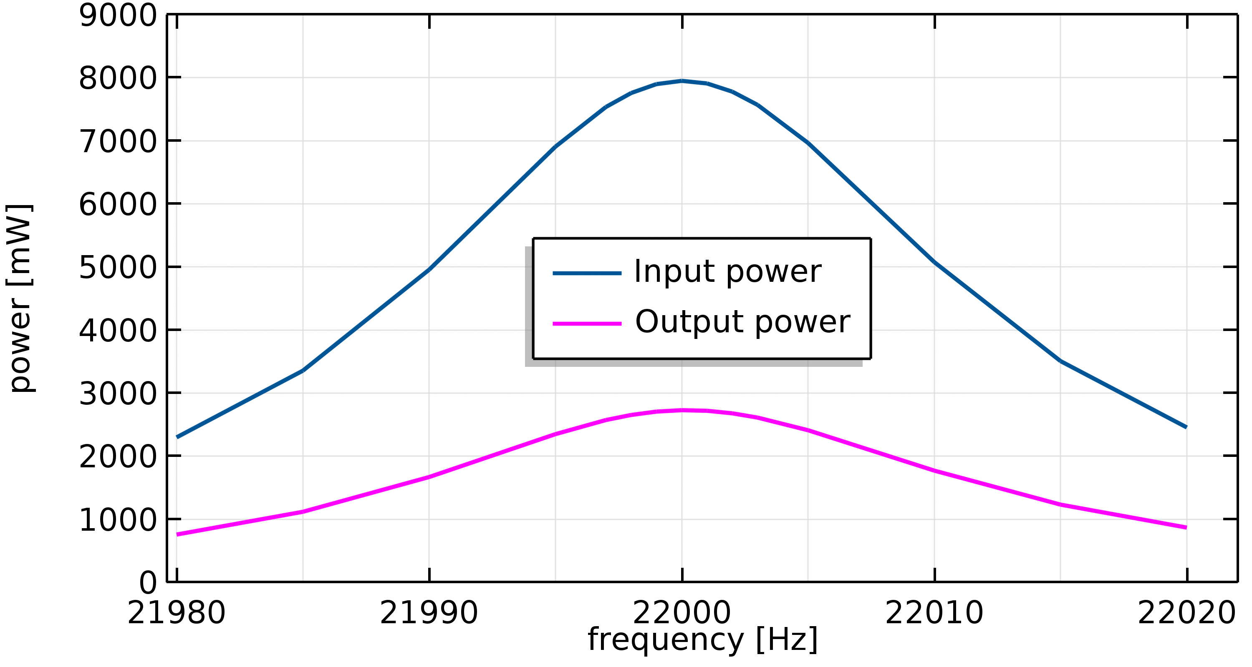
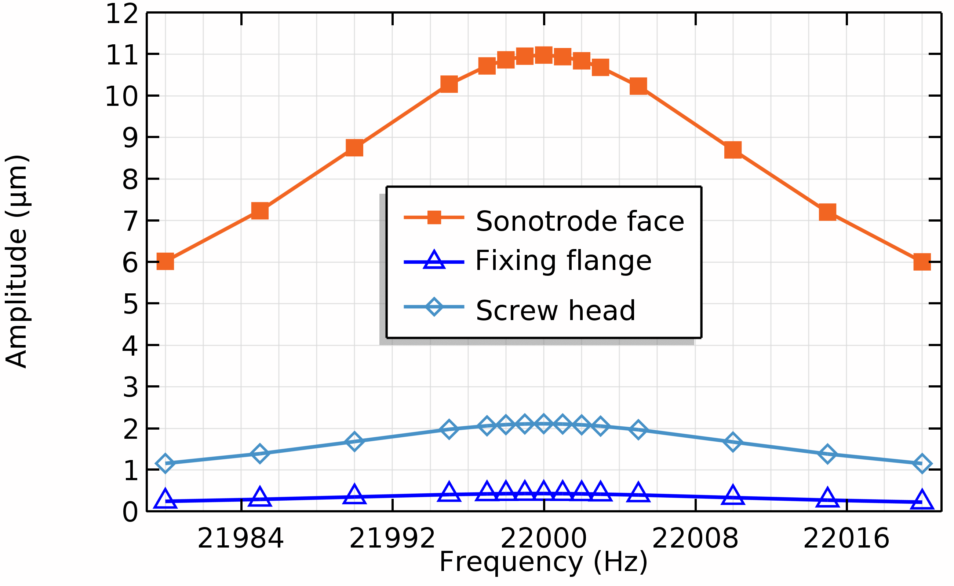
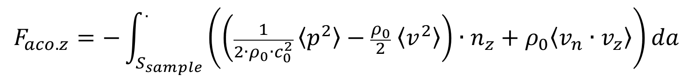
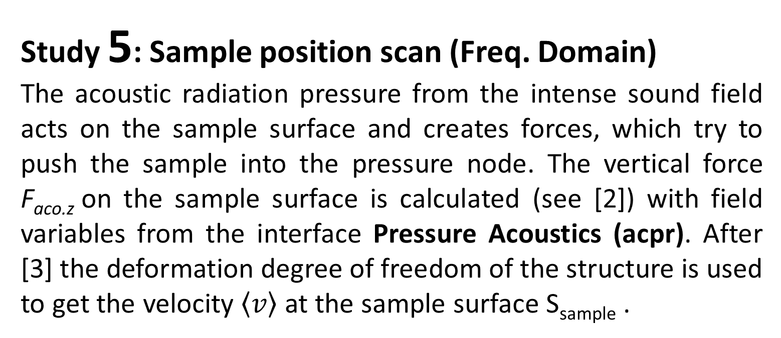
Acoustic Upside-down Levitator With A Solid Sample
Lothar Holitzner¹, Ernst Günter Lierke²
1. Paul Scherrer Institut, Laboratory for Scientific Developments and Novel Materials, Villigen, Switzerland;
2. tec5 AG, Oberursel, Germany.
Introduction:
Acoustic levitators are used to levitate small samples (ca. 0.01 - 6 mm) at a stable position in a gaseous or liquid environment. Acoustic levitators were first developed und used for experiments in space (1970s, by NASA / ESA), the application later became terrestrial (1990s). Meanwhile acoustic levitators are widespread. With the help of COMSOL Multiphysics® , we present a practical model, to show basic properties and interactions and some additional phenomena und aspects in a stepwise approach to the realistic world of acoustic levitators. In this acoustic levitator model the millimetre-sized spherical sample is located (in air environment) below the piezoelectric transducer (mechanical coupled resonator), which radiates the inaudible sound of 22 kHz downwards against the reflector. The transducer is based on a sophisticated 20 kHz model, designed by E.-G. Lierke. That version was also used at the Battelle Institute (Frankfurt/Main, Germany) [1]. The current available model contributes to understand details of acoustic levitation and helps to improve acoustic levitators for future applications.
Study 1: Piezo preload (Stationary, prestressed)
In the 1st development step of the FEM model, only the transducer was set up and the Structural Mechanics Module was used for a stationary study. In this transducer assembling
Study 6: Sample position balance (Frequency Domain, prestressed)
The mesh of the gas domain, which locally surrounds the solid sample, is based on a Moving Mesh and enables the sample domain to change its position. The 1st study step (Stationary) calculates the final vertical sample position with a simple force balance equation, defined in Global ODEs and DAEs (ge) and moves the sample by a Prescribed Displacement. The mesh in the sample proximity deforms accordingly. Then, the 2nd study step (Frequency Domain Perturbation) recalculates the pressure acoustics field in the new geometric situation. This confirms the force equilibrium between sample weight and vertical acoustic radiation forces on the sample surface.
step, the piezo rings of the transducer are axially preloaded by the central clamping screw (Bolt Pre-Tension). With open piezo electrode ports, the resulting piezo voltage indicates the mechanical preload in practice (Piezoelectric Effect).
region with resulting
compressive stress
bolt under
pre-tension
Study 5: Sample position scan (Freq. Domain)
The acoustic radiation pressure from the intense sound field acts on the sample surface and creates forces, which try to push the sample into the pressure node. The vertical force F_{aco.z} on the sample surface is calculated (see [2]) with field variables from the interface Pressure Acoustics (acpr). After [3] the deformation degree of freedom of the structure is used to get the velocity $\left\langle v\right\rangle$ at the sample surface S_{sample} .
resulting
piezo voltage
(Floating Potential)
Figure 11. Stable levitated sample in force equilibrium at vertical balance position below the 3rd pressure node
Figure 1.
Piezo voltage and axial stress after prestressing the central bolt.
$$F_{aco.z}=−\int_{S_{sample}}^{.}{\left(\left(\frac{1}{2∙ρ_{0}∙c_{0}^{2}} \left\langle p^{2}\right\rangle −\frac{ρ_{0}}{2} \left\langle v^{2}\right\rangle \right)∙n_{z}+ρ_{0}\left\langle v_{n}∙v_{z}\right\rangle \right)da}$$
Study 2: Transducer geometry (Eigenfrequency, prestr.)
In the 2nd development step, an eigenfrequency study inspects the undamped, axial natural oscillation of the prestressed piezoelectric transducer. By adjusting the transducer geometry, the resonance frequency was tuned to 22 kHz and the velocity node placed into the level of the fixing flange. This Eigenfrequency study also helps, to exclude undesired tilt and pendulum oscillations of the transducer.
The levitation force progression can be investigated with a Parametric Sweep of the vertical sample position over the pressure node region. This force progression is used as an input to study 6.
pressure node position
(velocity antinode)
driver
fixing flange (velocity node)
Figure 10. Vertical force F_{aco.z} from acoustic radiation pressure at different vertical sample positions. F_{aco.z} = F_{aco.bottom} + F_{aco.top}
sonotrode
Study 4: Transducer motion (Time Dependent)
This study explores the transducer
oscillation at the resonance frequency
(22 kHz) in timewise resolved motion
sequence.
Figure 3. Undesired oscillation at 19963 Hz
(deformation scale
factor = 130)
(velocity antinode)
Figure 2. Total displacement (amplitude) at transducer Eigenfrequency 22002 Hz (deformation scale factor = 500)
Study 3: Frequency scan (Frequency Domain, prestressed)
A frequency domain study (Harmonic Perturbation) vibrates the prestressed piezoelectric transducer to harmonic oscillations (with use of the AC/DC Module). The frequency scan over the resonance range also shows the internal mechanical (Rayleigh) Damping in the transducer material with the shape of the amplitude resonance curve (reasonable damping values taken from e.g. annealed high-grade titanium alloy).
The Acoustics Module was used, to calculate the Acoustic-Solid Interaction between transducer, acoustic levitation field, reflector and solid sample. The oscillating transducer radiates its maximum power into the gas domain, when the distance between sonotrode face and (spherical curved) reflector is tuned to resonance, namely at max. acoustic impedance.
Figure 8. Transducer displacement field, Z-component, resp. piezo voltage during swing up.
Figure 9. Snapshot of the axial stress in the transducer. (deform. scale factor = 3000)
AC voltage
(Harmonic
Pertubation)
stainless steel (1.4435)
Fig. 6 shows an optimized intense sound field with 5 stationary pressure nodes in the acoustic standing wave. A sample sphere Ø4mm is placed in the 3rd pressure node. Fig. 7 indicates the frequency-dependent power transfer on the way from the piezo electrodes into the levitation sound field. (Note: Fig. 4 to Fig. 7 with U_{piezo} = 7 V_{rms} )
Ti6Al4V (3.7165)
Rayleigh damping with material quality factor Q = 1500 - resulting mass damping parameter α = 45.936 [1/s]
- resulting stiffness damping parameter β = 2.409e-9 [s]
3rd pressure
node
Figure 4. Displacement amplitude at 22000 Hz
sonotrode
face
Figure 5. Displacement amplitude, z-component.
sound field
reflector
Figure 7. Input: Electrical power, calculated from piezo current and voltage. Output: Acoustically radiated power, calculated at the sonotrode face boundaries
Figure 6. Sound pressure level in the gas domain beween transducer and reflector
[1] L. Holitzner, Verbesserung der Funktions-Charakteristik eines elektrostatisch akustischen Hybridlevitators, FH Wiesbaden, Battelle Institut, Frankfurt/M., 1992
[2] Alon Grinenko, How to Compute the Acoustic Radiation
Force, COMSOL BLOG, January 29, 2015
[3] Mads Herring Jensen, COMSOL Support Case 3000332, 2018

