Slide 1
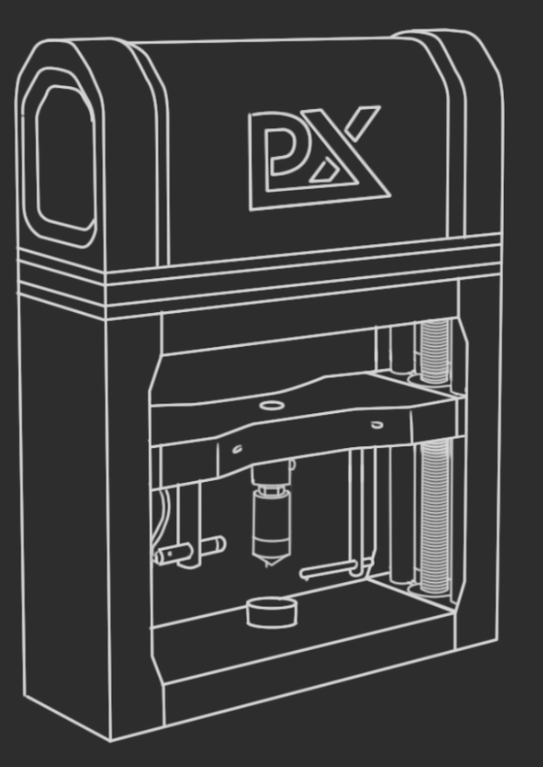




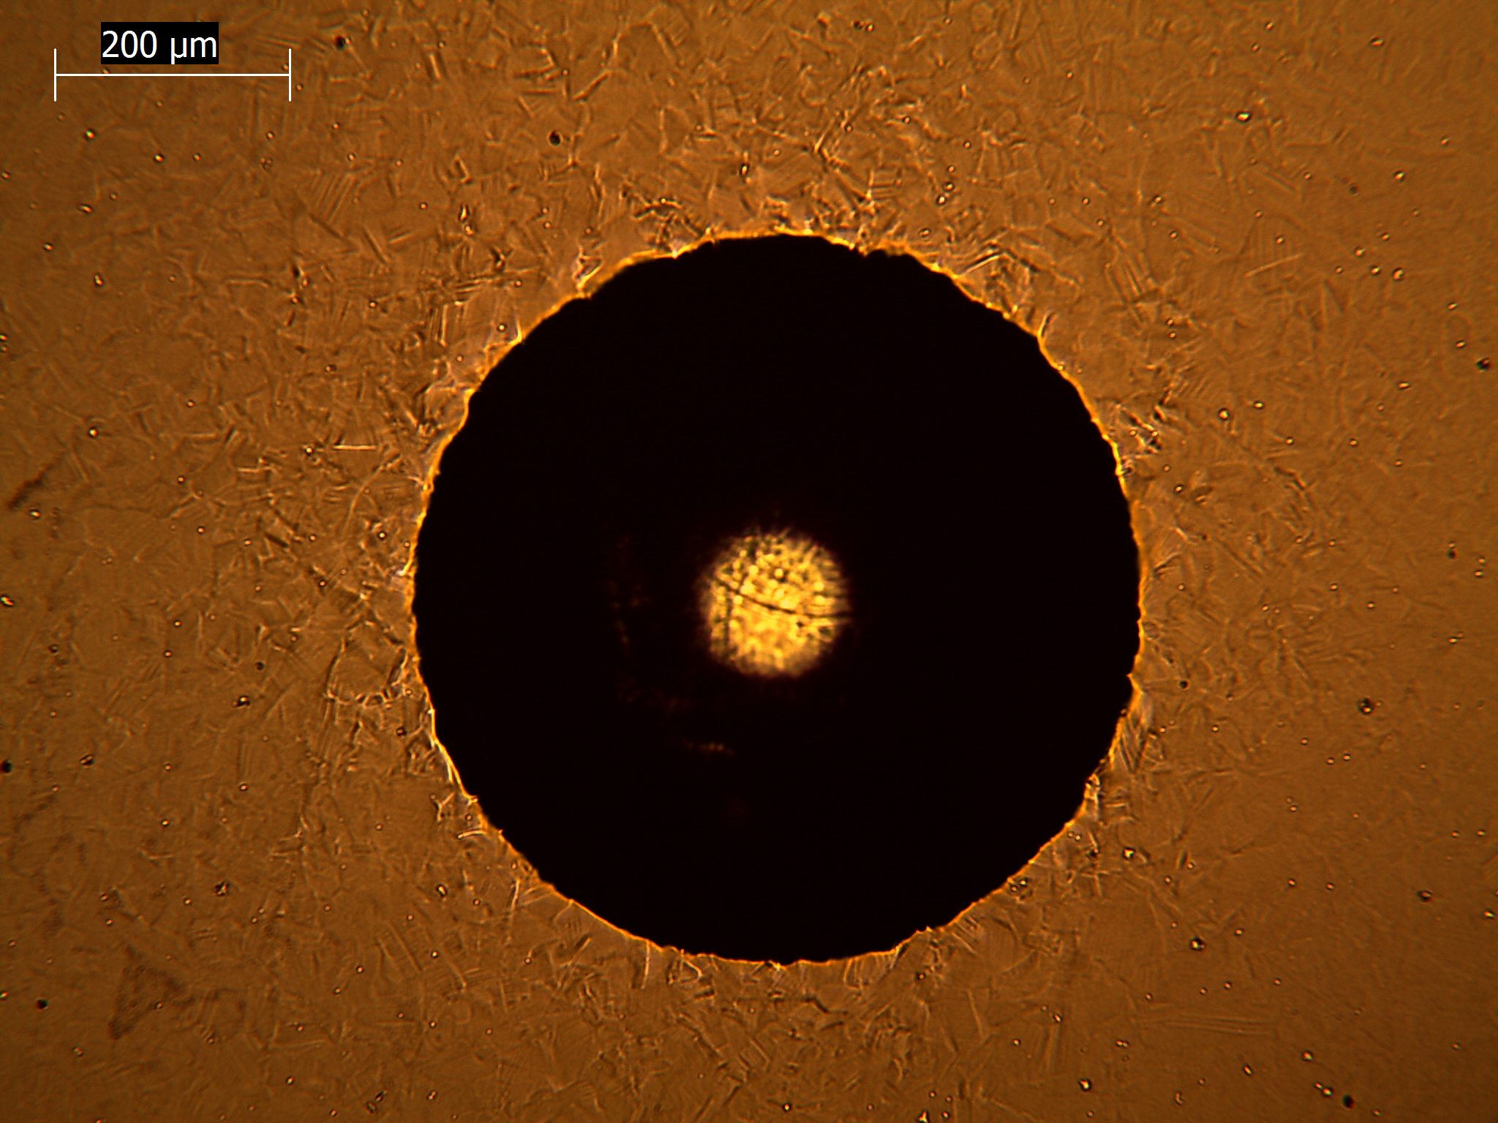
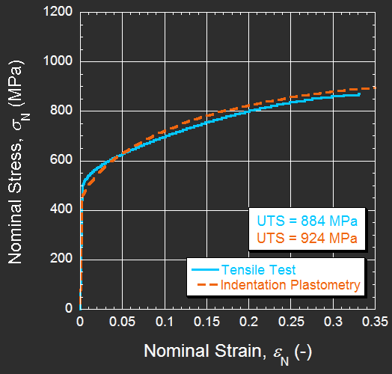
Indentation Plastometry:
A Revolutionary New Approach to Mechanical Testing of Metals
J. E. Campbell¹, M. Burley¹, J. Dean¹ & T. W. Clyne ¹
1. Plastometrex, Salisbury House, Station Road, Cambridge, CB1 2LA
Indentation Plastometry is now starting to become commercially available. It allows bulk mechanical properties, in the form of a tensile stress-strain curve, to be obtained from a single indentation experiment (via iterative FEM simulation of the process). Since indentation is an easy and rapid operation that can be carried out on small samples and real components, this constitutes an important advance.
The procedure is simple and robust. It is also extremely fast - tensile stress-strain curves can be obtained in just a few minutes. It is based on representation of the plasticity characteristics in a constitutive law relating the true von-Mises stress to the true von-Mises strain. The most common is the Ludwik-Holloman equation, in which σ_{y} is the yield stress, k is the work hardening coefficient and n is the strain exponent:
FEM simulation is then carried out repeatedly (using the Structural Mechanics Module of COMSOL Multiphysics), with the aim of finding the set of Ludwik-Holloman parameter values that give optimum agreement between experimental and predicted residual indent shapes.
The rate at which the optimisation process is handled has been significantly enhanced by combining COMSOL-based finite element simulations with advanced machine learning algorithms. The entire software package, called SEMPIDTM, is built using the COMSOL Application BuilderTM, compiled using COMSOL CompilerTM, and then distributed with our custom-built Indentation Plastometers.
1: Indent Sample
2: Measure Profile
3: SEMPIDTM Analysis
4: Stress-strain Curve
3 minutes
Validation example with Inconel 718
For more examples and further information visit www.plastometrex.com

