Slide 1
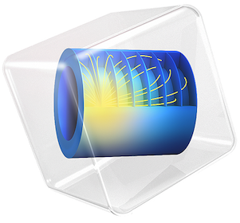
COMSOL Conference 2020
14 - 16 Oct 2020
Grenoble, France
A New Three Phase Triangle Core Measurement Type Voltage Transformer
Under the guidance of:
Prof. Dr. Okan ÖZGÖNENEL, Baris CEPKEN, Burcu CILSAL

Slide 2
Contents
Introduction
Definition of the Three Phase Triangle Core Measurement Type Voltage Transformer Model
Simulation Results
  Conclusion
  References

Slide 3
Introduction
Reliability and stability of power systems depend on the operation of all system components within specified limits.
Voltage measurement transformers take an important place among the power system components. Voltage measurement transformers
perform their protection and measurement tasks where they are connected.
reduce the primary circuit voltage to the measurable low levels for the measurement and protection devices connected to the secondary circuit.

Slide 4
Introduction
This paper simply propose a three phase dry-type voltage measurement transformer based on triangular cores.
The purpose of the new core design is
saving weight and space,
reducing the volume,
reducing harmonic content and magnetic stray losses, and
increasing energy efficiency

Slide 5
Introduction
This work presents the design and implementation of three phase voltage measurement transformer based on triangular core.
In the proposed transformer no-load losses, magnetic stray losses and harmonics are studied.
The modelling outcomes are then compared to real time data provided by ESITAS Company.

Slide 6
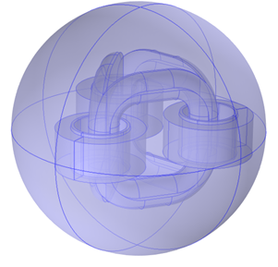
3D Modeling of Triangle Core Measurement Voltage Transformer
The product is dry-type epoxy cast resin measurement type voltage transformer.
Due to do providing symmetry of each flux distribution in the core legs importance for saturation, in the triangle-core transformer, three symmetrical legs are mounted in a triangle shape.
The complete 3D model of is given in Figure 1. The surrounding environment is selected as air in spherical shape. The model is designed on a scale 1:1.
The core material is selected as M5 laminated sheet and its BH curve is seen in Figure 2.
Figure 1. 3D model of triangular core measurement transformer
Figure 2. BH curve of M5 type core material

Slide 7
3D Modeling of Triangle Core Measurement Voltage Transformer
2D and 3D CAD models of current cast-resin voltage transformers have been prepared.
These models were transferred to COMSOL environment and necessary graphical operations were made on the models.
In the next step, the electrostatic analysis of the existing voltage transformers were conducted for both normal operating conditions and lightning pulse voltage analyses and compared with the real-time test results of the company.
After these two results were seen to be compatible, triangular core transformer models were created related to the proposed project subject and similar studies were carried out.
Table 1. Design parameters
Item | Value | Definition
Np | 27000 | Number of Turns - Primary
Ns | 82 | Number of Turns - Secondary
d1 | 0.12 mm² | Primary Cross Section
d2 | 3 mm² | Secondary Cross Section
U1 | 31.5 kV | Primary Voltage
f | 50 | Frequency
Rp | 10 Ohm | Primary Resistance
Rs | 10 kOhm | Secondary Resistance
Fs | 2000 Hz | Sampling Frequency
t-end | 0.04 sec | End of Simulation

Slide 8
Simulation Results
On the model open circuit and short circuit tests have been done and then ratio tests are performed.
Magnetic field and electrical circuit physics are chosen to complete analysis.
Time dependent study is chosen to see transient performances on the proposed model.
Amper-Law is applied to M5 type triangular core and BH curve is selected as magnetization.

Slide 9
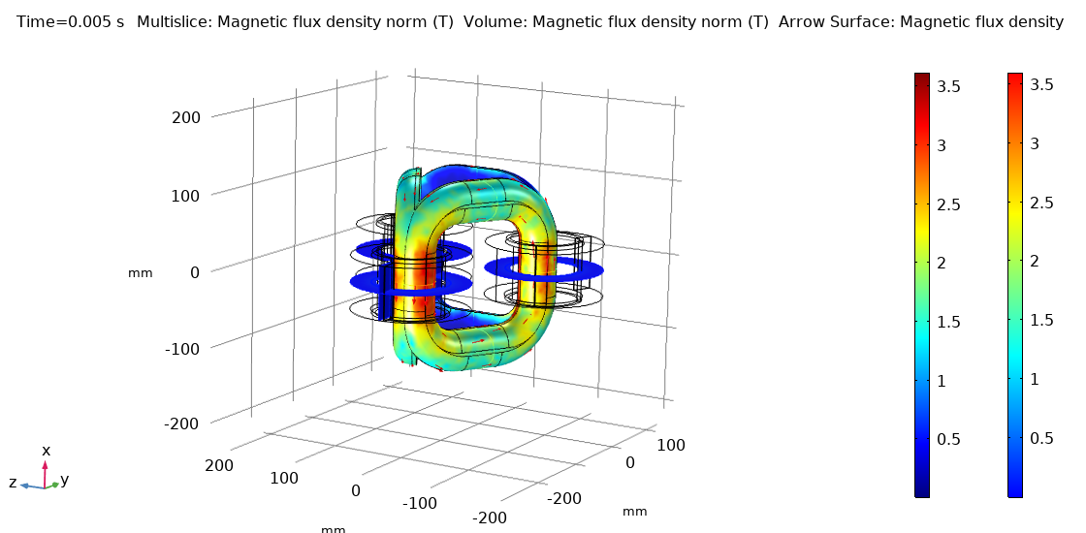
Simulation Results
Magnetic flux density is seen in Figure 3.
Figure 3. Magnetic flux density norm

Slide 10
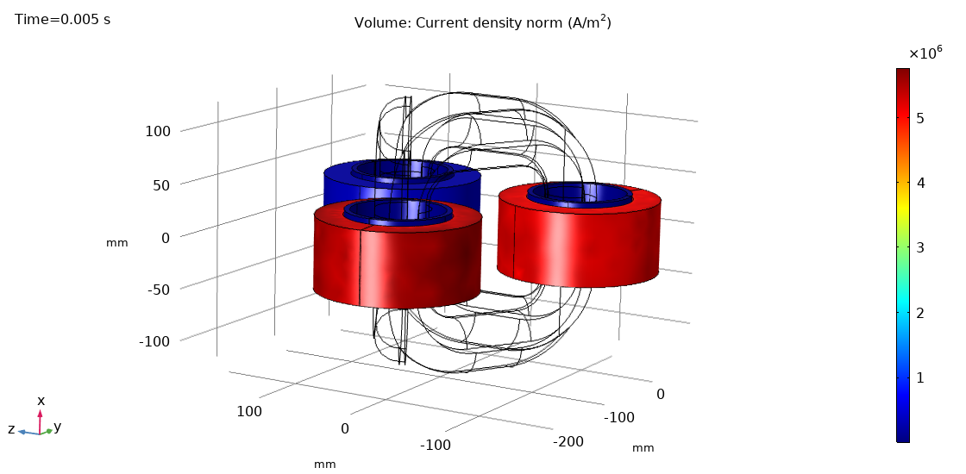
Simulation Results
Current density distribution is given in Figure 4.
Figure 4. Current density norm

Slide 11
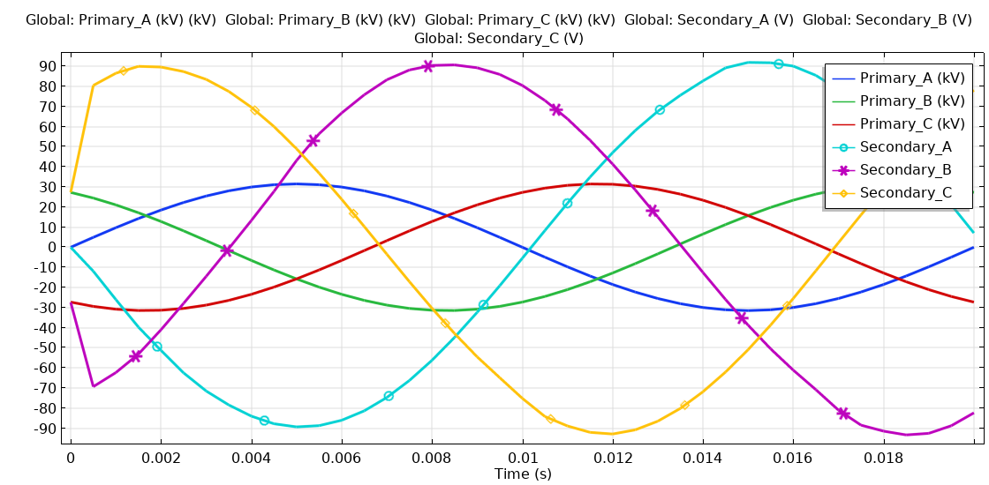
Simulation Results
Induced voltages are given in Figure 5.
Figure 5. Induced voltages in primary and secondary sides

Slide 12
Conclusion
This paper proposed a new type voltage measurement transformer based on triangular core shape.
The use of all useful aspects of the triangle core concept in voltage measurement transformers constitutes the main innovative aspect of our work.
On the proposed model FEA is performed its performance for both open and short circuit tests.

Slide 13
Conclusion
Some useful advantages have been observed.
Due to its symmetry the related losses and operation costs are reduced.
The symmetric structure and the lack of joints between core legs and yokes have an astonishing effect on the characteristics of the transformer.
Each of the three legs is linked directly to the other two and the distances covered by the magnetic flux in the core are symmetrical and shorter.

Slide 14
Conclusion
If the magnetic flux in the yoke of one of the core rings becomes too large, the remaining flux can make its way via the other core ring and even close back over the third core ring, providing a symmetric path.
This behaviour together with the different footprint results in impressive advantages over conventional transformers.

Slide 15
References
1. Yuhang Pan, Song Han, Jinling Feng, Xiao Hu, An analytical electromagnetic model of “Sen” transformer with multi-winding coupling International Journal of Electrical Power & Energy Systems Vol. 120, 2020.
2. Cezary Swieboda, Jan Walak, Marian Soinski, Jakub Rygal, Dominik Grybos, Nanocrystalline oval cut cores for current instrument transformer prototypes Measurement Vol. 136, Pages 50-58, 2019.
3. Selami Balci, Ibrahim Sefa, Necmi Altin, Design and analysis of a 35 kVA medium frequency power transformer with the nanocrystalline core material International Journal of Hydrogen Energy Volume 42, Issue 2813, Pages 17895-17909, 2017.
4. A. J. Moses, M. Yasin, M. Soiński, Evaluation of novel transformer cores Journal of Magnetism and Magnetic Materials, Volume 133, Issues 1–31, May 1994 Pages 637-639, 1994.
5. Pelayo E. Blanco Alonso, Andrés Meana-Fernández, Jesús M. Fernández Oro, Thermal response and failure mode evaluation of a dry-type transformer Applied Thermal Engineering Vol. 12025, Pages 763-771, 2017.

Slide 16
Thank you
Okan OZGONENEL
Engineering Faculty
Department of Electrical and Electronic Engineering
Ondokuz Mayıs University
Samsun, Turkey
okanoz@samsun.edu.tr
Barış CEPKEN, Burcu ÇİLSAL
ESITAS
İstanbul, Turkey

