Slide 1


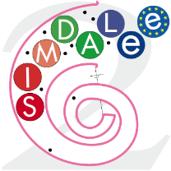


Simulation of low energy electrons in
Scanning Field Emission Microscopy (SFEM)
C.G.H. Walker, H. Cabrera and D. Pescia
Laboratorium für Festkörperphysik, ETH Zürich, 8093 Zürich, Switzerland

Slide 2
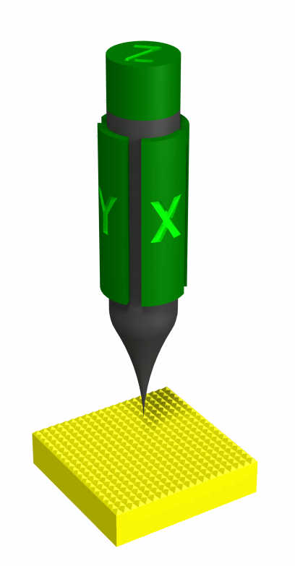
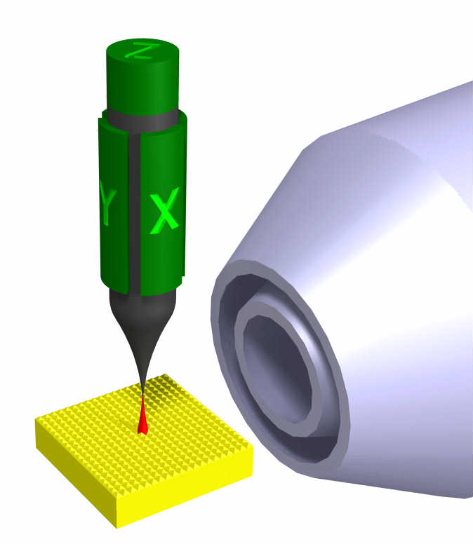
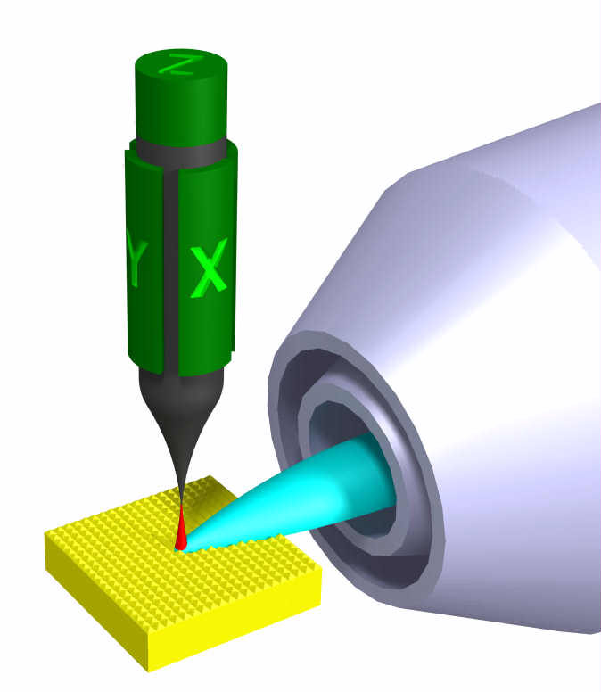
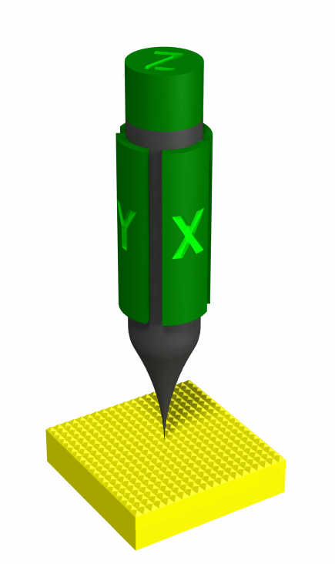
WHAT IS SFEM?
10 – 50 V
10 – 50 V
10 – 50 V
2 – 10 kV
2 – 10 kV

Slide 3
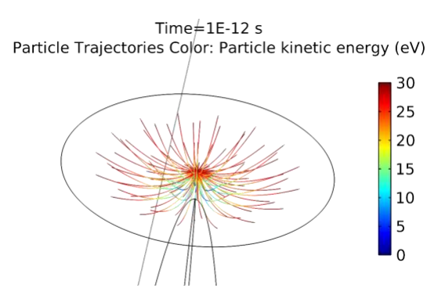
WHERE IS THE SOURCE OF THE ELECTRONS?
Fundamental question: which electrons leave the junction? Fine simulation is needed.
Notes:
mostly interested in secondary electrons from the sample and not in the elastic scattered electrons from the tip
Replace SED with an Energy Analyzer with a lens system
160 degree spherical energy analyzer with a resolution of 1 eV
Next slide: results of this analysis

Slide 4
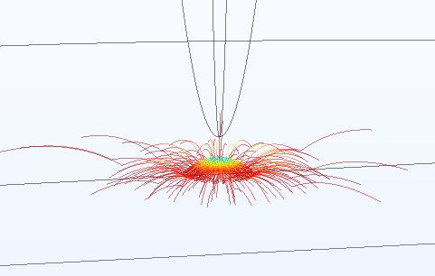
QUANTUM MECHANICAL REFLECTION OF ELECTRONS
Some electrons reflect from surface when they encounter the strong ATTRACTIVE force at the surface. But many electrons enter the material. Therefore we still need Monte Carlo simulation.
Notes:
mostly interested in secondary electrons from the sample and not in the elastic scattered electrons from the tip
Replace SED with an Energy Analyzer with a lens system
160 degree spherical energy analyzer with a resolution of 1 eV
Next slide: results of this analysis

Slide 5
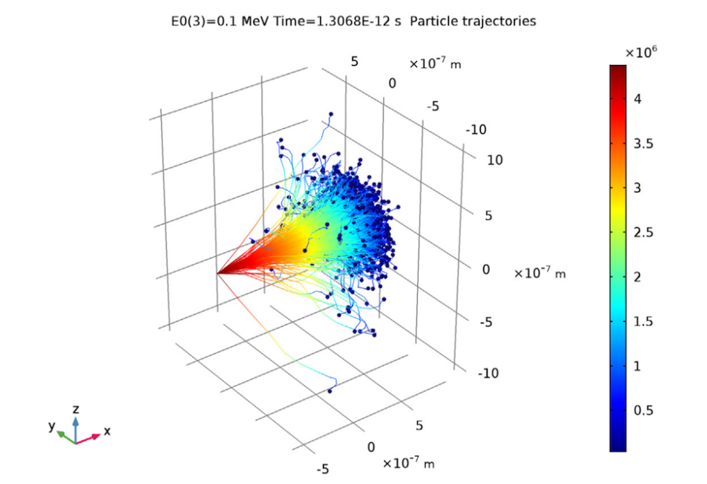
COMSOL ION RANGE BENCHMARK EXAMPLE
Monte Carlo simulation already exists within COMSOL – the ion range benchmark model (IRBM). Why not adapt this model for use with low energy electrons ?
We need to generate secondary electrons (SE), but the IRBM uses continuous slowing down approximation (CSDA).
The IRBM determines a scattering event at each time step, but scattering occurs at random times and is not suitable at low energies.
Notes:
mostly interested in secondary electrons from the sample and not in the elastic scattered electrons from the tip
Replace SED with an Energy Analyzer with a lens system
160 degree spherical energy analyzer with a resolution of 1 eV
Next slide: results of this analysis

Slide 6
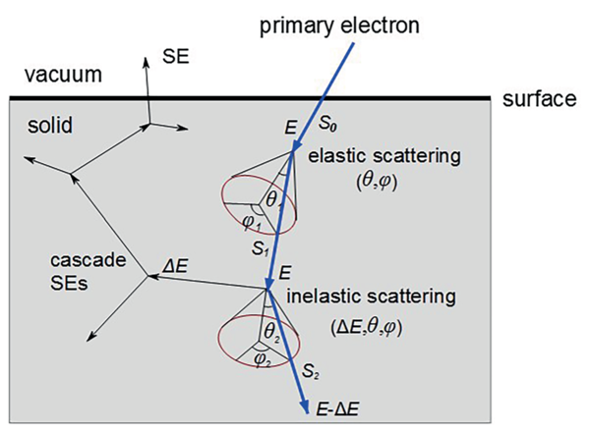
EXISTING MONTE CARLO MODELS
There are many existing Monte Carlo simulation packages available - e.g. CASINO, JMONSEL, PENELOPE, Kieft and Bosch (KB) [1] program using the Geant4 package [2].
Geant4 can also include electric and magnetic fields.
Why not adapt KB program to include electric fields ?
Electric fields created using COMSOL.
This was tried and would be fast, but many software development problems encountered.
Image source: Microbeam analysis — Scanning electron microscopy —
Method for evaluating critical dimensions by CD-SEM
Notes:
mostly interested in secondary electrons from the sample and not in the elastic scattered electrons from the tip
Replace SED with an Energy Analyzer with a lens system
160 degree spherical energy analyzer with a resolution of 1 eV
Next slide: results of this analysis

Slide 7
USING COMSOL WITH EXTERNAL MONTE CARLO PROGRAM
Launch electrons within COMSOL model.
Store position and velocities where electrons freeze on the surface (after bouncing).
Start Monte Carlo simulation using the particle locations and velocities from COMSOL.
If any particles return to the surface, store positions and velocities and pass back to COMSOL.
Keep looping until all electrons have lost too much energy or reach the edge of the simulation volume.
The trajectories from each COMSOL and Monte carlo run are stored seperately and need to be reconstructed to view entire trajectories. This issue is being addressed with a new feature in the COMSOL Geometric Optics module.
Notes:
mostly interested in secondary electrons from the sample and not in the elastic scattered electrons from the tip
Replace SED with an Energy Analyzer with a lens system
160 degree spherical energy analyzer with a resolution of 1 eV
Next slide: results of this analysis

Slide 8
USING COMSOL WITH EXTERNAL MONTE CARLO PROGRAM:
ADVANTAGES AND DISADVANTAGES
Advantages: Simply adapt existing COMSOL and Monte Carlo models, could be used with a variety of Monte Carlo models, flexible and easily adaptable to other COMSOL models.
Disadvantages: Slow. Storing data in files and passing data between the programs means we cannot simulate so many electron trajectories. Cannot be used if the electric field exists within the material (e.g. semiconductors or insulators).
Notes:
mostly interested in secondary electrons from the sample and not in the elastic scattered electrons from the tip
Replace SED with an Energy Analyzer with a lens system
160 degree spherical energy analyzer with a resolution of 1 eV
Next slide: results of this analysis

Slide 9
CONCLUSIONS
A model of the SFEM had been built using COMSOL for simulating electron trajectories in the vacuum and using a Geant4 based Monte Carlo model for simulating electron trajectories in the substrate.
The model operates by running each simulation model in turn until all electrons have lost sufficient energy such that they cannot be detected.
The electron trajectories from COMSOL and Monte Carlo simulations are stored in separate files.
In order to view the trajectories, a new feature from the COMSOL Geometric Optics model will be used.
Notes:
mostly interested in secondary electrons from the sample and not in the elastic scattered electrons from the tip
Replace SED with an Energy Analyzer with a lens system
160 degree spherical energy analyzer with a resolution of 1 eV
Next slide: results of this analysis

Slide 10
ACKNOWLEDGEMENTS
We would like to thank :
The Team of COMSOL Switzerland and COMSOL Support for their assistance in helping to build the simulation model and the visualisation.
Urs Ramsperger, Ann-Katrin Thamm and Maksym Demidenko, Steve Tear, Andrew Pratt and Mohamed El Gomati for useful discussions.
Financial support by the FP7 People: Marie-Curie Actions Initial Training Network (ITN) SIMDALEE2 (Grant No. PITN 606988) is gratefully acknowledged.
Notes:
mostly interested in secondary electrons from the sample and not in the elastic scattered electrons from the tip
Replace SED with an Energy Analyzer with a lens system
160 degree spherical energy analyzer with a resolution of 1 eV
Next slide: results of this analysis

