Slide 1
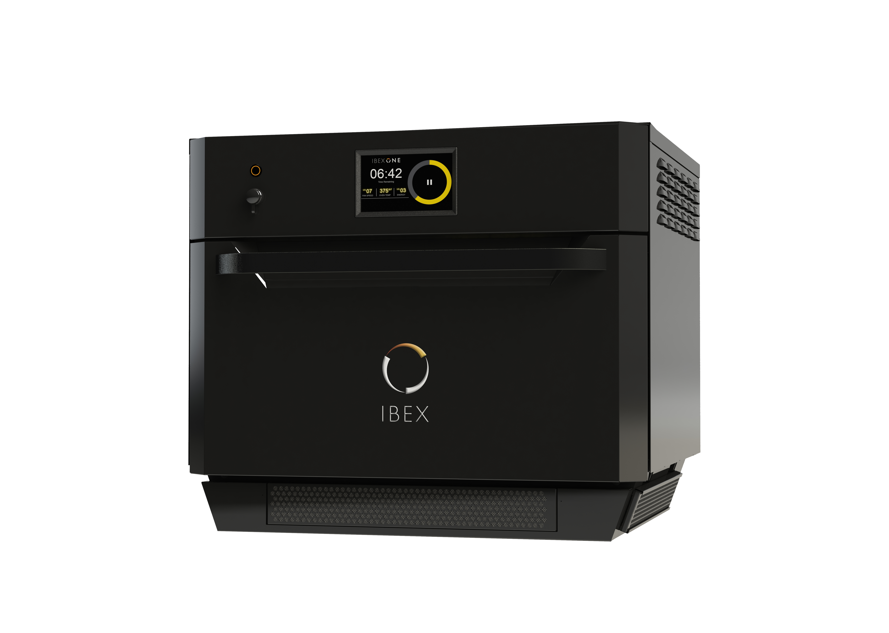
ILLINOIS TOOL WORKS
Optimizing Smart Microwave Designs
ITW Food Equipment Group
  Largest commercial food equipment company in the world
  Designs smart microwave ovens for professional kitchens
Smart microwave ovens with solid-state heating
  Faster
  More efficient
  More uniform heating
ITW Uses Multiphysics Simulation to Cook Up Smart Microwave Oven Designs”
Multiphysics Simulation 2019: Christopher Hopper, ITW, Illinois, USA
The IBEX solid-state microwave/convection oven
Notes:
Engineers at Volkswagen Kassel turned to multiphysics simulation to perform electromagnetic and structural analyses of rotor laminations in electric drives for EV motors
They then built and distributed simulation applications to automate these analyses and standardize their development processes throughout the organization

Slide 2
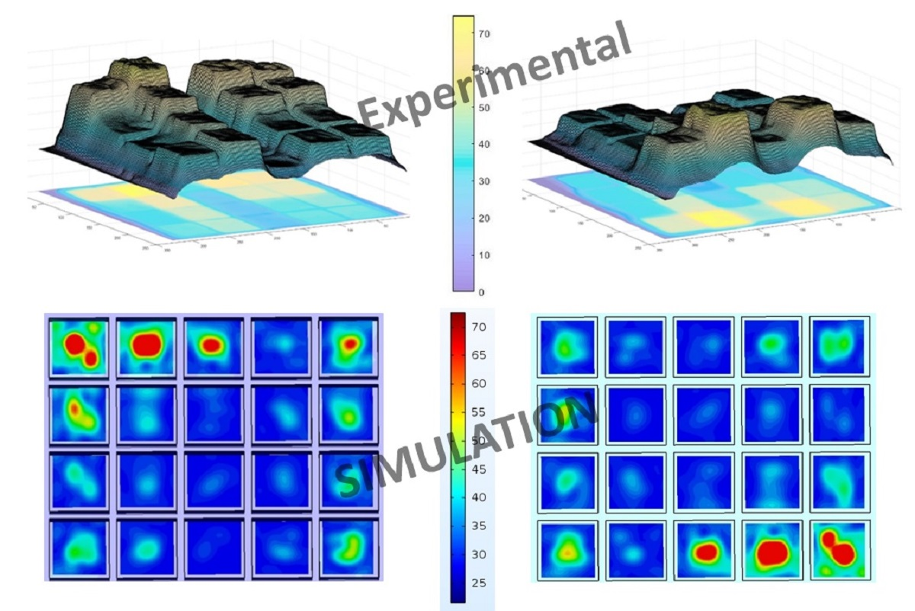
ILLINOIS TOOL WORKS
Optimizing Smart Microwave Designs
ITW Food Equipment Group
  Largest commercial food equipment company in the world
  Designs smart microwave ovens for professional kitchens
RF simulation used to:
  Study the oven’s heating patterns
  Design experiments
  Optimize the cavity/load systems
  And more
ITW Uses Multiphysics Simulation to Cook Up Smart Microwave Oven Designs”
Multiphysics Simulation 2019: Christopher Hopper, ITW, Illinois, USA
Improved uniformity in a smart microwave design when combining different heating patterns
Notes:
Engineers at Volkswagen Kassel turned to multiphysics simulation to perform electromagnetic and structural analyses of rotor laminations in electric drives for EV motors
They then built and distributed simulation applications to automate these analyses and standardize their development processes throughout the organization

