Slide 1
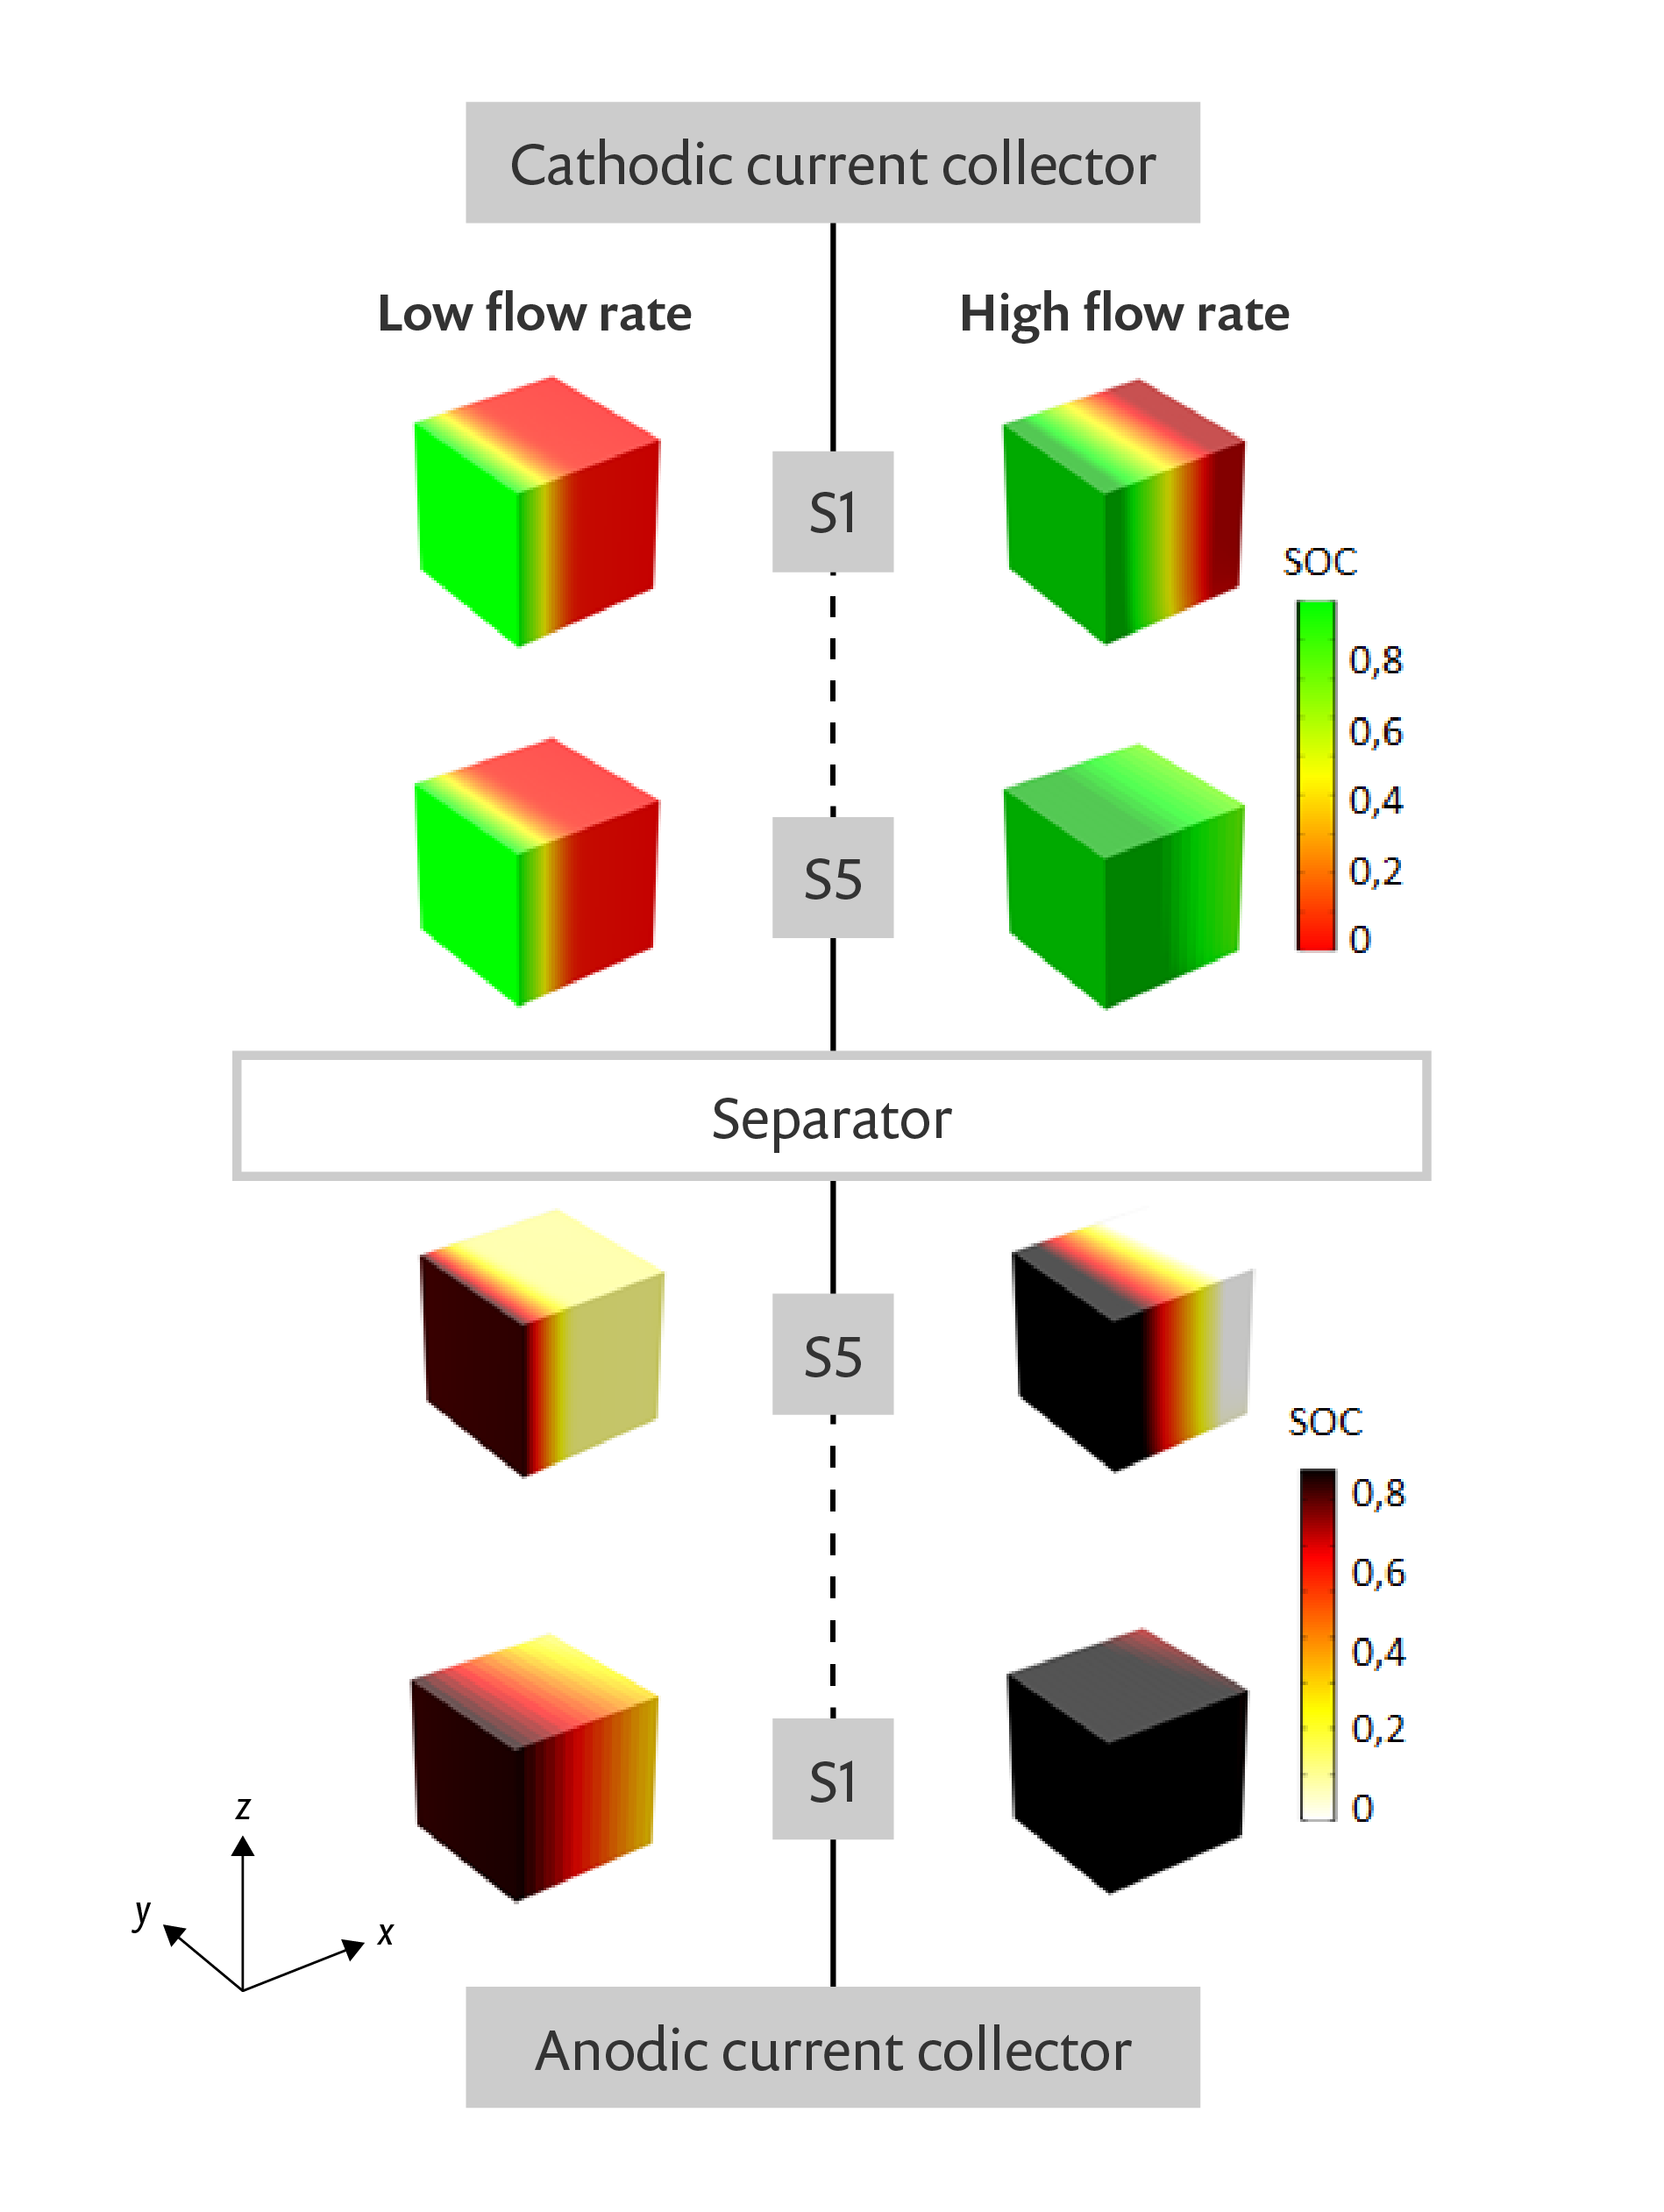
FLEMISH INSTITUTE FOR TECHNICAL RESEARCH (VITO/ENERGYVILLE)
Developing a Novel Model for Semisolid Flow Batteries
Semisolid flow batteries (SSFB)
  High volumetric energy density
  10x storage capacity of vanadium redox flow batteries (VRFBs)
Early SSFB models incorrectly describe transport mechanisms occurring within the active particles
Researchers developed an electrochemical model that accurately describes the kinetic and transport processes occurring within the design
Psuedo-3D (“P3D”) model shows how battery flow rate affects particle discharge
  Important factor for analyzing dynamic behavior of battery cells
“Developing a Novel Battery Model to Answer Classical Chemistry Questions”
COMSOL News 2020: Kudakwashe Chayambuka, Flemish Institute for Technical Research, Belgium
State of charge (SOC) distributions in a P3D NiMH SSFB model

