Slide 1
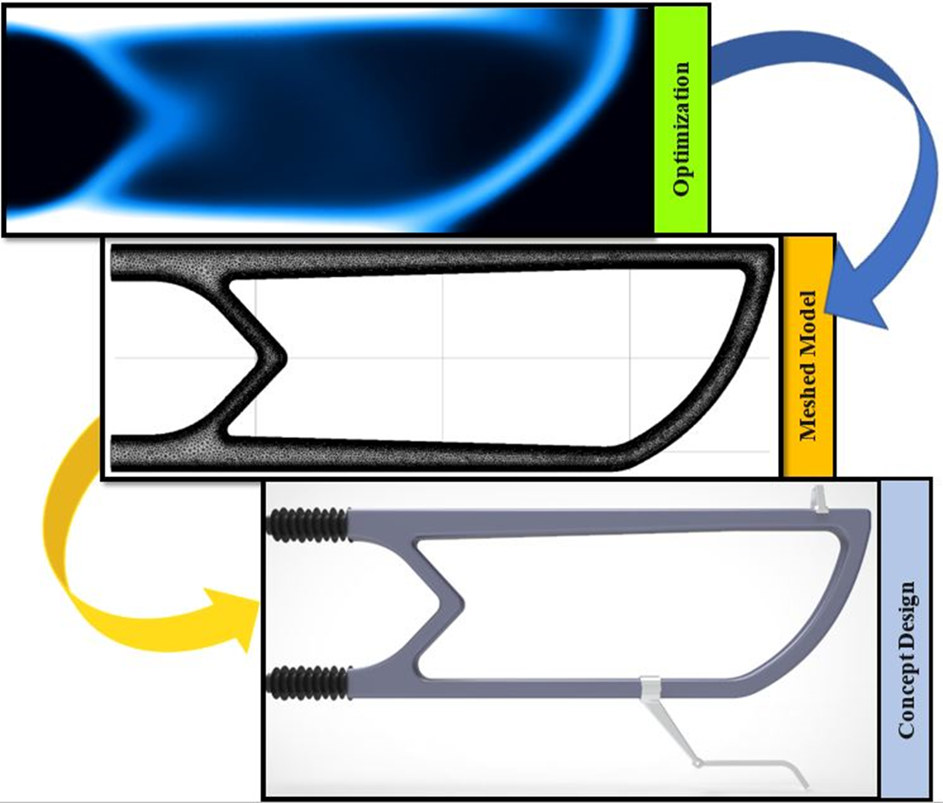
RAYCHEM RPG
Optimizing Railway Equipment Designs
Two expected changes to the Indian railway network by 2030:
  Electric and solar-powered trains
  Increase in train speed from 100 km/h to 160–220 km/h
Raychem used multiphysics simulation and topology optimization to design critical components for railway overhead equipment (OHE)
Autotensioning devices (ATD)
  50% reduction in assembly size (foldable design)
  Replaced the metallic spring with polymer
  80% decrease in the weight
Modular cantilevers (MC)
  Mass reduced by 75%
  Components reduced from 12 to 5
  Weight reduced by ~33%
“Improving Overhead Equipment Devices for a New Era of Railway Transportation”
COMSOL News 2020: Ishant Jain, Raychem RPG, India
Cantilever system design optimization

