Slide 1
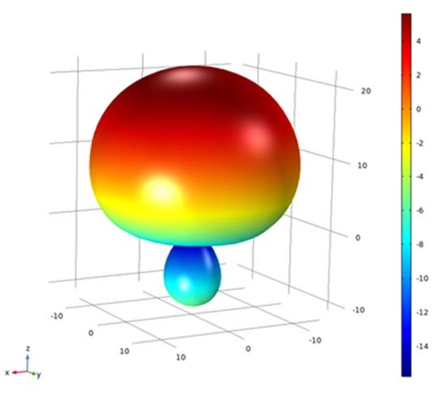
RADIOTELEVISIONE ITALIANA
Improving Antenna Designs with COMSOL Multiphysics®
Radiotelevisione Italiana (RAI) is in the process of designing new antennas to enhance their recording process of live sports events
Using simulation, RAI modeled and tested several antenna designs in the frequencies' band of interest, including an Archimedean spiral circularly polarized antenna
The simulated results have been confirmed in the prototypes by means of
  Laboratory measurements
  Field tests
RAI is currently working on developing a new dual-crossed, double-folded dipole (DCDFD) antenna with simulation
“Prototyping Antennas for Mobile Recording of TV Sports Events with Simulation”
COMSOL News 2020: Assunta De Vita, Alessandro Lucco Castello, and Bruno Sacco, Radiotelevisione Italiana, Italy
Realized gain of the DCDFD antenna

