Slide 1
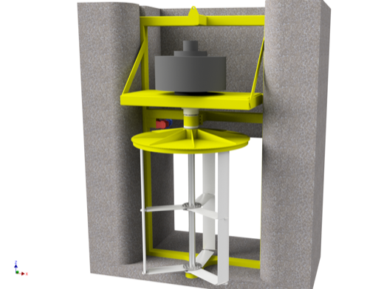
PHYSIXFACTOR
Designing a Water Turbine for Fish-Friendly Hydropower
Physixfactor used simulation to develop a new type of hydropower turbine for installation in Dutch tidal flood control structures
Replaced typical screw-type turbine rotor with adjustable vertical-blade design
  Increased power output
  Reduced harm to fish and other sea life
Used fluid flow simulation to:
  Refine turbine rotor blade profile to reduce turbulence
  Determine optimal angle of attack throughout blades’ path of rotation
Results:
  40% increase in power output over fixed-rotor design
  Reduced fish mortality rate from 20% to less than 1%
“Producing Power, Protecting Fish with a Darrieus Water Turbine”
Helger Van Halewijn, Physixfactor, The Netherlands
The water turbine developed by Physixfactor for Water2Energy. Rotor mechanism, including vertical blades, illustrated in white.

