Slide 1
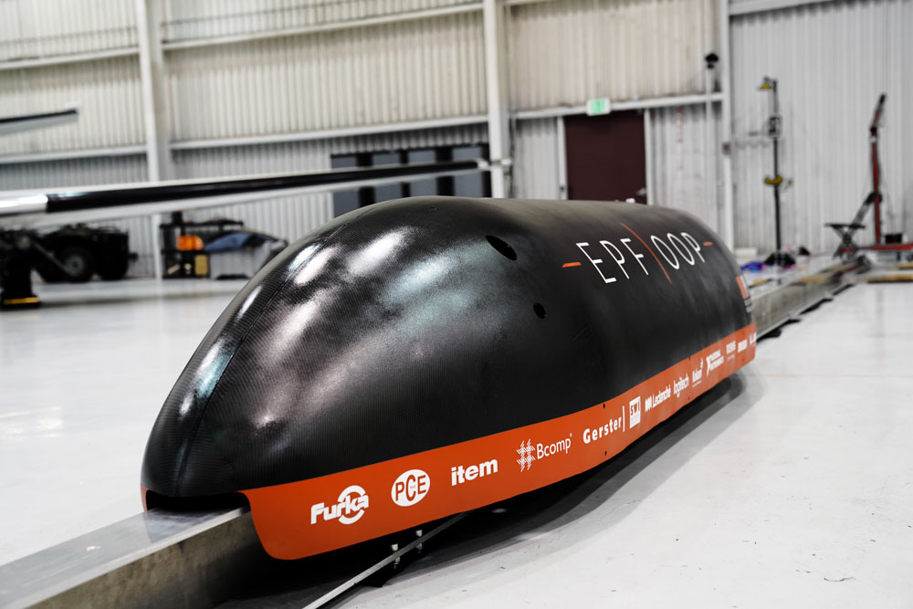
SWISS FEDERAL INSTITUTE OF TECHNOLOGY LAUSANNE Optimizing a Hyperloop Pod
Hyperloop Pod Competition
Annual student competition hosted by SpaceX
Top 20 teams worldwide: invited to the California testing facility
Top 3 teams: run on the track under vacuum at final event
Goal is to find transportation mode that is high speed, intercontinental, and self-propelled
“Inspiring Young Engineers to Design for the Future at EPFL”
COMSOL News 2019: Mario Paolone, EPFL, Switzerland
EPFLoop’s hyperloop pod for the 2018 SpaceX competition

Slide 2
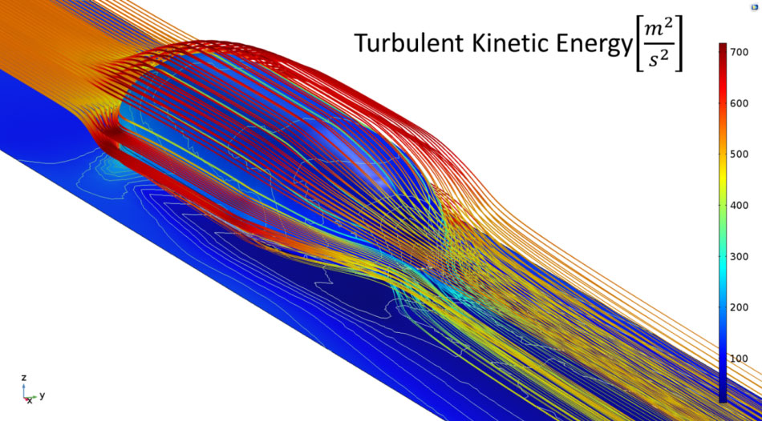
SWISS FEDERAL INSTITUTE OF TECHNOLOGY LAUSANNE Optimizing a Hyperloop Pod
EPFLoop team: first-time competitors in 2018
Multiphysics simulation:
Aeroshell: CFD, shape optimization, and mechanical stress analyses
Pressure vessel: structural analysis
Braking system: coupled heat transfer and mechanical study
Optimized pod placed 1st for design and 3rd overall
“Inspiring Young Engineers to Design for the Future at EPFL”
COMSOL News 2019: Mario Paolone, EPFL, Switzerland
Turbulent kinetic energy around the composite aeroshell structure of the hyperloop pod

